Slide 1
Understanding Convolutional Neural Networks (CNNs)

Slide 2
Motivation and Use Cases for CNNs
Why are CNNs crucial in the field of AI?
- CNNs excel at image processing tasks.
- They are pivotal in computer vision applications such as object detection, facial recognition, and self-driving cars.
- Use cases extend to video analysis, healthcare, and more.

Slide 3

Convolutional Operations: A Deep Dive
- Convolutions help extract spatial features from images.
- Imagine sliding a small window over an image and calculating dot products to uncover features.

Slide 4
Kernels (Filters) and Strides
- Kernels capture specific features like edges.
- Strides determine the movement of the kernel across the image.

Slide 5
Feature Maps, Pooling, and Activation
What follows convolution?
- Feature maps show extracted features.
- Pooling reduces spatial dimensions (max pooling as a common example).
- Activation functions like ReLU introduce non-linearity.

Slide 6
Typical CNN Architecture & Training Overview
- Typical blocks: Convolutional layers, pooling layers, and fully connected layers.
- Training involves loss calculation and optimization (e.g., using SGD or Adam).

Slide 7

Tackling Overfitting: Regularization Techniques
- Overfitting can plague model accuracy on unseen data.
- Regularization methods: Dropout layers and data augmentation are essential to mitigate this.

Slide 8
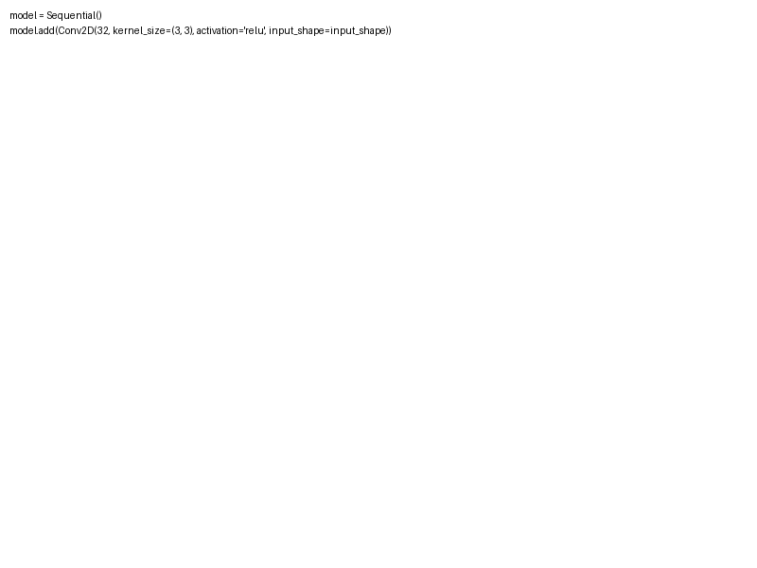
Code Walkthrough & Summary
- Let's explore a simple CNN code snippet.
- Summing up: CNNs are fundamental in processing visual data, leveraging layers to extract intricate features.

