Slide 1
Introduction to Convolutional Neural Networks (CNNs)

Slide 2
Learning Objectives
By the end of this session, you will be able to:
- Understand the role of CNNs in computer vision.
- Describe the function of kernels and filters in convolution.
- Explain the concepts of feature maps, padding, and stride.
- Identify typical CNN architectures and training processes.
- Implement a small CNN model using Python code.

Slide 3
The Intuition Behind Convolutions
Think of convolutions as the way to detect patterns within an image. When you scan a photo, your eyes perceive patterns—edges, shapes, textures.
**Question:** How can a computer mimic this perception?

Slide 4
Kernels and Filters
- **Kernels/Filters:** Small matrices that move across the input data to extract features.
**Comparison:**
- Kernel in image processing vs. Neural Network filter in CNN. Both aim to emphasize certain features over others.

Slide 5
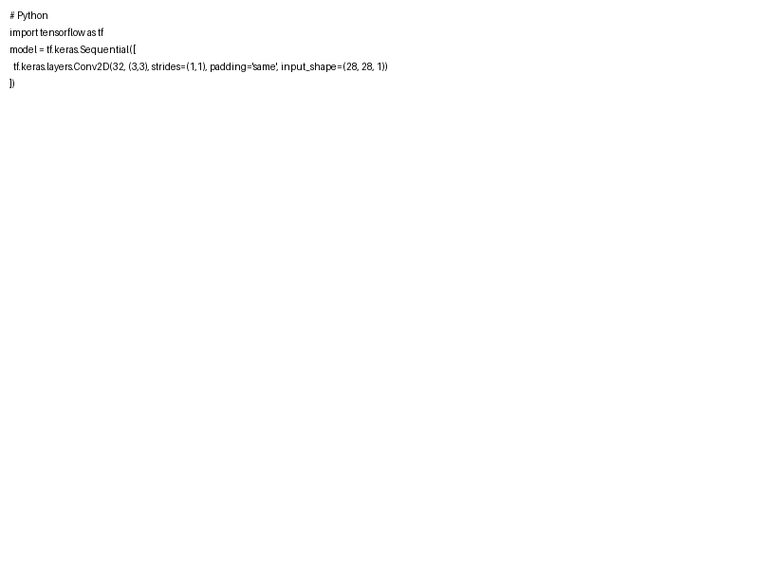
Feature Maps, Padding, and Stride
Feature maps are created as filters slide over the image.
- **Padding:** Keeps output size same as input.
- **Stride:** Dictates how filters slide.
**Code Example:** Python code snippet to demonstrate padding and stride.

Slide 6
Activation Functions
What changes data into insight within a CNN?
- **ReLU (Rectified Linear Unit):**
- Applies max(0, x) for each pixel.
- Speeds up training by introducing non-linearity.

Slide 7
CNN Architectures and Training Overview
- **Popular Architectures:** LeNet, AlexNet, VGGNet.
- **Training:**
- Loss Function: Computes error.
- Optimizer: Updates weights to minimize loss.
**Question:** What makes CNN architectures powerful for complex data?

Slide 8
Handling Overfitting and Regularization
- **Issue:** Overfitting occurs when a model learns noise.
- **Solutions:** Dropout, Data Augmentation, L2 Regularization.
**Code Walkthrough:** Dive into a provided code setup implementing these mitigations.

