Slide 1
Introduction to Convolutional Neural Networks

Slide 2
Learning Objectives
- Understand the intuition behind convolution operations
- Define kernels and filters
- Explore feature maps
- Explain padding and stride in CNNs
- Understand pooling layers
- Identify common activation functions
- Learn about typical CNN architectures
- Overview of CNN training processes
- Identify overfitting and regularization approaches
- Code walkthrough of CNN implementation

Slide 3
Intuition for Convolution
"Think of convolution as a way for the computer to see: scanning over an image to recognize patterns."

Slide 4
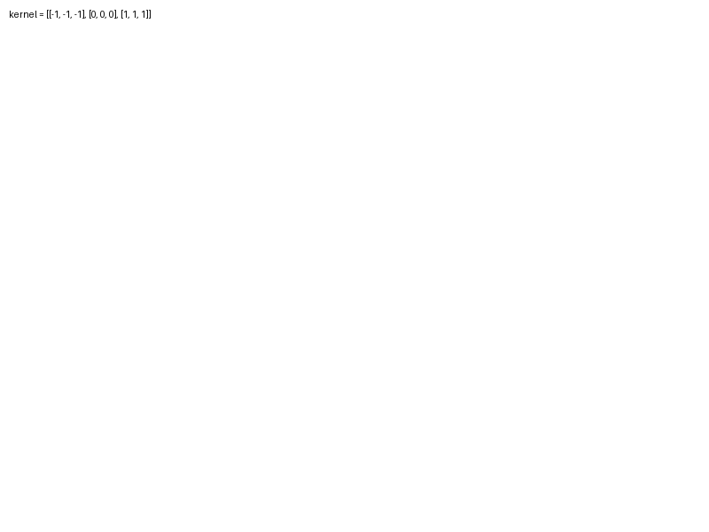
Kernels and Filters
Kernels, also known as filters, are key in feature detection:
- Smaller matrices that slide over the image to produce feature maps.

Slide 5
Padding and Stride
Padding: Prevents shrinking output size.
Stride: Determines how much to move the filter over the input.

Slide 6
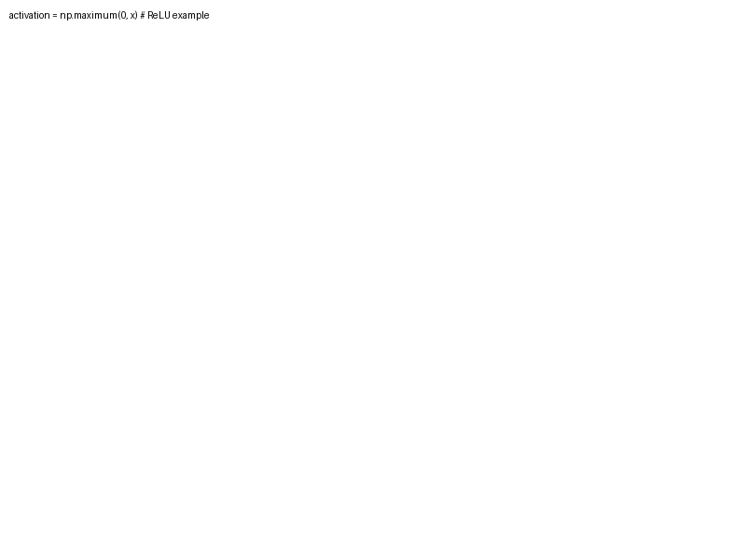
Pooling and Activation Functions
Pooling reduces dimensionality and controls overfitting.
Common functions: ReLU, Sigmoid, Tanh.

Slide 7
Typical CNN Architectures
- LeNet-5: Early architecture for digit classification
- AlexNet: Deep CNN that won ImageNet
- VGGNet: Known for its simplicity
- ResNet: Introduced residual connections for very deep networks

Slide 8
Training Overview & Code Walkthrough
- Loss functions: Cross-entropy, MSE
- Optimizers: SGD, Adam
- Regularization: Dropout, Batch normalization
```
# CNN code snippet
model = Sequential([
Conv2D(filters=32, kernel_size=(3,3), activation='relu', input_shape=(64, 64, 3)),
MaxPooling2D(pool_size=(2, 2)),
Flatten(),
Dense(128, activation='relu'),
Dense(num_classes, activation='softmax')
])
model.compile(optimizer='adam', loss='categorical_crossentropy', metrics=['accuracy'])
```
Explanation: Building a CNN with Keras to classify images

