Slide 1
Understanding Convolutional Neural Networks (CNNs)

Slide 2
Learning Objectives
- Understand the intuition behind convolutions
- Explain kernels, filters, and feature maps
- Describe padding, strides, and pooling
- Discuss activation functions
- Explore typical CNN architectures
- Outline training strategies including loss and optimization
- Identify overfitting and regularization techniques

Slide 3
The Intuition of Convolution
In essence, convolution is the application of a filter to an input that results in a feature map. But why do we do this?

Slide 4
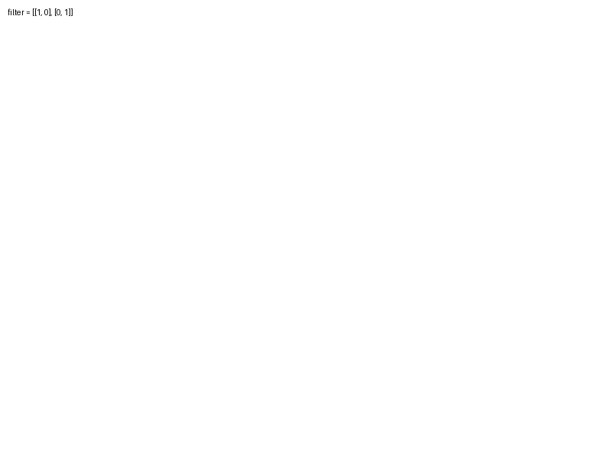
Kernels and Feature Maps
Kernels, or filters, slide over the input data to produce feature maps by applying mathematical operations.

Slide 5
Understanding Padding and Stride
Padding adds layers of zeros to the input data to preserve spatial dimensions. Stride controls how much the filter moves with each step.

Slide 6
Pooling: Reducing Dimensions
Pooling layers, such as max pooling, reduce dimensionality and help with overfitting by down-sampling the input representation.

Slide 7
Training CNNs: Loss and Optimization
- Loss functions quantify the difference between predicted outputs and true values.
- Optimizers, like SGD and Adam, adjust weights to minimize loss.

Slide 8
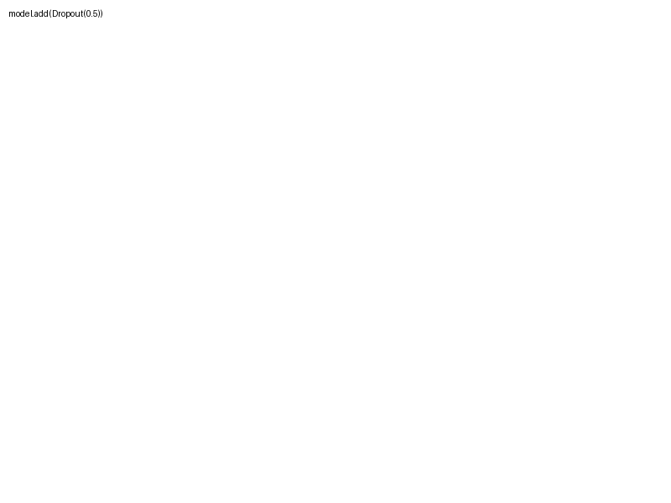
An Overview of Overfitting and Regularization
Regularization techniques such as dropout help prevent a model from capturing noise in the training data, which can lead to overfitting.

