Slide 1
Introduction to Linear Regression

Slide 2
Problem Setup
Question: How can we predict the price of a pizza based on its size?
- Linear Regression helps model the relationship between a dependent variable (e.g., price) and an independent variable (e.g., size).
- Example scenario: Predicting pizza prices through simple linear regression using Scikit-Learn.

Slide 3
Hypothesis/Model
- Linear Regression Hypothesis: h(x) = θ0 + θ1x
- Here, h(x) is the predicted value, θ0 is the intercept, and θ1 is the slope or weight that connects x and h(x).
- Aim: Find the best fitting line represented by optimal θ0 and θ1 values.

Slide 4
Cost Function Intuition
Quote: "The cost function quantifies the error between predicted values and actual data points."
- Definition: Mean Squared Error (MSE) is the most commonly used cost function in linear regression.
- Purpose: Minimize MSE to improve our model's accuracy.

Slide 5
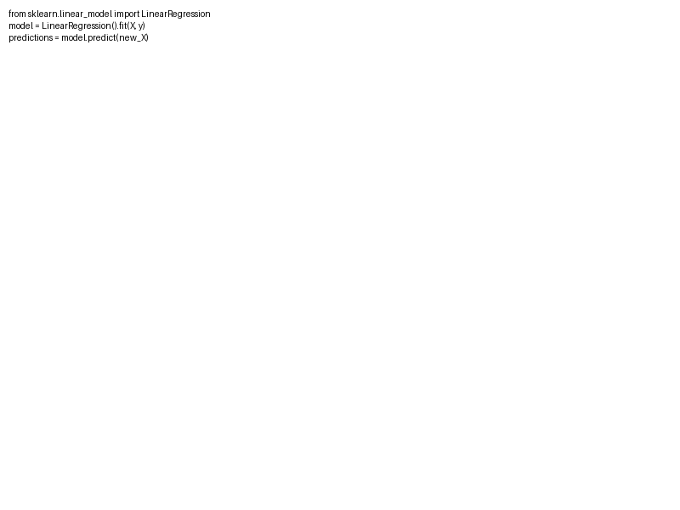
Fitting the Model
- Two main approaches:
1. Gradient Descent: Iteratively updates parameters to minimize the cost function.
2. Normal Equation: Solves for parameters analytically using 'theta = (X^T X)^-1 X^T y'.

Slide 6
Evaluation Metrics
- R-squared (R²): Proportion of variance explained by the model.
- Mean Squared Error (MSE) and Root Mean Squared Error (RMSE): Measure how close fitted line is to the data points.

Slide 7
Assumptions and Limitations
Questions to consider:
- Is the relationship between variables linear?
- Are errors Gaussian with constant variance (homoscedasticity)?
- Limitations: Sensitive to outliers, relies heavily on assumptions.

Slide 8
Overfitting and Train/Test Split
- Overfitting: Model captures noise instead of the underlying relationship.
- Mitigation: Divide dataset into train and test subsets to validate model's performance on unseen data.
- Quote: "A model too complex may fit the training data too perfectly."

