Slide 1
Understanding Linear Regression

Slide 2
Definition & Intuition
Linear regression is a fundamental statistical method used to model the relationship between a dependent variable and one or more independent variables using a linear equation. The goal is to find the best-fitting line through the data points.

Slide 3
Equation: y = β0 + β1x
This equation represents a line where:
- **y**: Dependent variable
- **β0**: Intercept of the line
- **β1**: Slope of the line
- **x**: Independent variable
The slope (β1) expresses the change in y for a unit change in x.

Slide 4
Least Squares Fitting
The Least Squares method is used to determine the line of best fit by minimizing the sum of the squares of the vertical distances of the points from the line.

Slide 5
Assumptions and Limitations
- Linearity: Relationship between variables is linear
- Independence: Observations are independent
- Homoscedasticity: Equal variance of errors
- Normal distribution of errors
- Limitations: Sensitive to outliers, assumes linearity

Slide 6
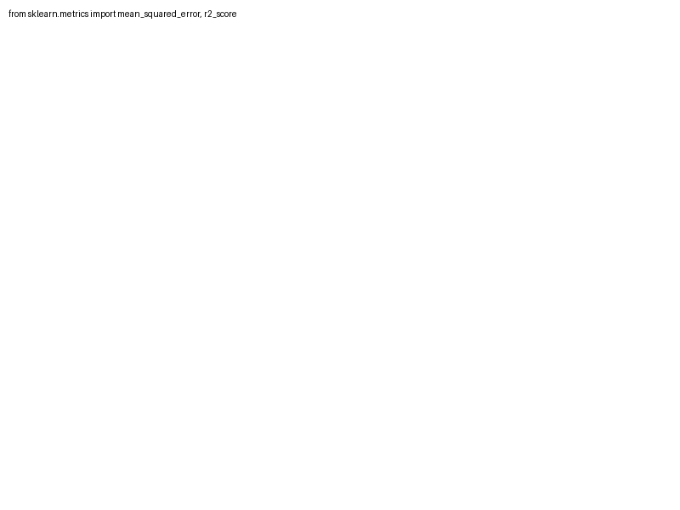
Metrics: MSE and R²
- **Mean Squared Error (MSE)**: An average of the squares of the errors. Lower is better.
- **R²**: The proportion of the variation in the dependent variable that's predictable from the independent variable(s). Ranges from 0 to 1.

Slide 7
Worked Example: Pizza Price Prediction
Imagine predicting pizza prices based on their diameter. Using actual data:
- Fit a model: Price ~ Diameter
- Verify model: Apply test data, interpret results
Predictive Model: Simple, interpretable example highlighting key concepts of linear regression.

Slide 8
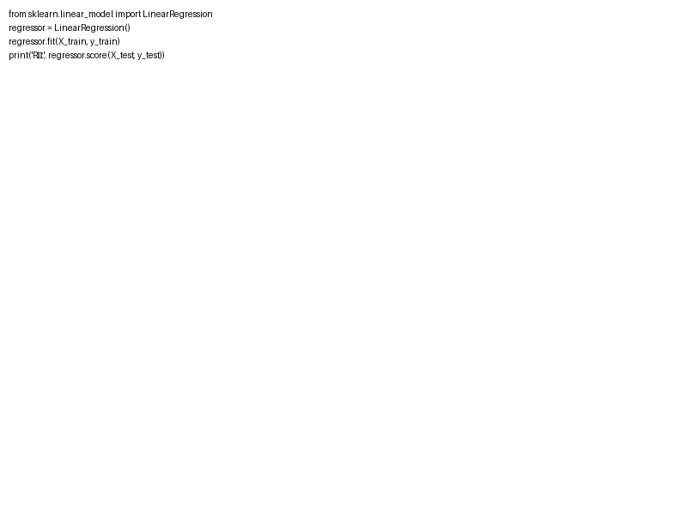
Python Demo Code
Here's a Python snippet to showcase linear regression:
- Import necessary libraries
- Define data
- Train the model
- Output R² value

