Slide 1
Mastering Machine Learning with Scikit-Learn

Slide 2
Learning Objectives
- Understand the core components of the scikit-learn library
- Become familiar with the scikit-learn workflow
- Implement a simple machine learning model
- Identify common pitfalls in using scikit-learn effectively

Slide 3
Prerequisite Knowledge
- Basic understanding of Python programming
- Familiarity with fundamental machine learning concepts
- Experience with data manipulation in Python (using Pandas, Numpy)

Slide 4
Conceptual Explanation
Scikit-learn is a Python library for machine learning that features various tools for classification, regression, clustering, and more.

Slide 5
Scikit-learn Workflow
1. Data Collection
2. Data Preparation
3. Feature Selection
4. Model Training
5. Model Evaluation
6. Hyperparameter Tuning
7. Model Deployment
8. Model Monitoring

Slide 6
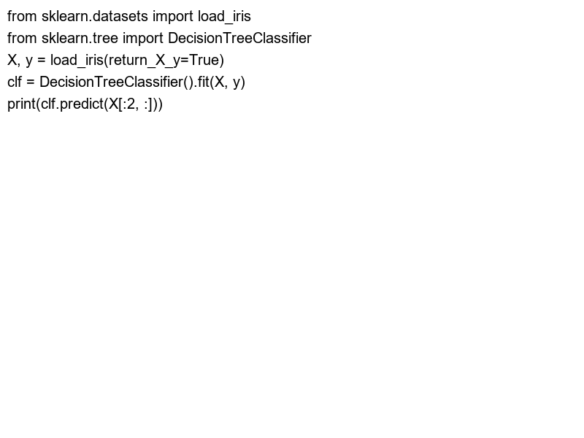
Worked Example: Classification with Scikit-learn
Let's classify the famous Iris dataset using a Decision Tree classifier.

Slide 7
Common Pitfalls
- Not scaling features
- Ignoring data imbalance
- Overfitting the model by not using cross-validation
- Misinterpreting model evaluation metrics

Slide 8
Summary
- Scikit-learn simplifies machine learning implementations
- Follow the structured workflow for better model performance
- Always be cautious of common pitfalls to improve model accuracy and reliability

