Slide 1
Understanding Convolutional Neural Networks (CNNs)

Slide 2
What is a CNN?
- Modeled after the human vision system.
- Specifically designed to process pixel data.
- Utilizes convolutional layers to capture spatial hierarchies in images.

Slide 3
CNN Architecture
Layer Types:
- **Input Layer**: Raw pixel data.
- **Convolutional Layer**: Detects features.
- **Pooling Layer**: Reduces dimensionality.
- **Fully Connected Layer**: Maps features to outputs.

Slide 4
Role of Each Layer
- **Input Layer**: Takes in arrays of pixel values.
- **Convolutional Layer**: Applies filters for feature detection.
- **Pooling Layer**: Performs dimensionality reduction.
- **Fully Connected Layer**: Acts as a classifier.

Slide 5
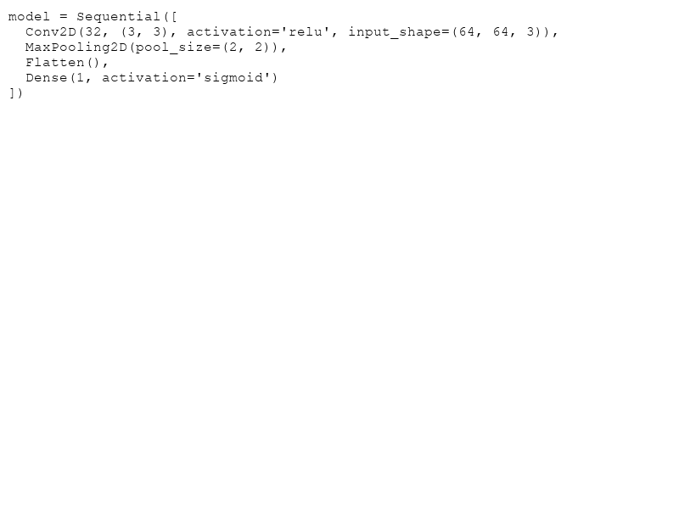
Minimal CNN Example
A simple CNN includes:
1. One Convolutional Layer.
2. One Pooling Layer.
3. A Fully Connected Layer.
4. Softmax or Sigmoid output functions.

Slide 6
Why Use GPUs?
- Training CNNs requires significant computational power.
- GPUs accelerate training by executing parallel computations.
- Essential for handling large datasets and deep networks.

Slide 7
Quote & Closing Thoughts
"The power of a CNN lies in its ability to automatically learn and extract features directly from raw data."
- CNNs are fundamental for image processing tasks.
- Constant development in hardware enhances CNN utility.

