Slide 1
Introduction to Convolutional Neural Networks (CNNs)

Slide 2
What are CNNs?
Convolutional Neural Networks are specialized models for processing grid-like data, such as images.
Key Quote: "CNNs mimic the visual system with their layered structure."

Slide 3
Why Convolutions?
- Convolutions detect patterns (e.g., edges) using a sliding window approach over pixels.
- They help CNNs focus on important features regardless of image location.
Question:
How do convolutions improve image recognition?

Slide 4
Basic Layers of CNNs
- **Convolutional Layer**: Extracts features from input images.
- **ReLU Layer**: Introduces non-linearity.
- **Pooling Layer**: Reduces dimensionality.
- **Fully Connected Layer**: Drives final classification.
Consider this, how does pooling help in data reduction?

Slide 5
CNN for Image Classification
CNNs excel at classifying images into predefined categories.
Example Task: Classifying handwritten digits using the MNIST dataset.

Slide 6
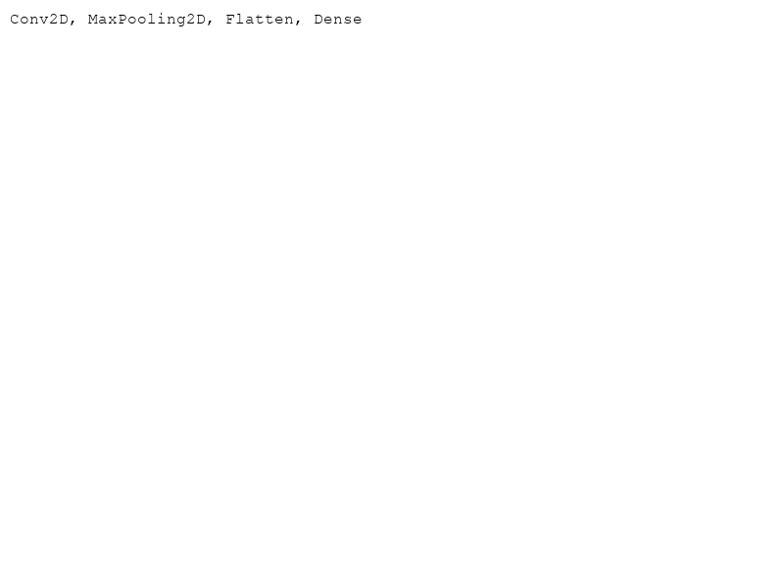
Minimal CNN Code Example
Let's build a simple CNN using Keras:
```python
from keras.models import Sequential
from keras.layers import Conv2D, MaxPooling2D, Flatten, Dense
model = Sequential([
Conv2D(32, (3, 3), activation='relu', input_shape=(28, 28, 1)),
MaxPooling2D((2, 2)),
Flatten(),
Dense(10, activation='softmax')
])
model.compile(optimizer='adam', loss='categorical_crossentropy', metrics=['accuracy'])
```
Think about how simple structures combining can build a powerful model.

Slide 7
Conclusion
- CNNs are powerful for image-related tasks.
- They use convolutions for feature extraction, which enhances recognition.
- Understanding and implementing CNNs lays the groundwork for advanced computer vision tasks.
Reflect:
How can CNNs be expanded for other uses like video recognition?

