Slide 1
Introduction to Linear Regression

Slide 2
What is Linear Regression?
Linear regression is a statistical method to model and analyze the relationships between a dependent variable and one or more independent variables.

Slide 3
Simple Linear Regression vs. Multiple Linear Regression
- **Simple Linear Regression:** Models relationship between one dependent and one independent variable.
- **Multiple Linear Regression:** Models relationship between one dependent and multiple independent variables.

Slide 4
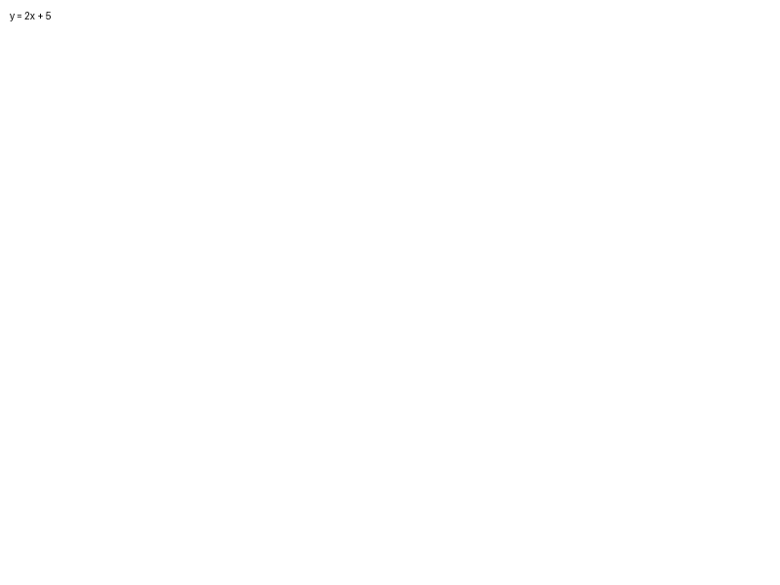
The Simple Linear Regression Equation
The equation is expressed as: y = mx + c
- `y` is the predicted dependent variable.
- `m` is the slope of the line.
- `x` is the independent variable.
- `c` is the y-intercept.

Slide 5
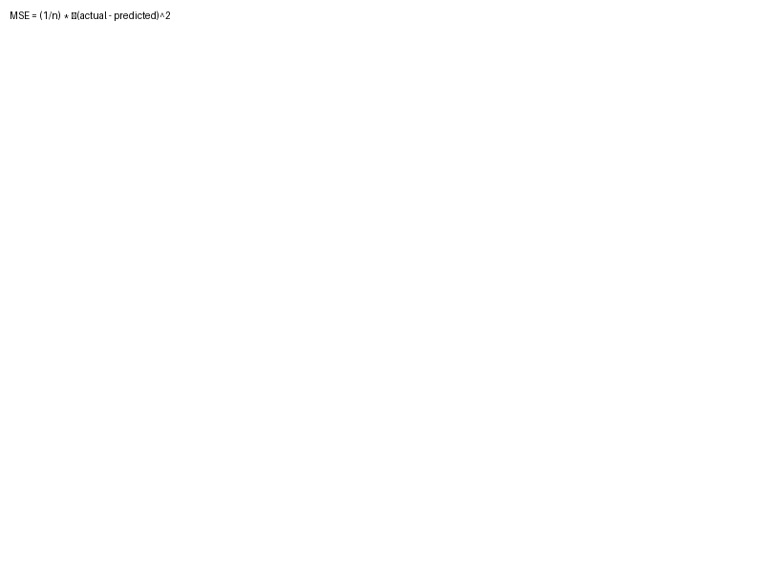
Cost Function & Optimization
The cost function used in linear regression is the Mean Squared Error (MSE), which measures the average squared difference between the actual and predicted values.

Slide 6
Fitting a Linear Regression Model
The goal is to find the best fit line, which is achieved by minimizing the cost function. This is done through methods like Gradient Descent.

Slide 7

Practical Example: Predicting House Prices
By using features such as size and location, we can apply linear regression to predict house prices.

Slide 8
Conclusion & Next Steps
Linear regression is the foundation for more complex models. Explore topics like polynomial regression and logistic regression to further your understanding.

