Slide 1
Understanding Support Vector Machines (SVM)
A Comprehensive Guide to SVM in Machine Learning

Slide 2
Introduction to SVM
Support Vector Machines (SVM) are a powerful set of supervised learning methods used for classification, regression, and outlier detection. SVMs are effective in high-dimensional spaces and are versatile, as they can be used for classification tasks, as well as regression tasks.

Slide 3

Concept of Hyperplanes
In SVM, a hyperplane is used to separate the different classes of data points. The goal is to find the hyperplane that maximizes the margin between the classes.

Slide 4
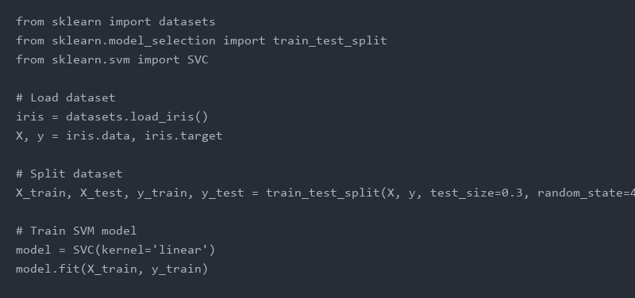
Example of SVM in Python
Here is a simple SVM implementation using Python's scikit-learn library. The code demonstrates how to create an SVM model and train it on a dataset.

Slide 5
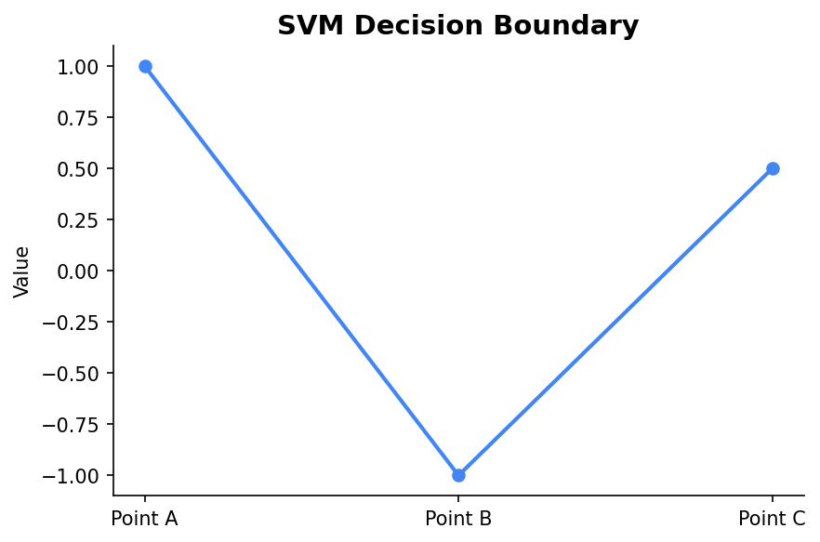
Visualizing SVM Decision Boundaries
This chart illustrates how an SVM model separates data points with a decision boundary in a simple classification task.

Slide 6
Applications of SVM
SVMs are widely used in various fields such as bioinformatics for gene classification, text categorization, image classification, and even in finance for stock market predictions. Their ability to handle large feature spaces makes them especially useful in these domains.

Slide 7
Conclusion
Support Vector Machines are a robust tool in the machine learning toolkit, especially for tasks requiring high accuracy and computational efficiency. They perform well in diverse applications due to their ability to manage large feature spaces and create clear decision boundaries.

