Slide 1
Understanding Recurrent Neural Networks (RNN)
A Comprehensive Introduction to RNNs

Slide 2
What is an RNN?
Recurrent Neural Networks (RNNs) are a class of neural networks designed to recognize patterns in sequences of data, such as text, genomes, handwriting, or the spoken word. They are particularly effective in temporal data, where the order of the data points is essential.

Slide 3
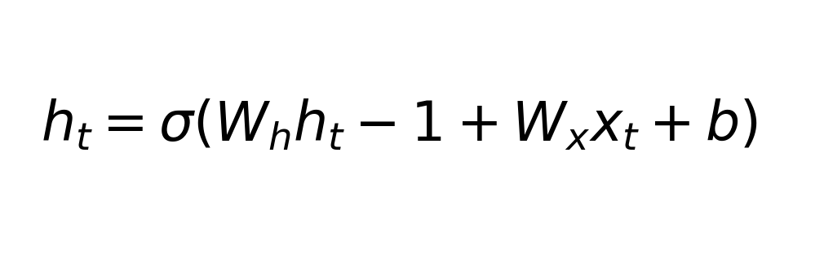
RNN Structure
RNNs have a unique structure where the output from the previous step is fed as input to the current step, enabling them to possess memory of previous inputs.

Slide 4
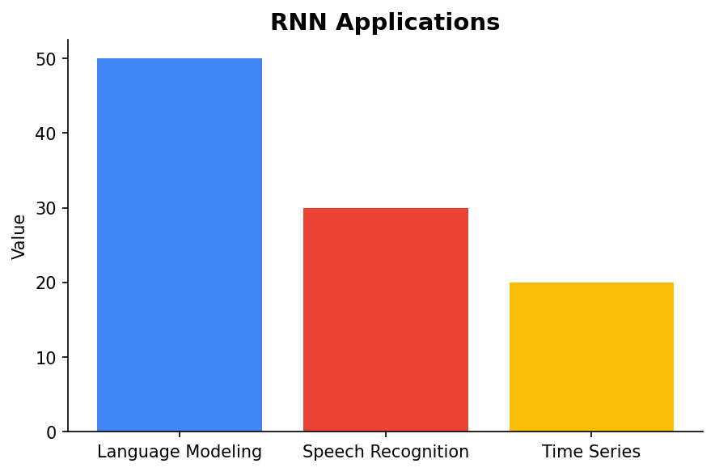
Applications of RNNs
RNNs are widely used in applications such as language modeling, speech recognition, and time series prediction. They excel in tasks where the context and sequence of input data are crucial.

Slide 5
Challenges with RNNs
Despite their strengths, RNNs face challenges such as vanishing gradients, which can make training difficult. Long short-term memory (LSTM) and gated recurrent units (GRU) are architectures designed to mitigate these issues.

Slide 6
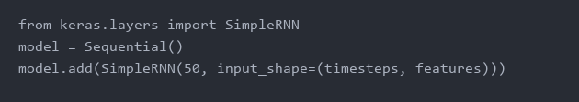
Basic RNN Code Example
Here is a simple Python example demonstrating the creation of an RNN layer using popular machine learning libraries.

Slide 7
Summary and Future Directions
RNNs are a powerful tool for sequence prediction tasks, but they come with challenges. Future developments are likely to focus on improving training efficiency and expanding their application scope.

