Slide 1
Understanding Random Forest
An Introduction to Ensemble Learning

Slide 2
What is a Random Forest?
A random forest is an ensemble method that uses multiple decision trees to improve model accuracy and reduce overfitting. It leverages the concept of bagging to create diverse sets of trees.

Slide 3

How Random Forest Works
Random forests use a combination of bagging and feature randomness to build each individual tree, aiming to create a diverse set of classifiers. The final decision of the ensemble is made by averaging the predictions of each tree.

Slide 4
Advantages of Random Forest
Random forests are robust against overfitting, handle large datasets efficiently, and provide insights into feature importance, making them a versatile tool in machine learning.

Slide 5
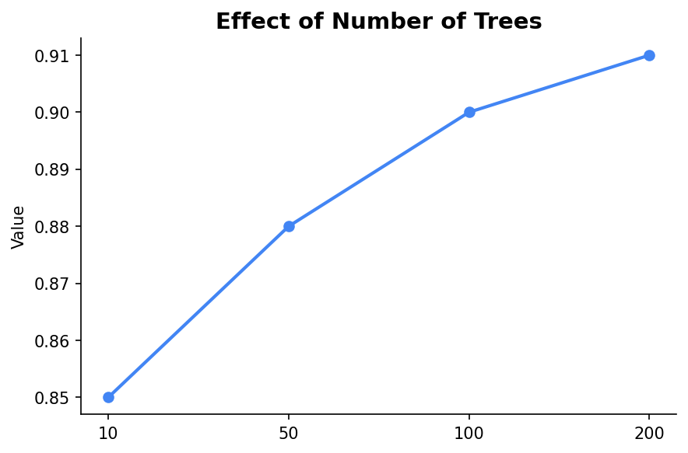
Hyperparameters in Random Forest
Key hyperparameters include the number of trees (n_estimators) and the maximum depth of the trees. Adjusting these can affect both the accuracy and computational efficiency of the model.

Slide 6
Use Cases of Random Forest
Random forests are used in various domains including finance for credit scoring, healthcare for predicting diseases, and e-commerce for recommendation systems.

Slide 7
Summary
Random forests are a powerful ensemble learning technique that combines multiple decision trees to improve prediction accuracy. By understanding their structure and tuning their parameters, they can be effectively applied to complex datasets.

