Slide 1
Understanding Convolutional Neural Networks (CNNs)
A Deep Dive into CNNs and Their Applications

Slide 2
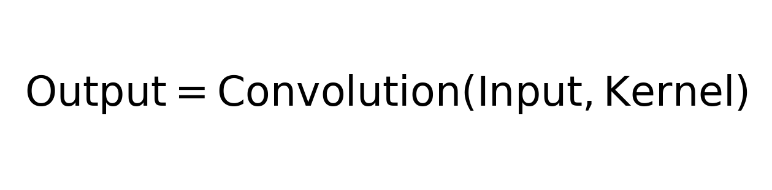
What are CNNs?
Convolutional Neural Networks (CNNs) are a class of deep learning models designed to process structured grid data, like images. They are particularly effective for visual recognition tasks.

Slide 3
Key Components of CNNs
CNNs are composed of layers such as convolutional layers, pooling layers, and fully connected layers. Each layer plays a specific role in feature extraction and data abstraction.

Slide 4
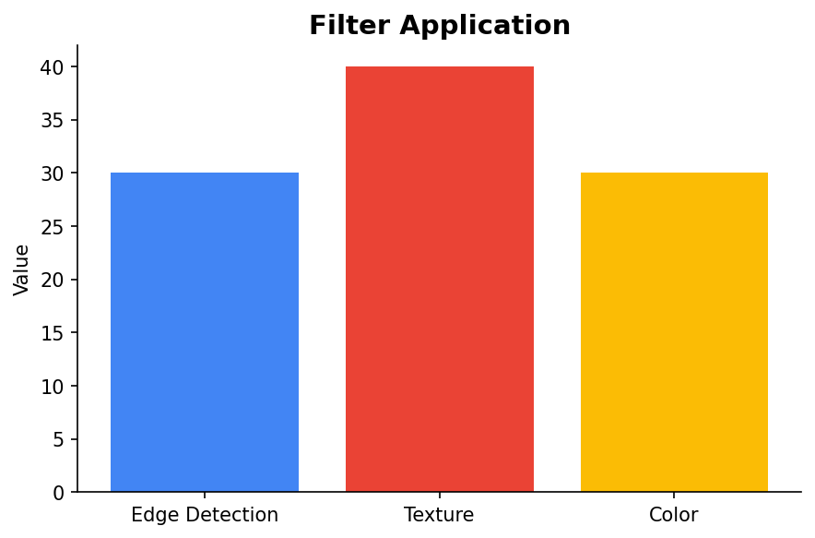
Convolutional Layer
The convolutional layer applies a number of filters to the input image, extracting features like edges and textures. This operation is crucial for understanding visual data.

Slide 5

Applications of CNNs
CNNs are widely used in applications such as image classification, object detection, and semantic segmentation. They are essential in fields like autonomous driving and medical imaging.

Slide 6
Advantages and Challenges
CNNs offer high accuracy in image-related tasks and can automatically detect important features. However, they require large datasets and significant computational power for training.

Slide 7
Conclusion
Convolutional Neural Networks have transformed the field of computer vision. Their ability to learn complex patterns makes them invaluable for a wide range of applications.

