Slide 1
Introduction to Random Forests
Understanding an Ensemble Learning Method

Slide 2
What is a Random Forest?
A random forest is an ensemble of decision trees used for classification and regression. It leverages bagging to reduce variance and improve prediction accuracy.

Slide 3
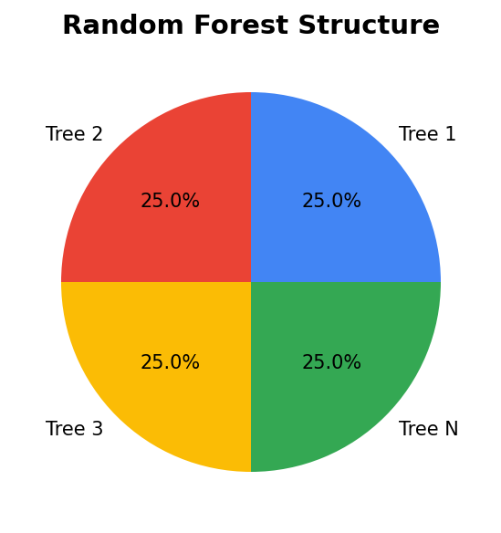
How Random Forests Work
Random forests create multiple decision trees during training and output the mode of the classes for classification or mean prediction for regression.

Slide 4
Advantages of Random Forests
Random forests provide higher accuracy, handle large datasets efficiently, and prevent overfitting compared to single decision trees.

Slide 5

Key Hyperparameters
The number of trees, depth of the trees, and number of features considered for splitting are crucial hyperparameters in a random forest.

Slide 6
Applications of Random Forests
Random forests are used in finance for risk assessment, in healthcare for disease prediction, and in marketing for customer segmentation.

Slide 7
Conclusion
Random forests are a versatile and powerful tool in machine learning, especially when dealing with complex datasets that require robust prediction models.

