Slide 1
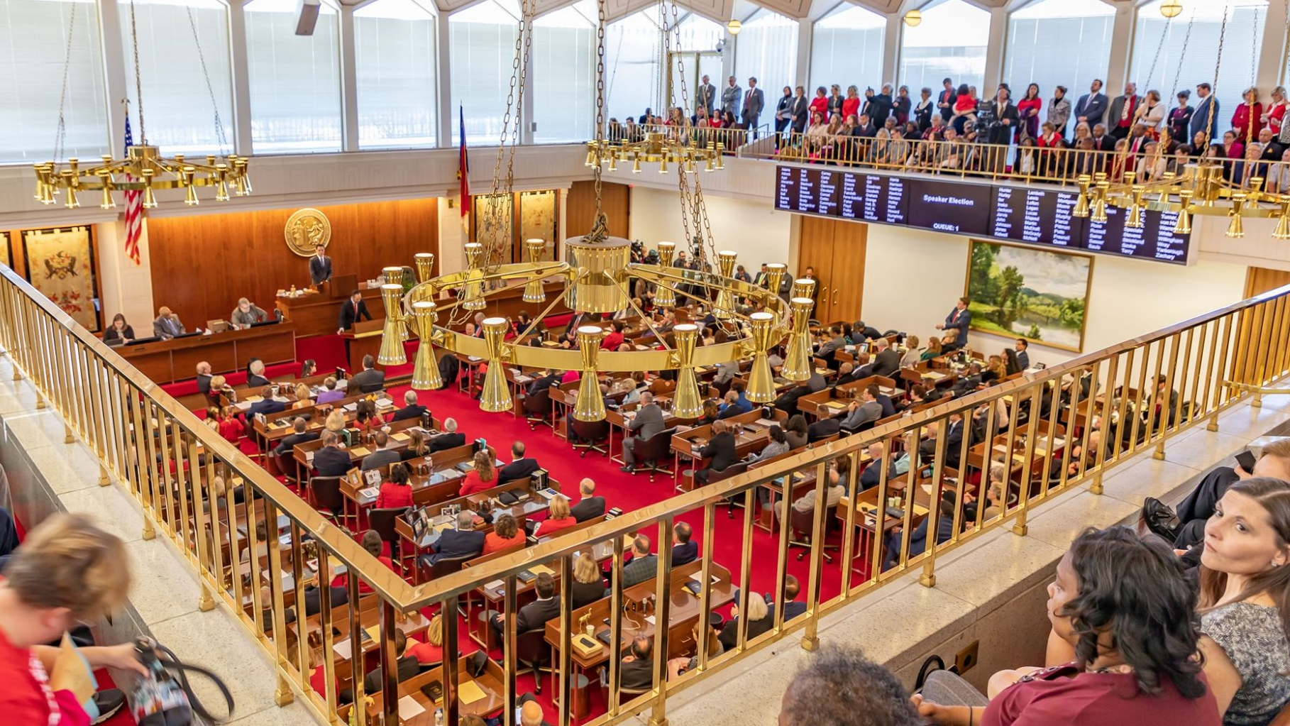
Donations from ceo’s during nc’s legislative session BY Amanda Hernandez & GREG MORTON

Slide 2
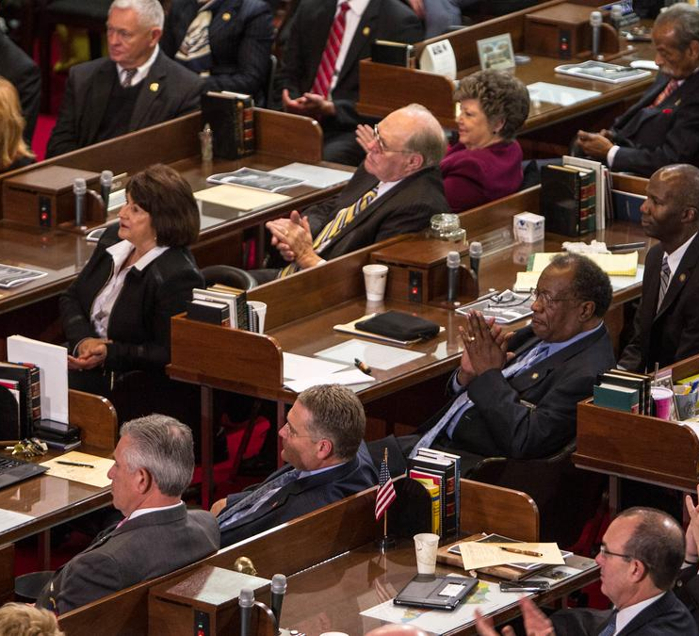
What’s going on in north Carolina?
North Carolina’s campaign finance laws forbid donations from lobbyists during legislative session
Employees (including top executives) can still donate during the session.
Donations from lobbyists and PAC’s often come in late

Slide 3
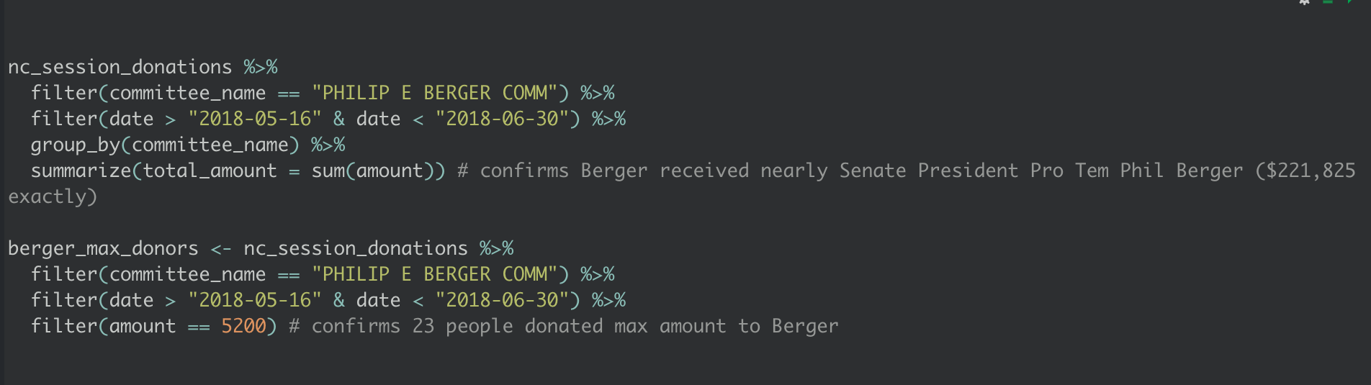
“Senate President Pro Tem Phil Berger's campaign alone raised nearly $222,000 during session. Twenty-three people gave him the maximum allowed: $5,200.”
Notes:
Large outbreaks in large cities and their surrounding metro areas defined the narrative around COVID-19 in 2020

Slide 4
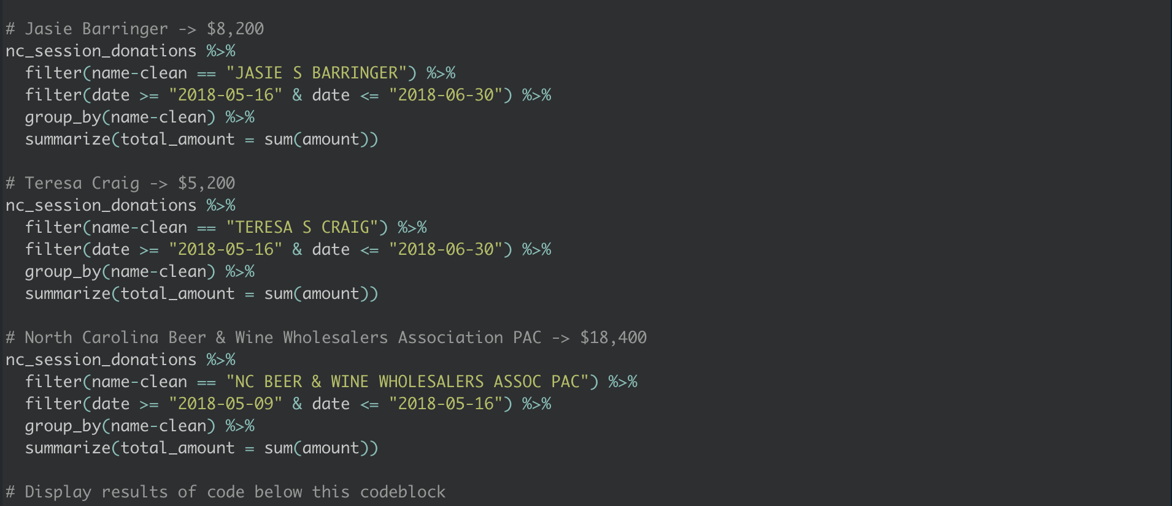
“R.H. Barringer's board chair, Jasie Barringer, donated another $8,200 in-session, and Teresa Craig kicked in another $5,200 to Berger. The North Carolina Beer & Wine Wholesalers Association PAC gave $18,400 during the week before session and on opening day.”
Notes:
Large outbreaks in large cities and their surrounding metro areas defined the narrative around COVID-19 in 2020

Slide 5
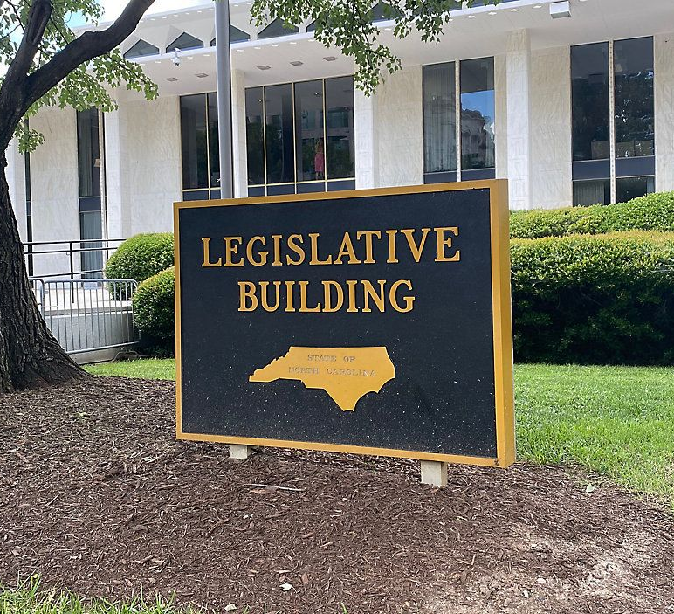
The Data
The data provides us with several important variables to help find this out
Name of Donor
Date of Donation
Recipient(s) of Donation(s)
This database was compiled by WRAL Reporters from campaign finance reports filed with the State Board of Elections and Ethics Enforcement in 2018

Slide 6
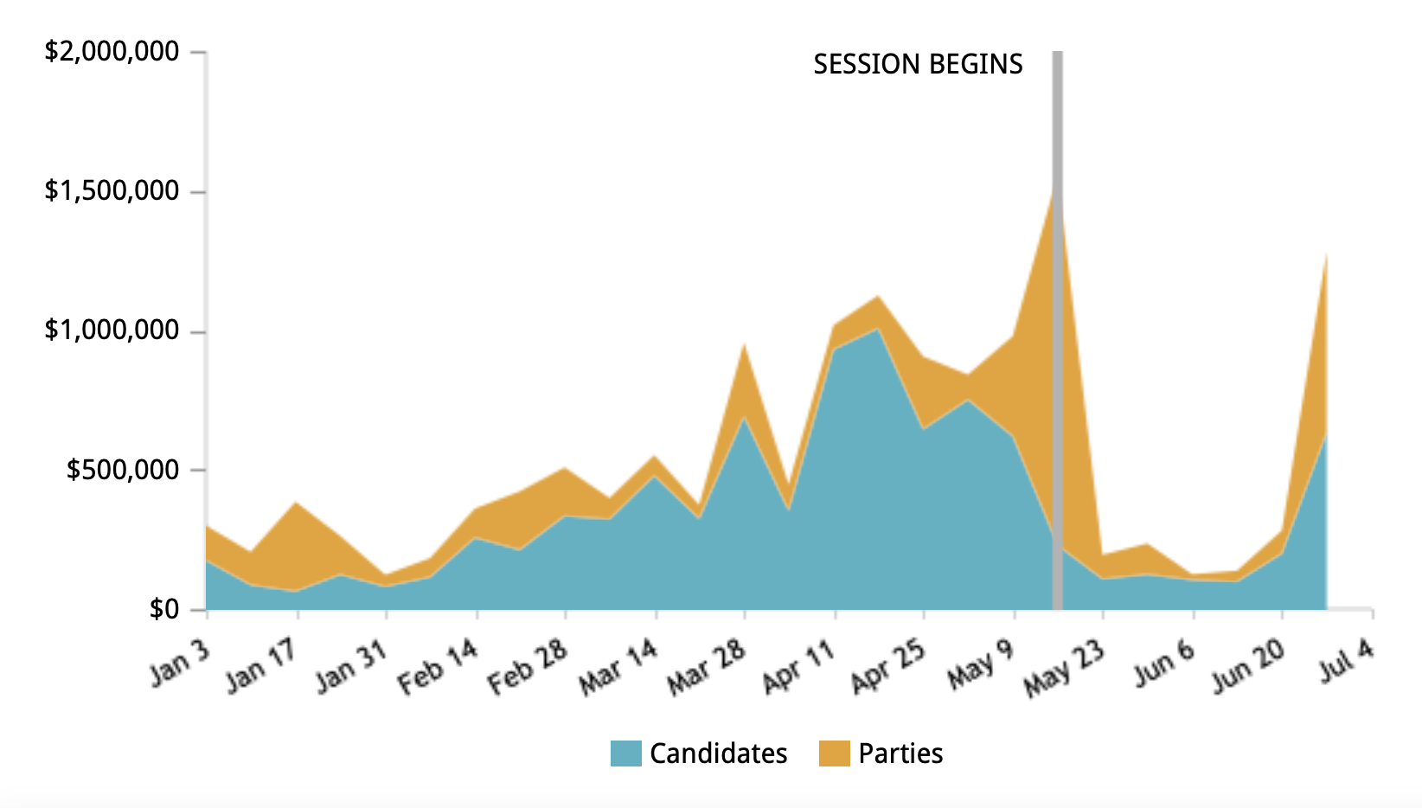
Weekly Donations
This visualization from WRAL’s story is quite effective at showing giving the reader an instant sense of the problem at hand
While most people are following the rules, the money faucet never truly turns off
Notes:
Give people a chance to digest the scale of the numbers and their movement over time. Incidence rate is clear – it has shifted from a crazy skewed distribution to an almost textbook normal distribution. We spend a lot of time looking at what COVID is doing right now but COVID has actually behaved very interestingly.

