Slide 1

Toward Robust and Scalable
AI Biomarkers for Systemic Disorders
From Multi-Omics Validation to Wearable Time-Series Foundation Models
Eddie Massey III
Invisible Illness Project · Roeh Health
ME/CFS
POTS
Long COVID
Wearable AI

Slide 2
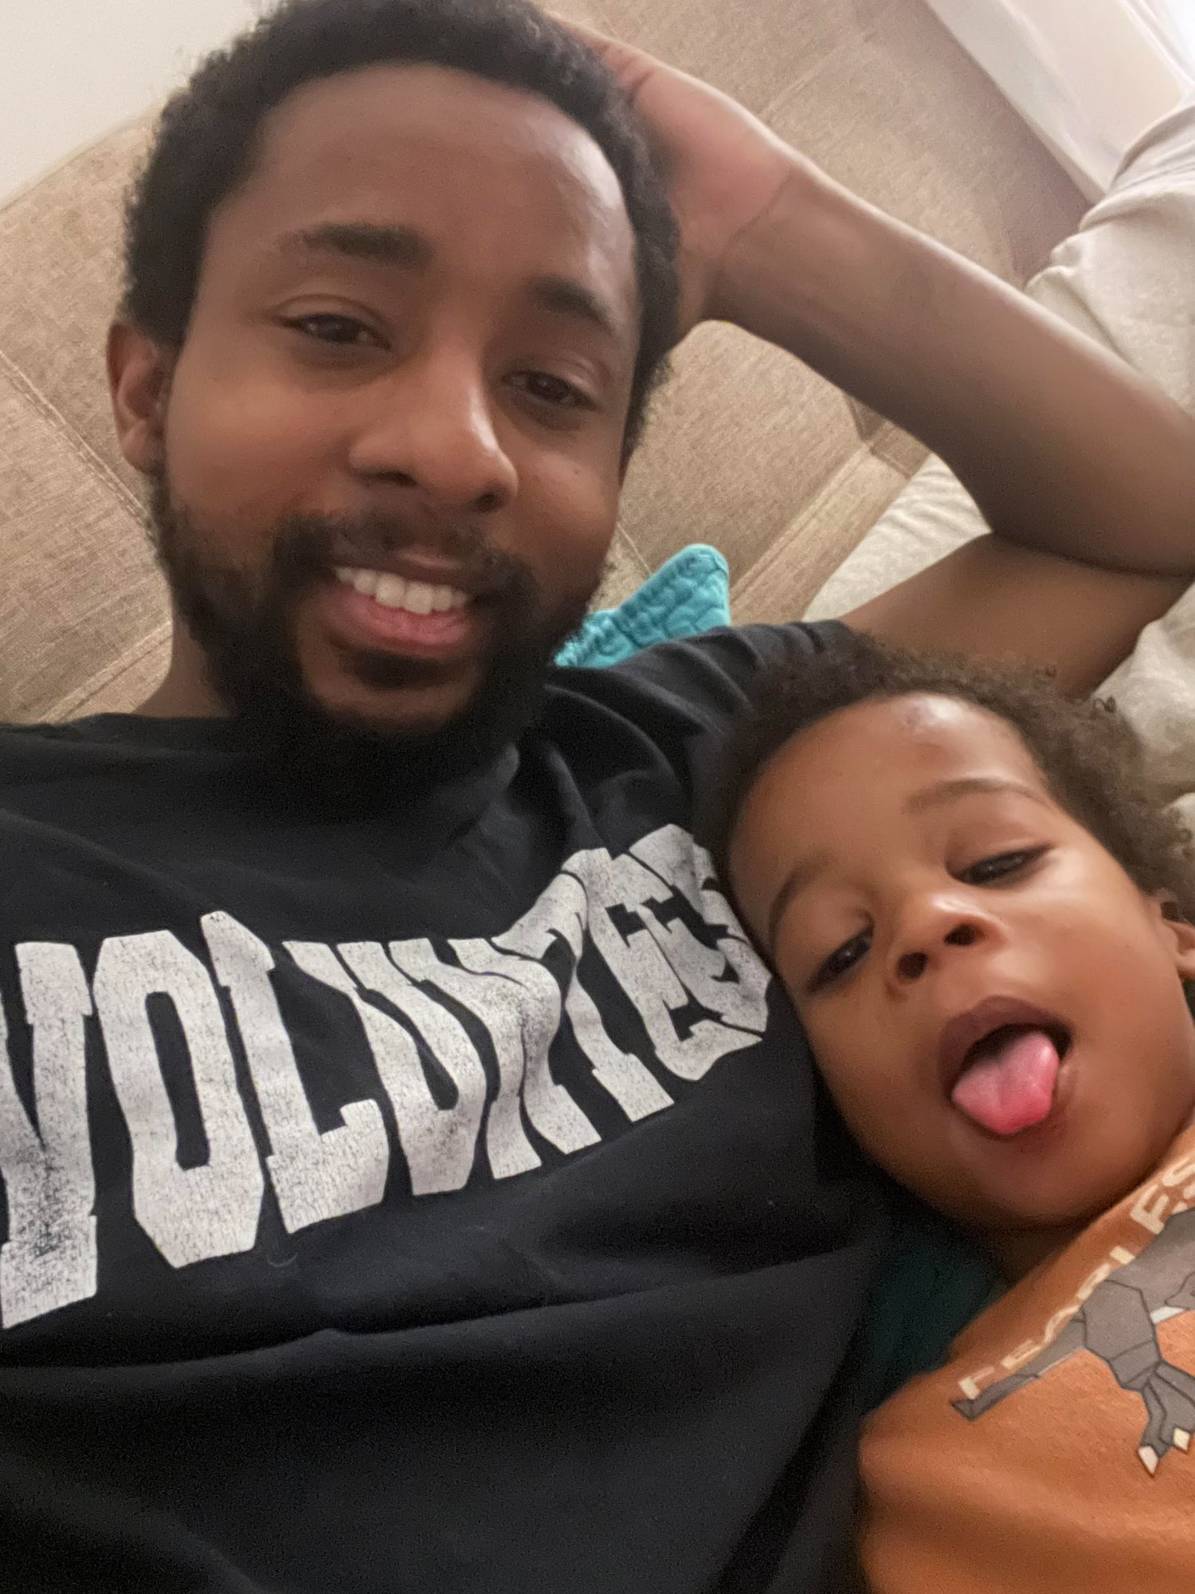





This Is Personal
Single father — driven to find answers
8+ specialists consulted, no definitive diagnosis
Dismissed, misdiagnosed, told to 'manage symptoms'
Engineering background became research leverage
Founded Invisible Illness Project to serve thousands more like me
"The research gap is a personal emergency."

Slide 3

Why This Problem Is Technically & Clinically Important
The intersection of heterogeneous disease and complex ML
Heterogeneous & Fluctuating
Diagnostic Gap
Core ML Challenge
ME/CFS, POTS, Long COVID present differently across patients and across time — one-time testing routinely misses them.
Millions remain undiagnosed despite high symptom burden and severe functional impairment.
Not simply classification — learning robust representations under missingness, cohort shift, modality imbalance, and weak ground truth.

Slide 4

Why Traditional Biomarker Discovery Struggles Here
Multifactorial Etiology
ME/CFS involves interacting immune, metabolic, microbial, autonomic, and behavioral processes varying across patients.
Classic Approach
Attractive but Fragile
BioMapAI explicitly argues that single-outcome / single-modality framing is poorly matched to these diseases.
Seeks 1–2 key biomarkers in isolation, treating disease as a simple binary label
Overfitting Risk
Especially vulnerable to spurious correlations and non-generalizable 'biomarkers' when systems interact.

Slide 5



Duke/Jackson BioMapAI: Why It Is Novel
AI-driven multi-omics modeling of ME/CFS (2025)
Multi-modal integration
249
Gut metagenomics, plasma metabolomics, immune profiling, blood labs, and clinical symptoms in a single framework.
participants
Multi-output learning
Maps high-dim omics to a matrix of multiple symptom outcomes, capturing both disease-level and symptom-specific biology.
153 ME/CFS
96 healthy controls
Biological connectivity
4-year
longitudinal
Uses SHAP explainability to derive connectivity maps across microbiome, metabolome, and immune features.
multi-omics
dataset
Systems disease framing
One of the strongest attempts to treat ME/CFS as a heterogeneous systems disease, not a simple binary label.

Slide 6
BioMapAI Architecture in Technical Terms
Supervised deep neural network with multi-output symptom-aware design
Omics Feature Matrix
Shared Hidden Layers
Outcome-Specific Layers
Gut metagenomics · Metabolomics
Immune profiling · Blood labs
2 shared layers
General pattern learning
Parallel sublayer per
clinical output
SHAP Interpretability
Multi-Output Clinical Matrix
Local & global feature
importance across all
omics modalities
Fatigue · Pain · Sleep
Cognition · Function
Key novelty: multi-output symptom-aware multi-omics integration — not just a neural net applied to biology.

Slide 7
BioMapAI Results: What Is Promising
Not just a classifier — a hypothesis-generating multimodal systems model
Competitive Performance
~0.91
Better than several baselines across the full omics set and individual modalities in cross-validation.
AUC (cross-validation)
External Validation
Outperformed comparators in 5 of 6 external cohort comparisons, though external AUCs were notably lower than internal CV.
disease discrimination
Biologically Interpretable Links
5 of 6
Identified altered relationships among short-chain fatty acids, BCAAs, mucosal/inflammatory immune cells, and symptom burden.
external cohort
comparisons won
Hypothesis Generation
BioMapAI is not just a classifier — it provides a systems-level map connecting microbiome, metabolome, and immune biology.

Slide 8
But BioMapAI Is Not the End of the Story
A breakthrough that makes robustness analysis the required next step
Modest dataset size:
249 participants is deep but small by deep learning standards — generalization remains uncertain.
External performance drop:
Cohort differences (technical and clinical) and incomplete feature overlap reduce external AUCs significantly.
Unvalidated symptom biomarkers:
Some symptom-specific outputs were powerful for hypothesis generation but not validated on held-out data.
Supervised label dependency:
Fundamentally tied to available labels and cohort-specific measurement structure — limits prospective deployment.
Feature selection dependency:
Integrated representation depends on prior modality-specific feature selection choices — a hidden sensitivity.

Slide 9
Why a Deeper Robustness & Ablation Study Is the Logical Next Paper
If a multimodal model performs well — what is it actually depending on?
Technical Motivations
Expected Outputs
Measure modality dependence — microbiome vs. immune vs. metabolomics?
Test redundancy — are expensive modalities adding real signal?
Assess clinical feasibility — can lower-burden inputs proxy high-cost assays?
Probe overfitting — if accuracy collapses when a modality is perturbed, the biomarker claim is much weaker.
Modality importance ranking
Redundancy map across assay types
Robustness curves under degraded input
Lower-burden proxy candidates
Feasibility guidance for deployable pipelines

Slide 10
What the Ablation Study Should Do Technically
Proposed experimental design
01
Leave-one-modality-out
02
Progressive degradation
03
Cross-cohort robustness
Remove microbiome, metabolome, immune, lab, wearable, or symptom-history groups one at a time.
Simulate lower-resolution assays, noisier measurements, missingness, and reduced feature overlap.
Evaluate whether modality importance is stable across internal folds, held-out subjects, and external cohorts.
04
Subgroup dependence
05
Calibration & uncertainty
Test whether different patient subtypes rely on different modality families.
Measure whether the model knows when it is out of distribution.

Slide 11


Why This Matters Beyond BioMapAI
The bridge from deep phenotyping to scalable wearable monitoring
Multi-Omics
Wearable Physiology
• Deep biological signal
• Lower burden & high frequency
• Expensive & sparse
• Longitudinal & ecologically valid
• Not continuously available
• Noisy but continuous
• Powerful for discovery
• Essential for flare / recovery dynamics
The most accessible future measurement layer may not be multi-omics — it may be wearable longitudinal physiology.

Slide 12
What Is a Time-Series Foundation Model?
Pretrained on unlabeled temporal data to learn transferable physiological representations
Candidate Pretraining Signals
Traditional vs. TSFM Approach
ECG / RR intervals
PPG
Traditional
Hand-engineer HRV / actigraphy features → fit a task-specific model for each outcome
HR / HRV
Accelerometry
EDA
Temperature
TSFM
Respiration proxies
Sleep & circadian rhythms
Learn broad physiology representation via self-supervised pretraining → fine-tune or probe for specific tasks

Slide 13


Why TSFMs Are Attractive for Systemic Disorders
Directly targeting the bottlenecks in this space
Label Scarcity
Device Heterogeneity
Clinical labels are expensive and noisy. Self-supervised pretraining can dramatically reduce labeled-data requirements.
Pretrained representations may transfer better across sensors and cohorts than hand-engineered pipelines.
Longitudinal Structure
Personalization
These models exploit rhythms, transitions, missingness patterns, and context at multiple time scales.
Embeddings may support patient-specific baselines and drift detection instead of one-size-fits-all thresholds.

Slide 14
Current TSFM Work We Can Build On
Key prior art across wearable biosignal foundation models
Biosignal Foundation Models:
Apple
Self-supervised pretraining on PPG & ECG from ~141K participants shows consumer wearables encode useful health information.
Behavioral Wearable FMs:
Apple
2.5B hours, 162K individuals, strong across 57 health tasks — behavioral representations complement raw-sensor embeddings.
Accelerometer FM via Distillation:
Apple
Lower-fidelity sensors inherit informative structure from richer biosignals — exciting for low-cost digital biomarkers.
PaPaGei PPG Foundation Model:
Open
57,000+ hours of unlabeled PPG from public datasets, strong performance across 20 downstream tasks.
Pulse-PPG:
Field
Field-trained on raw, noisy wearable PPG — emphasizes generalization across field, lab, and clinical environments.

Slide 15
What Is Still Missing for ME/CFS / POTS / Long COVID
The gap is the opportunity
Disease-Specific Dynamics
Wrong Training Objectives
Field Generalization
Most TSFM work is not designed around orthostatic intolerance, PEM-like crashes, or autonomic instability.
Models are trained on general wellness or standard clinical benchmarks — not the disease dynamics that matter here.
Cross-device and field generalization remain hard when signals are noisy and posture/exertion labels are weak or absent.
Needed Representation Learning Emphases
Posture transitions
Exertional context
Circadian state
Symptom-coupled drift
Missingness robustness

Slide 16
Proposed TSFM Research Direction
Pretrain autonomic wearable representations → test on systemic-disorder tasks
Pretraining Signals
Self-Supervised Objectives
Downstream Tasks
ECG / RR intervals
Masked reconstruction
Phenotype discrimination
PPG
Contrastive learning across windows
Flare prediction
HR / HRV
Motif-aware relative contrastive
Recovery trajectory modeling
Accelerometry
Cross-modal alignment
Drift detection
EDA
Circadian-context prediction
Personalized thresholding
Temperature
Posture-transition prediction
Respiration proxies
Sleep / circadian features

Slide 17

Why TSFMs and BioMapAI Belong in the Same Program
Together, they form a coherent research pipeline
Project A: BioMapAI Robustness
Project B: Wearable TSFMs
→ Identifies which modalities are truly informative
→ Provides the candidate substitute measurement layer
→ Tests whether lower-burden substitutes are plausible
→ Captures longitudinal physiology unavailable in static multi-omics
→ Establishes methodological standards for AI biomarker validation
→ Enables prospective monitoring at scale
Together they support a pipeline:
Deep Phenotyping
Modality Analysis
Proxy Discovery
Wearable Representation Learning
Prospective Monitoring
▶
▶
▶
▶

Slide 18
Strong Candidate Research Questions for PhD Students
Technically rich, scientifically open, clinically meaningful
Q1
Can BioMapAI-like models retain performance under systematic modality dropout?
Q5
Can self-supervised embeddings predict flare risk with less labeled data than HRV feature engineering?
Q2
Which modality families add unique vs. redundant information?
Q6
How should uncertainty be estimated when the model is outside the training distribution?
Q3
Can wearable embeddings recover signal lost when specialty assays are absent?
Q7
Can cross-modal distillation help low-cost wearables approximate richer physiological states?
Q4
Can posture-aware or circadian-aware pretraining improve systemic-disorder phenotyping?

Slide 19
What Makes This a Strong PhD Research Program
Technically real · Scientifically open · Clinically meaningful · Tractable
Technically Real
Scientifically Open
Multimodal fusion, representation learning, domain shift, uncertainty, interpretability, weak supervision, and causal confounding are all in play.
The core digital biomarkers for these diseases are not settled. Every finding is a genuine contribution.
Clinically Meaningful
Tractable Portfolio
Underserved populations with real diagnostic gaps. Research here directly translates to patient impact.
Designed as a portfolio of subprojects rather than one moonshot — permits steady PhD progress with cumulative impact.

Slide 20


Invitation to Collaborate
Invisible Illness Project · Research Opportunities
Multimodal ablation & robustness pipelines
Wearable time-series foundation models
Physiological signal processing
Domain adaptation across devices
Symptom-aligned labeling & dataset design
Interpretable flare prediction
Eddie Massey III · Invisible Illness Project · Roeh Health

