Slide 1
Some notes about implementing ajp for RFC9535 with ixml
ajp – A JSONPATH Processor
https://github.com/xmljacquard/ajp
Alan Painter
Presented at the 1st International Symposium on iXML
Thursday, 26 February 2026
Notes:
In 2025, I had the opportunity to use invisible XML in the development of an implementation of JSONPATH, an implementation that I call 'ajp'. There's a a link to the source repository on this page. At last year's Declarative Amsterdam, I presented the overall implementation, attempting to demonstrate that the combination of ixml, xslt and xpath makes the implementation easy to connect to the specification. Today I want to go into more detail of the usage of Invisible XML in ajp.

Slide 2
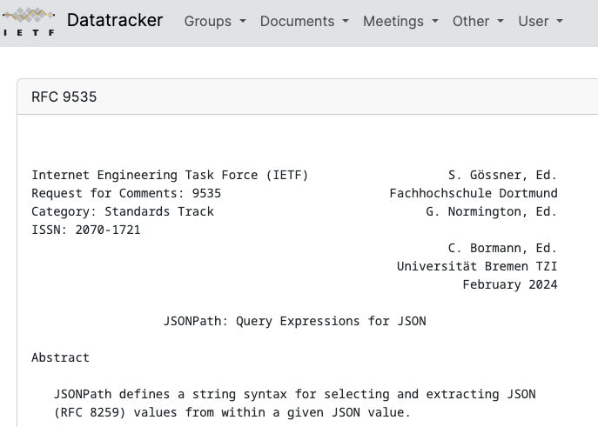
RFC9535 – JSONPATH – appeared Feb 2024
A standard for JSONPATH after around 50 implementations were developed.
https://datatracker.ietf.org/doc/rfc9535/
Notes:
JSONPATH was first introduced in 2007 by Stephan Goessner. It became very popular with lots of usage in mainstream systems and over 50 implementations, but due to an incomplete definition of JSONPATH, the implementations did not all recognize the same queries and they produced different results. Two years ago this month, RFC9535 was published as an IETF proposed standard for JSONPATH, hereby setting the record straight on JSONPATH.

Slide 3
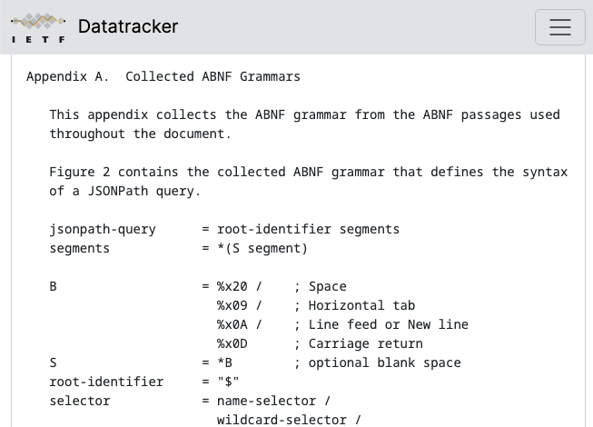
RFC9535 – ABNF grammar at its heart (1)
Around 150 lines of ABNF to describe the query grammar in IETF RFC5234 (a.k.a STD68).
https://datatracker.ietf.org/doc/std68/
https://datatracker.ietf.org/doc/rfc5234/
Notes:
An important part of RFC9535 is the ABNF grammar that describes the JSONPATH query. This grammar is expressed in terms of another IETF standard, RFC5234, also known as STD68 because it is no longer just a proposed standard but has been promoted to standard, and it describes the ABNF grammar that is used in many of the IETF RFCs, including 9535. Appendix A of 9535 provides the grammar for JSONPATH in about 150 lines of text, while the conversion to ixml is closer to 200 lines of text.

Slide 4
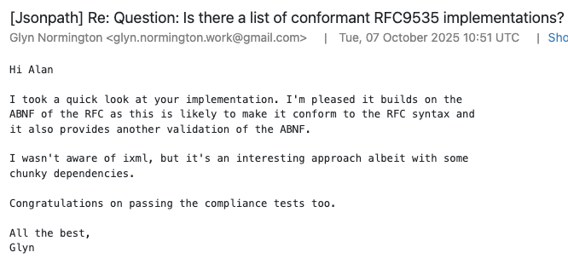
RFC9535 – ABNF grammar at its heart (2)
Remarks from Glyn Normington, one of the editors of RFC9535, on using ixml for the implementation.
https://mailarchive.ietf.org/arch/browse/jsonpath/?q=invisible#
Notes:
I wrote a note to the JSONPATH mailing list to announce the implementation of 'ajp' and I mentioned using invisible xml, specifically NTW's nineml/CoffeeSacks ixml processor. Glyn Normington, one of the three editors of 9535, showed some enthusiasm about implementing around the grammar as well as some interest in ixml. Glyn mentions that it's "another validation of the ABNF". Considering how many IETF RFCs are based on grammars, having tools like ixml is important. Another testimony to this is that the ERRATA raised for RFC9535 all concern the grammar.

Slide 5
RFC9535 ABNF grammar versus ixml grammar (1)
jsonpath-query = root-identifier segments
root-identifier = "$"
segments = *( S segment )
segment = child-segment / descendant-segment
child-segment = bracketed-selection /
("." (wildcard-selector / member-name-shorthand))
descendant-segment = ".." (bracketed-selection /
wildcard-selector /
member-name-shorthand)
ABNF
jsonpath-query = root-identifier , segments .
-root-identifier = - "$" .
segments = ( S , segment )* .
segment = child-segment | descendant-segment .
child-segment = bracketed-selection |
( - "." , ( wildcard-selector | member-name-shorthand ) ) .
descendant-segment = - ".." , ( bracketed-selection |
wildcard-selector |
member-name-shorthand ) .
ixml
Notes:
This is a slide that I presented originally at Declarative Amsterdam. These are the top 6 rules of the JSONPATH grammar in both ABNF and ixml. I wanted to give an idea of how few differences there are between the two. I've highlighted here in yellow the characters that change and in blue the additional markings in ixml compared to ABNF. Both ABNF and ixml use the asterix character to indicate a factor that can repeat, but in ABNF the asterix precedes the repeatable factor, whereas in ixml the asterix follows the factor. Separators between alternative factors are forward slashes in ABNF and can be semicolons or, here, vertical bars for ixml. ixml requires the comma separator between two adjacent factors in a sequence and a full stop or period to terminate the rule. ixml allows you to add marks for serialization. Other than these minor differences, the two grammars are identical for these first six rules.

Slide 6
RFC9535 ABNF grammar versus ixml grammar (2)
logical-not-op = "!"
paren-expr = [ logical-not-op S ] "(" S logical-expr S ")" true = %x74.72.75.65 ; true
false = %x66.61.6c.73.65 ; false
null = %x6e.75.6c.6c ; null
ABNF
logical-not-op = - "!" .
paren-expr = ( logical-not-op , S )? , -"(" , S , logical-expr , S , -")" .
true = - "true" .
false = - "false" .
null = - "null" .
ixml
Notes:
Another couple of differences between 5234 and ixml. Optional sequences of factors are surrounded by square braces in ABNF whereas factor optionality is indicated by the question mark in ixml. In ABNF, letters in a literal string or terminal are considered non-case-sentive, so for ABNF to indicate only lower-case characters in the JSON literal "true", it has to be specified in unicode code points. ixml, on the other hand, is case sensitve. The two grammars still read very much same.

Slide 7
Handling some special characters (1)
escapable = %x62 / ; b BS backspace U+0008
%x66 / ; f FF form feed U+000C
%x6E / ; n LF line feed U+000A
%x72 / ; r CR carriage return U+000D
%x74 / ; t HT horizontal tab U+0009
"/" / ; / slash (solidus) U+002F
"\" / ; \ backslash (reverse solidus) U+005C
ABNF
-escapable = BS | FF | LF | CR | HT | SLASH | BACKSLASH .
BS = -"b" . { \b BS backspace U+0008 }
FF = -"f" . { \f FF form feed U+000C }
-LF = -"n" , +#a . { \n LF line feed U+000A }
-CR = -"r" , +#d . { \r CR carriage return U+000D }
-HT = -"t" , +#9 . { \t HT horizontal tab U+0009 }
-SLASH = -"/" , +#2f . { \/ slash (solidus) U+002F }
-BACKSLASH = -"\" , +#5c . { \\ backslash (reverse solidus) U+005C }
ixml
Notes:
JSONPATH has similar conventions to JSON itself in terms of escaped characters, hence '\n' is read as a linefeed character, '\r' as a carriage return, etc. The ABNF grammar includes the escape sequences to be recognized, whereas ixml both recognizes and also allows us to replace the escape sequence with the target character, at least for the last 5 escape sequences in this list. We use the "-" mark on, for example, "CR" and the character "r" to suppress serialization and the + mark to insert the character 13 or hex D. For the first two characters, BS and FF, ixml can't substitute the target characters directly because those two characters are among those that are not allowed in an XML document, even in XML1.1; instead, for ajp, the xml elements BS and FF are produced by ixml in the XML output document, to be replaced during downstream processing.

Slide 8
Handling some special characters (2)
; see RFC 8259
unescaped = %x20-21 / ; omit 0x22 "
%x23-26 / ; omit 0x27 '
%x28-5B / ; omit 0x5C \
%x5D-D7FF / ; skip surrogate code points
%xE000-10FFFF
ABNF
{ see RFC 8259 }
-unescaped = [ #20-#21 ] | { omit 0x22 " }
[ #23-#26 ] | { omit 0x27 ' }
[ #28-#5B ] | { omit 0x5C \ }
[ #5D-#D7FF ] | { skip surrogate code points }
[ #E000-#10FFFD ] . { omit #10FFFE - #10FFFF }
ixml
https://en.wikipedia.org/wiki/Specials_(Unicode_block)
https://datatracker.ietf.org/doc/rfc9839/
Notes:
9535 gives the list of unescaped characters than can be part of a string literal, spanning across the 17 unicode planes. I discovered that ixml/CoffeeSacks does not accept FFFE and FFFF as characters in a character class, apparently because they are listed a "noncharacters". So I had to exclude these characters from the range, and I should probably, as per RFC9839, exclude FFFE and FFFF from all of the 17 planes. I may get around to doing that.

Slide 9
Constructing Messages for Parser Errors
let $failed := parse-xml($error_description)/failed
return 'Parsing error in query line ' || $failed/line ||
' column ' || $failed/column ||
' unexpected character: ' || "'" || $failed/unexpected || "'" || '.'
$[?2.2] | Parsing error in query line 1 column 6 unexpected character: ']'.
$[?null] | Parsing error in query line 1 column 7 unexpected character: ']'.
$[?true || false] | Parsing error in query line 1 column 9 unexpected character: '|'.
$[?true == false && false] | Parsing error in query line 1 column 25 unexpected character: ']'.
$[?true == false || false] | Parsing error in query line 1 column 25 unexpected character: ']'.
$[?false && true == false] | Parsing error in query line 1 column 10 unexpected character: '&'.
$[?false || true == false] | Parsing error in query line 1 column 10 unexpected character: '|'.
$[?@==True] | Parsing error in query line 1 column 7 unexpected character: 'T'.
Notes:
When parsing unrecognized input, we'll be getting XPath errors raised by the ixml parser, you need to do something with them, especially providing meaningful error mesages. I use this bit of code with CoffeeSacks to retrieve the error messages from the $error_description value which is XML serialized as a string. Here I give a few examples of the erroneous JSONPATH input and the resulting error messages. I'm looking for a way of giving some more meaningful information as a message but I haven't found anything better for the moment.

Slide 10
A use-case for ixml round-tripping
$[?length(@[1, 2])<3] | ajp:FCT0008: argument 1 of function length() must be a singular query.
<xsl:template match="function-argument[filter-query]" >
<xsl:param name="functionName" as="xs:string" />
<xsl:variable name="argumentType" select="ajp:argumentAtPosition($functionName, position())" />
<xsl:sequence select="if ($argumentType is $VALUE_TYPE and not(ajp:isSingularQuery(filter-query)))
then ajp:error('FCT', 8, 'argument ' || position() ||
' of function ' || $functionName || '()’ ||
' query: "' || to-expression(filter-query) '" ' ||
' must be a singular query.’)
else … " />
</xsl:template>
function-argument = literal |
filter-query | { includes singular-query }
logical-expr |
function-expr .
Notes:
Also for error messages, but this time not a parsing error but a semantic error, I found a place where it would be useful to use round-tripping from ixml, recreating fragments of the original input from the parsed output. Here we have the case where the grammar accepts a general 'filter-query' for a function argument, but implementing the rules for the types of the function arguments, which are not addressed in the grammar but are part of the semantics, then for a formal function argument declared to be a VALUE_TYPE, we need to perform an additional check to require that the form of the query is a "singular query". If it's not a singular-query, we return a static/compile-time error. Round-tripping of the filter-query that is not singular would be nice, here, to put the text of the erroneous subquery directly in the message.

Slide 11
A case of ambiguity: $[?value(@.*)==4] (1)
function-argument = literal |
filter-query | { includes singular-query }
logical-expr |
function-expr .
logical-expr = logical-or-expr .
logical-or-expr = logical-and-expr , ( S , - "||" , S , logical-and-expr )* .
logical-and-expr = basic-expr , ( S , - "&&" , S , basic-expr )* .
-basic-expr = paren-expr | comparison-expr | test-expr .
test-expr = ( logical-not-op, S )? , ( filter-query | function-expr ) .
Notes:
One point of ambiguity that I’ve run into with the ABNF grammar is that a function argument can be one of four different non-terminals, including a filter-query or a logical-expr. Here, the expression @.* is the argument to the value() function, and it should be parsed as a filter-query. But a filter-query can always also be parsed as a logical-expr. The rules by which filter-query is composed into a logical-expr contain either no additional factors or only optional factors. Semantically, a logical-expr is different from a filter-query, producing a boolean value. This expression will raise a static/compile-time error if the @.* is interpreted as a logical-expression. 9535 is considered as being designed for PEG (Parsing Expression Grammar) which prioritizes alternatives by order, returning the first alternative that matches for that rule. However, ixml is a context-free grammar (CFG) and hence can produce multiple outputs in case of ambiguity.

Slide 12
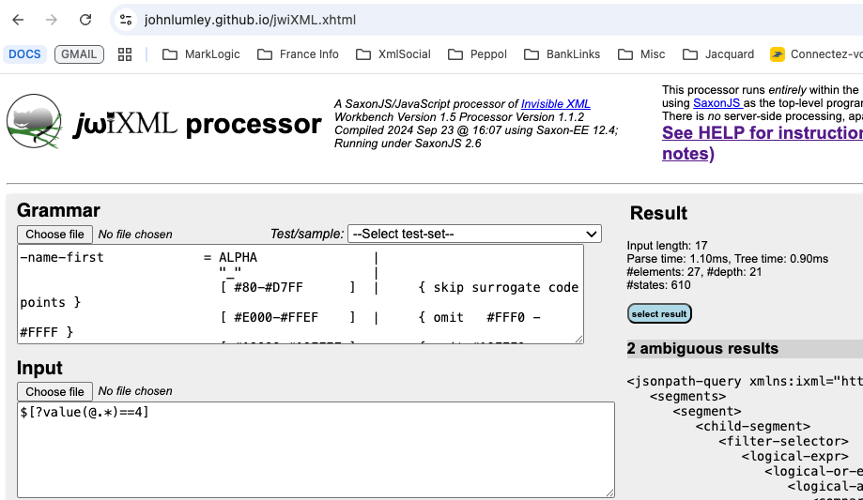
A case of ambiguity: $[?value(@.*)==4] (2)
https://johnlumley.github.io/jwiXML.xhtml
Notes:
One way of visualizing the ambiguity is by using John Lumley’s online ixml processor, jwiXML, for which the link is here. It shows the two outputs for this query.

Slide 13
A case of ambiguity: $[?value(@.*)==4] (3)
<function-expr>
<function-name>value</function-name>
<function-argument>
<logical-expr>
<logical-or-expr>
<logical-and-expr>
<test-expr>
<filter-query>
<rel-query>
<segments>
<segment>
<child-segment>
<wildcard-selector>*</wildcard-selector>
</child-segment>
</segment>
</segments>
</rel-query>
</filter-query>
</test-expr>
</logical-and-expr>
</logical-or-expr>
</logical-expr>
</function-argument>
</function-expr>
<function-expr>
<function-name>value</function-name>
<function-argument>
<filter-query>
<rel-query>
<segments>
<segment>
<child-segment>
<wildcard-selector>*</wildcard-selector>
</child-segment>
</segment>
</segments>
</rel-query>
</filter-query>
</function-argument>
</function-expr>
Notes:
The ambiguous outputs are identical except for the “extra” hierarchy of four levels on the left from “logical-expr” down throught “test-expr”. ajp needs to process the parse tree on the right and not the one on the left. There are a few different ways of addressing this problem 1) Transform the ixml output to elide the elements logical-expr through test-expr inclusive when they have only one child 2) Treat the logical-expr as if it were a filter-query when the elements logical-expr .. test-expr have only one child. 3) Indicate to the ixml processor to prefer the filter-query over logical-expr in cases of ambiguity. I still haven't addressed this, mostly because, up to this point, the ixml processor produces 'filter-query'.

Slide 14
Can mail me at: contact@xmljacquard.org
Thanks!

