Slide 1
Docker for Developers
Presented by : Alex Campos
“Build, ship and run any app, anywhere”
Notes:
Hello everyone and welcome to today’s presentation which is called Docker for Developers.
My name is Alex Campos, and for those of you who don not know me, I graduated from computer science back in 2005 and I’ve been working in IT pretty much since that day.
Currently I work as a Data Center Engineer for UTRGV and even though I have prior experience with Computer Virtualization and Cloud services this is my first time looking at Docker.
Personally, I learned to love this technology and I strongly encourage everybody in this room to at least set up a lab environment and try to gasp the basic concepts behind docker.
Before we begin though, I would like to ask the audience, who in this room is familiar with virtualization – meaning that you have deployed at least one virtual machine on virtual box, vmware, hyper-v, etc. ?
Who is familiar with docker (and by familiar I mean you have used it before)?

Slide 2
Agenda
What is Docker and why should we care ?
Docker growth statistics
Docker Container Architecture
Containers vs Virtual Machines
Docker Images
Live Demo
Additional Resources
Notes:
Firtst and foremost, here we have the agenda for today. I was tryingto keep this presentation short so that we can go over a Demo of docker, but at the same time I want to make sure we cover some basics like
The definition of docker and the relevance to us
Basic architecture
Comparison of a docker container vs virtual machines
Talk about docker images
Jump into the demo and then just give you all some additional resources.
At any given time, please feel free to ask a question, specially during the demo since I would very much like it to be interactive.

Slide 3
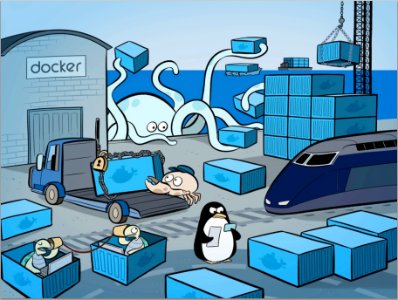
What is Docker ?
An open platform for developing, shipping and running applications using container virtualization technology
It uses the kernel on the host’s operating system to run multiple isolated units of work called containers
Each container has its own file system, processes, memory, devices, network ports and everything you need to run your application.
Each app runs inside its own isolated container and this container is “shipped” to other Docker systems as needed.
Notes:
Lets begin.
What is docker? Docker is an open source platform that was designed with developers in mind and lets them build, ship and run an application anywhere.
They do this by using something called a container, which is nothing more than an isolated process running on your kernel.
This process has its own abstraction layer composed of a file system component, processes, memory, network devices and in addition, a developer can add any of the dependencies they need to build and run their app
Each app runs inside this isolated container and can be shipped anywhere ! (think of the analogy of a shipping company that puts products inside a big container and then they ship them across the world via boat, train, truck, etc. until the contents of the container get to their final destination.
Now, this is the definition but…..

Slide 4
Why should we care ?
It facilitates application deployment. Developers make sure that their application builds successfully and server admins just need to make sure the container deploys successfully.
Build once, ship many and run (almost) anywhere
It is the smallest unit of software delivery that guarantees all the dependencies of the application are included in each and every deployment.
According to James Bottomley (Parallels’ CTO of server virtualization): “With a perfectly tuned container system, you can have as many as four-to-six times the number of server application instances as you can using Xen or KVM VMs on the same hardware”.
Eliminate inconsistencies between development, test and production environments
Notes:
Why should we as developers care ?
Well, first of all, like we briefly mentioned on the previous slide, Docker aims at simplifying the application deployment process by ensuring that a properly built docker container can run inside any docker platform.
Think of this as your Java Code that can run inside of any virtual machine but now we can also include other external dependencies like Web Servers, Spefic version of a library, etc.
Because of this abstraction layer, you can take a docker container and
For instance, you can take a docker container that was built inside an Ubuntu machine and deploy it to a Redhat server that runs docker. Because of this, one can say that Docker was built from the ground up to enable developers to build once, ship it wherhever we need and run it almost anywhere.
Also, if we compare docker to virtual machines, the docker footprint is much more smaller which in turns enable sys admins to run as many as four to sis times the number of applications as compared to them running inside virtual machines.
No more deployment nightmares where you have many things to coordinate and different environments to support.
Which bring us to the next point, lets spend a couple of minutes looking at the traditional application deployment and compare it with the promis of docker.

Slide 5
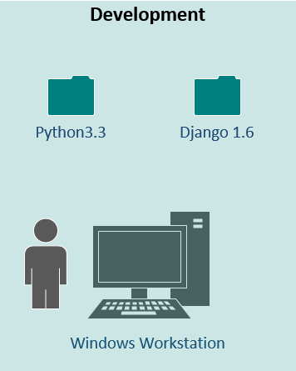
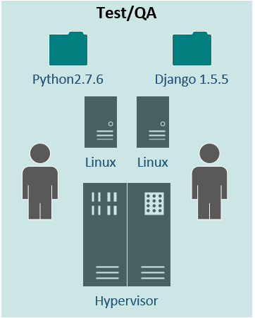
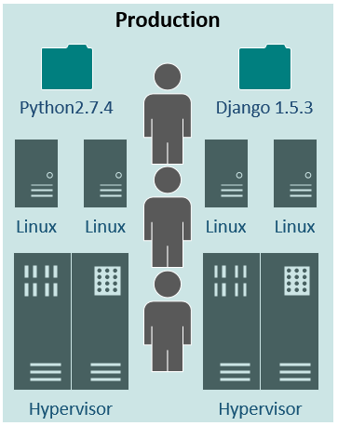
Traditional Application Deployment
Notes:
Today, it is not uncommon for a developer to install tools on his local development machine, like a specific version of python or a specific version of a web server like Django. He goes through all the preliminary testing himself but when is time to move his code to a test environment, he realizes that they only have Python 2.7.6 and a different version of your web server
The developer needs to either test the application using these settings, ask the admin for an upgrade (hoping that other applications that are already installed don’t depend on his libraries) and/or go back to the development box and match the version of the library to those available in the server.
Same thing happens with production, although there is a tendency to have much more complex environments and more restricted maintenance winwows.

Slide 6
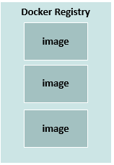
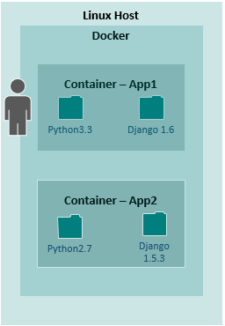
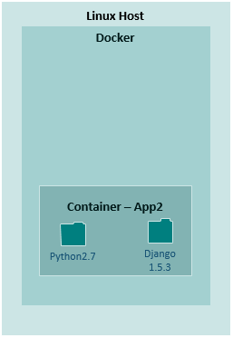
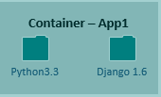
Docker Deployment Workflow
PUSH
PULL
Notes:
With docker, the developer needs to just build his container, publish it to a registry (private or public) and then either a Job or a system admin deploys the container into another environment running docker
Any questions so far ?
Well, if this didn’t convince you that docker is a cool solution for a complex problem,…..

Slide 7
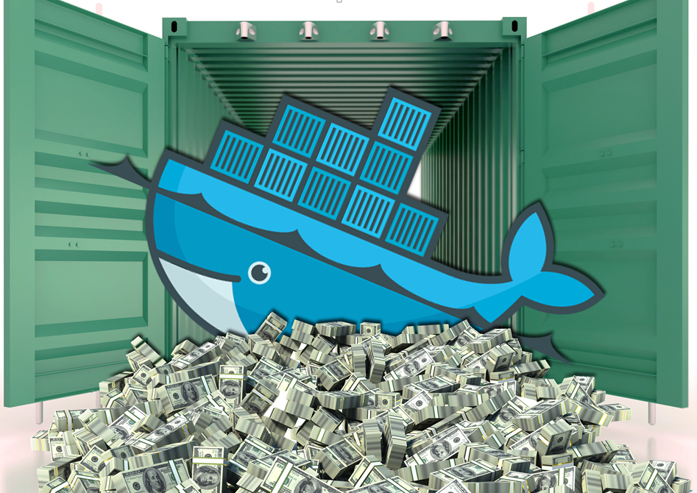
but really… why should we care ?
Notes:
Docker is growing fast…..

Slide 8
Some Growth Statistics
 | June 2014 | June 2015 | Growth
Contributors | 460 | 1,300 | 183%
Projects on GitHub | 6,500 | 40,000 | 515%
Docker Job Openings (indeed.com) | 2,500 | 43,000 | 1,720%
Dockerized Applications | 14,500 | 150,000 | 934%
Boot2Docker Downloads | 225,000 | 3,500,000 | 1,456%
Container Downloads | 2,750,000 | 500,000,000 | 18,082%
Source: DockerDay2015: Getting Started with Docker available at:
http://www.slideshare.net/Docker-Hanoi/dockerday2015-getting-started-with-docker

Slide 9
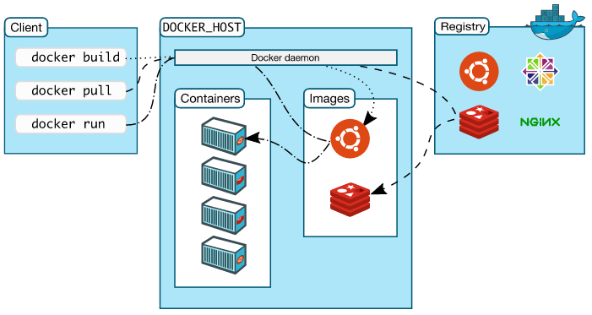
Docker Architecture
Docker can be divided in different components which are represented in the following picture
Notes:
To understand Docker’s internals, you need to know about three components:
Docker images.
Docker registries.
Docker containers.
Docker images
A Docker image is a read-only template. For example, an image could contain an Ubuntu operating system with Apache and your web application installed. Images are used to create Docker containers. Docker provides a simple way to build new images or update existing images, or you can download Docker images that other people have already created. Docker images are the build component of Docker.
Docker registries
Docker registries hold images. These are public or private stores from which you upload or download images. The public Docker registry is provided with the Docker Hub. It serves a huge collection of existing images for your use. These can be images you create yourself or you can use images that others have previously created. Docker registries are the distribution component of Docker.
Docker containers
Docker containers are similar to a directory. A Docker container holds everything that is needed for an application to run. Each container is created from a Docker image. Docker containers can be run, started, stopped, moved, and deleted. Each container is an isolated and secure application platform. Docker containers are the run component of Docker.

Slide 10
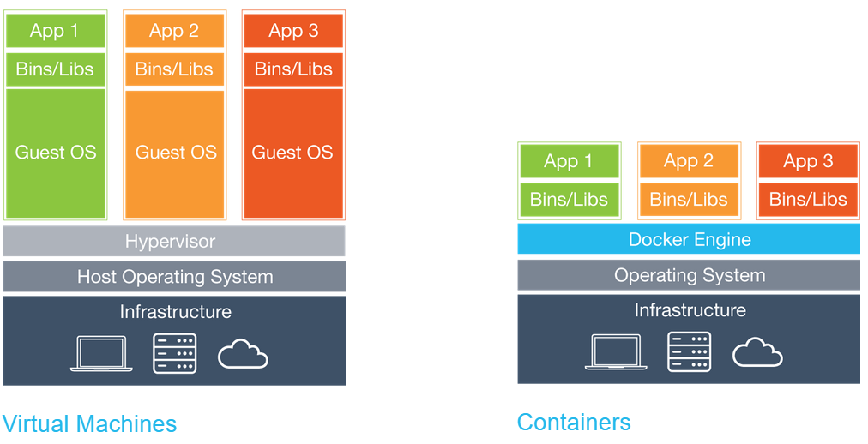
Container vs Virtual Machines
Each virtual machine includes : application + dependencies + the entire operating system.
Containers include: application + dependencies and share the host kernel with other containers.
Due to architectural approach, containers are more portable and efficient than VMs
Notes:
A virtual machine is nothing more than a full operating system where you install your application and all of the dependencies. This OS runs on top of a hypervisor and it is the job of the hypervisor to communicate with the unrelying hardware
A docker container runs directly as a process on the Host operating system. Each container has all the dependencies needed for your application to run successfully on any other docker engine.
Because containers run on top of the Host OS and there is not a full OS overhead, you can say that containers are much more efficient….

Slide 11
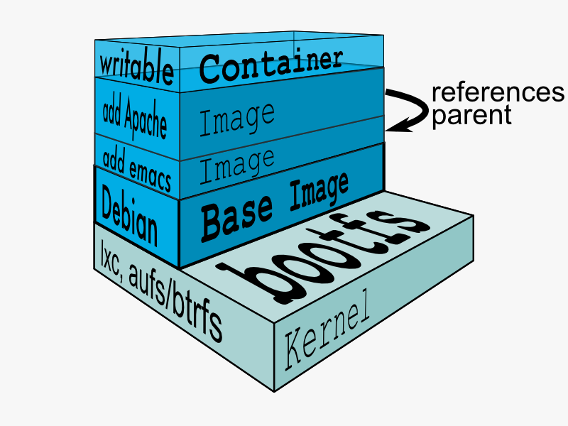
Docker Images
Building blocks of containers
Each image is constructed of several “read-only” layers placed on top of each other.
On top of each image, there is a “writable” layer which takes care of the changes done inside the container.
Can be created after a commit or via a Dockerfile (we will demo this part)

Slide 12
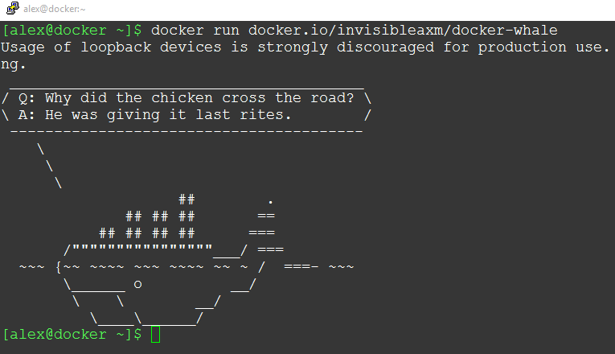
Live Demo

Slide 13
Additional Resources
What is Docker and why is it so darn popular?
Docker Hub
Docker Compose
Getting started with Docker
Understanding Docker
Notes:
http://www.zdnet.com/article/what-is-docker-and-why-is-it-so-darn-popular/

