Slide 1
Image Classification
Basic WorkFlow

Slide 2
Data Collection and Preparation:
We Sampled a subset of dataset with 40 images containing 20 samples of both normal and diseased paddy crop plants and oragnized them into separate folders for normal and diseased samples.
Data Loading and Preprocessing:
We Implement a function to load images from the dataset folders.
Preprocess the images:
We Resize images to a fixed size (e.g., 100x100 pixels) to ensure uniformity.
Flattened the image arrays to create feature vectors for input to the classifier, and Assign labels to the images (0 for normal, 1 for diseased).
Dataset Splitting:
We Split the dataset into training and testing sets using a suitable ratio (e.g., 80% training, 20% testing), to ensures that the classifier is trained on a portion of the data and evaluated on a separate portion to assess its performance.
Classifier Initialization and Training:
Initialize the Support Vector Machine (SVM) classifier with appropriate parameters (e.g., kernel type = linear , random state).
Train the classifier using the training dataset:
Feed the training images and corresponding labels to the classifier.
The classifier learns to determine the optimal hyperplane that separates the classes in the feature space.
Classifier Evaluation:
We used the trained classifier to make predictions on the testing dataset.
Evaluated the performance of the classifier using metrics such as accuracy, precision, recall, and F1-score.
Generate a classification report to summarize the performance of the classifier on each class.
Prediction of New Images:
Once the classifier is trained and evaluated, it can be used to classify new images.
We loaded a new image and preprocess it in the same manner as the training/testing images.
Used the trained SVM classifier to predict the class label of the new image.
Printed the predicted class label to the user.

Slide 3
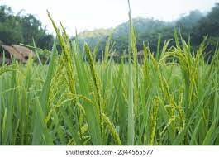
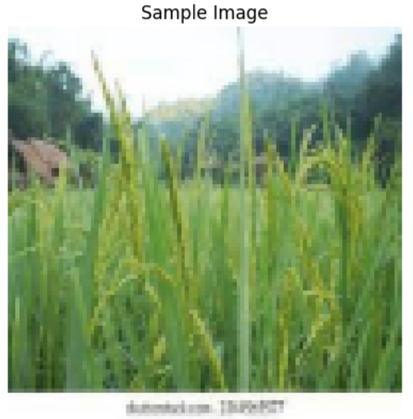
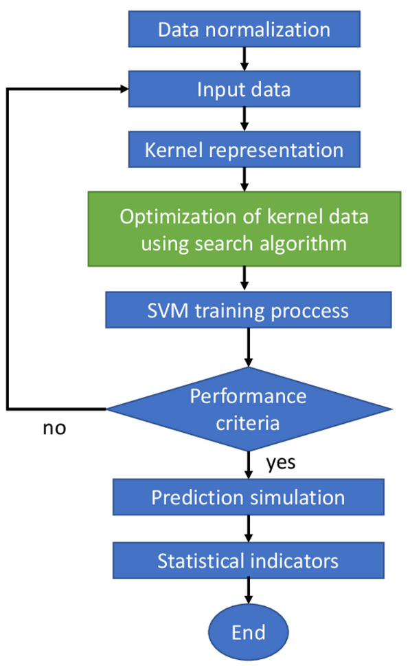
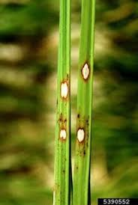
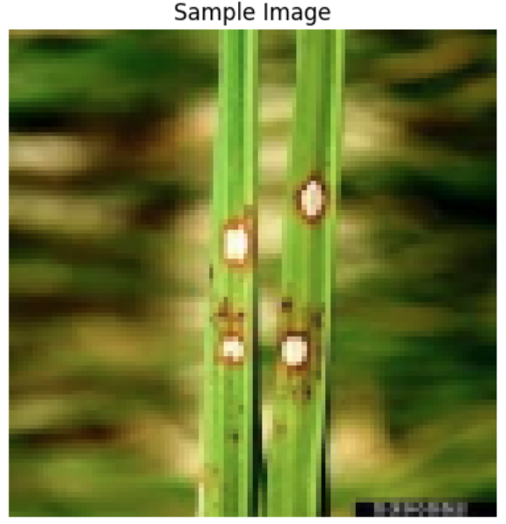
Flowchart:

