Slide 1
Stagnation of Japanese Economic Growth
- Abdul Ahadh [17AG3FP02]
Notes:
Background
<a href="https://www.freepik.com/free-photos-vectors/business">Business vector created by pikisuperstar - www.freepik.com</a>
Cheery Blossom
<a href="https://www.freepik.com/free-photos-vectors/banner">Banner vector created by freepik - www.freepik.com</a>

Slide 2
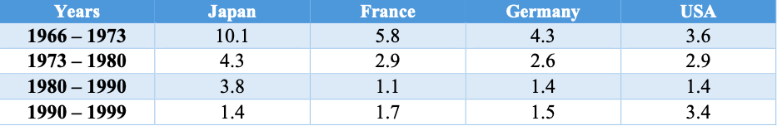
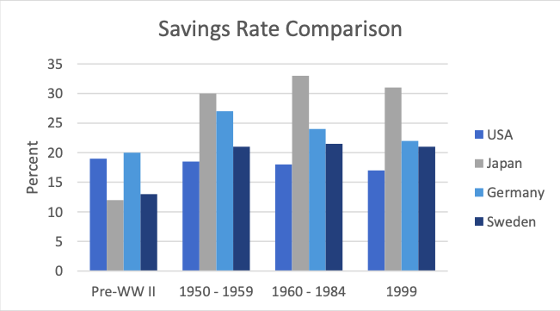
Macroeconomic Performance, Policy and Planning
i
Notes:
Gate
<a href="https://www.freepik.com/free-photos-vectors/flower">Flower vector created by macrovector - www.freepik.com</a>
Background
<a href="https://www.freepik.com/free-photos-vectors/banner">Banner vector created by macrovector - www.freepik.com</a>
Cheery Blossom
<a href="https://www.freepik.com/free-photos-vectors/banner">Banner vector created by freepik - www.freepik.com</a>

Slide 3
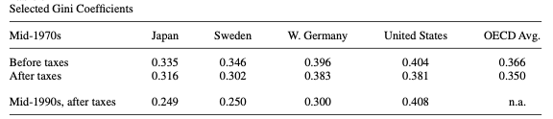
Quality of Life
Relatively Low PPP
Lower crime rates than other countries
Labor Management system led to more equal income distribution
Highly congested cities --> Long hours spent in commuting
Notes:
Cheery Blossom
<a href="https://www.freepik.com/free-photos-vectors/banner">Banner vector created by freepik - www.freepik.com</a>
Cat
<a href="https://www.freepik.com/free-photos-vectors/business">Business vector created by pikisuperstar - www.freepik.com</a>

Slide 4

Collapse of Japanese Bubble
- Savings Rate
- Non-Tradeable Goods
- Financial Markets
- Capital Leakage
- Tax Cut
- Overinvestment
- Bad Loans
- Work Ethics
Notes:
Background
<a href="https://www.freepik.com/free-photos-vectors/background">Background vector created by freepik - www.freepik.com</a>
Cheery Blossom
<a href="https://www.freepik.com/free-photos-vectors/banner">Banner vector created by freepik - www.freepik.com</a>

Slide 5
Thank You
Notes:
<a href="https://www.freepik.com/free-photos-vectors/business">Business vector created by pikisuperstar - www.freepik.com</a>

