Slide 1

Calculator
EC 1+1+1.1.1
Chuka Nwokolo

Slide 2
Goal/Motivation:
This project presents a fully functional calculator. Which allows the user input numbers from a host computer as well as using the switches on the FPGA and outputs the results in 4 bit binary.
The core of the project is manipulate different adders to achieve different results function (Like multiplication and division).
The core of this project is to allow people do small scale calculations on an FPGA

Slide 3
Functionality
I originally thought about making an Morse code encoder but due to some unforeseen instances I ended up making a calculator.
I found this to be a perfect project which blended a lot of what has been covered in class as well as a few new functionalities.

Slide 4
Specification and Overview
The project is divided into two parts:
1. Encoder
2. ALU
3. VGA
The main bulk of the product involved the implementation of new functions as well as displaying their output on the VGA.

Slide 5
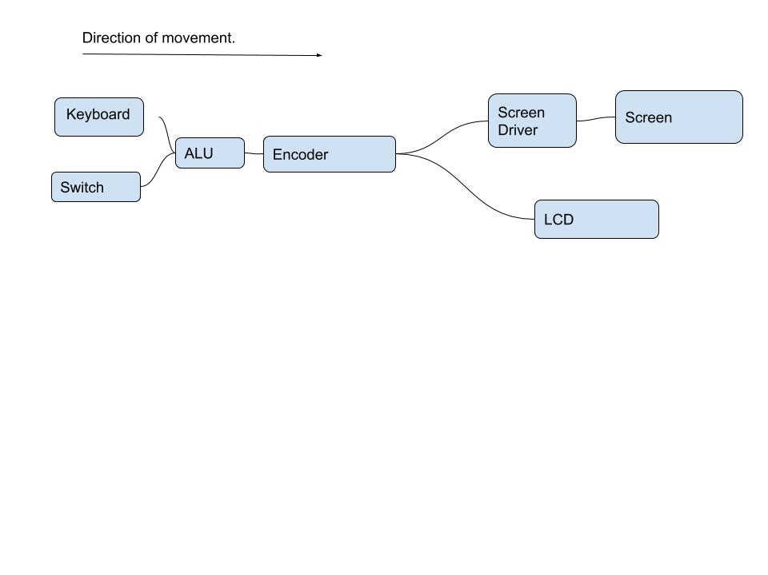
Block Diagram
A Block diagram of the system.
This system was created to be able to receive two inputs either
using the keyboard or using the switches and in the same sense
was created to be able to display between two results, using the
LCD or using the screen.

Slide 6

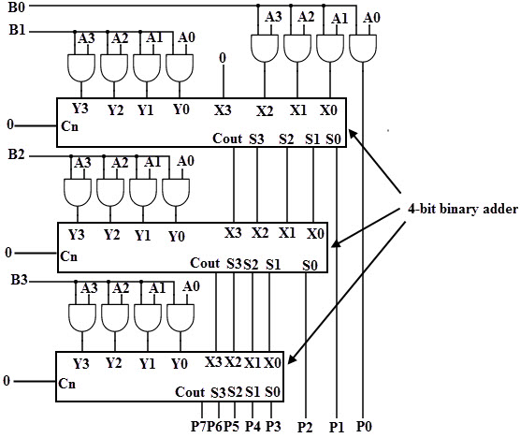
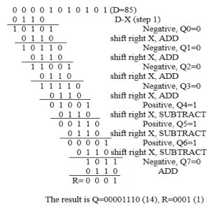
Logic snippet behind challenging functions

Slide 7

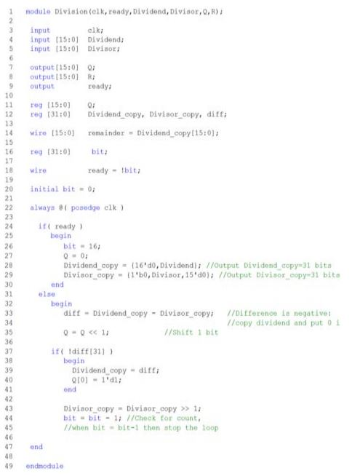
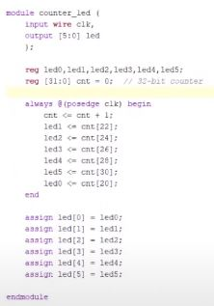
Division module Power on display

Slide 8
Successes and Difficulties
Successes
Implementing all calculator functions I was interested in. (And throwing in a few binary manipulations for good measure)
Multiple inputs and displays (Allowing the user to input in multiple ways and allowing the user get results in multiple ways
Difficulties
VGA text output
Keyboard input

Slide 9
Thank you!
Questions? Email inwokolo@bu.edu

