Slide 1
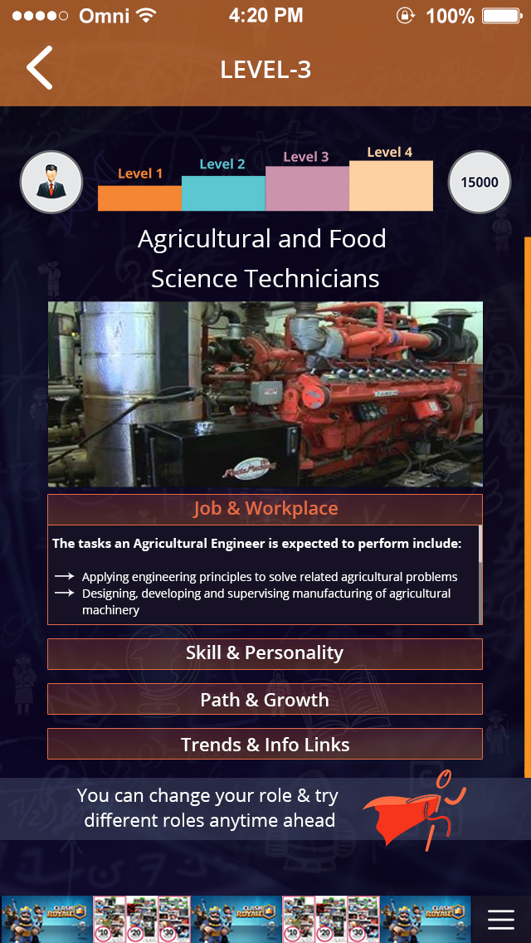
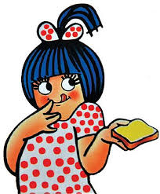
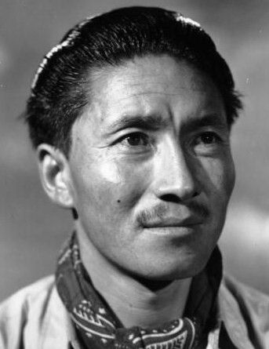
INPUT
1
ICON Related | Fictional | Non-Fictional (Real)
ICON IMAGE
ICON NAME | Amul Girl | Tengzing Norgay
ICON Type/Profession | Cartoon | Mountaineer
ICON UID Tag | UID 1 | UID 2
INPUT
2
Career Name | Basket Name | Career ID
Actor | Basket 1 and 3 | UID 1
Sportsman | Basket 7 and 8 | UID 2
Engineer | Basket 16 and 12 | UID 3

