Slide 1

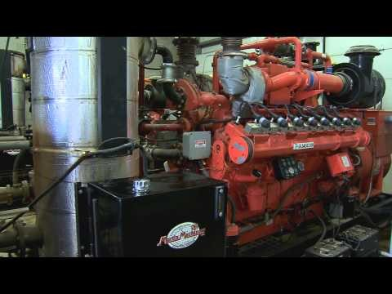
L3 Career Research Headers & Content (Example : Agriculture Engineer)
Job & Workplace
Skill & Personality
Path & Growth
Trends & Info Links
Job & Workplace
Skill & Personality
Path & Growth
Trends & Infolinks
Job & Workplace
Path & Growth
Skill & Personality
Trends & Infolinks

Slide 2
Job & Workplace
The tasks an Agricultural Engineer is expected to perform include:
Applying engineering principles to solve related agricultural problems
Designing, developing and supervising manufacturing of agricultural machinery
Laying out and supervising construction of farm buildings and utilities
Managing crop processing plants and rural electric power distribution systems
Conserving soil by installing soil erosion control system
Saving water by setting up flood control system
Managing all the farm operations
Taking necessary steps to ensure pest control
Maintaining rural roads and protecting farm against fire
It is not a desk job, Work from home option is not available, Part-time work and contractual jobs maybe available
Local travelling is part of the job
Supervising a team of trainees or workers is required
Working is 9 hours everyday for 6 days a week
Overtime maybe required
Shift system is not available
This job is considered mildly hazardous or dangerous
Health risks include exposure to extreme temperatures, dust, pesticides, chemicals, constant contact with machinery and equipment, etc.
Occupational hazards include physical strain, accidents and injury to body while using machinery, sharp tools, etc.
This job is not suitable for a candidate with special needs

Slide 3
Skills & Personality
Knowledge of engineering and mechanical principles
Knowledge of various technical designs, farm machines, tools and equipment, etc.
Efficient in development and management of agricultural processes
Knowledge of diverse solutions to environmental issues
Familiar with irrigation management
Knowledge of pest control and disease prevention
Efficient in maintaining health and safety standards at the farm
Good communication skills
Problem solving skills
Team player
Attention to detail
Diligence
Result-oriented

Slide 4
Path & Growth
Academic
10th Grade
12th Grade
Graduation preferably Bachelor's degree in Agriculture/Electrical/Mechanical Engineering
Learning Avenues
Colleges and universities providing B.Tech or B.Sc in agriculture across India
Agricultural colleges and universities across India
Growth Potential
Engineering Trainee – Agricultural Engineer – Senior Agricultural Engineer – Team Leader – Operations Manager – Head of Geographical Unit – Head of Company
Starting Salaries
Entry level– ₹ 10,000 to ₹ 12,000 per month
3-5 years Experience ₹ 20,000 to ₹ 35,000 per month

Slide 5
Trends & Infolinks
Growth of Agricultural Activities in India
According to a report by NSDC, agriculture and allied activities accounts for about
15.7 % of country’s GDP and is estimated to employ about 124.7 million people as cultivators and 106.8 million as agricultural labour (Census 2001).
Agricultural Engineering encompasses chalking out and implementing multipronged scientific and practical strategies to help in the production and development of better crops and achieving higher yield.
Enhancement in agricultural productivity is directly linked to the technological advancements in agricultural engineering. To fulfil the ever increasing food demand despite shrinking natural resources and impending climate change, there is a high demand
for Agricultural Engineers in India. Agricultural engineering has a very critical role to play in higher agricultural production, post harvest management and rural employment generation. These trends suggest a vast scope of employment for Agricultural Engineers across India.
More Information Links
Links to be within ProTeenLife.com…
http://entrance-exam.net/agriculturalengineer-how-to-becomeanagricultural-engineer
http://www.icar.org.in/en/agriculturalengineering.htm

