Slide 1
Computer Aided Instruction using Conversational Intelligence
Lennon D. Pajar

Slide 2
Chapter 1

Slide 3
INTORDUCTION
Overview of the Current State of Technology
Students, specifically those assigned with programming courses cannot easily grasp in taking off on the
basics of understanding programming concepts.
Though a lot of these student’s may say that it is a challenging task, the process of understanding the
basics is the foundation to become skillful in a specific programming platform.
A programming instructors’ intervention provided to the students covers programming concept topics, of which, is
difficult to be managed when a class has a size of 40 students.
Students taking computer programming courses very often come with various backgrounds and ability levels (Wang,
F.L., Wong, T.-L., 2008).
Since the level of the students’ skill is not easily identified, various rubrics are developed, which may possibly measure the skill
set of the student through a scoring method, but can never measure the programming skill level.

Slide 4
INTORDUCTION
Overview of the Current State of Technology
Classroom management, especially on teaching programming courses is a great challenge to both the instructor and students since the interaction and the monitoring of learnings is very wide ranged.
Computer Aided Instruction (CAI) is one of the vast innovating technologies needed to support classroom intervention of a student to develop a skill, especially in the aspect of ones’ programming skills to become adept on a programming platform.
It has been showed that CAI technology can be a more effective way of teaching introductory programming courses (Anderson & Skwarecki, 1986), which can be used by the instructor as a supplementary teaching tool in a classroom intervention.

Slide 5
INTORDUCTION
Problems of the Study
Different programming concepts and fundamentals resources are being used to assist students on their programming queries.
Insufficient information examples on code structures pertaining to programming fundamentals.
Unavailability of instructors to cater students’ queries outside of their class schedules.
Insufficient instructional materials to supplement in the development of a computer program.

Slide 6
OBJECTIVES OF THE STUDY
General Objectives
To develop a Computer Aided Instruction using Conversational Artificial Intelligence.
Specific Objectives
To provide students with a learning tool to enhance their computer programming skills.
To develop a knowledge base of various programming concepts and principle fundamentals to provide more instructional materials for students.
To provide an online and onsite console that will be accessible to students who are learning programming.

Slide 7
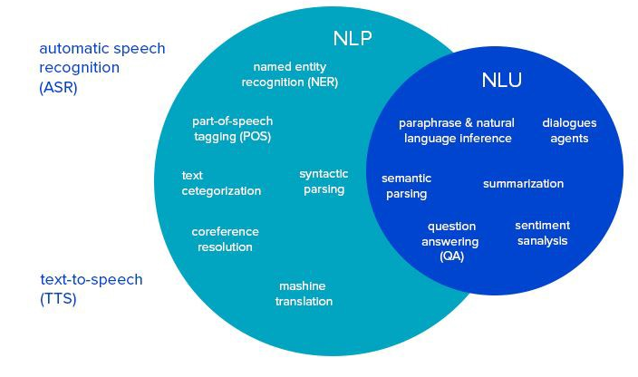
THEORETICAL AND CONCEPTUAL FRAMEWORK
Theoretical Framework
Figure 1. Theoretical Framework of the Study

Slide 8
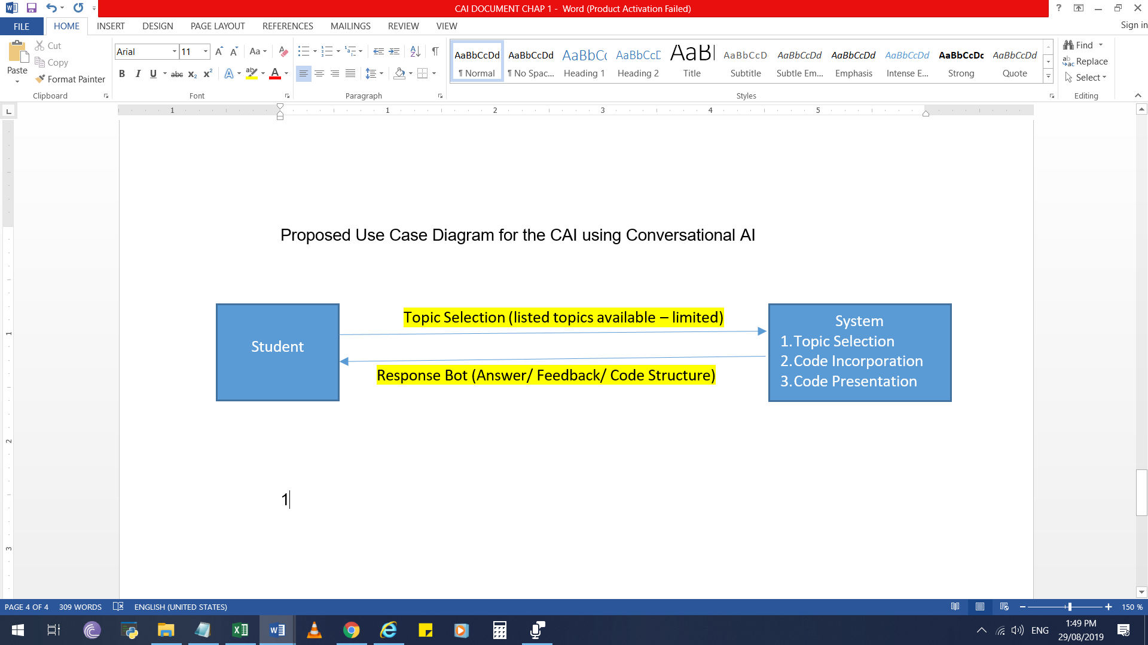
THEORETICAL AND CONCEPTUAL FRAMEWORK
Conceptual Framework
Figure 2. Student Intervention to System and Receiving Response

Slide 9
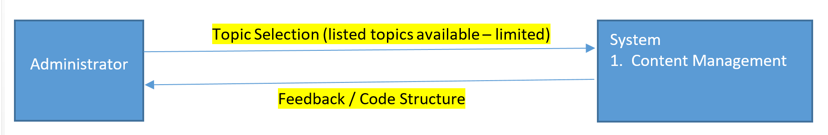
THEORETICAL AND CONCEPTUAL FRAMEWORK
Conceptual Framework
Figure 3.Encoding and Update of Content

Slide 10
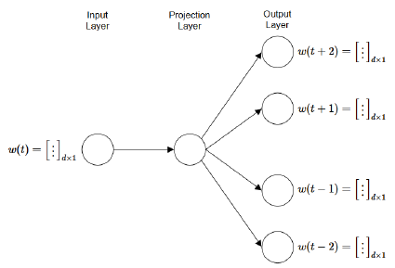
THEORETICAL AND CONCEPTUAL FRAMEWORK
Conceptual Framework
Figure 4. Word2Vec Algorithmic Representation

Slide 11
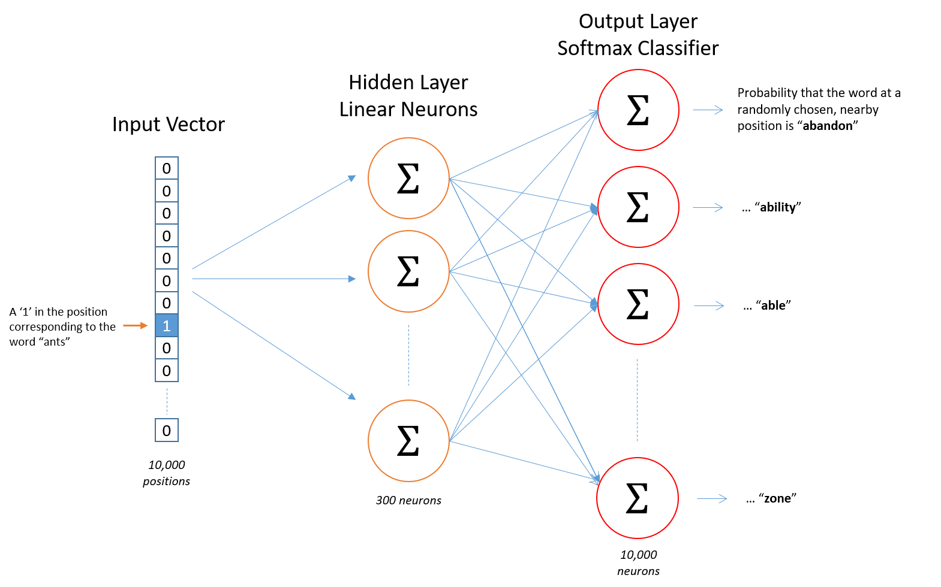
THEORETICAL AND CONCEPTUAL FRAMEWORK
Conceptual Framework
Figure 5. Word2Vec Algorithmic Visualization

Slide 12
SCOPE AND LIMITATIONS
As the limitations on development has been set only to focus on the need of a specific type of programming platform to be used, a deliberation has to be made to be able to access which one will be selected and be made available to the students on which will be included on the system to be developed.
Focusing mainly for its availability on various programming languages that is delivered for the different courses for Central Philippine University, College of Computer Studies.
This will then arise to the availability of expanding the content of the current information to further enhance the capability of the system, more likely to those who entail it to develop it on a different and better perspective.
Expansion of the system is essential to enable the further growth of its development and it being able to stay up to date with the latest programming topics that would be include.

Slide 13
SIGNIFICANCE OF THE STUDY
This study helps in gaining further understanding of the faculty and students of Central Philippine University in preparation for the use of a Computer Aided Instruction with conversational AI.
University. As the need of innovation is implemented in the University, adopting to changes can entirely bring the level unto a
new scenario that could be an advantage on many aspects. Investments in new and interactive technologies as applied in
education may require both technical and intuitive skills to be able to put them in proper use.
Faculty. The need of the faculty, as well as in the institutional level is to identify and articulate the occupational realities when
technology and competencies intersect, while understanding and communication how technological resources and strategies
can engage the student in enhanced and independent learning.
One of the many benefits to instructors implementing this will allow them to fully utilized the programming skills and pace
students who are advanced and those that may need more focus on
Students. The accessibility of these resources can be the most advantageous when students uses the CAI more often. By
developing programs independently, the skills on programming will be intensely developed and enhanced.

Slide 14
Chapter 2

Slide 15
REVIEW OF RELATED LITERATURE
Automatic Assessment of Programming Assignment
In today’s world study of computer’s language is more important.
Effective and good programming skills are need full all
computer science students.
They can be master in programming, only through intensive exercise practices.
Due to day by day increasing number of students in the class, the assessment of programming exercises leads to extensive
workload for teacher/instructor, particularly if it has to be carried out manually (Gupta, S., Dubey, S.K., 2012).

Slide 16
REVIEW OF RELATED LITERATURE
Designing Programming Exercises with Computer Assisted Instruction
Learning computer programming has been known to be difficult for many beginners (Boulay, 1989).
A number of challenges have been identified for both teaching and learning programming (Sleeman, 1986). A programming
course typically has a large class size.
Large class size is one of the major barriers to effective instruction.
It is difficult to closely monitor individual student’s learning progress.
The teachers do not have enough time to interact with all students in a class of hundreds of students within a few hours of
lectures and tutorials each week.

Slide 17
REVIEW OF RELATED LITERATURE
On the Didactic Principles , Models and E-Learning
The educational process is based on pedagogy – the methods used for teaching and learning, and the ‘teaching objects’ in a
course, such as assignments, learning activities, objectives, prerequisites, etc.
There are three options for any learning technology when it comes to model didactic approaches: pedagogy-neutral (supporting
no pedagogy at all), pedagogy-standard (supporting a single pedagogy) and pedagogy-driven (supporting a diversity of
pedagogy).
A great part of the contemporary software tools and technologies in the e-learning field can be characterized as subject-
dependent (reorganized for specific fields and users) and pedagogically neutral (they don’t support or provide any kind of
methodical strategies and more specifically they don’t specify ways for interpretation of learning content and objectives that are
dependent on other conditions).

Slide 18
REVIEW OF RELATED LITERATURE
Computer Aided Instruction to Teach Concepts in Education
With the rapid development of computer science and technology, Computer Aided Instruction(CAI) has being playing a more
crucial role in modern teaching management and education itself.
While in the teaching modules related to the art of programming, the position of human graders can be well taken by automated
programming assignments graders such as Online Judge(OJ).
At present, a large proportion of universities and institutions have adopted OJ program which were developed by themselves in
programming modules, which leads to huge cost of human resources in its development and maintenance.

Slide 19
REVIEW OF RELATED LITERATURE
Online Learning Management System
21st century education is entirely different from the classical education. Education now a day is accompanied by technology.
Hence, schools without computer technology has considered lame.
This study assessed the effectiveness of computer aided instruction towards students behavior and achievements in
Mathematics. This study used a quasi-experimental method of research.
The researcher assigned a group using traditional teaching and learning, and a group of respondents using computer-aided
instruction.
The data obtained were analyzed using weighed mean, standard deviation and T-test and it was tested at 5% level of
significance two-tailed test if there exist a performance mean difference between the Traditional learning and teaching and CAI
used in the group of respondents.
This present research work is a critical evaluation to determine the effectiveness of CAI as alternatives instructional methods in
teaching. This study will help educators to consider using an alternative delivery mode of teaching in meeting the desired
outcomes.

Slide 20
REVIEW OF RELATED LITERATURE
COMES: A CAI System Oriented to Programming Languages
COMES, a system for computer aided instruction oriented to programming languages, is described here.
The system allows a full integration of theory learning and practical applications since it offers two different teaching strategies,
one corresponding to a purely tutorial environment and one to a programming and problem-solving environment that has to be
specialized for a given programming language.
Thus, the learning process can be based on a tight alternation of theory and practice and relies more on personal experience
than on memorization of abstract information.
The main design choices are discussed in the paper and two examples of dialogues are supplied (Manzo, M. D., et.al. (1978).

Slide 21
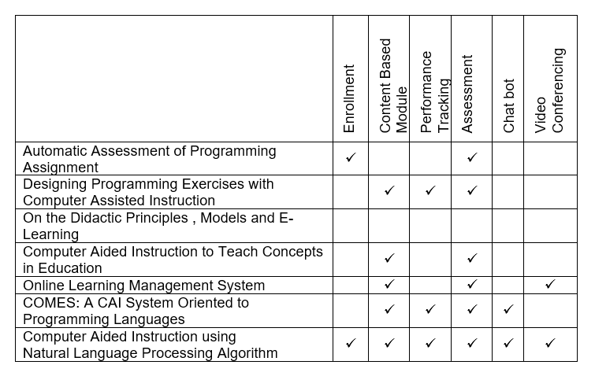
REVIEW OF RELATED LITERATURE
Synthesis

Slide 22
Chapter 3

Slide 23
METHODOLOGY
The research was conducted through following a series of procedural step to be able to obtain all the needed information for the
implementation of the proposed system.
Looking into the different modes on how Virtual Learning Environments are used and implemented, a mode of observation and
testing the system was done to fully get an overview if the system to be developed would be probable for development and if its
feasibility can be able to allow the definition that would be used for the research.
After going through the observation state, it was then determined that the basic idea of using the System Development Life Cycle
methodology, specifically, the Iterative Model would be used as the methodology for the system development.

Slide 24
METHODOLOGY
This method allows the development of a system through repeated cycles (iterative) and in smaller portions at a time
(incremental), allowing software to take advantage of what was learned during development of earlier parts or versions of the
system.
Learning comes from both the development and use of the system, where possible key steps in the process start with a simple
implementation of a subset of the software requirements and iteratively enhance the evolving versions until the full system is
implemented.
At iteration, design modifications are made and new functional capabilities are added.
The iterative model as shown in Figure 6.0 is consists of six (6) different phases that includes: the planning phase, requirements
phase, design phase, implementation and test phase, and the deployment phase.

Slide 25
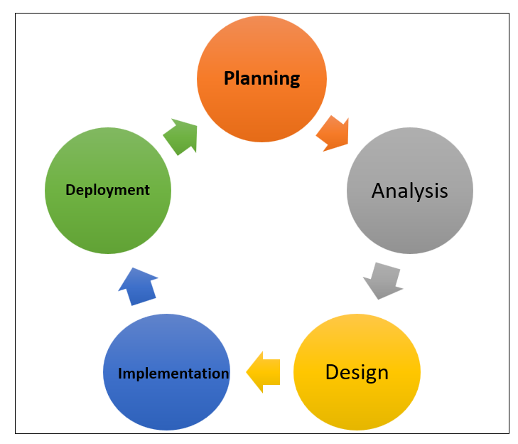
METHODOLOGY
Figure 6. System Development Life Cycle: Iterative Life Cycle Model

Slide 26
Chapter 4
Computer Aided Instruction using Conversational Artificial Intelligence

