Slide 1



How efficient is your public transport network?
A data-driven approach using GeoPandas and
GTFS
Pycon.DE 2017

Slide 2
AGENDA
What we do
Tools
  GeoPandas
  GTFS
  Geonotebook
Maps & Projections
Demo

Slide 3
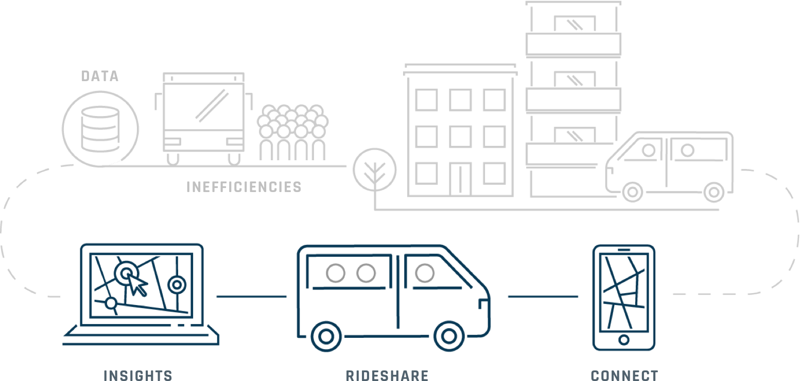
door2door PLATFORM

Slide 4
INSIGHTS

Slide 5

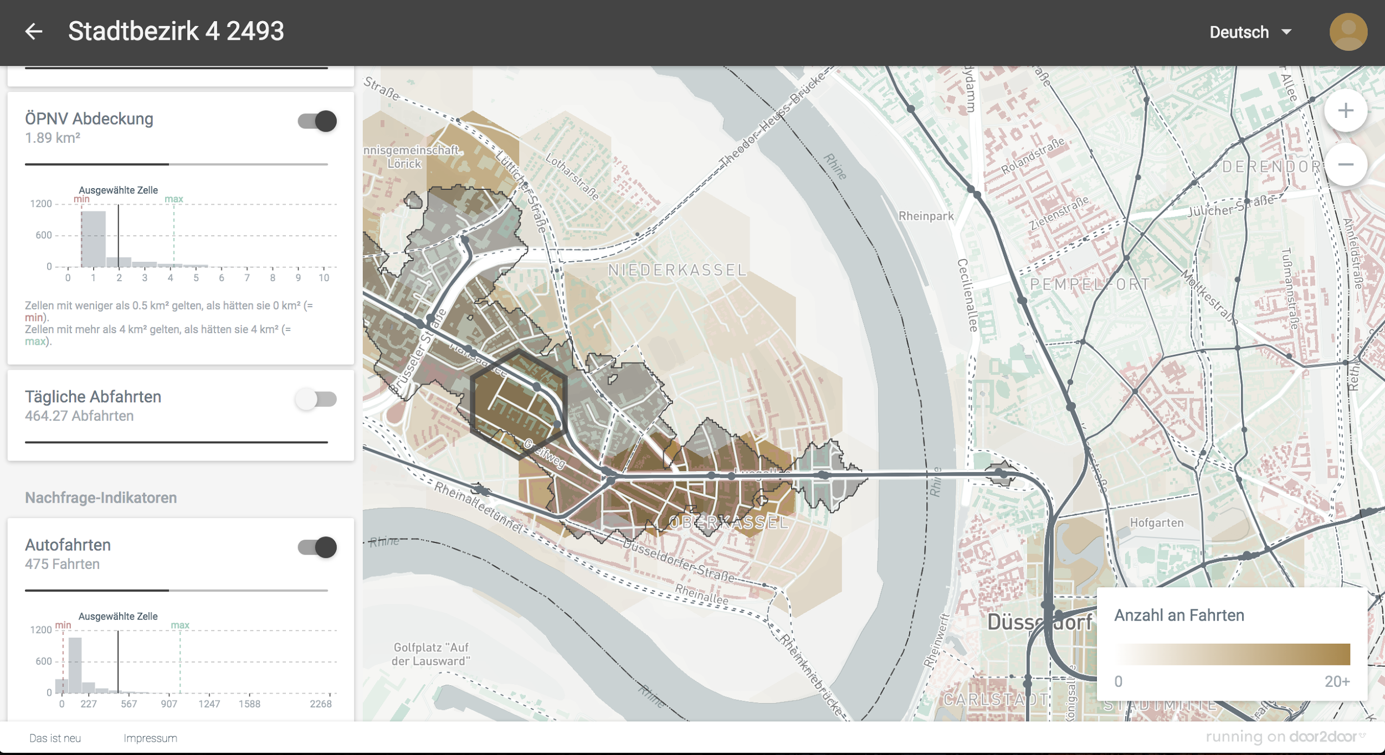

WEB APP
Analyze current supply and demand
Plan Rideshare

Slide 6
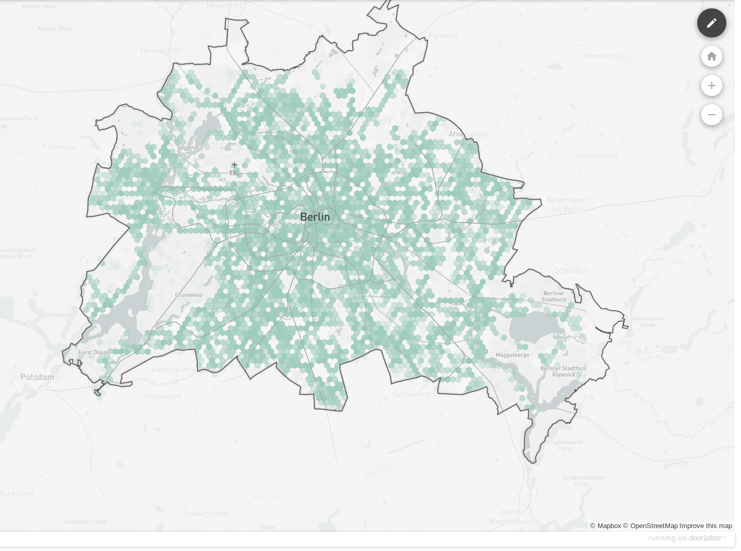
SUPPLY
Population density and demographics
Current public transport infrastructure

Slide 7
TOOLS

Slide 8
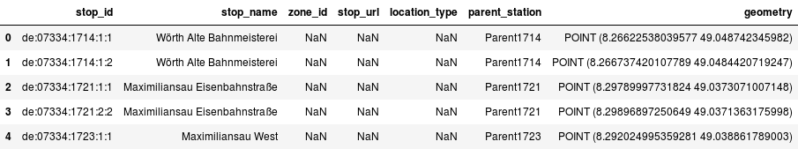
GeoPandas
> GeoPandas extends the datatypes used by pandas to allow spatial operations on geometric types.
http://geopandas.org

Slide 9
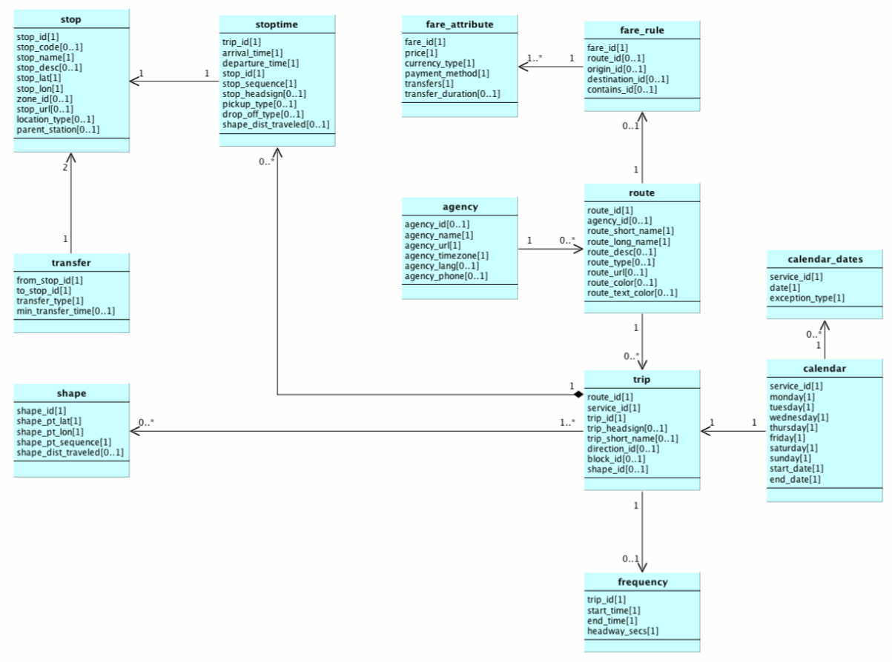
GTFS
General Transit Feed Specification
> Defines a common format for public transportation schedules and associated geographic information.
https://developers.google.com/transit/gtfs/
Zipfile
Csv files

Slide 10
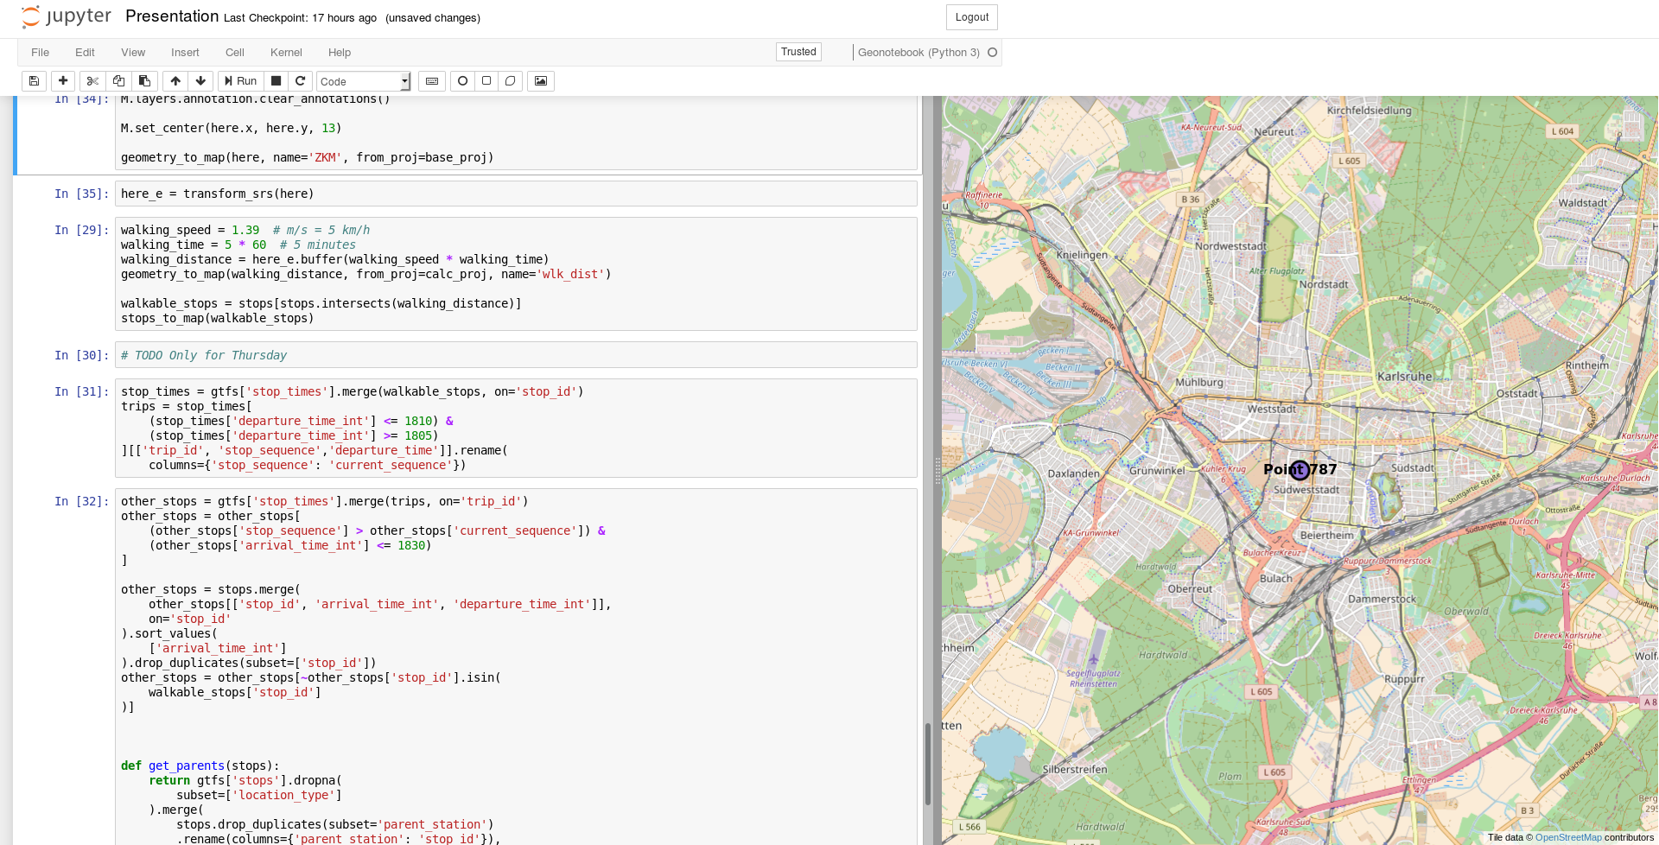
GeoNotebook
> GeoNotebook is an extension to the Jupyter Notebook that provides interactive visualization and python-based analysis of geospatial data.
http://geonotebook.readthedocs.io/en/latest/

Slide 11
MAPS & PROJECTIONS

Slide 12
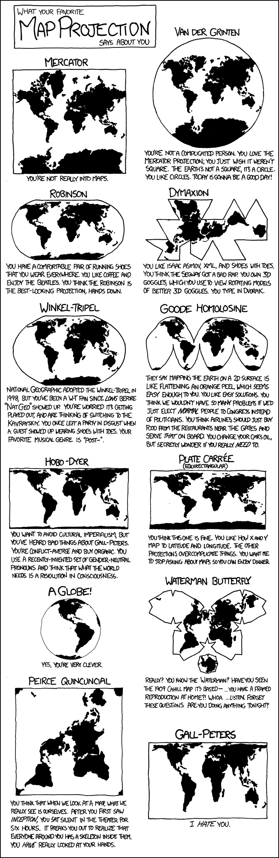
MAPS
xkcd.com
Maps are hard!
How do you print an elliptical planet earth on a flat surface?

Slide 13



PROJECTIONS
http://hive5g.blogspot.de/2016/09/earth-as-orange-peeled.html
Me
ETRS89 (Europe in meters)
WSG84 (Google maps)

Slide 14
DEMO

Slide 15
OTP
>OpenTripPlanner (OTP) is an open source multi-modal trip planner, which runs on Linux, Mac, Windows, or potentially any platform with a Java virtual machine.
http://opentripplanner.readthedocs.io/

Slide 16
Questions?

Slide 17


Pieter Mulder
pieter@door2door.io
https://github.com/inytar/pycon2017
LEARN MORE
www.door2door.io
CONNECT WITH US
@door2doorHQ
facebook.com/door2door.io
Torstraße 109, 10119 Berlin
Rua Cel. Bordini, 487 - Sala 401, Porto Alegre

