Slide 1
Presentation Outline
2
3
1
Game play
& features
Conclusion & Futures scope
Introduction

Slide 2
Introducing
TT
BY,
Md.Inzamam-Ul-Haque
Mahamudur Rahman

Slide 3
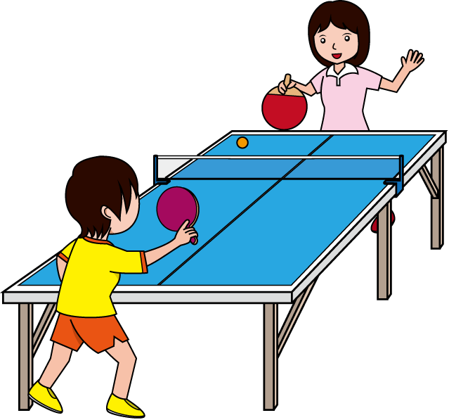
TT
This game is made being Inspired by Table Tennis game

Slide 4
Project goal :
Learning implementation of GUI programming with Java swing and also an easy-to-use OOP.

Slide 5
Project summury:
>> Written in Java language mostly
>> Uses Java Swing ,AWT ,Event Handling & OOP.
>> Netbeans used as the IDE

Slide 6
Project feature:
Object Oriented Programming introduced
GUI Programming introduced

Slide 7
2
The game play

Slide 8
Fully keyboard controlled game
Game of Two Players
Point depends on one’s miss
Who Score 10, win the game

Slide 9
CONTROL
Left player’s controller is Up & Down arrow
Right player’s controller is W & S button.

Slide 10

T T

Slide 11
SOME EXCITING FEATURES:
Sound Effects
HighScore Board

Slide 12
Algorithm flowchart:
Start
New Game
Life?
No
Yes
Level Clear?
No
Retry?
Yes
Yes
No
Level ++
End

Slide 13
Limitations:
Perceived as “too slow for real games”
Write once, test everywhere
Memory hungry

Slide 14
Reference
https://docs.oracle.com
www.google.com
http://www.javatpoint.com/
Java The Complete Reference Ninth Edition By Herbert Schildt

Slide 15
Thank you

