Slide 1
Employee Attrition Prediction
Inzamamul Alam Munna
inzimunna@gmail.com
Global Intern, Data Analyst at Hash Analytics
MSc , University of Dhaka Department of CSE
Junior Programmer at Dohatec New Media (On leave)
RESEARCH Programmer at TRIN
Collaborator with Facebook DevC Dhaka
Project By Hash Analytics
ACTIONABLE INSIGHT FROM DATA TO EASE DECISION MAKING.
It's all about Business Intelligence.
Manipulating different data points to get an idea of who your customers are, so you can target the right people for your product.

Slide 2
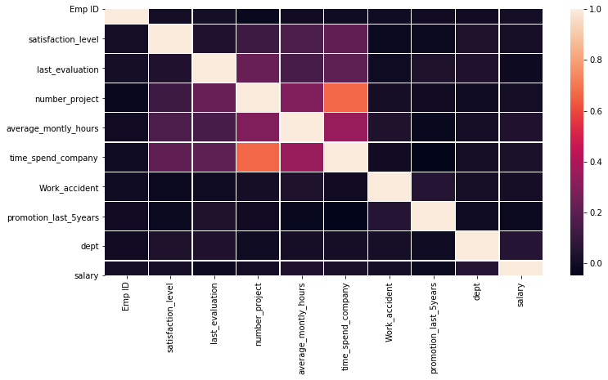
In [10]:
#main task is we want to know which features is more pimportant mainly reason to left
#so at first let check how data data is visualized
In [11]:
ax = sns.catplot(y="salary", kind="count", data=df_left, height=2.6, as pect=2.5, orient='h')
In here We do correlation between our datasets and see which factors is most important but din’t do any features selection.
And then we plot the dataset into a catplot to show which salary people are most.
Create PDF in your applications with the Pdfcrowd HTML to PDF API
PDFCROWD

Slide 3
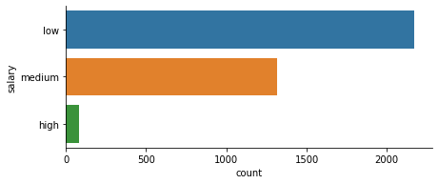
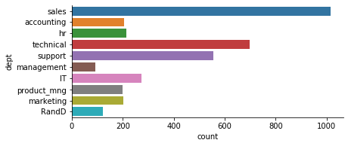
In [12]:
ax = sns.catplot(y="dept", kind="count", data=df_left, height=2.6, aspe ct=2.5, orient='h')
In [13]:
plt.figure(figsize=(15,10))
plt.title("last evaluation vs Satisfication level") ax=sns.scatterplot(x=df_left['satisfaction_level'],y=df_left['last_eval uation'],hue='number_project',data=df_left, palette='cool')
ax
Out[13]:
We then plot a cat plot to see which has most person in which dept just to make sure which dept has most leave
Then plot a scatter plot to see the satisfaction level against last evaluation of number of projects.
<matplotlib.axes._subplots.AxesSubplot at 0x26173e150c8>
Create PDF in your applications with the Pdfcrowd HTML to PDF API
PDFCROWD

Slide 4
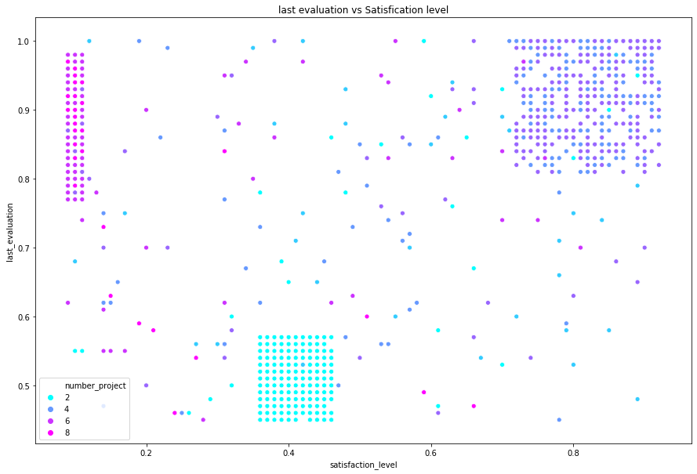
In [14]:
plt.figure(figsize=(15,10))
plt.title("last evaluation vs Satisfication level") ax=sns.scatterplot(x=df_left['satisfaction_level'],y=df_left['last_eval uation'],hue='time_spend_company',data=df_left, palette='cool')
ax
Out[14]:
For this plot we can say Satisfcation level is very low for employees who has number of projects more than 4
And also Last evaluation for employees having number of projects 2 is low, also they have low satification level.
<matplotlib.axes._subplots.AxesSubplot at 0x26173d93fc8>
Create PDF in your applications with the Pdfcrowd HTML to PDF API
PDFCROWD

Slide 5
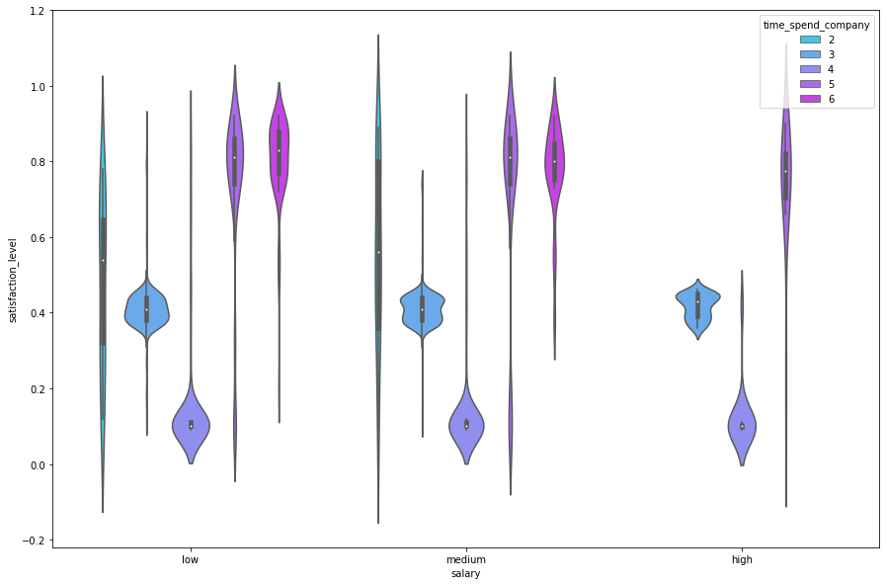
In [17]:
plt.figure(figsize=(15,10)) ax=sns.boxplot(x=df_left['salary'],y=df_left['satisfaction_level'],hue= 'time_spend_company',data=df_left, palette='cool')
ax
Out[17]:
<matplotlib.axes._subplots.AxesSubplot at 0x26173d617c8>
We plot satisfaction level to salary to a violin plot and see having a low salary of less than 5 years time spend
Has a low satisfaction rate
Then we go to the box plot for visualization.
Create PDF in your applications with the Pdfcrowd HTML to PDF API
PDFCROWD

Slide 6
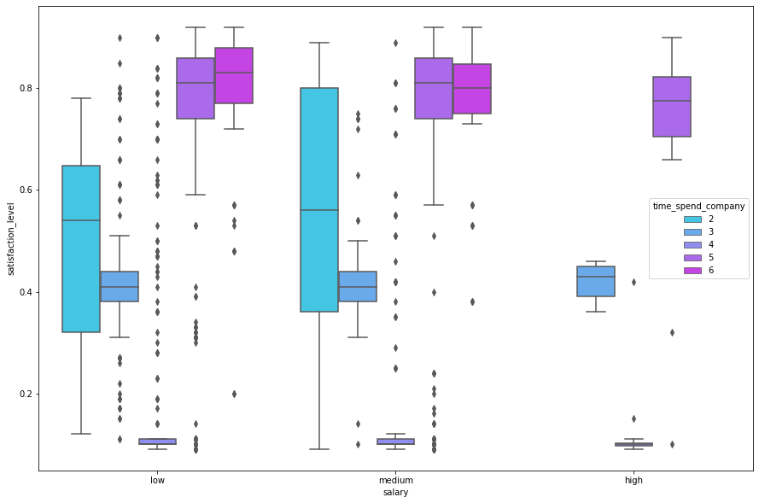
In [18]:
plt.figure(figsize=(15,10)) ax=sns.boxplot(x=df_left['dept'],y=df_left['satisfaction_level'],hue='t ime_spend_company',data=df_left, palette='cool')
ax
In boxplot here do the same thing before the violin plot just to make sure boxplot has better visualization than violin plot.
Then do the dept wise visualization. We see that dept has a good correlation.
Out[18]:
<matplotlib.axes._subplots.AxesSubplot at 0x26173b12548>
Create PDF in your applications with the Pdfcrowd HTML to PDF API
PDFCROWD

Slide 7
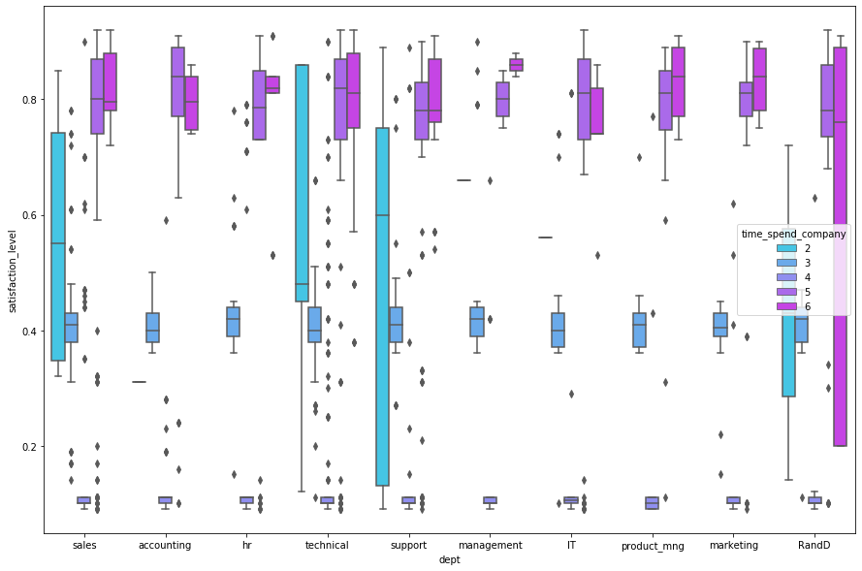
In [19]:
plt.figure(figsize=(15,10)) ax=sns.scatterplot(x=df_left['dept'],y=df_left['satisfaction_level'],hu e='average_montly_hours',data=df_left, palette='cool')
ax
We see here in sales , support, marketing has a low satisfaction rate.
And also having less than 4 years has a low satisfaction rate , visualize it carefully we can see who has spent 5 or 6 years most of the them has a good satisfaction rate , the problem is that less than 4 years.
Out[19]:
<matplotlib.axes._subplots.AxesSubplot at 0x26173711188>
Create PDF in your applications with the Pdfcrowd HTML to PDF API
PDFCROWD

Slide 8
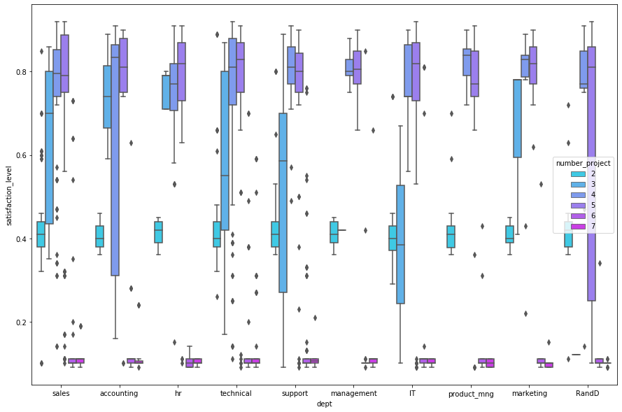
In [21]:
# So, ultimateley we found the reason why employees were leaving and wh ich types of employees are leaving.
# Employees who are stressed up working more hours and having higher nu mber of projects.
# Mostly from sales,support and technical department were leaving the c ompany.
# And, the employees are not getting promotion even they are working ti relessly.
So, ultimately we found the reason why employees were leaving and which types of employees are leaving.
Employees who are stressed up working more hours and having higher number of projects.
Mostly from sales, support and marketing department were leaving the company.
And, the employees are not getting promotion even they are working tirelessly.
Lastly less than 4 years time spend has a most number of leaving.
In [22]:
#merge two dataset for prediction
# Adding both dataset from employees who left with existing employees
df_left['Left']=1
Create PDF in your applications with the Pdfcrowd HTML to PDF API
PDFCROWD

Slide 9
3 | 1
4 | 1
 | ..
11423 | 0
11424 | 0
11425 | 0
11426 | 0
11427 | 0
Name: | Left, Length: 14999, dtype: int64
In [29]:
# Splitting the X and y into train and test set
from sklearn.model_selection import train_test_split
from sklearn.tree import DecisionTreeClassifier
from sklearn.feature_selection import RFE
from sklearn.metrics import accuracy_score, precision_score, recall_sco re, f1_score
from sklearn.metrics import confusion_matrix, classification_report
X_train,X_test,y_train,y_test=train_test_split(X,y,train_size=0.7,test_ size=0.3,random_state=102)
In [30]:
DC = DecisionTreeClassifier(max_depth=5, random_state=101, max_features
=None, min_samples_leaf=15) DC.fit(X_train, y_train)
Out[30]:
DecisionTreeClassifier(class_weight=None, criterion='gini', max_depth= 5,
max_features=None, max_leaf_nodes=None, min_impurity_decrease=0.0, min_impurity_split=No
ne,
min_samples_leaf=15, min_samples_split=2, min_weight_fraction_leaf=0.0, presort=False, random_state=101, splitter='best')
In [31]:
y_pred = DC.predict(X_test)
In [32]:
#model accuraccy is not so good.
Do the splitting and before that making the variables as dummy and convert the text attribute to integer.
And without any pre- processing run a method for prediction: DECISION TREE CLASSIFIER.
Accuracy is not so good in this.
Create PDF in your applications with the Pdfcrowd HTML to PDF API
PDFCROWD

Slide 10
#why the model accuraccy is not so good. let's find out . train_accuracy = accuracy_score(y_train, DC.predict(X_train)) test_accuracy = accuracy_score(y_test, y_pred)
print('Train Accuracy:', train_accuracy) print('Test Accuracy:',test_accuracy)
Train Accuracy: 0.9730450519097057
Test Accuracy: 0.9686666666666667
In [33]:
print("employees left is {}% from total dataset".format(round(final_df. Left.value_counts()[1]/len(final_df)*100,2)))
employees left is 23.81% from total dataset
In [34]:
#see that 24% only dataset has left employee so the model is imbalance.
from sklearn.ensemble import RandomForestClassifier
rfc = RandomForestClassifier(n_estimators=10).fit(X_train, y_train) rfc.fit(X_train, y_train)
Out[34]:
RandomForestClassifier(bootstrap=True, class_weight=None, criterion='gi ni',
max_depth=None, max_features='auto', max_leaf_no
des=None,
min_impurity_decrease=0.0, min_impurity_split=No
ne,
min_samples_leaf=1, min_samples_split=2, min_weight_fraction_leaf=0.0, n_estimators=10, n_jobs=None, oob_score=False, random_state=None, verbose=0, warm_start=False)
In [35]:
y_pred_new = rfc.predict(X_test)
In [36]:
#A good accuraccy after using random forest classifier but test accurac y is not so good
train_accuracy = accuracy_score(y_train, rfc.predict(X_train)) test_accuracy = accuracy_score(y_test, y_pred_new)
Find that train accuracy is 97% and test is 96% . So bad. Find out Why?
See that the model is actually imbalance we have not enough number of left employee so that this happens.
Create PDF in your applications with the Pdfcrowd HTML to PDF API
PDFCROWD

Slide 11
 |  | print('Train Accuracy:', train_accuracy) print('Test Accuracy:',test_accuracy)
 |  | Train Accuracy: 0.998571292504048 Test Accuracy: 0.986
In | [37]: | #doing upsample
In | [38]: | from sklearn.utils import resample
 |  | y_new = final_df['Left'] X_new= final_df.drop(['Left'],axis=1)
 |  | X_train, X_test, y_train, y_test = train_test_split(X_new,y_new,train_s ize=0.75,random_state=50)
 |  | X=pd.concat([X_train,y_train],axis=1)
In | [39]: | # unsampling the minority by adding dummy rows to the left equal to 1
 |  | left_upsampled= resample(X[X.Left==1],replace=True,n_samples=len(X[X.Le ft==0]),random_state=50)
 |  | left_upsampled=pd.concat([X[X.Left==0],left_upsampled])
In | [40]: | left_upsampled.Left.value_counts()
Out[40]: |  | 1 | 8573
 |  | 0 | 8573
 |  | Name: Left, dtype: int64
In [41]: |  | # Preparing for X train and Y train dataset
 |  | y_train=left_upsampled.Left X_train=left_upsampled.drop(['Left'],axis=1)
In [67]: |  | rfc_upsample = RandomForestClassifier(n_estimators=20,random_state |  | = 10
Find for solution then want to apply random forest with estimators and see accuracy is up . But I am trying to gain highest accuracy so for unbalancing dataset needs to to unsampling.
Create PDF in your applications with the Pdfcrowd HTML to PDF API
PDFCROWD

Slide 12
1)
rfc_upsample.fit(X_train.drop('Emp ID',axis=1), y_train)
Out[67]:
RandomForestClassifier(bootstrap=True, class_weight=None, criterion='gi ni',
max_depth=None, max_features='auto', max_leaf_no
des=None,
min_impurity_decrease=0.0, min_impurity_split=No
ne,
min_samples_leaf=1, min_samples_split=2, min_weight_fraction_leaf=0.0, n_estimators=20, n_jobs=None, oob_score=False, random_state=101, verbose=0, warm_start=False)
In [68]:
y_pred_final = rfc_upsample.predict(X_test.drop('Emp ID',axis=1))
In [69]:
#model is now at the best position
train_accuracy = accuracy_score(y_train, rfc_upsampl
e.predict(X_train.drop('Emp ID',axis=1
)))
test_accuracy = accuracy_score(y_test, y_pred_final) print('Train Accuracy:', train_accuracy) print('Test Accuracy:',test_accuracy)
Train Accuracy: 1.0
Test Accuracy: 0.9864
So want to unsampling for this I choose random classifier unsample. This is pretty easy to do unsampling the minority by adding dummy rows to the left equal to 1 . Look that now we are having same counts to who left or who exists now.
And see our accuracy rate now I gain 100% accuracy with train test and 99% accuracy with test set. I am preety sure no one gain this kind of accuracy.
In [156]:
# x_prone=pd.DataFrame(y_pred_final,columns=["predicted"]) # #x_prone = x_prone.DataFrame(x_prone)
# x_prone.to_csv('predicted.csv')
# #x_prone=x_prone.loc[~x_prone.index.duplicated(keep='first')] # #y_prone = pd.DataFrame(y_test)
# #y_prone=y_prone.loc[~y_prone.index.duplicated(keep='first')] # #empID = X_test['Emp ID']
In [157]:
# y_prone=pd.DataFrame(y_test)
# #x_prone = x_prone.DataFrame(x_prone) # y_prone.to_csv('actual.csv')
Create PDF in your applications with the Pdfcrowd HTML to PDF API
PDFCROWD

Slide 13
g',
'dept_sales', 'dept_support', 'dept_technical', 'salary_high', 'salary_low', 'salary_medium'],
dtype='object')
In [73]:
features=np.array(X_train.drop('Emp ID',axis=1).columns) important=rfc_upsample.feature_importances_ indexes_features=important.argsort()
for i in indexes_features:
print("{} : {:.2f}%".format(features[i],important[i]*100))
dept_marketing : 0.11%
dept_product_mng : 0.12%
dept_IT : 0.14%
dept_RandD : 0.17%
dept_hr : 0.17%
dept_accounting : 0.17%
promotion_last_5years : 0.22%
dept_management : 0.24%
dept_support : 0.32%
dept_sales : 0.33%
dept_technical : 0.40%
salary_medium : 0.50%
salary_low : 0.53%
Work_accident : 0.90%
salary_high : 1.04%
last_evaluation : 13.57%
average_montly_hours : 14.02%
number_project : 15.32%
satisfaction_level : 25.18%
time_spend_company : 26.54%
In [174]:
# Finding employees who are prone to leave
#concat the two columns for prediction
y_test1=pd.concat([y_test,X_test['Emp ID']],axis=1) y_test3=pd.DataFrame(y_pred_final)
In here we want to see the important features who are factors behind the left. We see
Time spend company , number of projects ,average monthly hours is the main factors behind lefting employee and have a low satisfaction rate for this.
Create PDF in your applications with the Pdfcrowd HTML to PDF API
PDFCROWD

Slide 14
y_test3.reset_index(inplace=True, drop=True) gf=pd.concat([y_test1.reset_index(),y_test3],1)
gf
Out[174]:
 |  | index | Left | Emp ID | 0
 | 0 | 1961 | 0 | 3962 | 0
 | 1 | 3341 | 1 | 14770 | 1
 | 2 | 5016 | 0 | 7017 | 0
 | 3 | 3357 | 1 | 14786 | 1
 | 4 | 2 | 0 | 2003 | 0
 | ... | ... | ... | ... | ...
 | 3745 | 9234 | 0 | 11235 | 0
 | 3746 | 81 | 1 | 82 | 1
 | 3747 | 347 | 1 | 348 | 1
 | 3748 | 3597 | 0 | 5598 | 0
 | 3749 | 2436 | 0 | 4437 | 0
3750 rows × 4 columns
In [178]:
gf.columns=['index','Left','Emp ID','Predicted_left']
In [179]:
Employees_prone_to_leave = gf[(gf['Left']==0) & (gf['Predicted_left']== 1)]
Employees_prone_to_leave
Out[179]:
 |  | index | Left | Emp ID | Predicted_left
 | 11 | 4466 | 0 | 6467 | 1
 | 247 | 415 | 0 | 2416 | 1
 | 505 | 4854 | 0 | 6855 | 1
Now we got the factors , right? We have now predict next which employee can leave for our company safety , :P (LOL)
The Idea is Preety simple:
Create PDF in your applications with the Pdfcrowd HTML to PDF API
PDFCROWD

Slide 15
 | index | Left | Emp ID | Predicted_left
680 | 2519 | 0 | 4520 | 1
858 | 3831 | 0 | 5832 | 1
1713 | 3773 | 0 | 5774 | 1
2237 | 1890 | 0 | 3891 | 1
3274 | 4448 | 0 | 6449 | 1
3572 | 2769 | 0 | 4770 | 1
In [195]:
#this EmpID is predicted to be left new_df=Employees_prone_to_leave.drop('index',axis=1) new=new_df.drop(['Left','Predicted_left'],axis = 1) new
Out[195]:
 |  |  | Emp ID
 |  | 11 | 6467
 |  | 247 | 2416
 |  | 505 | 6855
 |  | 680 | 4520
 |  | 858 | 5832
 |  | 1713 | 5774
 |  | 2237 | 3891
 |  | 3274 | 6449
 |  | 3572 | 4770
In [ ]:
Concate y_test to X_test’s emp id because we need emp id . Then concat again to the y_prediction.
Give a condition left = 0 and predicted left =1 to find which employee leaves next.
See there we got 9 employee who can leave next and this accuracy for leaving is 99%
Create PDF in your applications with the Pdfcrowd HTML to PDF API
PDFCROWD

