Slide 1
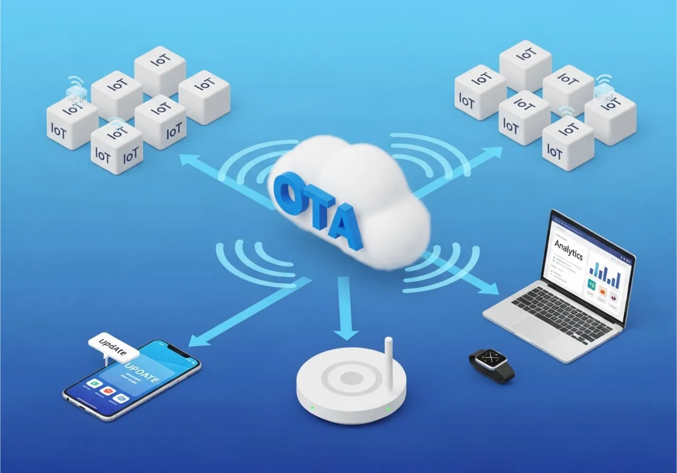

OAT - Over The Air
Remote Update Process
Nelson Junior

Slide 2

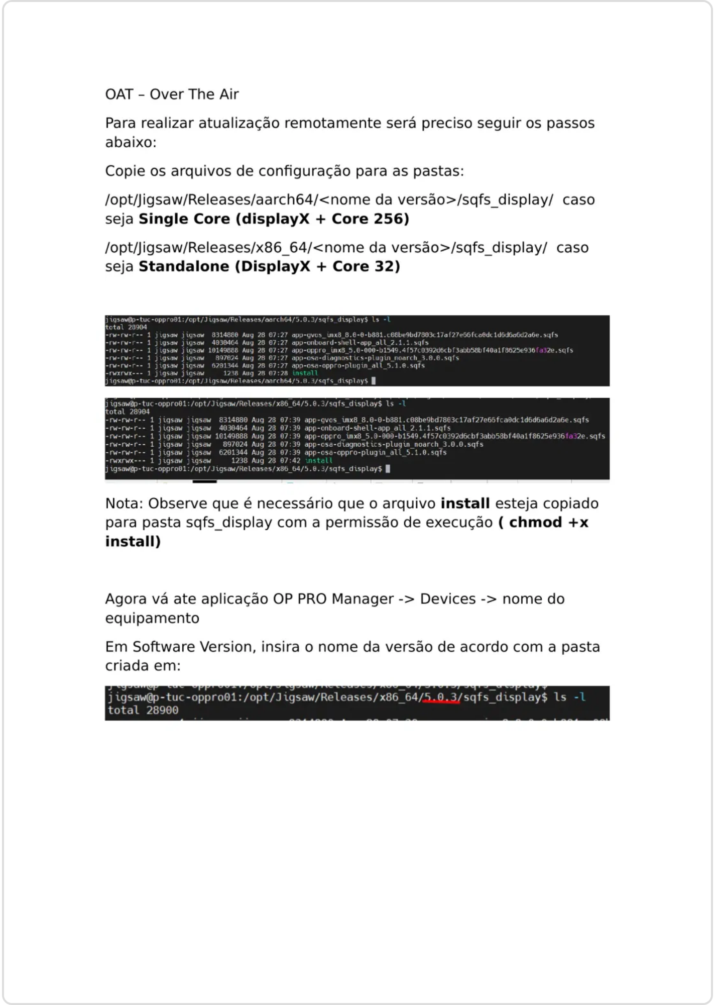
Preparing for Remote Update - File Copy
To perform a remote update, you need to copy the configuration files to the appropriate folders based on your system type:
For Single Core (displayX + Core 256):
/opt/Jigsaw/Releases/aarch64/<version name>/sqfs_display/
For Standalone (DisplayX + Core 32):
/opt/Jigsaw/Releases/x86_64/<version name>/sqfs_display/
The file structure should include all necessary configuration files for the update process to work correctly.

Slide 3
Preparing for Remote Update - Permissions
Important Note:
It is necessary that the
install
file is copied to the sqfs_display folder with execution
permission.
After copying the configuration files, you must set the execution permission for the install file using the chmod command:
$ cd /opt/Jigsaw/Releases/x86_64/5.0.3/sqfs_display/
$
chmod +x install
This permission is required for the system to execute the install file during the update process. Without this permission, the update will fail.

Slide 4

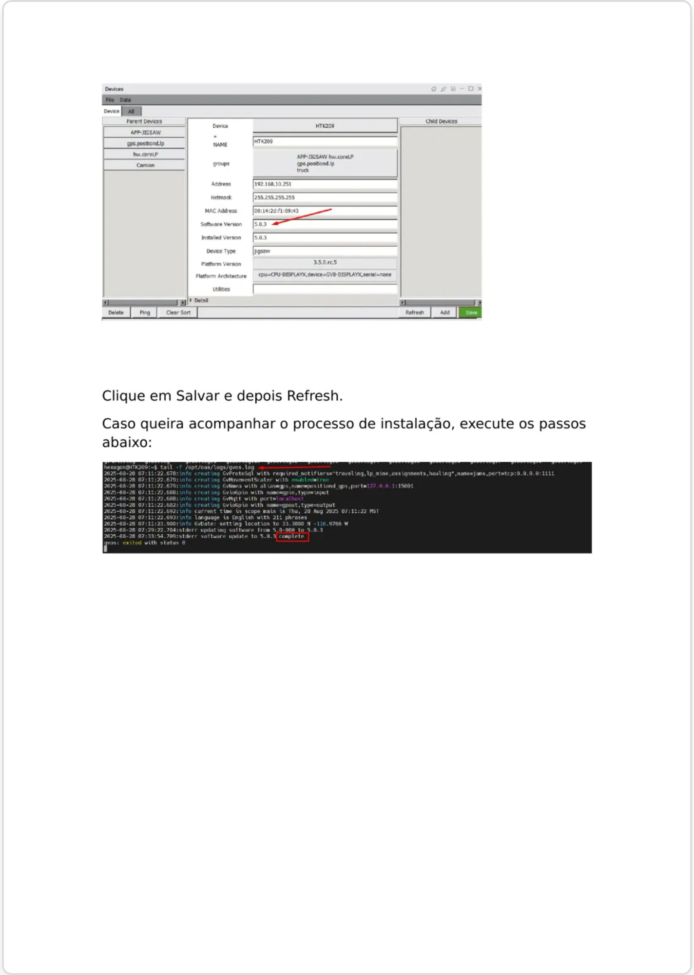
Configuring in OP PRO Manager
After preparing the configuration files, you need to access the OP PRO Manager application to configure the device for the update:
OP PRO Manager -> Devices -> [equipment name]
Follow these steps to configure the device:
Open the
OP PRO Manager
application
Navigate to the
Devices
section
Select your
equipment name
from the list
The OP PRO Manager interface allows you to manage device configurations and initiate the remote update process for your equipment.

Slide 5

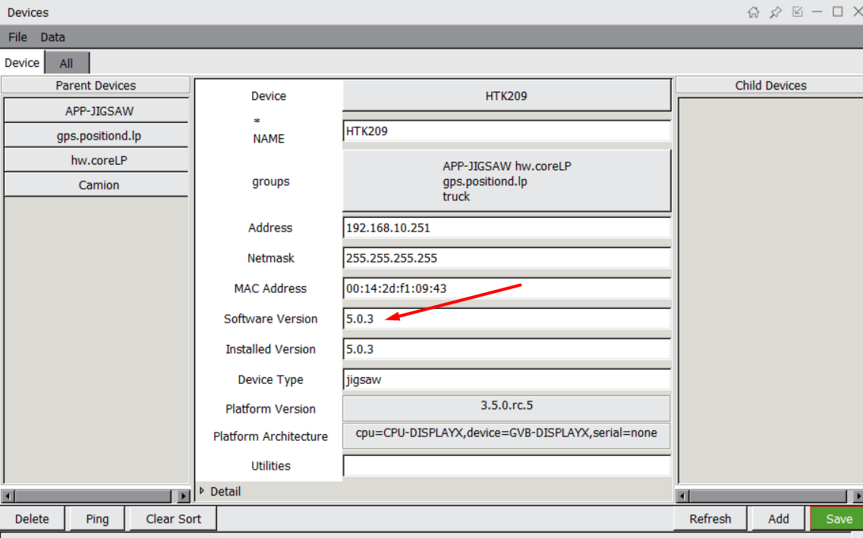
Setting Software Version
After accessing the device in OP PRO Manager, you need to set the software version for the update:
In the
Software Version
field, enter the version name that matches the folder you created
Click the
Save
button to apply the changes
Click
Refresh
to update the device information
Important:
The version name must exactly match the folder name you created in the
previous step (e.g., "5.0.3").
After saving the version information, the system will prepare for the remote update process.

Slide 6
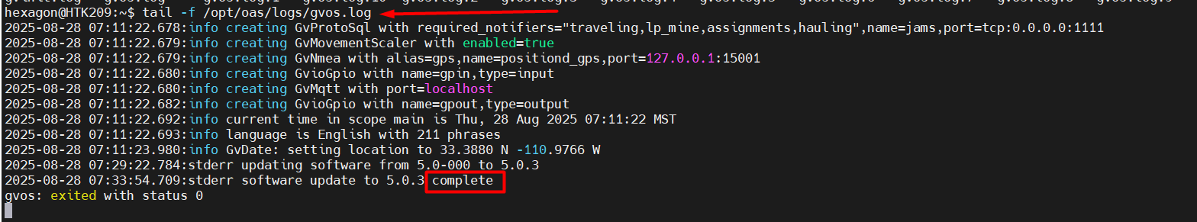
Monitoring Installation Process
success message
confirming that the software

