Slide 1

inzva Applied AI Program Week 5
Machine Learning Model Deployment
Duygu Ay
21.08.2021

Slide 2
Today’s Topics
Front end web development with HTML & CSS
Deploying ML models with Flask (Back end)
Google cloud server setup
Serving Flask Applications with uWSGI and Nginx
Git basics
Model deployment with App Engine on GCP
Model deployment with Streamlit

Slide 3
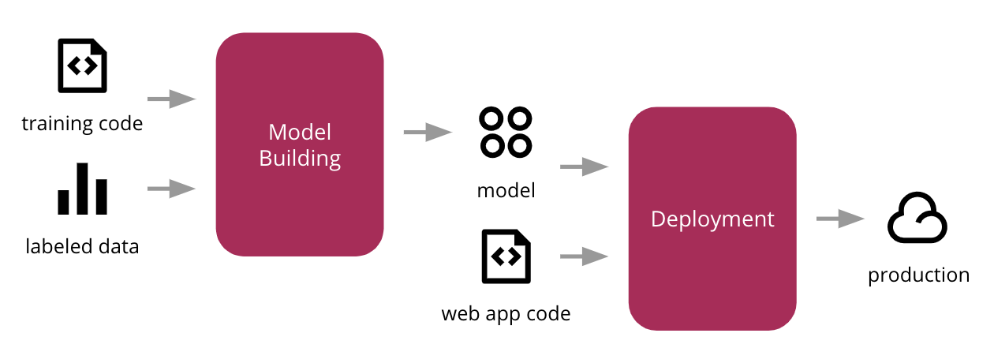
What is Deployment?
Deployment is the method by which you integrate a machine learning model into an existing production environment to make practical business decisions based on data.

Slide 4
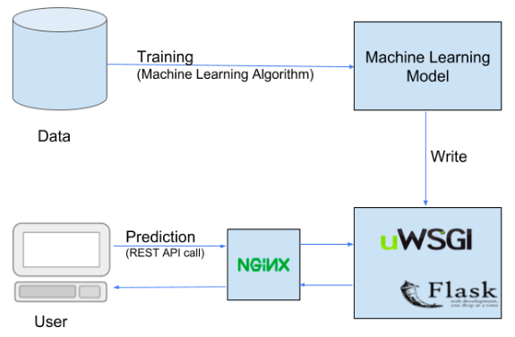
Deploying with Flask and Serving Web App with uWSGI and Nginx

Slide 5
ML Model: Diabetes Prediction
This program builds a classifier for Pima Indians Diabetes dataset - https://www.kaggle.com/uciml/pima-indians-diabetes-database.
It is a binary (2-class) classification problem.
There are 768 observations with 8 input variables and 1 output/target variable. The variable names are as follows:
Pregnancies: Number of times pregnant
Glucose: Plasma glucose concentration a 2 hours in an oral glucose tolerance test
BloodPressure: Diastolic blood pressure (mm Hg)
SkinThickness: Triceps skin fold thickness (mm)
Insulin: 2-Hour serum insulin (mu U/ml)
BMI: Body mass index (weight in kg/(height in m)^2)
DiabetesPedigreeFunction: Diabetes pedigree function
Age: Age (years)
Outcome: Class variable (0 or 1) 268 of 768 are 1, the others are 0
Notes:
Triceps: Kol kası
BMI: vücut kitle indexi
DPF: aile geçmişine dayalı olarak diyabet olasılığını puanlayan bir fonksiyon

Slide 6
Front end Web Development with HTML & CSS What is HTML?
Hyper Text Markup Language
NOT a programming language
Markup language for creating webpages and documents
Building blocks of the web
Does not need a web server
Files must end with the .html extension
Runs in a web browser
index.html is the root/home page of a website
http://something.com : loads index.html file
http://something.com/about : loads about.html file
Notes:
Show front end of a website : inspect
CSS ve HTML’I source’dan görebilirsiniz.
Metin işaretleme dili

Slide 7
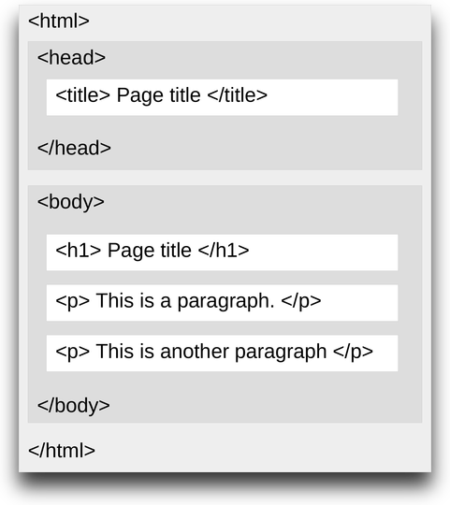
HTML Page Structure
Element names surrounded by angle brackets.
Normally come in pairs.
End tag is same but with a forward slash.
Notes:
Head kısmı tab da çıkan görüntü
Window > tile window left ve diğerine çift tıkla

Slide 8
Tags in HTML
The <nav> tag defines a set of navigation links.
The <a> tag defines a hyperlink, which is used to link from one page to another.
The <div> tag defines a division or a section in an HTML document.
The <br> tag inserts a single line break.
<meta> tags always go inside the <head> element, and are typically used to specify character set, page description, keywords, author of the document, and viewport settings.
The <input> tag specifies an input field where the user can enter data.
For other tags visit https://www.w3schools.com/tags/.
Notes:
Comment nasıl yapılır <!---->

Slide 9
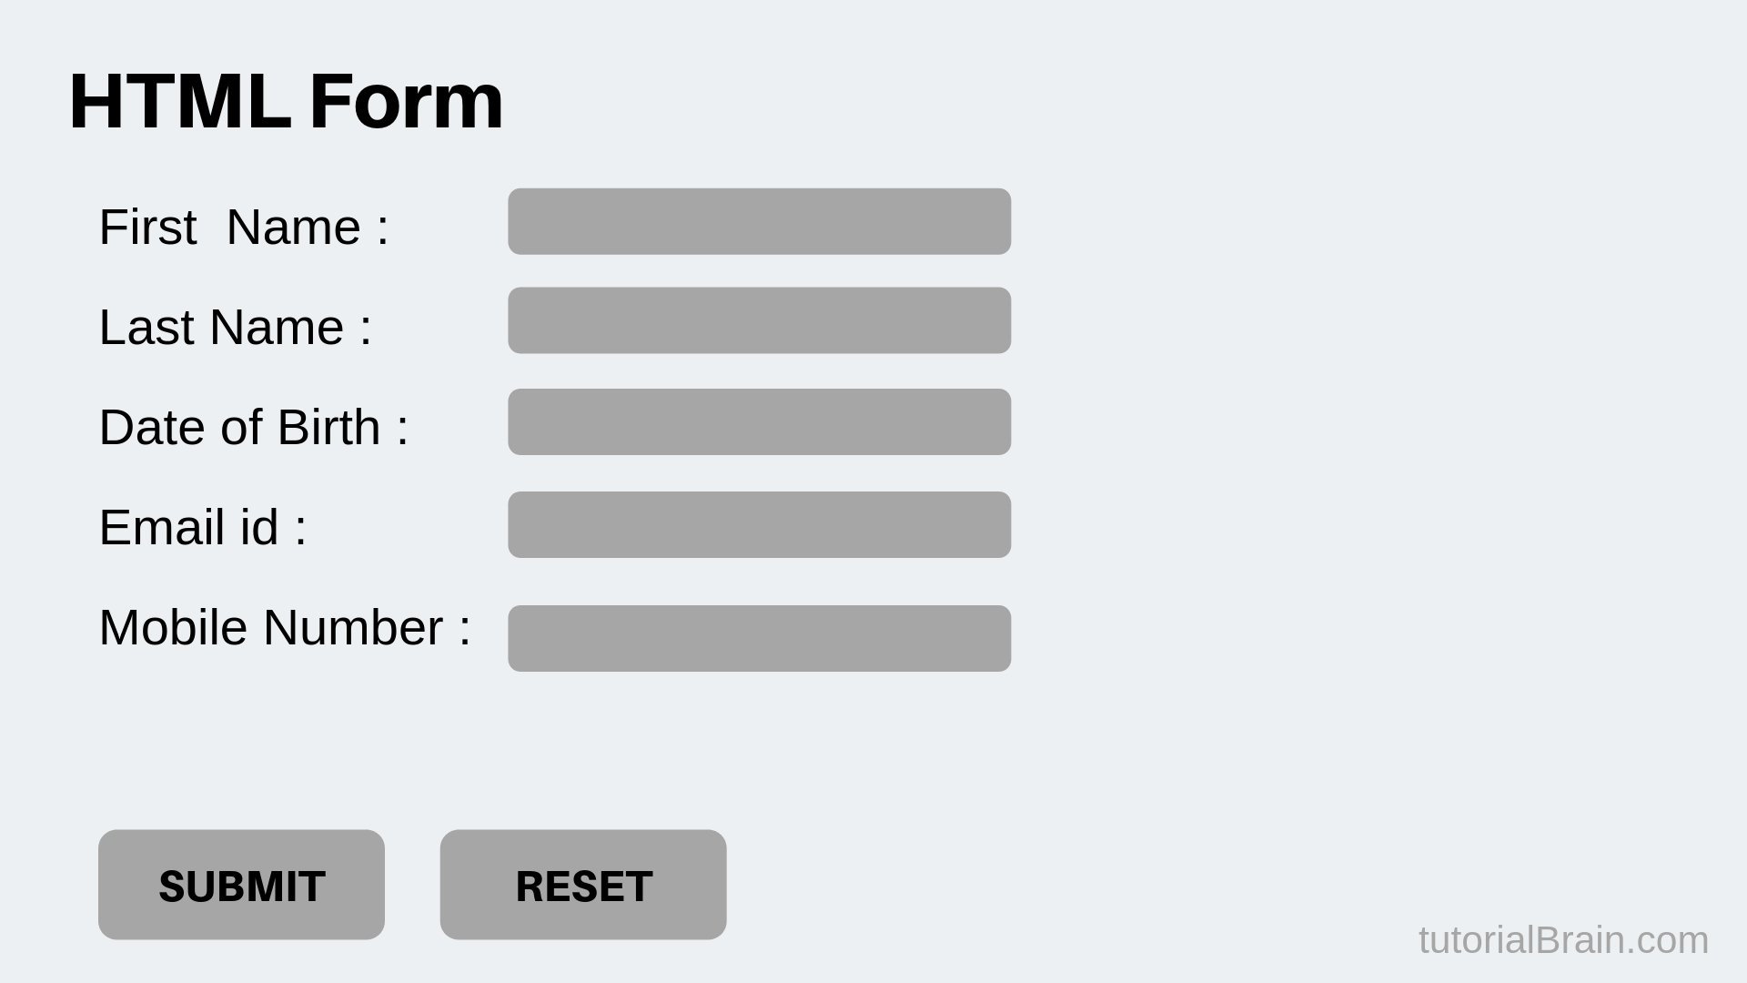
Creating Forms
Notes:
Action özelliği form verilerinin nereye gönderileceğini tanımlar.
the name attribute is used for posting to e.g. a webserver. The id is primarily used for css (and javascript). Suppose you have this setup:
<input id="message_id" name="message_name" type="text" /> in order to get the value with PHP when posting your form, it will use the name-attribute, like this:
$_POST["message_name"];
The id is used for styling, as said before, for when you want to use specific css.
#message_id { background-color: #cccccc; }
Anlat hazırladığını sonra css file olmadan göster.

Slide 10
What is CSS?
Cascading Stylesheets
NOT a programming language
Styling language
Used for website layout and design

Slide 11
Methods for Adding CSS
Inline CSS: Directly in the html element. (not preferrable!)
Internal CSS: Using <style> tags within a single document.
External CSS: Linking an external .css file.

Slide 12
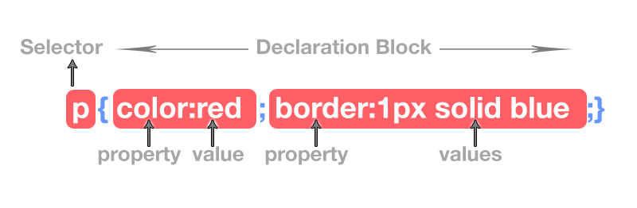
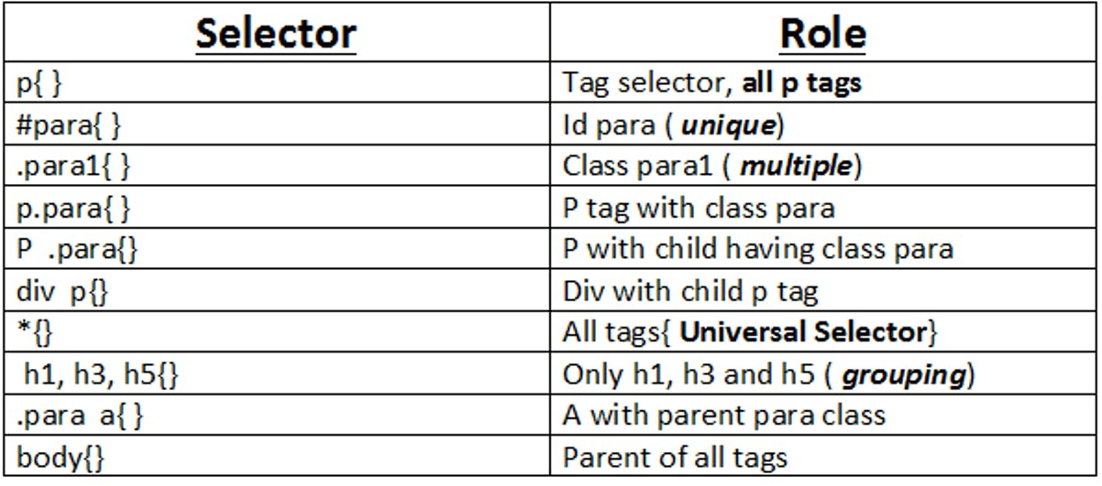
CSS Selectors
Notes:
Selector types
P tagine ait class para.

Slide 13
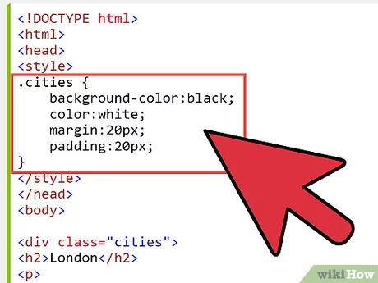
Creating Classes in CSS

Slide 14

Deploying ML models with Flask (Back end) What is Flask?
Flask is a web framework, it’s a Python module that lets you develop web applications easily.
It is a lightweight micro framework.
It enables web application developers to write applications without worrying about low-level details such as protocol, thread management, and so on.

Slide 15
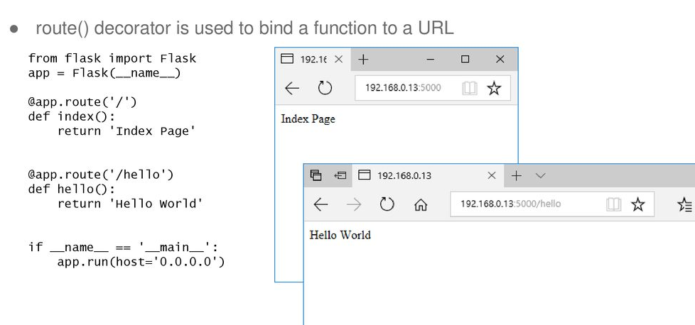
Routing

Slide 16
Debug Mode
The debugger allows executing arbitrary Python code from the browser.
If we write app.run() and our application is under development, it should be restarted manually for each change in the code. So for every change in the program we have to restart the server and try to observe the changes.
To overcome this problem, enable debug support. The server will then reload it self if the code changes.

Slide 17
Link to HTML File
render_template() is used to generate output from a template file that is found in the application's templates folder.

Slide 18
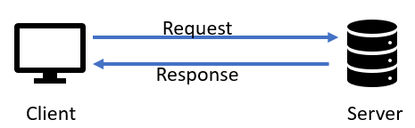
Request
To access the incoming data in Flask, you have to use the request object.
The request object holds all incoming data from the request.

Slide 19
HTTP Methods
The method is the type of action you want the request to perform and is sent from the client to the server on every request.
GET - Used to fetch the specified resource. It is used to return data at a specified resource/location.
Returning text
Rendering templates
POST - Used to create new data at the specified resource.
POST requests should be used to create NEW resources (New users, devices, posts, articles, datasets etc..)
PUT, PATCH, DELETE
Notes:
Flask routes listen for GET requests by default, so we must implicitly instruct them to listen for anything other than GET.
In the example below, we've passed methods=["POST"] to the @app.route() decorator, meaning this route will ONLY respond to POST requests:
Get: sending client an information . Default. Insecure way.
Client servera herhangi bir request gönderdiğinde bu gönderdiği requestin action çeşitidir.
GET - Belirtilen kaynağı getirmek için kullanılır
POST - Belirtilen kaynakta yeni veri oluşturmak için kullanılır
PUT - Belirtilen kaynakta yeni veriler oluşturmak veya mevcut verileri değiştirmek için kullanılır
PATCH - Belirtilen kaynakta yeni veriler oluşturmak veya mevcut verileri güncellemek/değiştirmek için kullanılır
DELETE - Belirtilen kaynaktaki mevcut verileri silmek için kullanılır

Slide 20
Other files for app
Create __init__.py file (for setting python package)
from flask import Flask
myapp=Flask(__name__,template_folder='templates',static_folder='static:css')
from myapp import main
Create run.py file outsite of app folder
from myapp import myapp
if __name__ == "__main__": myapp.run(debug=True)
Import myapp in flask framework file
from myapp import myapp
Creating requirement.txt
pip install pipreqs
pipreqs ./
Try
python run.py
Notes:
Önce folderin ismini değiştir
Change model path ./myapp/model

Slide 21
Google Cloud (GCP) Server Setup
Create project
Create VM instance from Compute Engine
Create SSH key on local computer
ssh-keygen -t rsa -f ~/.ssh/”folderName” -C “username”
cd ~/.ssh and cat “foldername”.pub
Copy and past the key to VM instance by editing.
Connect server from your local computer
ssh –i ~/.ssh/”folderName” “username”@[IP address of VM instance]
Or
ssh “username”@[IP address of VM instance]
Notes:
Depending of region memory and machine type change
folderName: ssh key will be stored in there
There will be private and public key(.pub)
Ubuntu 18.04
Connect from vscode
Command palette > remote ssh connect host
Open folder home>duyuay

Slide 22
Setting Requirements
Installing the Components from the Ubuntu Repositories
sudo apt update
sudo apt install python3-pip python3-dev build-essential libssl-dev libffi-dev python3-setuptools
Move your app files to server
Install requirement.txt
cd myapp
pip3 install -r requirements.txt
Install uwsgi and nginx
sudo apt install uwsgi-core
sudo apt install uwsgi-plugin-python3
sudo apt-get install nginx
Check nginx from server IP address
http://[IP]
Notes:
https://www.digitalocean.com/community/tutorials/how-to-serve-flask-applications-with-uswgi-and-nginx-on-ubuntu-18-04

Slide 23
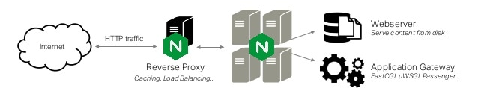
Serve Flask Applications with uWSGI and Nginx on VM Machine What is NGINX?
Nginx is a web server that can also be used as a reverse proxy, load balancer, mail proxy and HTTP cache.
It can handle high http traffic.
It is good at security and cashing.
Notes:
Flask yazdığımız app’i test etmemiz için bize basit bir development server sağlıyordu. Ancak internet ortamında çalışmamızı yayınlamak istiyorsak daha güvenli ve daha güçlü bir web server kullanmamız gerekir. Nginx de en çok kullanılan web serverlardan biridir. Yoğun internet yani http trafiğinle kolayca handle edebilir. Security ve cashing de iyidir. Yani arka tarafta bazı şeyleri çok iyi optimize eder. Fakat nginx aldığı bir requesti doğrudan flask’e iletemez. Çünkü python’ı bilmiyor.

Slide 24
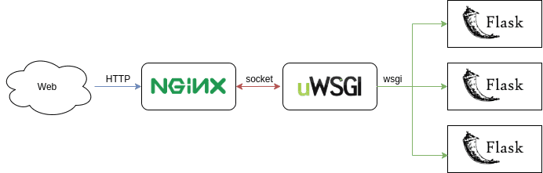
What is uWSGI?
uWSGI is a Web Server Gateway Interface (WSGI) server implementation that is typically used to run Python web applications.
The uWSGI server is responsible for loading your Flask application using the WSGI interface.
Notes:
İşte bu noktada uwsgi’ye ihtiyaç duyuyoruz. Uygulamayı çalışır hale getirebilmek için bir tane ara katmana ihtiyaç duyuyoruz. Web serverlarının ve python web uygulamalarının nasıl haberleşmesi gerektiğini söyleyen bir standard var. Bu wsgi. Açılımı. Web server geçit arayüzü. Bu kuralları uygulamış sunuculardan bir tanesi de uwsgi.

Slide 25
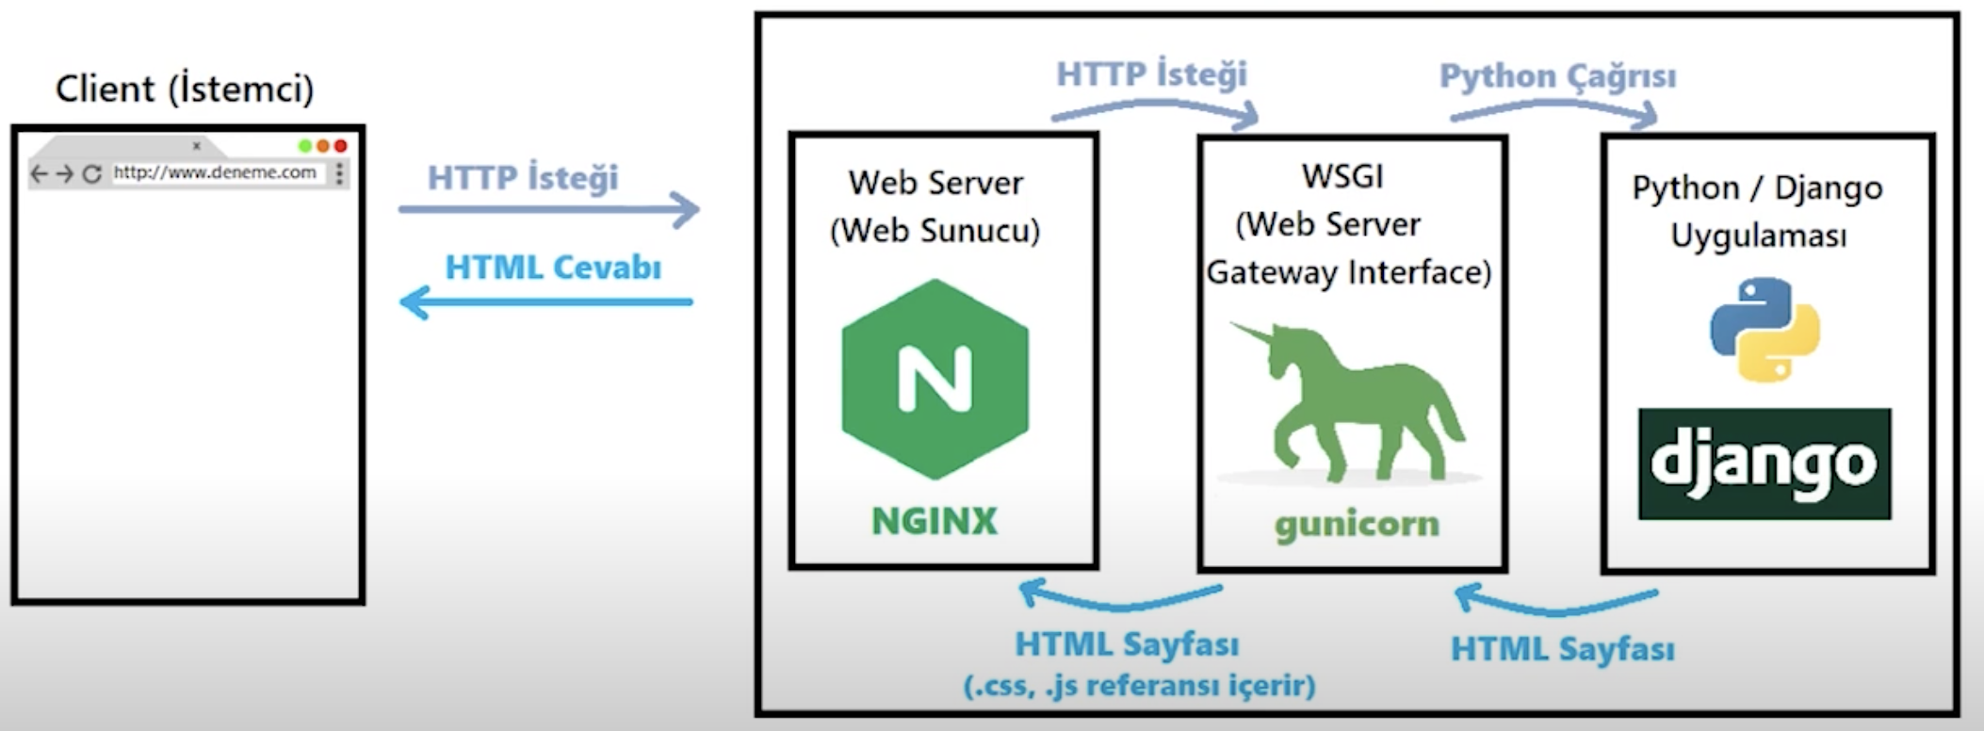


Python / Flask Uygulaması

Slide 26
Creating a uWSGI Configuration File
Create outside of app folder named myapp.ini
[uwsgi]
wsgi-file = run.py
callable = myapp
socket = 127.0.0.1:4242
processes = 4
master = true
chmod-socket = 660
vacuum = true
die-on-term = true
plugins = python3

Slide 27
Configuring Nginx to Proxy Requests
cd /etc/nginx/sites-enabled/
sudo nano default
location / {
include uwsgi_params;
uwsgi_pass 127.0.0.1:4242; }
Test
sudo nginx -t
sudo systemctl restart nginx
Notes:
Comment out root and index lines
bunu yapmamız daki amaç neydi?
configure Nginx to pass web requests to that socket using the uwsgi protocol.
Next, let’s add a location block that matches every request. Within this block, we’ll include the uwsgi_params file that specifies some general uWSGI parameters that need to be set. We’ll then pass the requests to the socket we defined using the uwsgi_pass directive:

Slide 28
Run app
Add log file
touch file.log
Run app on background
open myapp.ini
daemonize = /home/duyguay/file.log
uwsgi myapp.ini
Check server! Congrats ☺
Notes:
killall uwsgi
sudo systemctl stop nginx

Slide 29
Push the Project to GitHub
Create myapp.ini file also in your local
Creating a repo in Github
Check for Git Version, If not installed download the git according to OS of your system.
git --version
Clone the repo you created with ssh link
git clone “repo link”
Copy your files to cloned empty repo or move
Committing files into the git repo.
cd ‘your repo name’
git add .
git commit -m "First Commit”
Final push
git push origin ‘branch_name’
https://hackernoon.com/step-by-step-guide-to-push-your-first-project-on-github-fec1dce574f
Notes:
env1/bin/python -m pip freeze > requirements.txt
env2/bin/python -m pip install -r requirements.txt
Switch branch:
git checkout main
mv ./’filename’ ./’deployment’
cd deployment
Login
git config global user.emal ‘github user email’
git config global user.name ‘github user name’
Developer settings > personal access tokens > generate a personal access token > add note > click repo > admin: repo hook > copy token > enter token instead of password
Ls –la : to see hidden files > remove git file from myapp folder
Rm –rf ‘filename’: to remove file
By using the ssh protocol, we can connect and authenticate to remote servers and services. With ssh keys we can connect to GitHub without supplying our username and password at each visit with the help of passphrase. In HTTPS method, you will need to fill our username and password at every visit, which will be very inconvenient.
Move: mv ./myapp.ini ./deployment
https://www.youtube.com/watch?v=WgZIv5HI44o&ab_channel=SyntaxByte

Slide 30
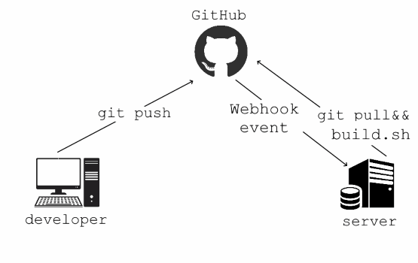
Continuous Integration of your Code and App with Git
Everytime you push your code to github from your local, you will see the change in your server directly.
Notes:
Bu repoya bir push request geldiğinde, bizim sana verdiğimiz bu adrese bir post request gönder dedik.

Slide 31
Webhooks
Webhooks: A webhook is a way for an app to provide other applications with real-time information.
A webhook delivers data to other applications as it happens, meaning you get data immediately.
Whenever you trigger an event in your github repo, it will send the information to the http address.
Repo/settings/webhooks/Add webhook
Write payload url:
http://[IP Adress]/update
Change content type to json

Slide 32
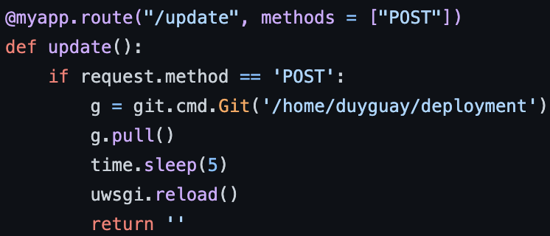
Adding Webhook Route to Flask
import time
import uwsgi
import git
Change model path in main.py
Commit and push
clone git repo to server with http link
pip install GitPython
cd repo - uwsgi myapp.ini
Change background color on your local and push
Check server IP
Notes:
Githubdan bu (update) urlye post request geldiğinde reponun içerisine giriyor, sonra pull request yapıyor. Ne değiştiyse onu alıyor githubdan. Sonra 5 sn bekliyor. Sonra uwsgiyi tekrardan çalıştırıyor.

Slide 33
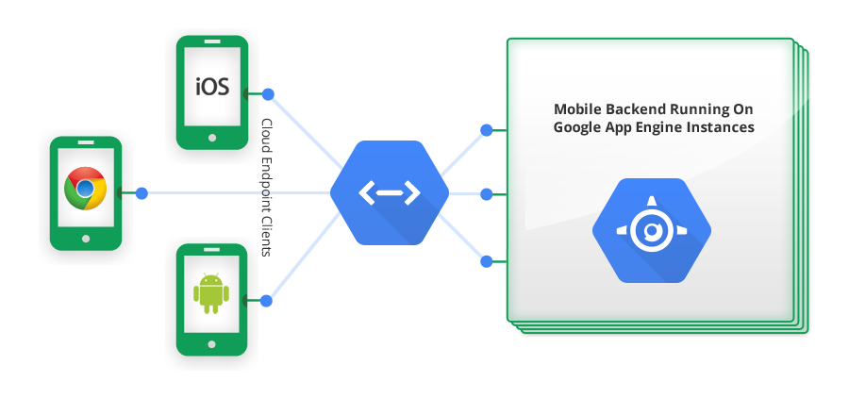
Model Deployment with App Engine on GCP
App Engine is a fully managed, serverless platform for developing and hosting web applications at scale.
Popular languages and framework
Focus on your code
Multiple storage options
Powerful built-in services
Familiar development tools
Deploy at google scale

Slide 34
File Structure
Make sure your flask file named as main.py
Make sure to use app. in main.py
Create a file called app.yaml to configure runtime
runtime: python38
Notes:
python -v

Slide 35
Installing Google Cloud SDK
Orchestrate virtual machine instances directly from your command line
https://cloud.google.com/sdk/docs/install
./google-cloud-sdk/install.sh
Notes:
uname -m
Nereye indirdiysen o directiroye cd yap.

Slide 36
Initialize Gcloud
Enable Cloud Build API
cd ’your project folder path’
gcloud init
Notes:
To shut project : manage resources – delete
Create new project and enable api

Slide 37
Deploying App
gcloud app deploy app.yaml --project “project name”
Don’t forget to disable app engine!
App engine > settings > disable application
Notes:
gcloud app logs read

Slide 38

Streamlit
Streamlit is an open-source python framework for building web apps for Machine Learning and Data Science.
The best thing about Streamlit is it doesn’t require any knowledge of web development. If you know Python, you’re good to go!
A few demos in streamlit
pip install streamlit
streamlit hello
Notes:
https://www.analyticsvidhya.com/blog/2021/06/build-web-app-instantly-for-machine-learning-using-streamlit/
https://towardsdatascience.com/streamlit-101-an-in-depth-introduction-fc8aad9492f2

Slide 39
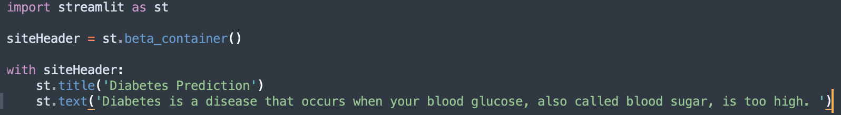
Creating Containers
streamlit run main.py
Notes:
Rerun vs always rerun

Slide 40
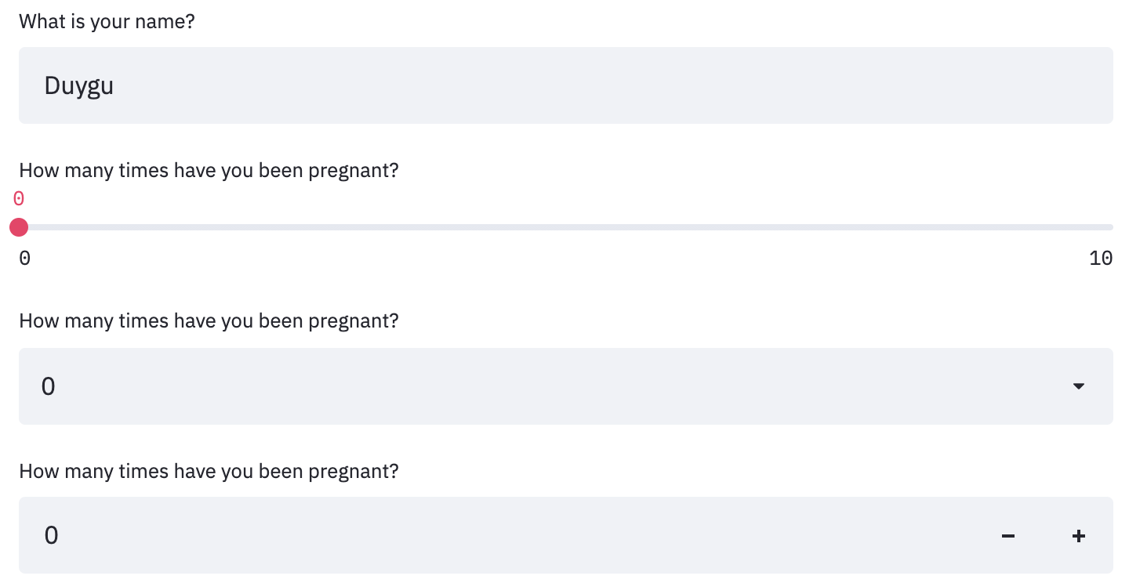
Collecting User Input
Text input
Slider
Drop down menu
Number input
Notes:
import streamlit as st
import joblib
model = joblib.load('model')
site_header = st.beta_container()
with site_header:
st.title('Diabetes Prediction')
st.text('Diabetes is a disease.')
with st.form(key='form'):
input_text = st.text_input('What is your name?')
slider = st.slider('AGE', min_value=0, max_value=100, value=0, step=1)
drop_down = st.selectbox('Education level', options =['high school', 'college', 'master'])
number = st.number_input('Age', min_value=0, max_value=100, value=0, step=1)
submitted = st.form_submit_button('Submit')
if submitted:
st.text(input_text)

Slide 41
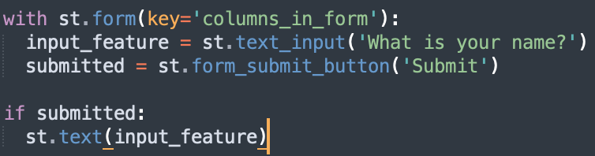
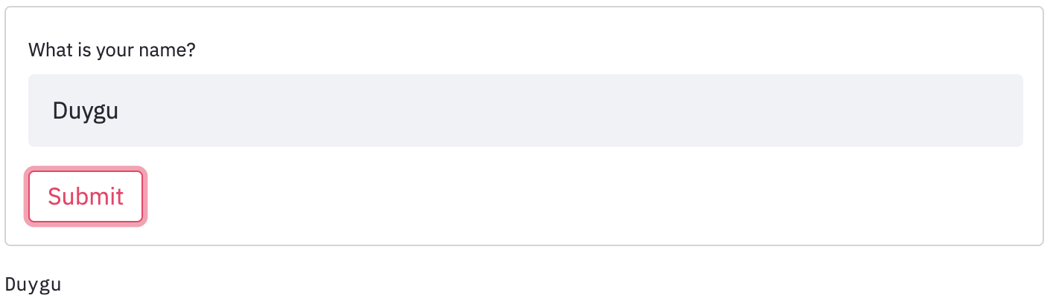
Creating Forms

Slide 42
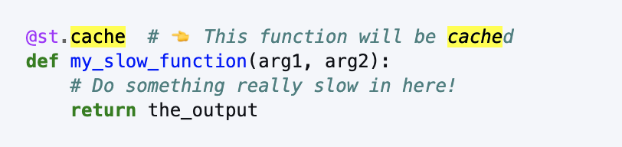
Optimizing App’s Run Time
Every time the user changes an input, the whole application runs from the beginning.
If your application includes a lot of calculations, works with big amounts of data or does calls to a database to retrieve data, your application will quickly become too slow to interact with.
As a solution, the streamlit team developed “caching”.

Slide 43
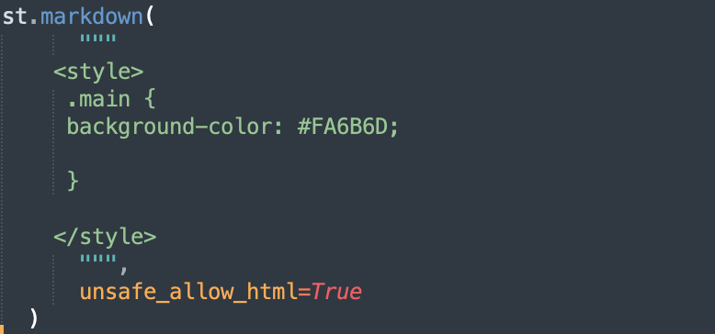
Styling

Slide 44
Deploying a Streamlit App
Getting an account from streamlit.io/sharing.
Sign up.
Get invite in the next 1-2 business days.
Create a github repo.
Make sure it is a public repo and it has a requirement.txt file.
Sign in to streamlit.io
Make sure you sign up with e-mail in your github account.
New app > Deploy
Notes:
Pip install pipreqs
Pipreqs ./

Slide 45
Thank you!

