Slide 1


IOEC Stock Predictor
0

Slide 2
Stock Market Prediction Is Hard
The stock market is an unpredictable mechanism.
There are so much parameters affecting it, for instance, news, politics, weather etc.
This project tries to predict the market on the basis of the numerical data that has been recorded continuously since any of the stock present on the market with IPOd.
1

Slide 3
How can we predict the market without a Machine Learning Model ?
Data can be reviewed manually, for many years market analysts have used that data with statistics knowledge to try and predict the market behavior.
There are two major analytical approaches:
Technical Analysis – Drawing indicators and scalers on a given graph.
Fundamental Analysis – Learn and analyze the company financials
2

Slide 4
Our Approach
Our project is using Machine Learning methodologies and Algorithms.
It consists of 9 Major sections:
Imports
Data Acquisition
Data Cleanning
Feature Engineering
Normalization
Making learnable data for the model
Define and Tune the model
Model Evaluation
Plotting the conclusions
3

Slide 5
Imports
yfinance – python library that wraps yahoo finance api
ta – a python library to extract financial indicators
Pandas
NumPy
Mathplotlib.pyplot
Seaborn
tensorflow
sklearn
datetime
4

Slide 6

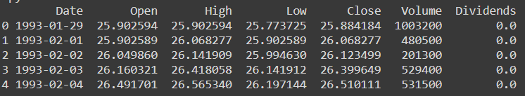
Data Acquisition
Calling yfinance api
5

Slide 7
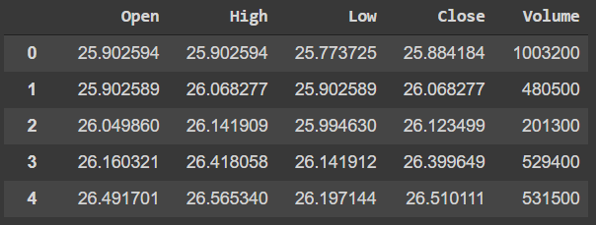
3. Data Cleaning
6

Slide 8
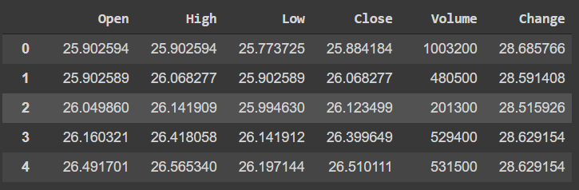
Adding prediction value
Adding ‘Change’ – The value of the stock after 240 days.
This is the value we predict
7

Slide 9
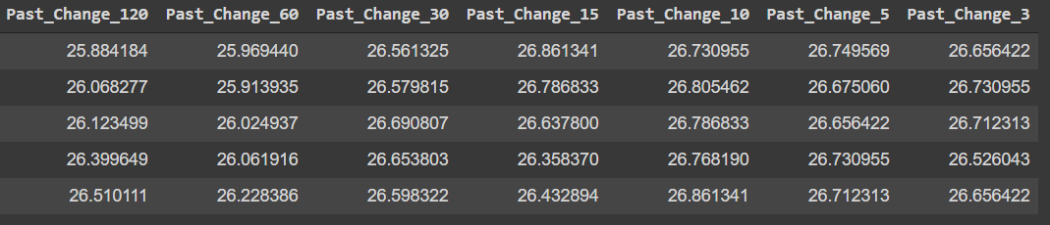
Adding some indicators
Adding indicators that represents the price the stock had BEFORE X days.
When X we used is a list containing the values : 120,60,30,15,10,5,3
We selected those values to ensure the model is consuming a good picture of the stock past.
8

Slide 10
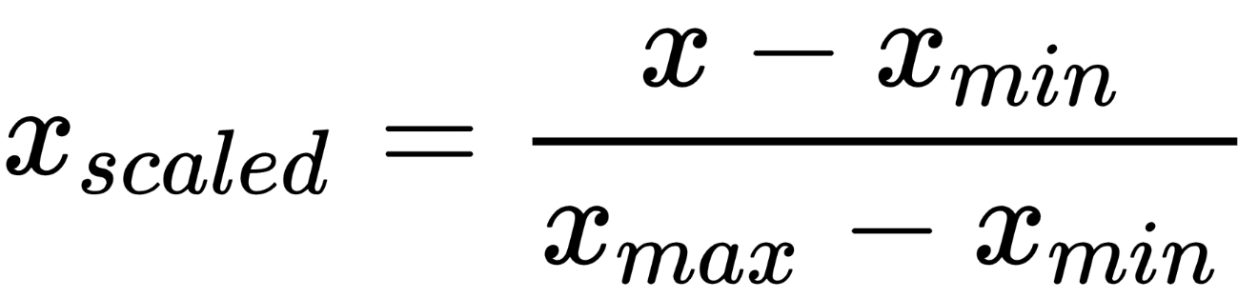
Normalization
We have used Min Max normalization on stock prices values
Using that approach we yield values between 0 to 1 that are much easier for machine learning model to comprehend.
9

Slide 11
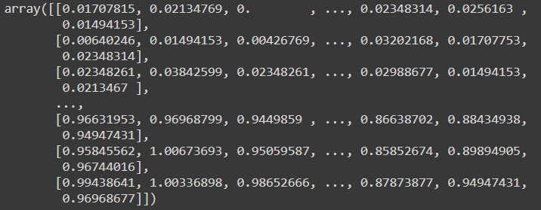
Normalization
10

Slide 12
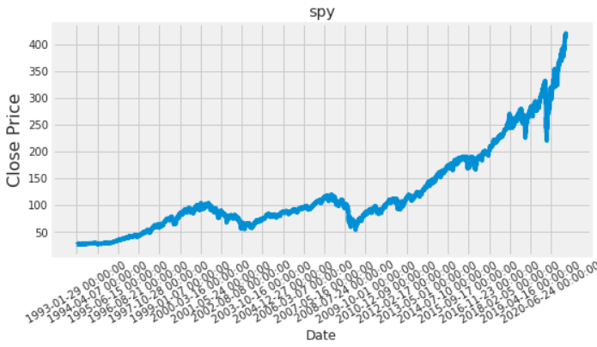
Making learnable data for the model
Split the data into 0.7 train and 0.3 validation:
11

Slide 13
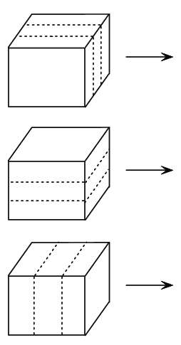
Input Size
That dimension – commonly known as ‘depth’ on 3D is the number of samples taken.
The total value of that dimension is : (Total Days / jump) – Days ahead to predict
* Jump – a parameter passed and make the algorithm skip “jump” amount of days. That value defaults to ‘1’ – no jump.
The amount of rows when each row is a trainable day.
The value of that dimension defaults to 550 and recognized as days_batch – the days ahead to forecast.
The columns are the features selected by the client.
It has various options as a result of tunable indicators
12

Slide 14
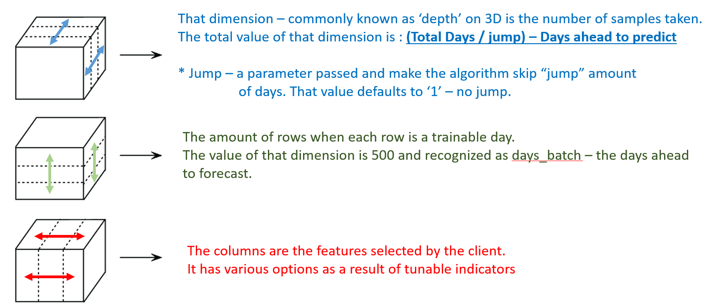
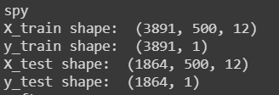
Input Size - Example
(Num_of_Samples,Days_Batch,Features_Num)
13

Slide 15
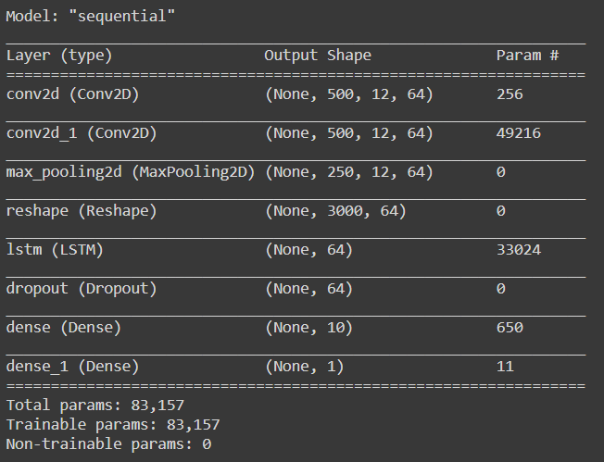
The model
---
1.
---
2.
---
3.
---
4.
---
5.
---
6.
---
7.
---
8.
On following slides all of the model layers will be explained.
14

Slide 16
Convolutional Neural Network
A convolutional neural network or CNN or ConvNet is a network that is based on a sliding window mechanism.
Each input window is multiplied with specific filter values
Those filters are also called “kernels”
The number of kernels yields different manipulations to the input.
9

Slide 17
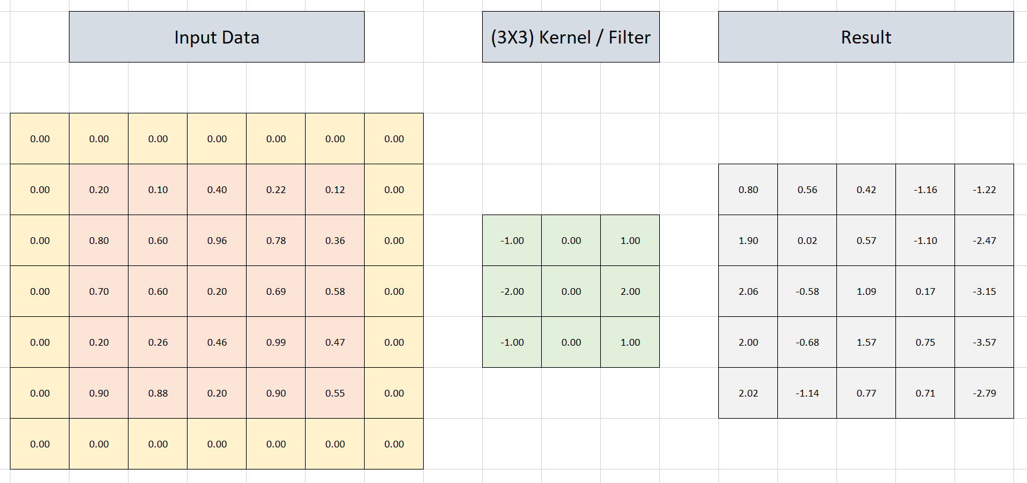
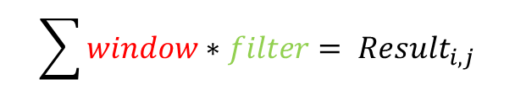
Convolutional Neural Network
$$\sum{window∗filter{= Result}_{i,j}}$$
16

Slide 18
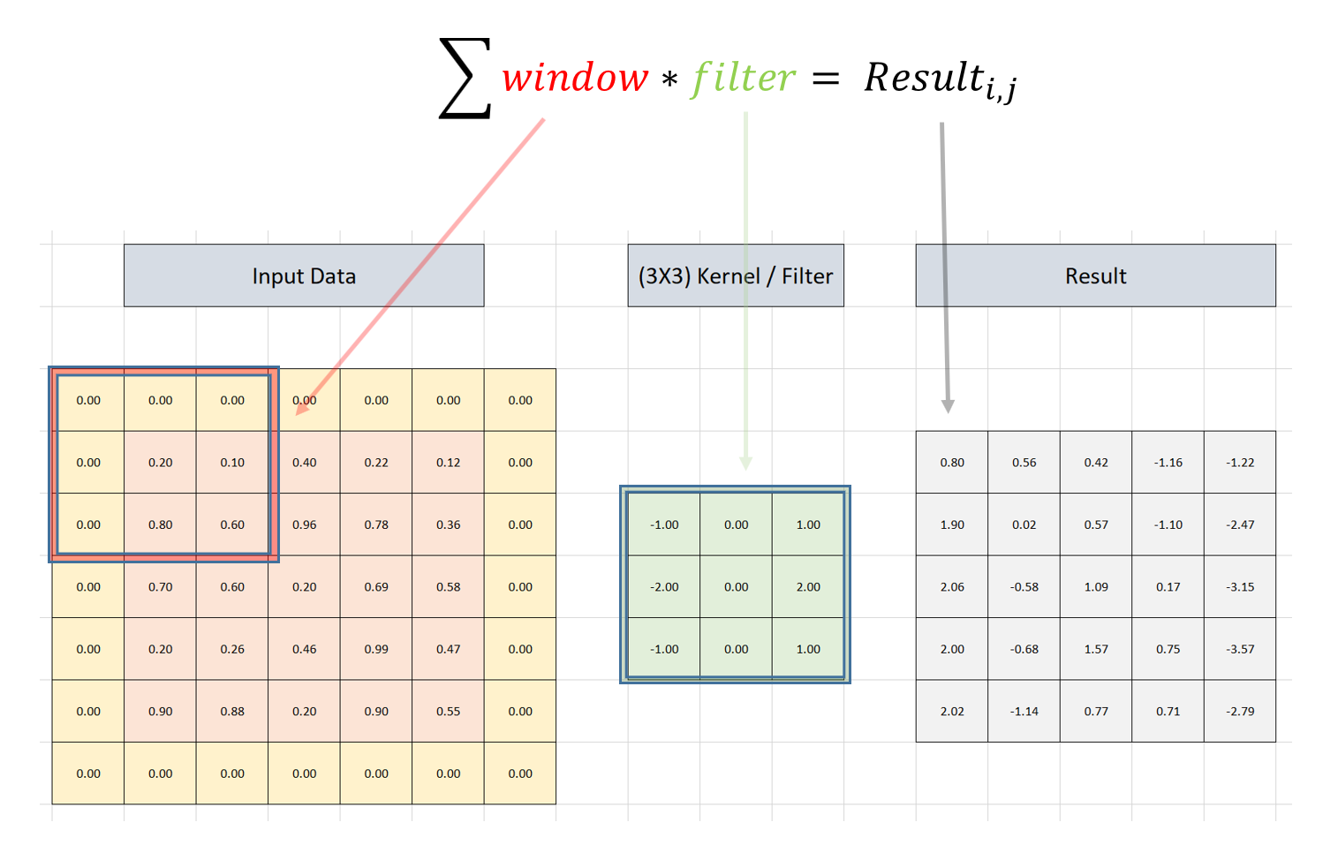
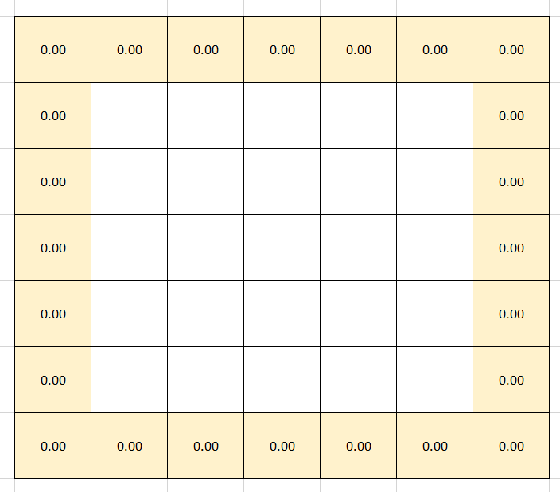
Padding
A computation can not succeed on the corners as a result of mismatch dimension.
Thus, a technique called ‘padding’ add pre defined values
17

Slide 19
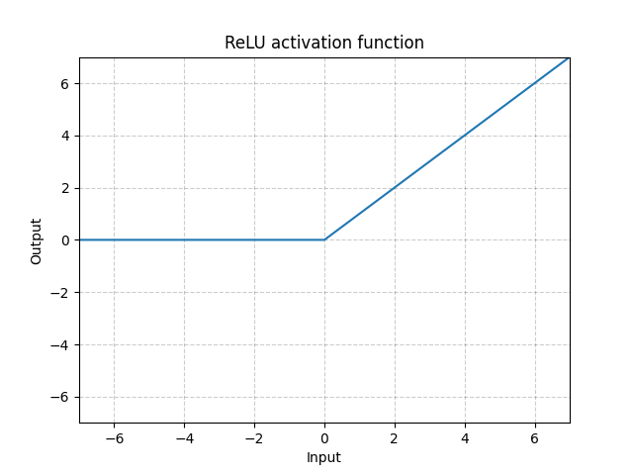
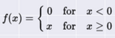
Activation
This process in charge of activating or deactivating certain neurons regarding their results.
We use “relu” activation which behaves as following:
18

Slide 20
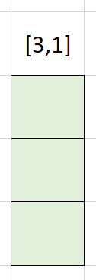
First Conv2D
Bias is a tunable vector in the size of [1,1].
This ensures more activations will occur
On that layer we use 3 row by 1 column kernel
We use 64 of these.
That kernel looks on 3 days on same fuature.
64
*
= 192 + bias = 256
Tunable parameters
19

Slide 21
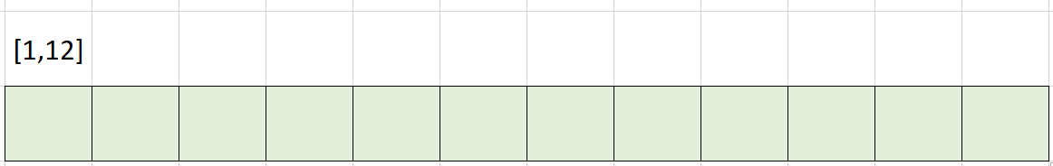
Second Conv2D
Feature Num = 12,
Thus [1,12]
64
*
On that layer we use 1 row by features_num column kernel
We use 64 of these.
That kernel looks on the same day and try to comprehend the result on that day between all the features present on thein put data.
= 768 * 256 from previous layer =
= 49152+bias = 49216 Tunable parameters
20

Slide 22
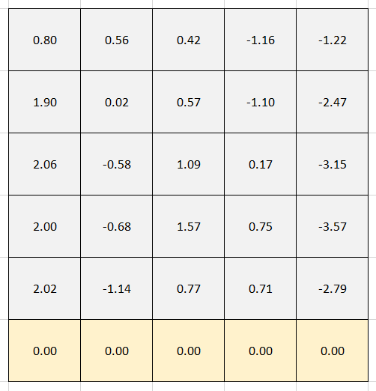
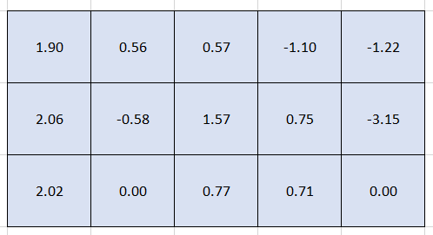
Max Pooling
Max Pooling is a process that uses sliding window mechanism and pull the maximum value from the viewed window.
This process emphasizes strongly activated neurons.
We use [2,1] which means it emphasizes strongest market day between two following days pulled with the api.
21

Slide 23
ReShape
We reshape the layer in order to fit for the LSTM model after pooling process.
We use the following formula : (T/2) * features_num when T = days_batch = the number of days observed as a single input.
We default this value to 500
We left with (250*12,64) = (3000,64)
22

Slide 24
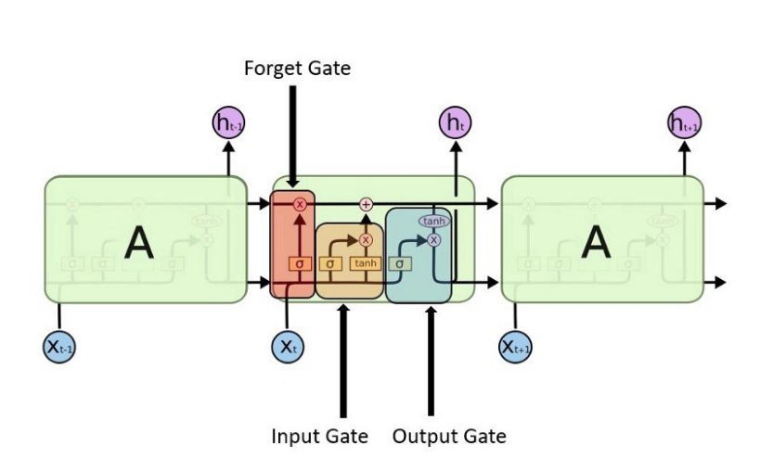
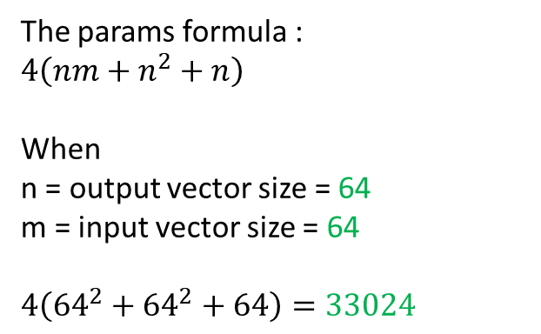
LSTM
RNN – Recurrent Neural Network – This type of neural network differs significantly from other networks on one key roll : It uses the former output as the current input. This behavior make the model decisions consider all of the inputs to account.
That approach suffers from vanishing and exploding gradients.
LSTM – Long Short Term Memory - an RNN based that handles the gradients problem by selecting the appropriate input.
The params formula :
$$4\left(nm+n^{2}+n\right)$$
When
n = output vector size = 64
m = input vector size = 64
$$4\left({64}^{2}+{64}^{2}+64\right)=33024$$
23

Slide 25
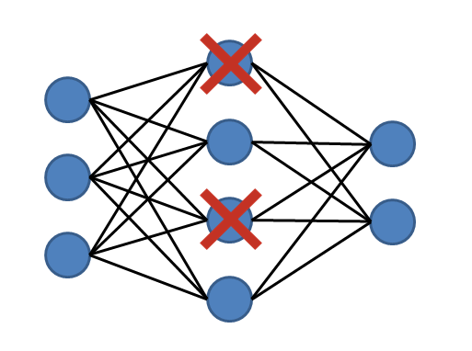
Dropout
On the example below the dropout value is 0.5
Dropout layers have created to address overfitting problems.
Those layers behavior is easily self-explained by their name “dropout” – the layer let a certain percentage of the values to precede to the next layer and “dropping” a percentage of the input data.
The percentage dropped is the dropout value.
It is important to acknowledge the fact, the actual neurons dropped are selected randomly.
We used on our model a dropout value of 0.2
24

Slide 26
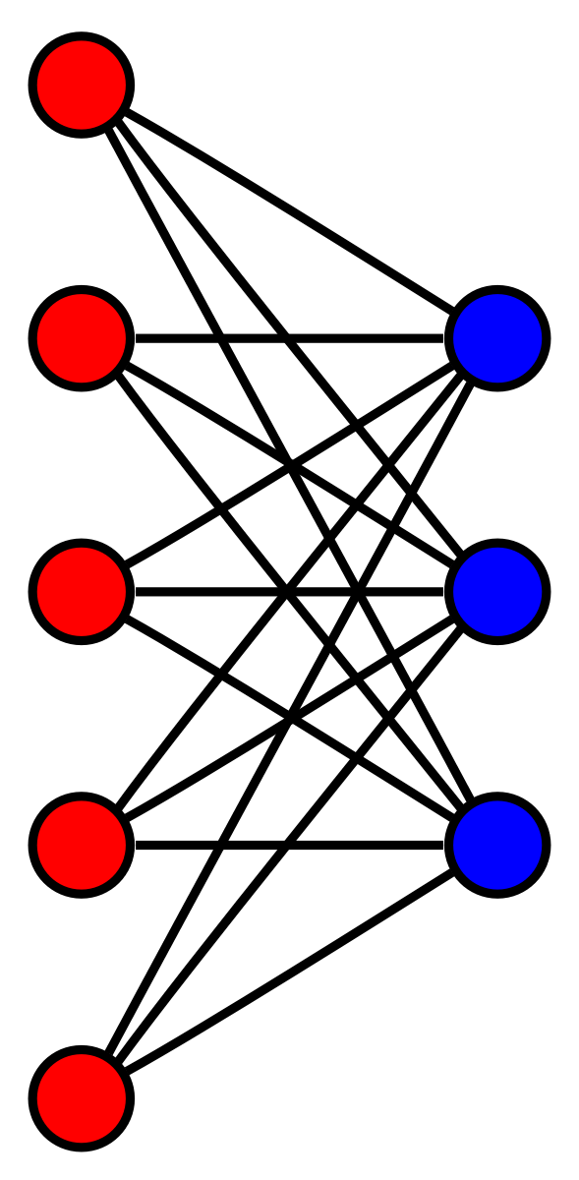
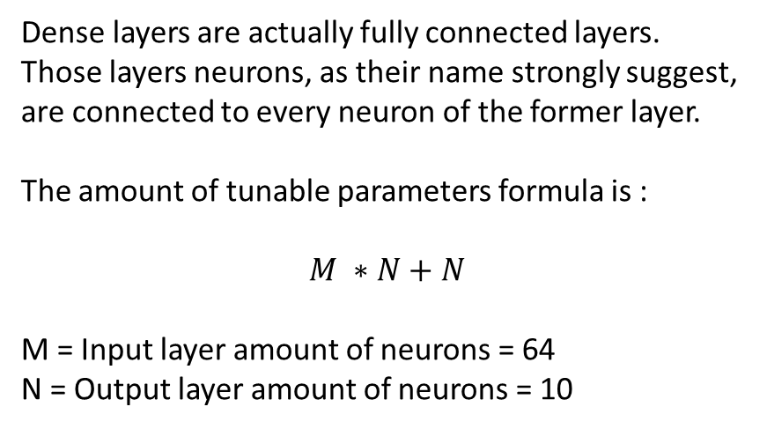
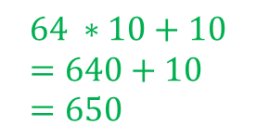
Dense
M = 64
Dense layers are actually fully connected layers.
Those layers neurons, as their name strongly suggest, are connected to every neuron of the former layer.
The amount of tunable parameters formula is :
$$M ∗N+N$$
M = Input layer amount of neurons = 64
N = Output layer amount of neurons = 10
N = 10
$$64 ∗10+10=640+10=650$$
25

Slide 27
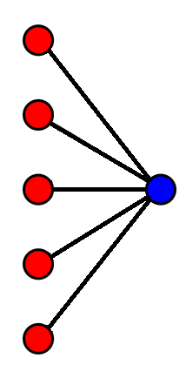

Another Dense
M = 10
$$10 ∗1+1=10+1=11$$
N = 1
That is the output neuron which predicts the stock price
26

Slide 28
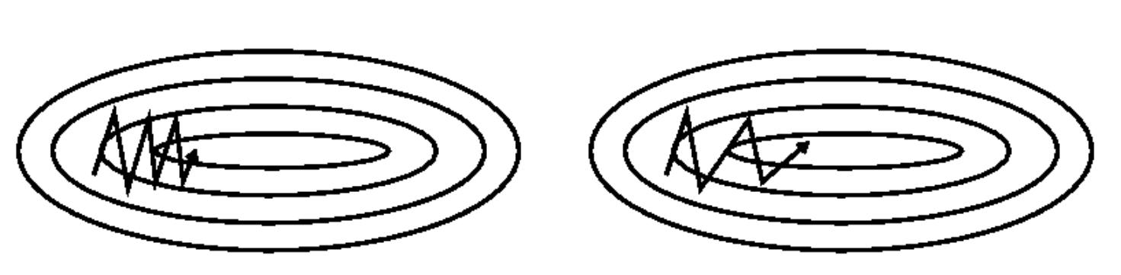
Optimizer
The optimizer is in charge of optimizing the learning process.
We use adam optimizer.
27

Slide 29
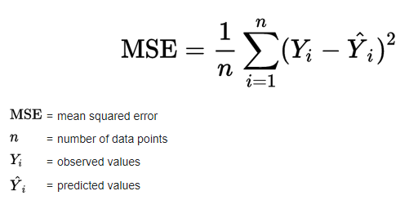
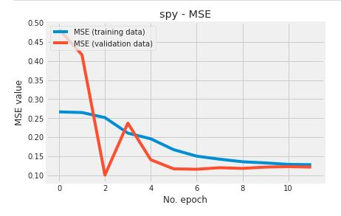

Loss
The loss we use is mean squared error
28

Slide 30
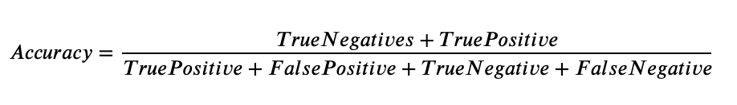
Model Evaluation
To evaluate our model performance we used Accuracy
29

Slide 31
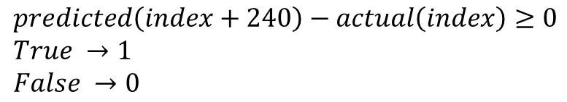
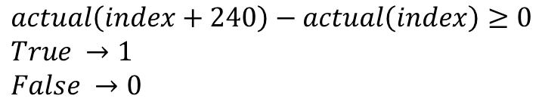
Model Evaluation
In order to evaluate the model, we had to change regression value into binary.
For that we have used the following formula:
We Compare that to the actual value that was present:
$$predicted\left(index+240\right)−actual\left(index\right)≥0 \\ True →1 \\ False →0$$
$$actual\left(index+240\right)−actual\left(index\right)≥0 \\ True →1 \\ False →0$$
30

Slide 32
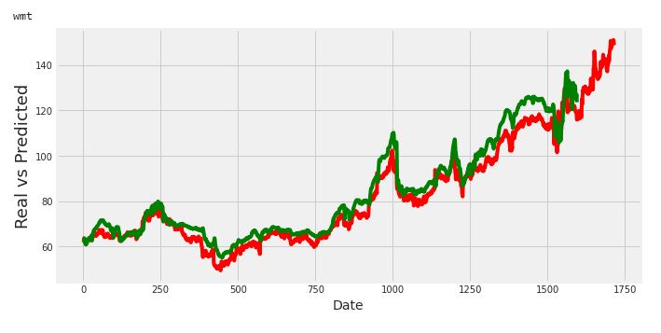
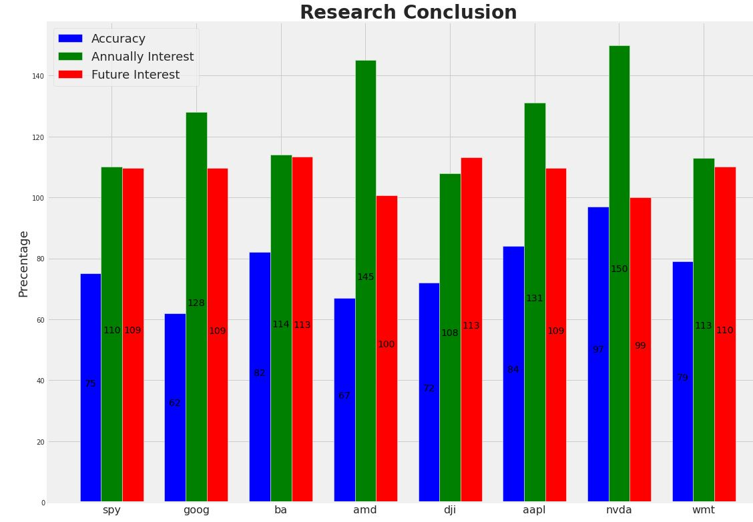
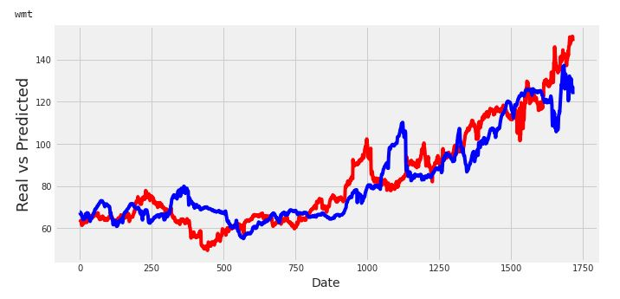
Plotting the conclusions
31

Slide 33
Drawbacks of our approach
Singular prediction – we predict one and only stock price with a precise value of days ahead.
We split the data into fixed ratio – that is problematic when the stock behavior vary drastically on a relatively short amount of time.
Model Construction – a lot of model variations can be achieved, hence, we can and will not guarantee that ours is the way to go.
32

Slide 34
Thank You !
We will finish with a Warren Buffet quote:
“Our Advice, Beware of geeks bearing formulas.”
We say:
“Our Advice, Be aware of geeks bearing formulas.”
33

