Slide 1
IO-SEA Task 3.4:
Progress on the
Recommendation System

Slide 2
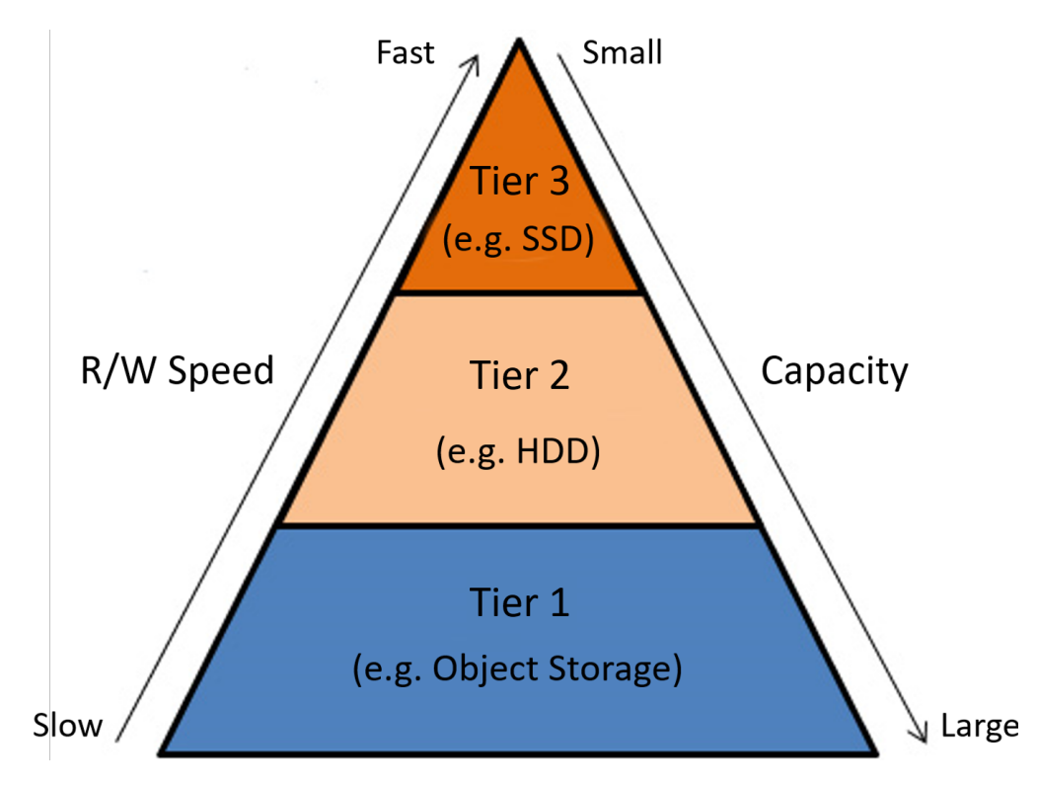
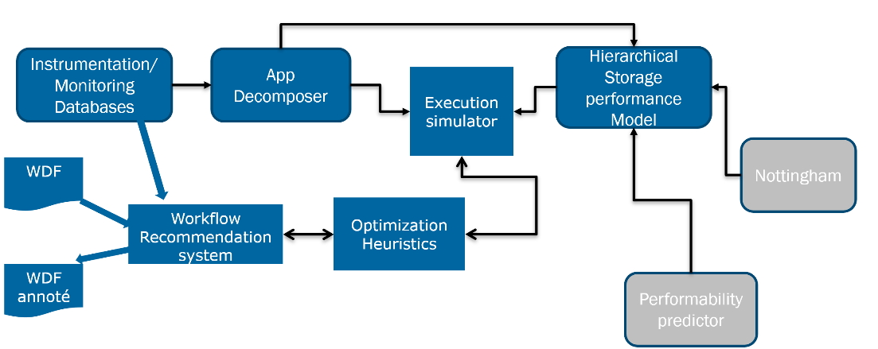
Introduction
The objective is to recommend through the WDF the optimal placement of data:
In terms of performance (execution time)
In terms of energy consumption (eco mode)
IO Instrumentation:
Collects I/O data during the execution of an application
App Decomposer:
Decomposes time series in order to be able to replay them in a different execution environment
Execution Simulator:
Allows simulating/replaying a job in a specified resource environment
Performance Model:
Stores the characteristics of a storage tier

Slide 3
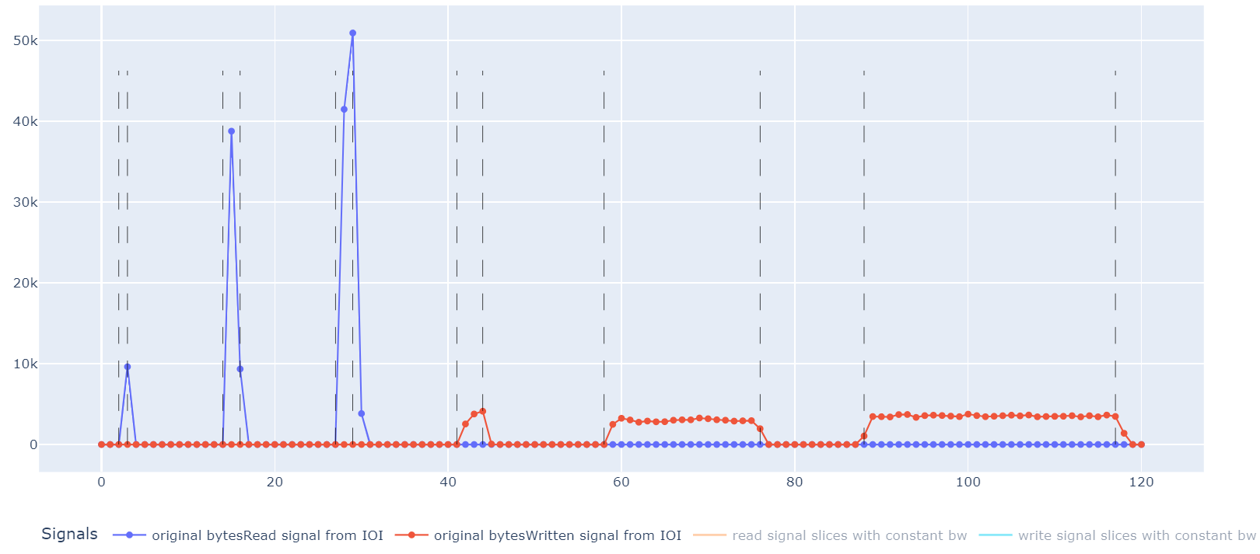
AppDecomposer
Detects I/O phases from compute phases
Identify each I/O phases with characteristics (block size, pattern,…)
Keep the chronology of the I/O phases and compute phase sequence
IOI
AppDecomposer
Performance Model
Execution
Simulator

Slide 4
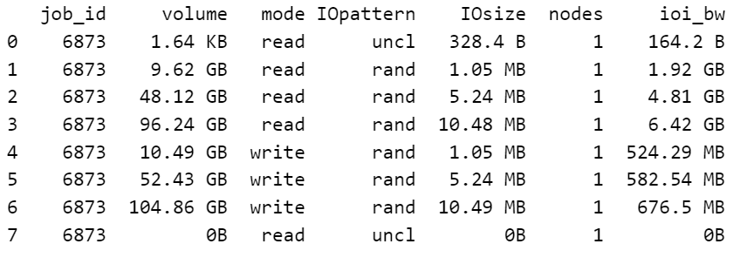
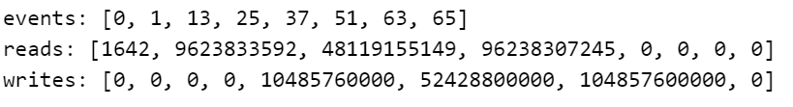
Representation and phases
Phases
Representation
phases
App Decomposer
Performance Model
IOI
representation
Execution
Simulator

Slide 5
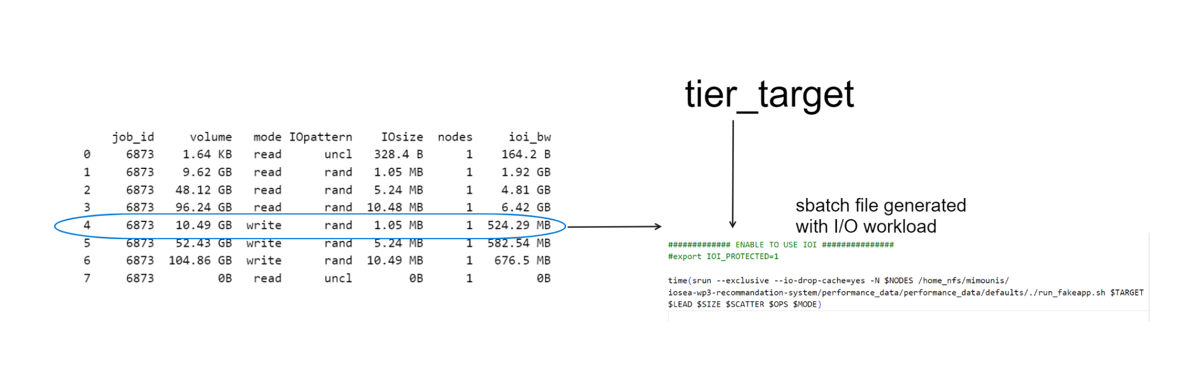
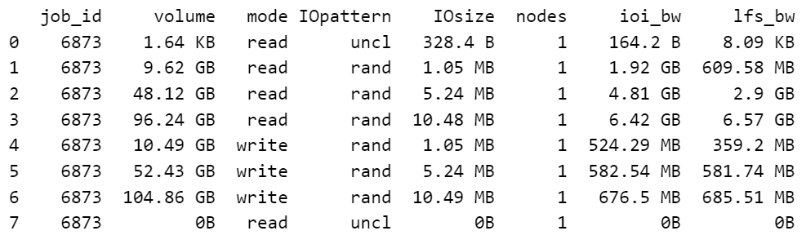
Performance Model
Similarly we could have a column for each storage tier storing measured energy consumption for each I/O phase

Slide 6
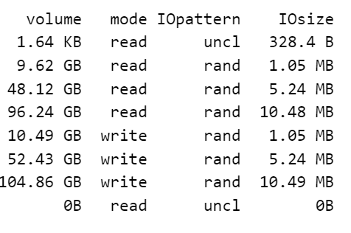
Performance Model
Approximations
One dominant pattern per phase (instead of a distribution)
One average block size per phase (instead of a distribution)
We drop the cache, used exclusive mode and uses slurm real time as latency reference (maybe some overhead)
Measured tier may experience other workloads ;-(

Slide 7
Simulating job with execution simulator
Phases table
AppDecomposer
Performance Model
Tiers
performances
Execution
Simulator
Representation
Time series reconstruction
Execution time prediction
Energy consumption

Slide 8
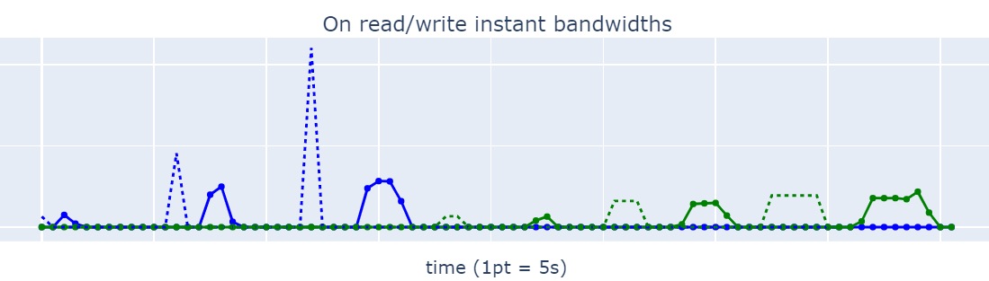
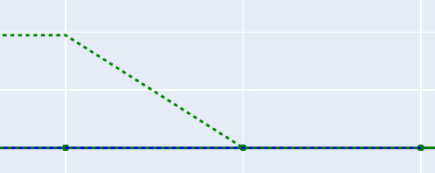
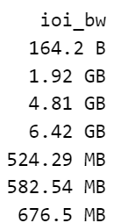
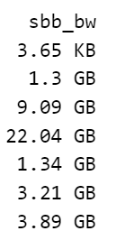
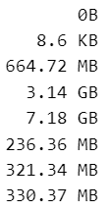
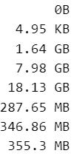
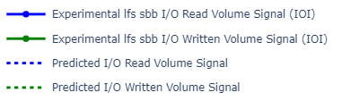
Results
predicted

Slide 9
Remarks
Reading phases performance measurements are not accurate enough.
This incurs cumulative shifts on the time series chronology
Writing phases performance measurements are enough accurate on SBB
Sequence of write checkpoints are quite similar.
The execution time is the endpoint of the simulated signal --

