Slide 1
DATA SCIENCE GROUP PROJECT
-Allen Daniel Sunny
-Sangeeth Devan
-Deepika Veluswamy

Slide 2
DATA SOURCE
Dataset – We used the publicly provided dataset by Bike Sharing system in Washington DC
Data Contained the start and end times of every user that used the Bike in the system
Station ID and Station Name was also mentioned.
It also did not contain any other factor that affected bike usage in the city.
However based on the previous studies and our intuitive knowledge, we can see that weather patterns are a major cause in bike usage.
Thus we took weather data from meeto.com for 2012 and we added it to the original bike sharing system.

Slide 3
DATA PROCESSING
As we only obtained data per ride, there was a lot of data preprocessing. We split the dataset we had and generated an algorithm that split the data per station, per day, per month.
From this new dataset, we can obtain station-wise bike sharing information.
The capital bike sharing stations start with 20 bikes at the beginning of the day and then the station slowly rebalance as the day goes on.
Thus we need to also find an optimal path in order to adequately re-distribute bikes at the end of the day.
For this project, we have taken the example of station number 3100 and looked to see how the bike count changes over the course of the day.

Slide 4
PROJECT GOALS
In this project, we have attempted to solve three questions.
Q1) Generation algorithm- To find the bike usage at a particular station any day.
Q2) To find the overall bike prediction across the city any day.
Q3) To find an optimal rebalancing route at the end of each day

Slide 5
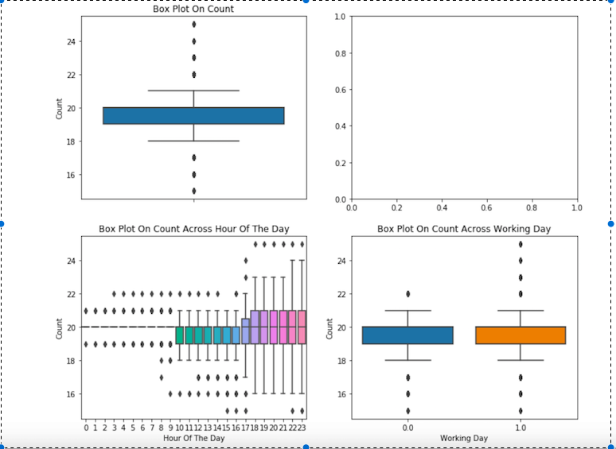

Slide 6
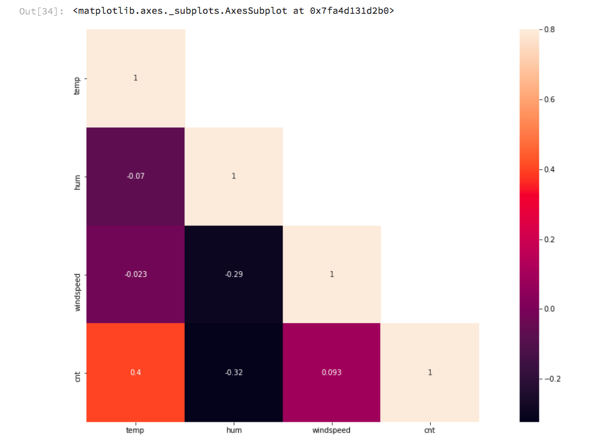

Slide 7
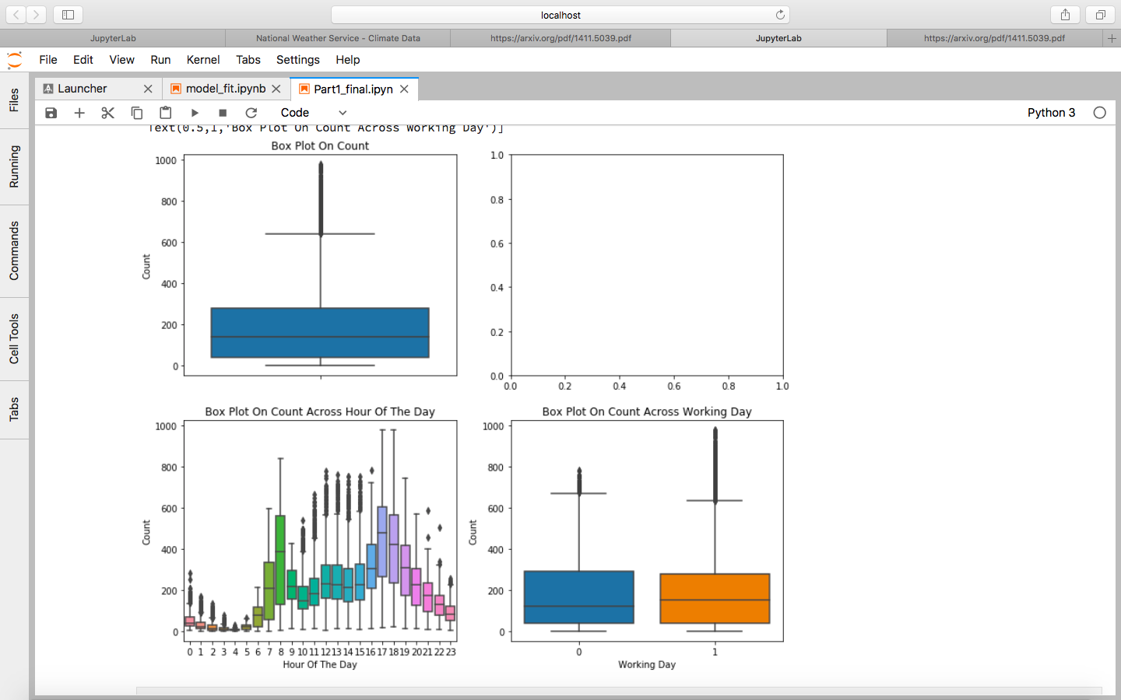
Overall Bike System

Slide 8
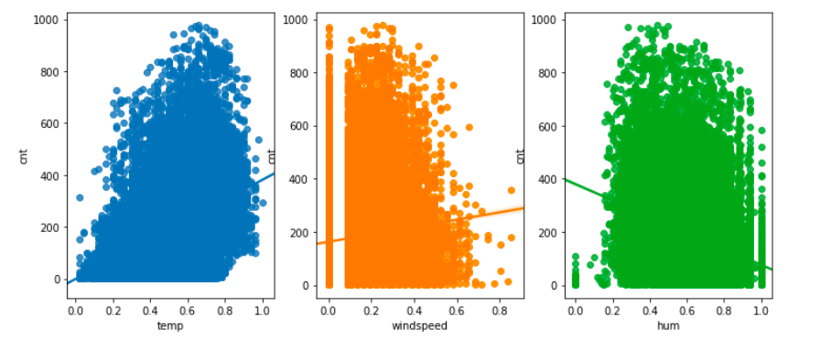

Slide 9
METHODS
From the dataset, we have observed that there’s a strong influence of the weather upon bike usage in the city as demonstrated below.
There’s also a change in the weekdays and weekend’s.

Slide 10
DATA CLEANING
In our project, we found that wind speed has large number of null values that skewed the data when it was fitted to out model.
Thus we used Random Forests to predict the value of those zeroes before fitting the entire model.
Thus we cleaned our entire dataset and we did this both city wise and station wise.

Slide 11
REBALANCE METHOD
The rebalance method that we picked was based on weighted K-means Classifier.
K-means algorithm generates random clusters whose points are nearest to each other.
This is a very good method to cluster bike stations as it is previously assumed that the clusters are self contained, as it’s assumed that people do not bike outside of their cluster.
The weighted K-means assigns values to each point, thereby changing the centroid of the cluster.

Slide 12
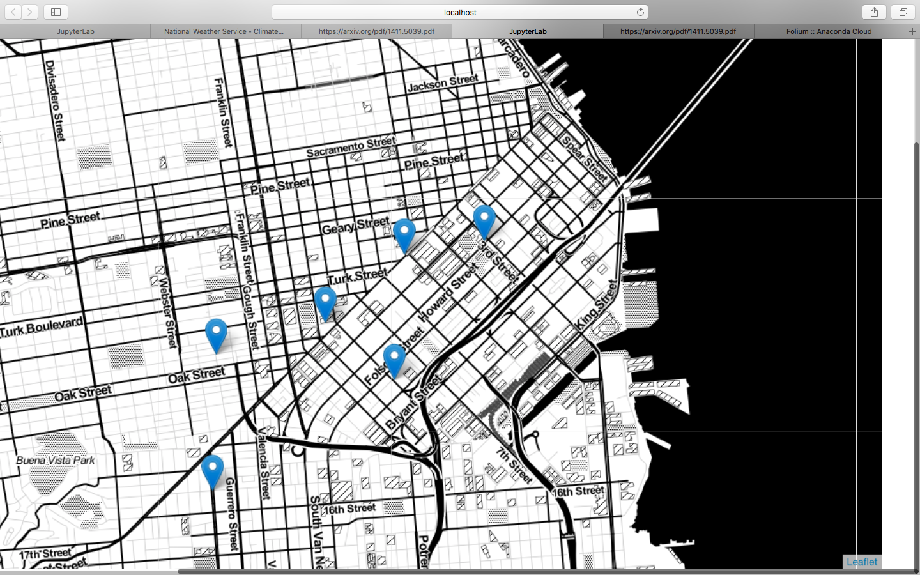
Geographical View Of Bike Stations In One Cluster

Slide 13
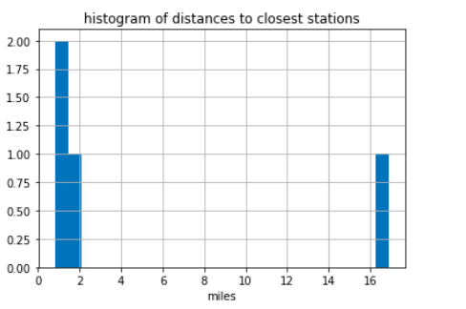

Slide 14
Based on our station frequency, we have assigned the weights as average count value across three months.
Using the Latitude and Longitude, we can create a closed draft with the edges being the weight of the cyclic craft.
Thus this problem now reduces to a simple travelling salesman problem.
From this we can obtain, the desired route.

Slide 15
RESULTS
Linear Regression:
RMSLE: 1.3333479197911722
MAE: 110.83327569060327
Grid Search
RMSLE: 1.3802457589771415
Best params: {'model_fitting__alpha': 10}
RandomForestRegressor
RMSLE: 1.3581414146510238
GradientBoostingRegressor
RMSLE: 1.3915906329273127

