Slide 1
Classroom learning dynamics using a cellular automata spatiotemporal model comparing peer instruction and traditional instruction
Instrumentation Physics Laboratory
AY 2024-2025 1st Sem Progress Report
November 4, 2024
Sy, Clarence Ioakim T.
BS4+ Applied Physics
Adviser: Dr. Johnrob Bantang
Complexity Science Group

Slide 2


Traditional instruction vs peer instruction
Traditional instruction | Peer instruction
The instructor delivers a lecture to the whole class for the duration of the class time. | Students are given the chance to learn from each other during class time after an initial lecture by the instructor.

Slide 3
Advantages of peer instruction (PI)
Improve students’ conceptual understanding and problem-solving skills compared to traditional instruction
Benefit groups even if no one in it initially knew the answer
Students with less background knowledge learn as much as students with more background knowledge (vs traditional instruction)

Slide 4
Research questions
How does the number of learned students develop over time?
Spatial position of high aptitude students in class
How does the positioning of learned students affect the learning rate of the class for peer instruction?
Learning rate
Traditional vs peer instruction
When is peer instruction better than traditional instruction?
Which factors lead to a difference in performance?

Slide 5
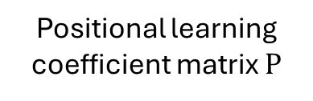
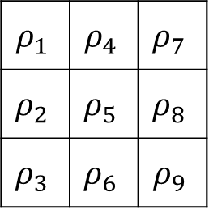
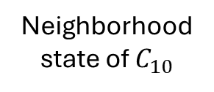
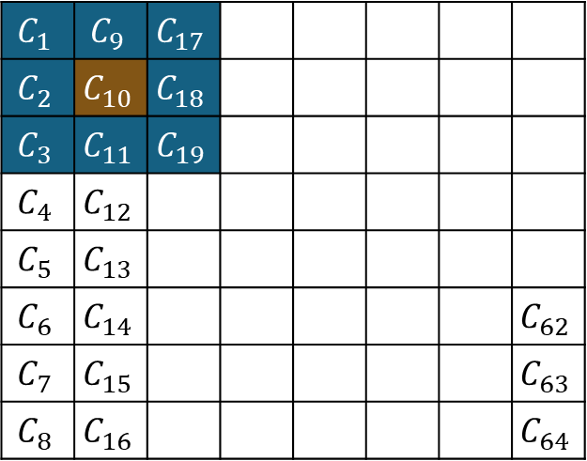

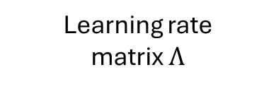
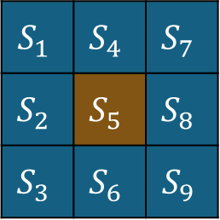

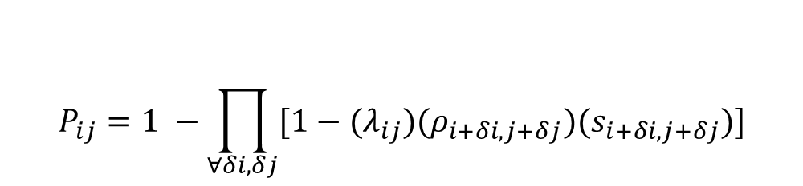
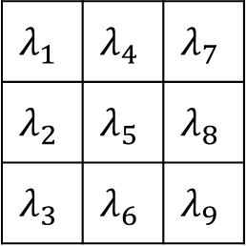
PCA model overview
$$S_{1}$$ | $$S_{4}$$ | $$S_{7}$$
$$S_{2}$$ | $$S_{5}$$ | $$S_{8}$$
$$S_{3}$$ | $$S_{6}$$ | $$S_{9}$$
$$ρ_{1}$$ | $$ρ_{4}$$ | $$ρ_{7}$$
$$ρ_{2}$$ | $$ρ_{5}$$ | $$ρ_{8}$$
$$ρ_{3}$$ | $$ρ_{6}$$ | $$ρ_{9}$$
$$λ_{1}$$ | $$λ_{4}$$ | $$λ_{7}$$
$$λ_{2}$$ | $$λ_{5}$$ | $$λ_{8}$$
$$λ_{3}$$ | $$λ_{6}$$ | $$λ_{9}$$
$$C_{1}$$ | $$C_{9}$$ | $$C_{17}$$
$$C_{2}$$ | $$C_{10}$$ | $$C_{18}$$
$$C_{3}$$ | $$C_{11}$$ | $$C_{19}$$
$$C_{4}$$ | $$C_{12}$$
$$C_{5}$$ | $$C_{13}$$
$$C_{6}$$ | $$C_{14}$$ |  |  |  |  |  | $$C_{62}$$
$$C_{7}$$ | $$C_{15}$$ |  |  |  |  |  | $$C_{63}$$
$$C_{8}$$ | $$C_{16}$$ |  |  |  |  |  | $$C_{64}$$
$$⊙$$
$$⊙$$
Neighborhood state of $C_{10}$
Positional learning coefficient matrix $Ρ$
Learning rate matrix $Λ$
$$P_{ij}=1 −\prod_{∀δi,δj}{[1−{(λ}_{ij})(ρ_{i+δi, j+δj})(s_{i+δi, j+δj})]}$$
Learning probability:
Classroom represented as lattice of cells

Slide 6
Binary probabilistic CA model
The classroom is set to be a 2D square grid of varying lengths.
Students are either learned or not learned (state: 0 or 1) with varying individual learning rates.
Simulations are initialized with 4 different seating arrangements (SA): inner corner, outer corner, center, random.
The simulation is considered done when all students are learned.

Slide 7
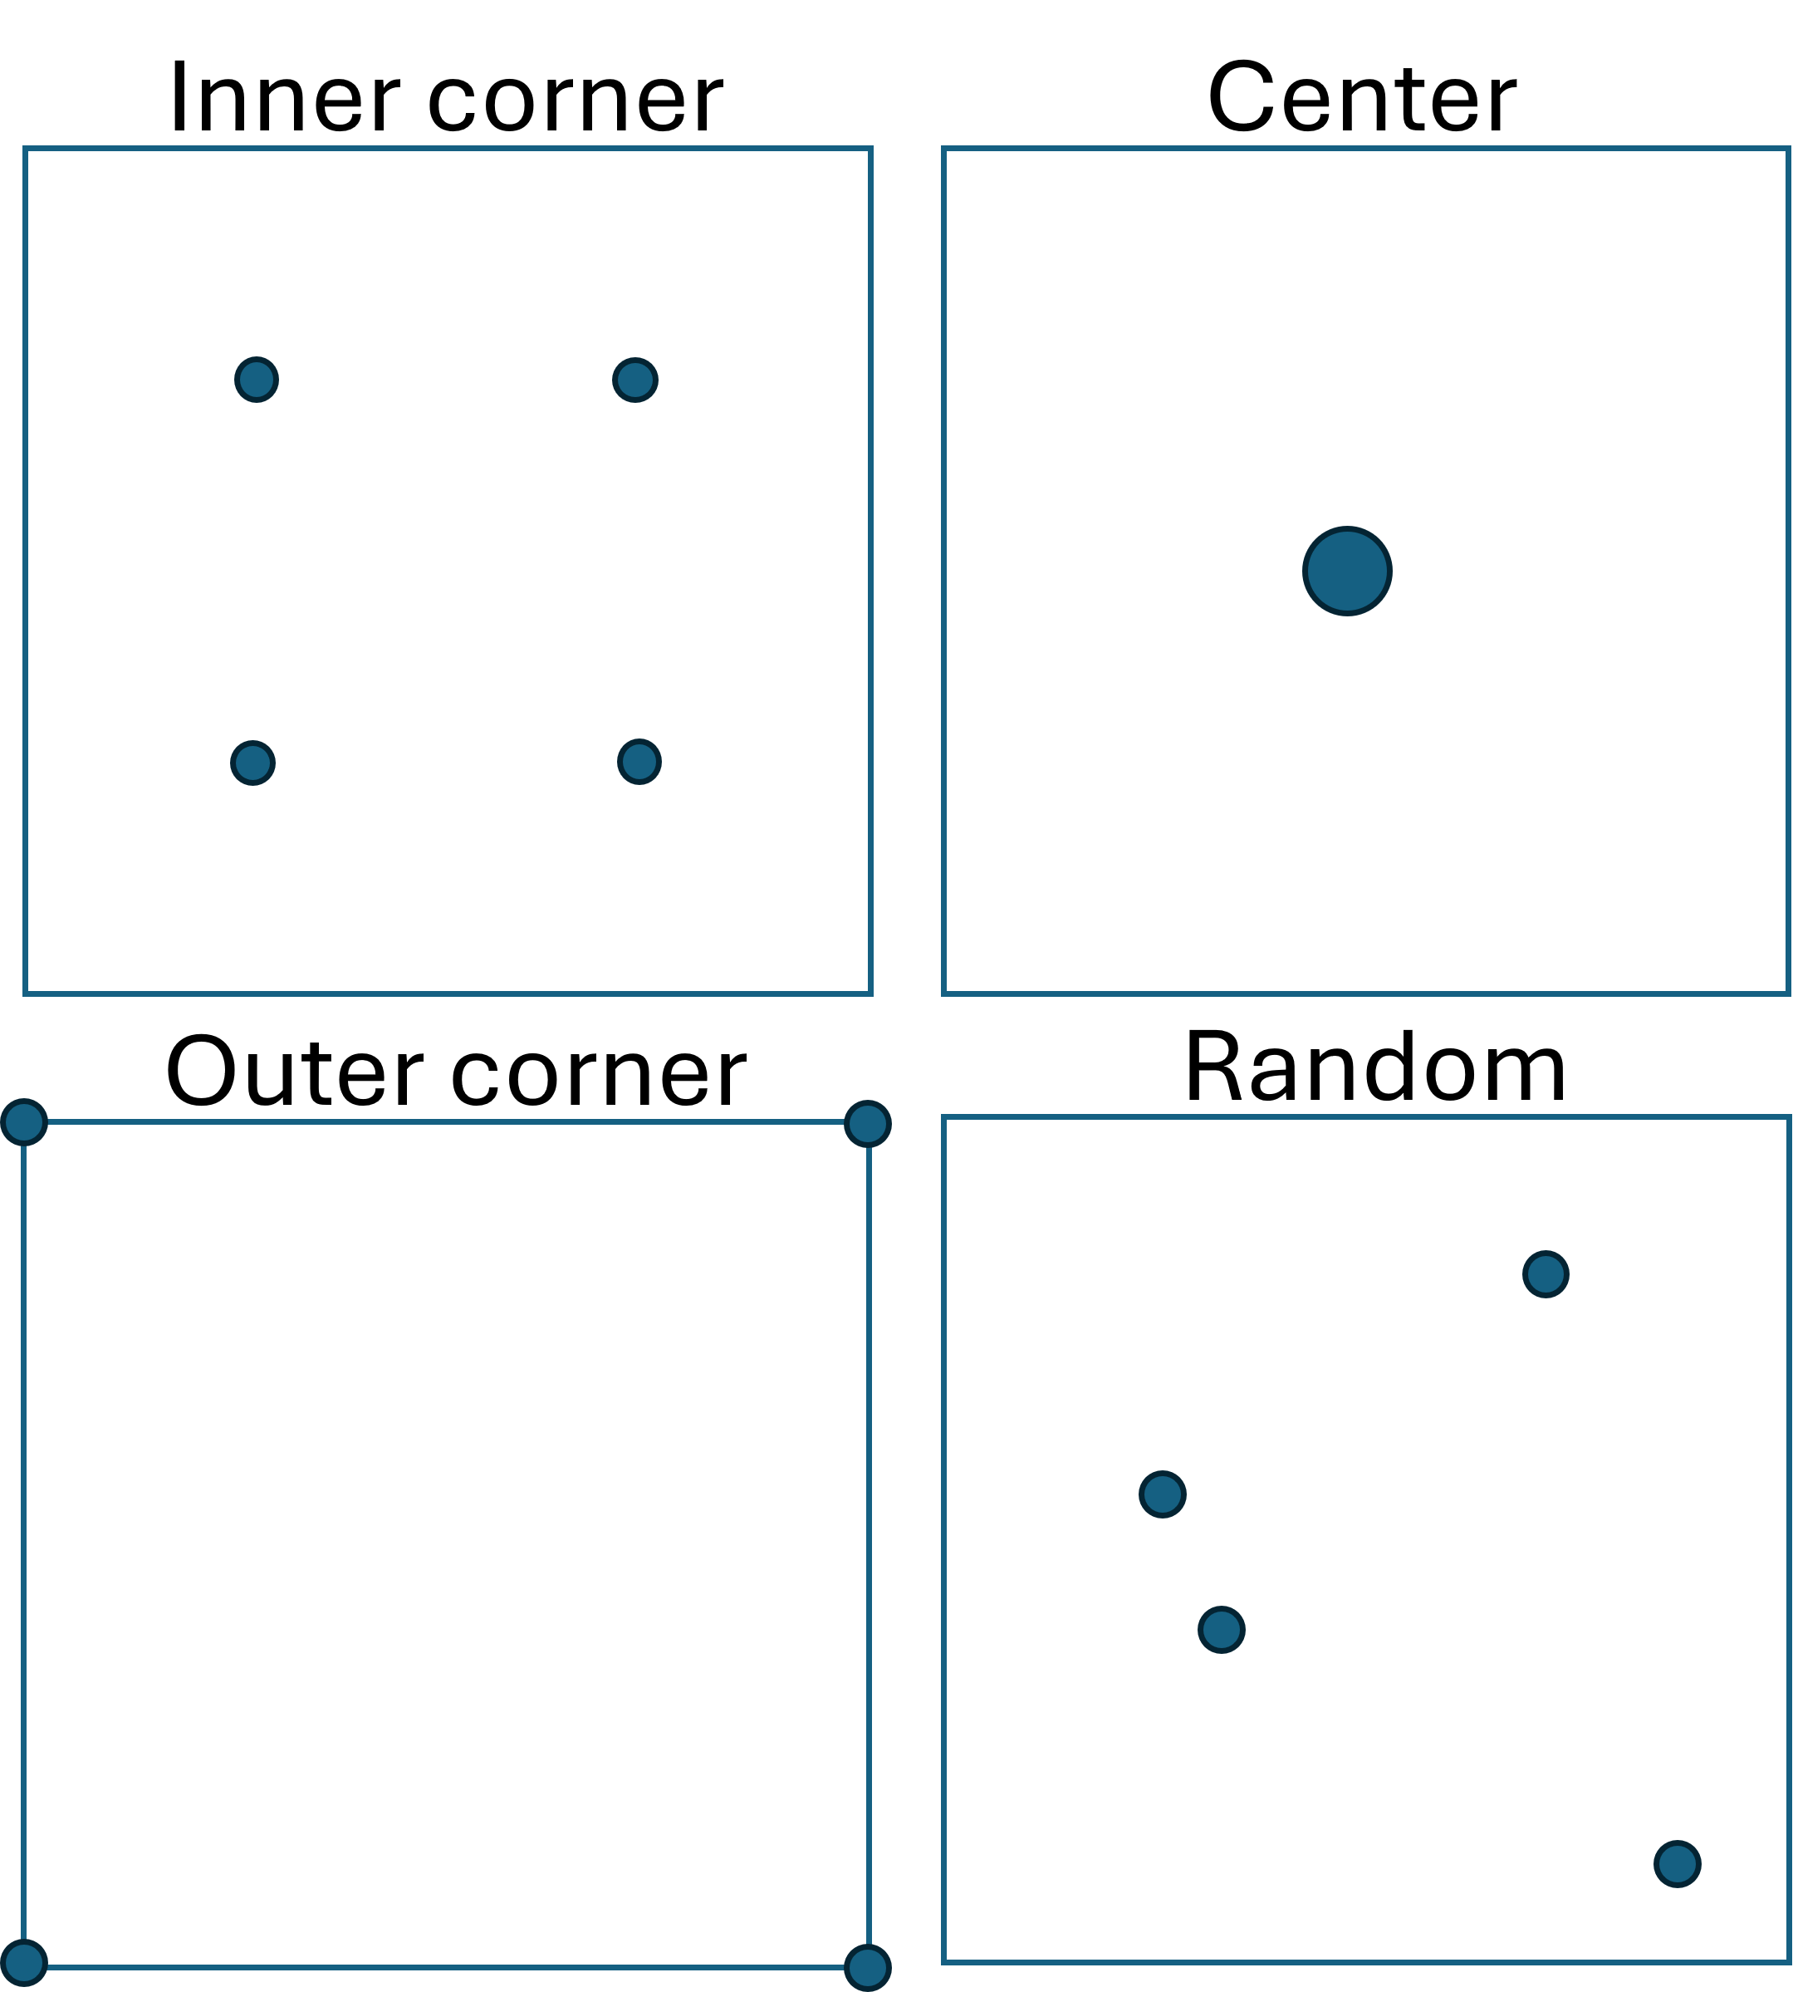
Different initial conditions for PI
- Circles indicate location of learned students

Slide 8


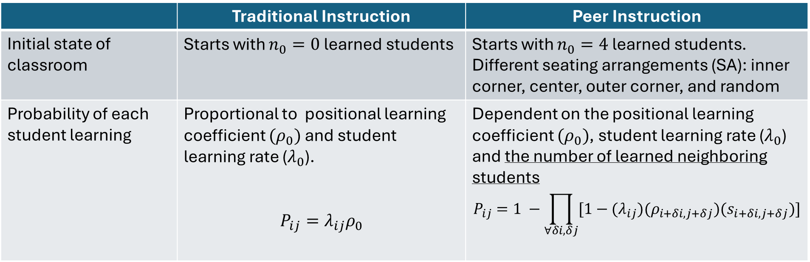
PCA rules for classroom simulation
 | Traditional Instruction | Peer Instruction
Initial state of classroom | Starts with $n_{0}=0$ learned students | Starts with $n_{0}=4$ learned students. Different seating arrangements (SA): inner corner, center, outer corner, and random
Probability of each student learning | Proportional to positional learning coefficient $(ρ_{0})$ and student learning rate ($λ_{0}$). $$P_{ij}=λ_{ij}ρ_{0}$$ | Dependent on the positional learning coefficient $(ρ_{0})$, student learning rate ($λ_{0}$) and the number of learned neighboring students $$P_{ij}=1 −\prod_{∀δi,δj}{[1−{(λ}_{ij})(ρ_{i+δi, j+δj})(s_{i+δi, j+δj})]}$$
Notes:
Main difference b/w traditional and peer instruction

Slide 9
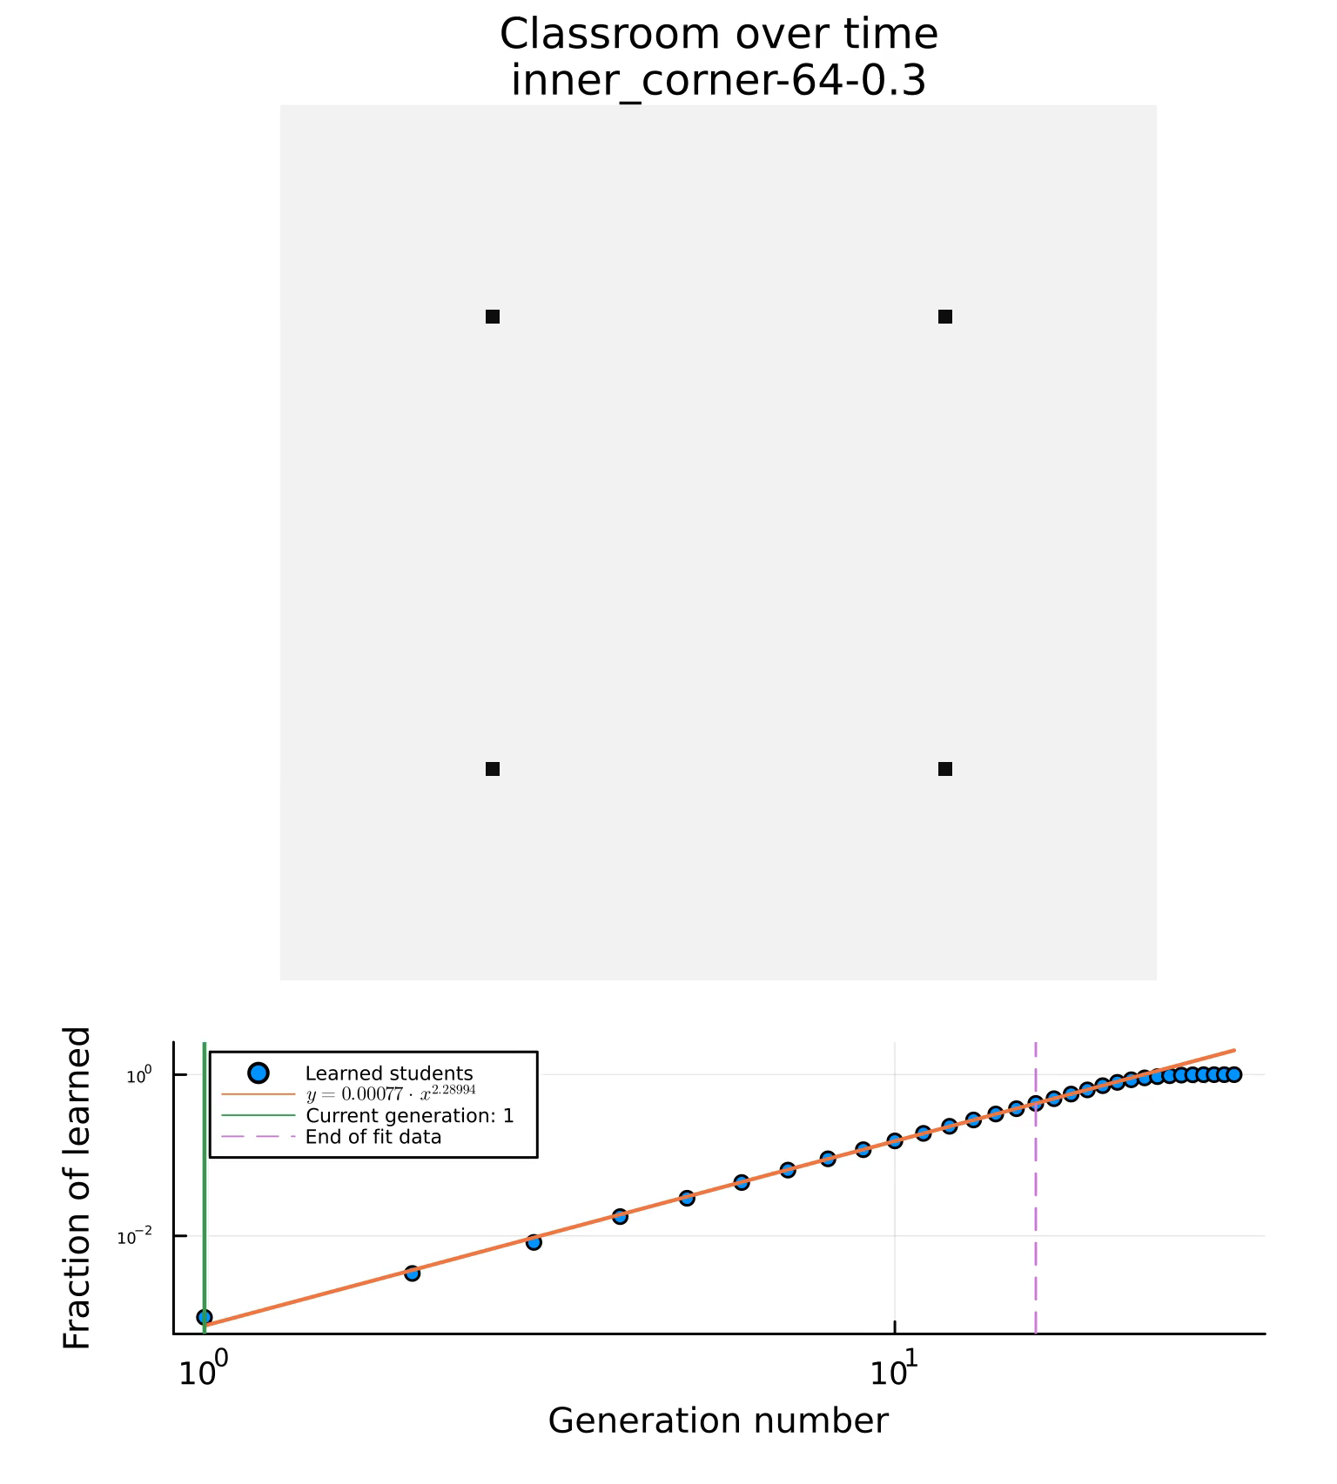
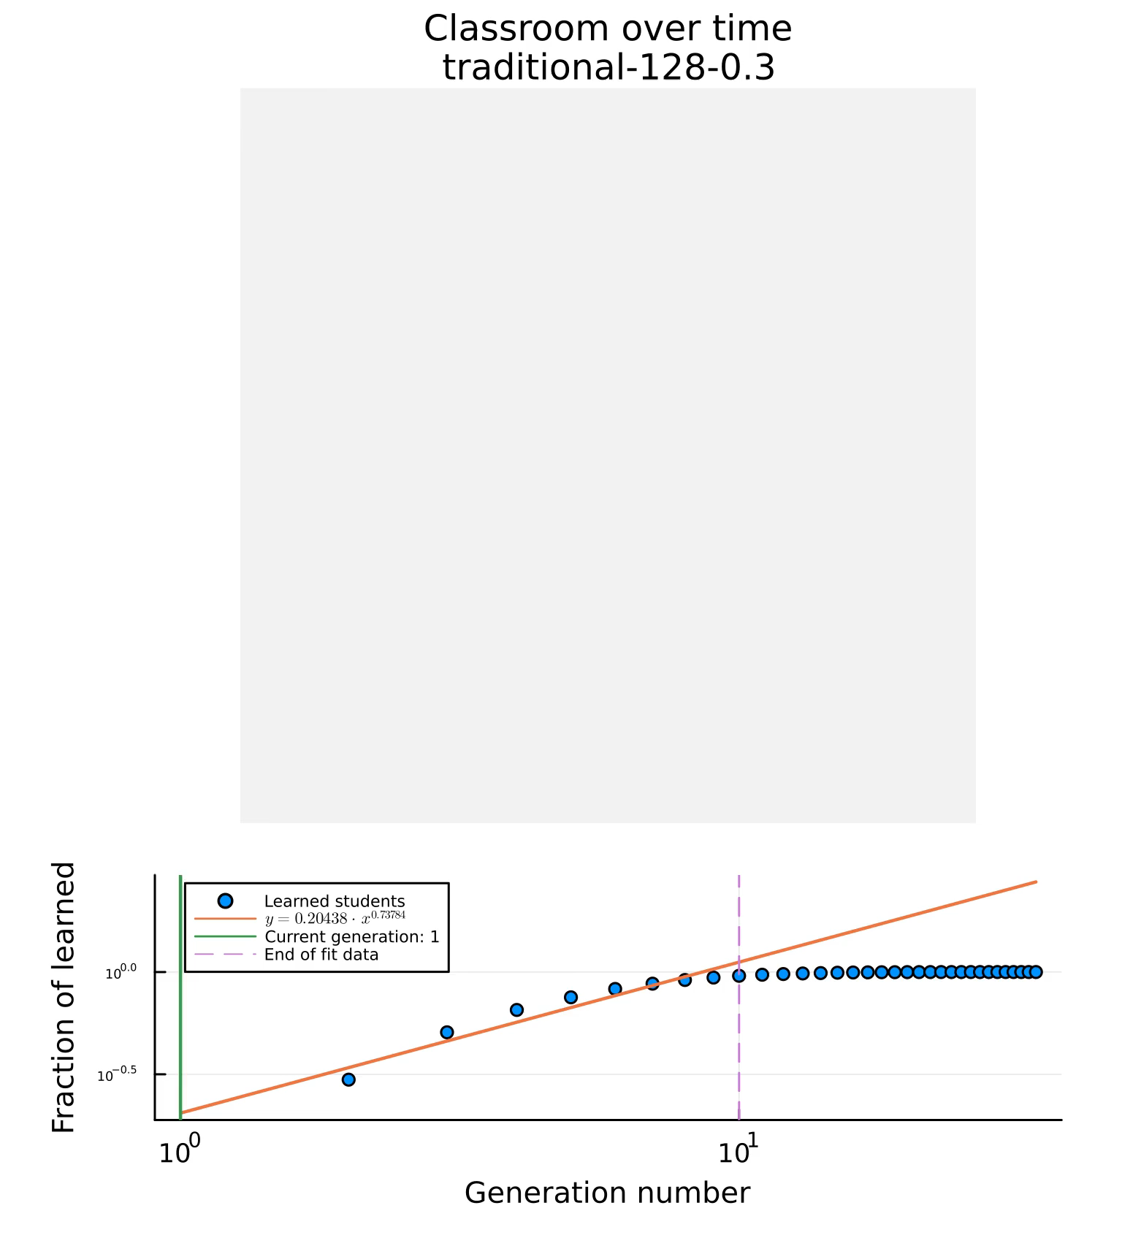
Time step
Time step
Notes:
Say what metrics were used to measure performance

Slide 10
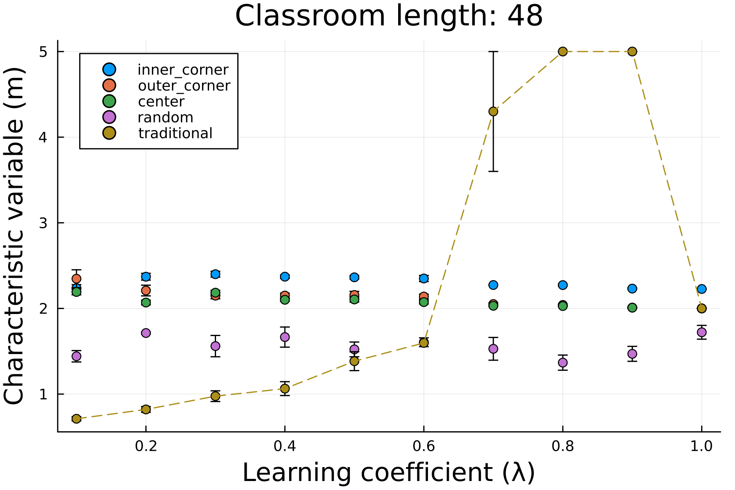
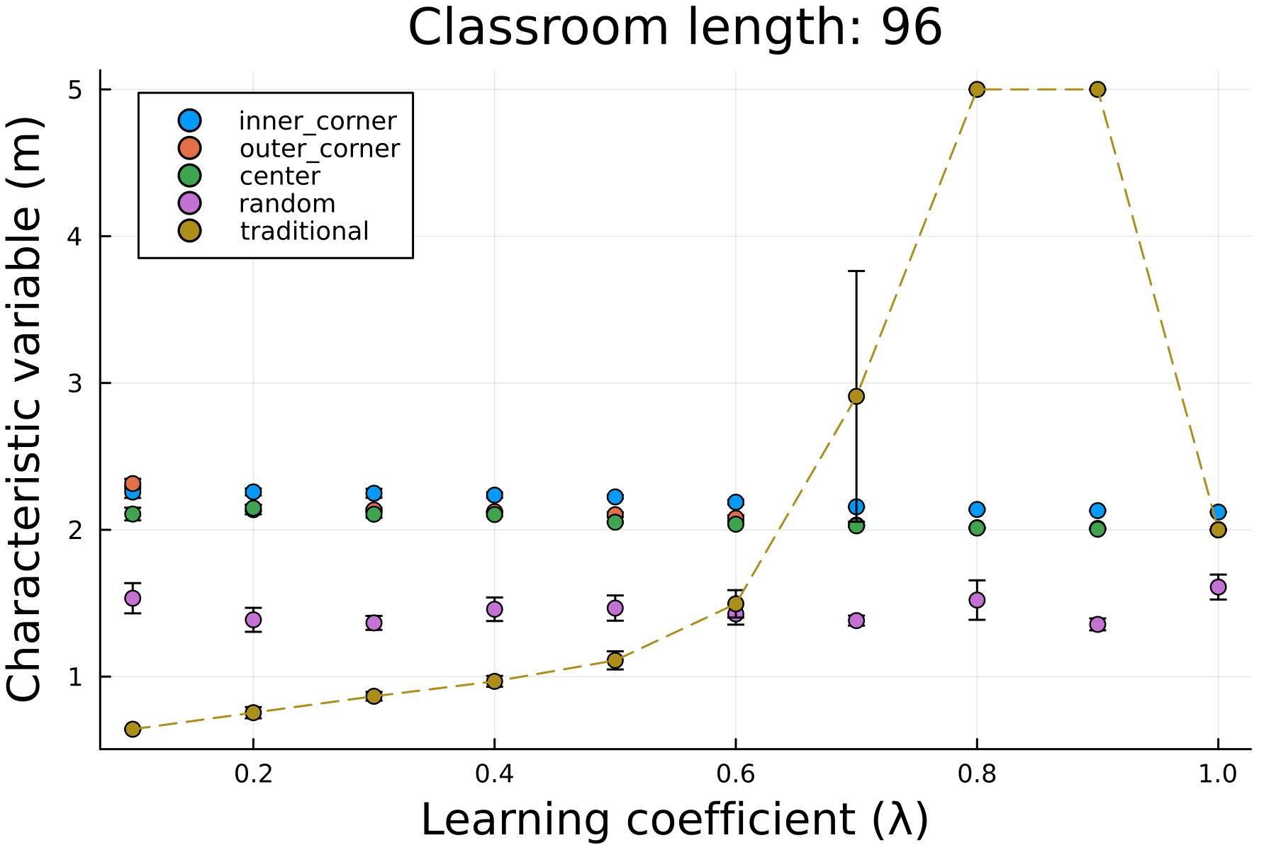


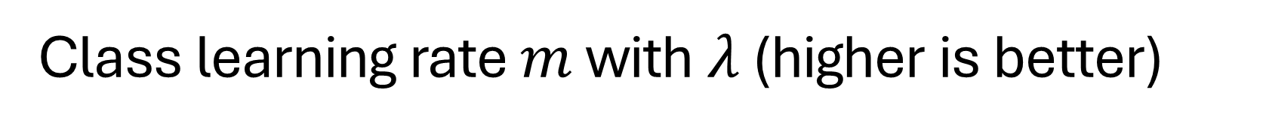

Class learning rate $m$ with $λ$ (higher is better)
Learning rate $(m)$
Learning rate $(m)$
For smaller learning coefficients $λ$, classrooms using PI have higher learning rates compared to their traditional counterparts

Slide 11
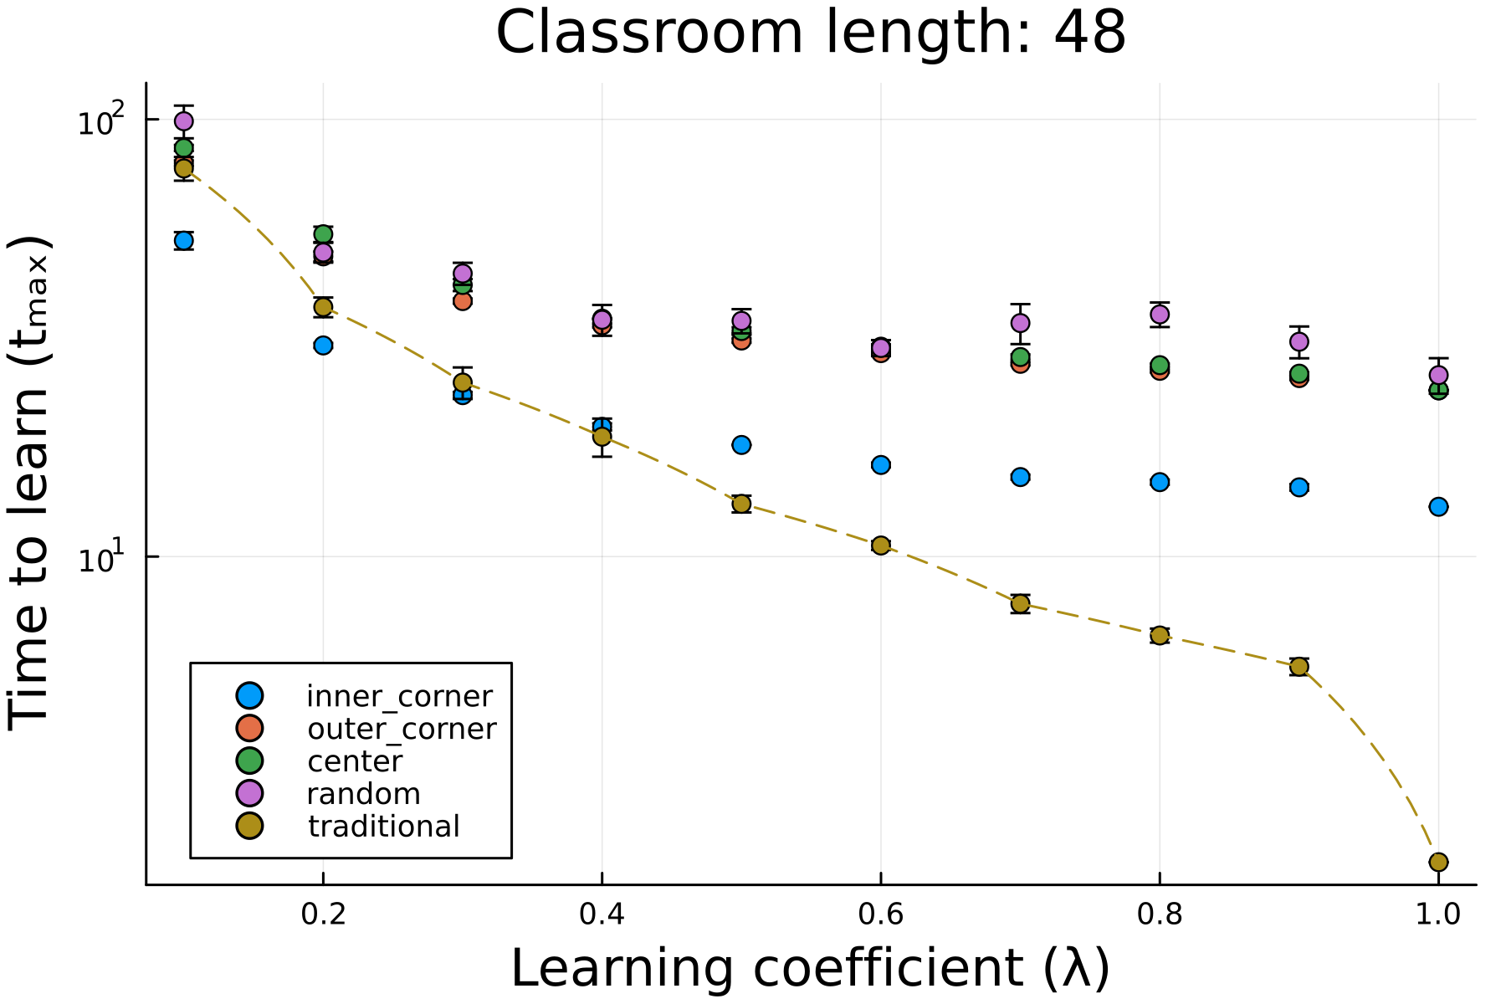
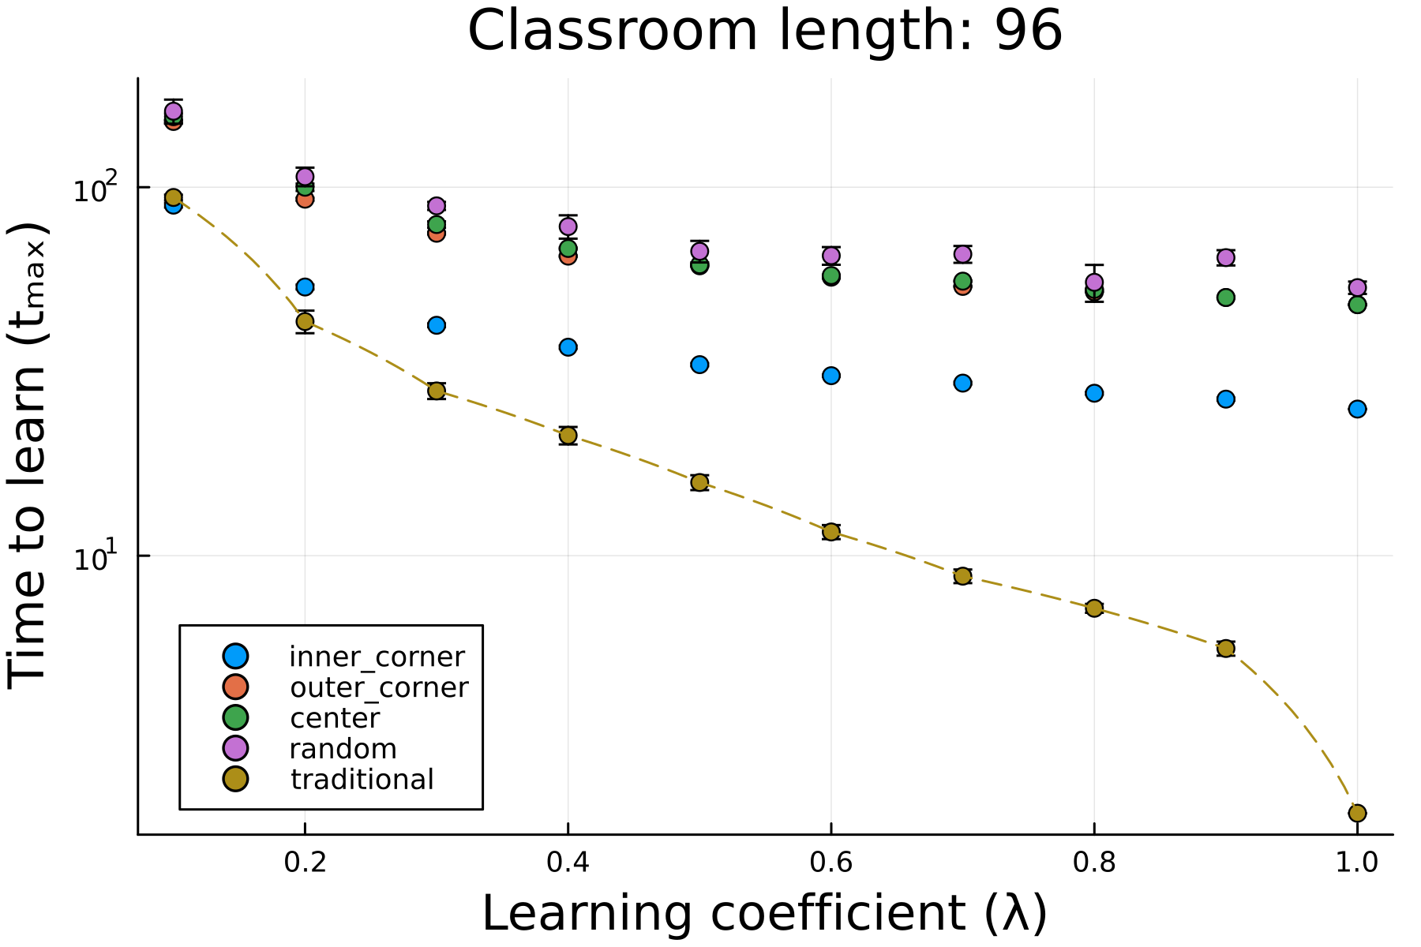
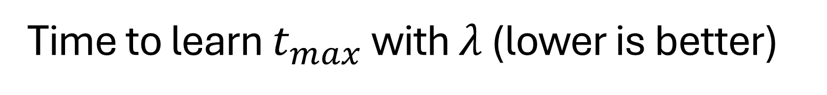
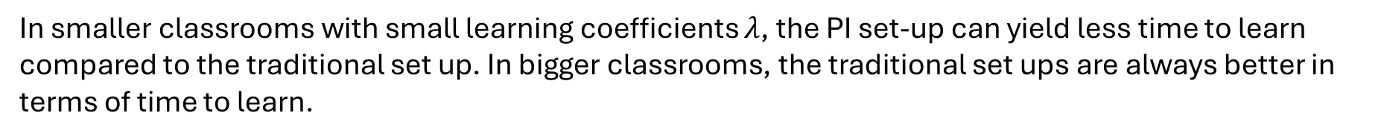
Time to learn $t_{max}$ with $λ$ (lower is better)
In smaller classrooms with small learning coefficients $λ$, the PI set-up can yield less time to learn compared to the traditional set up. In bigger classrooms, the traditional set ups are always better in terms of time to learn.

Slide 12
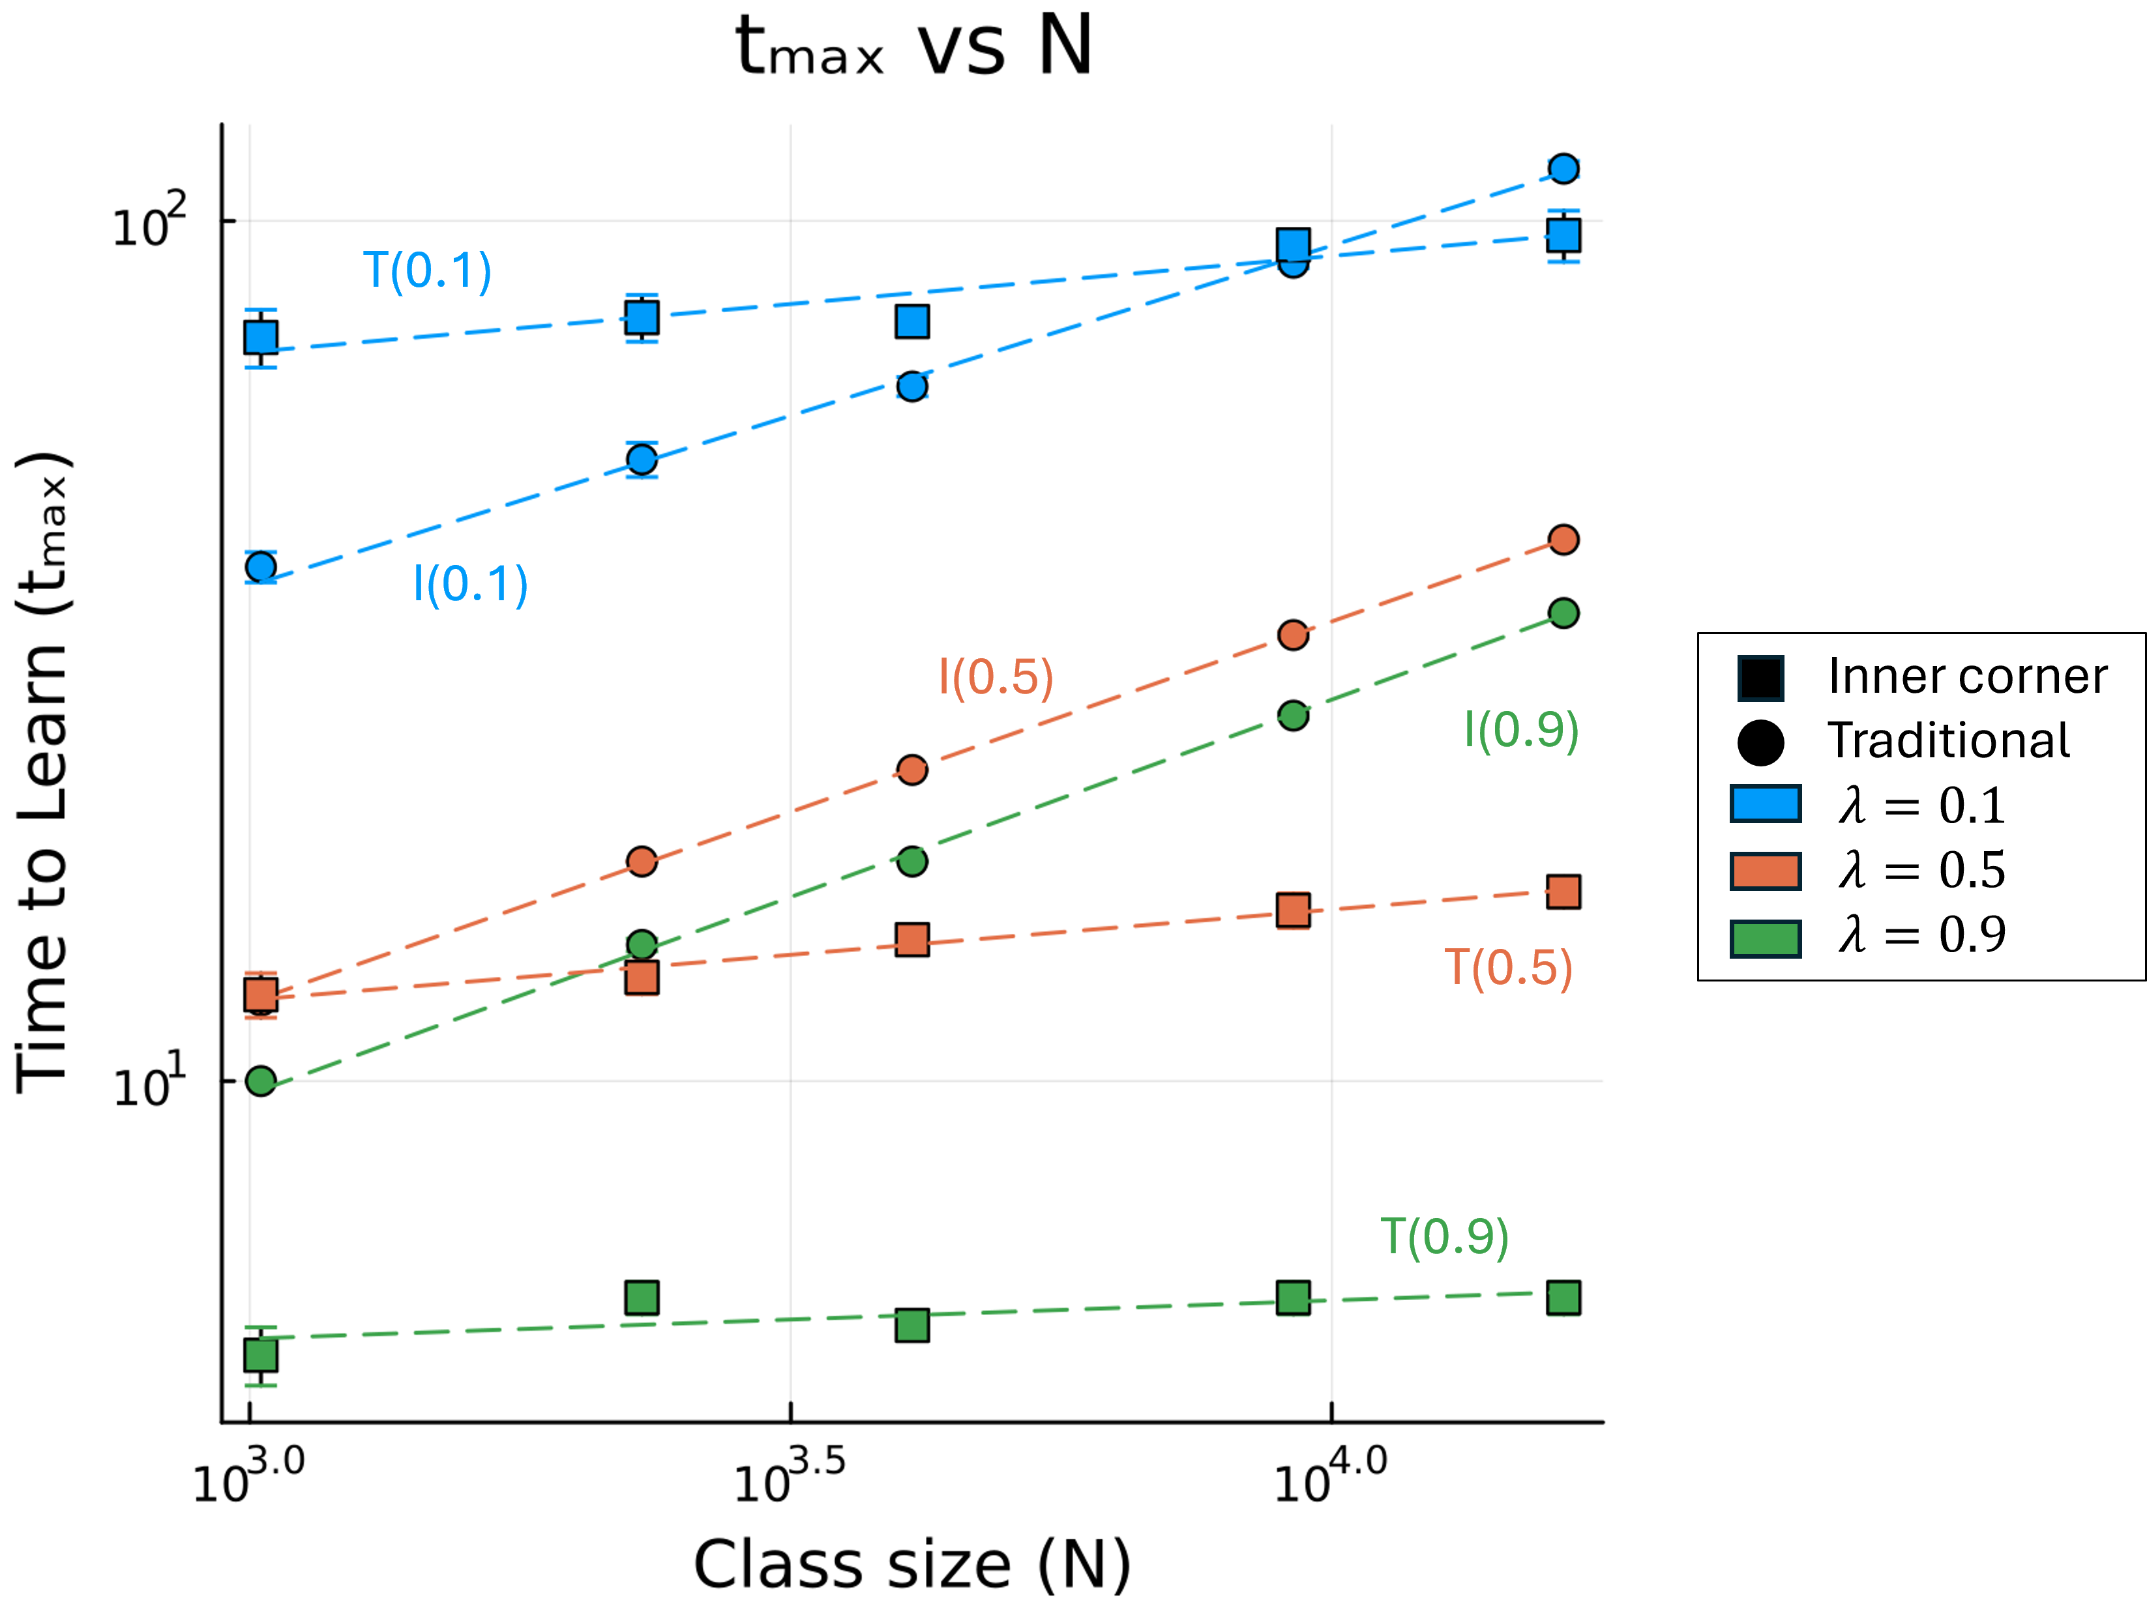
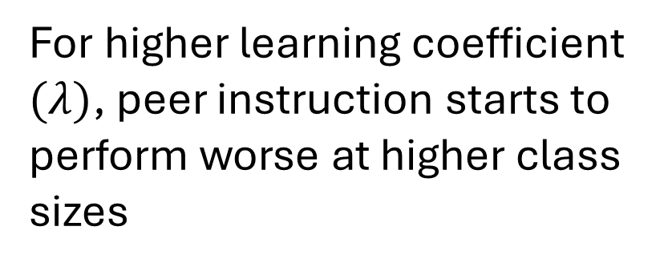
Time to learn $t_{max}$ with class size $N$ (PI vs. Traditional)
For higher learning coefficient $(λ)$, peer instruction starts to perform worse at higher class sizes
Traditional
PI (inner corner)

Slide 13
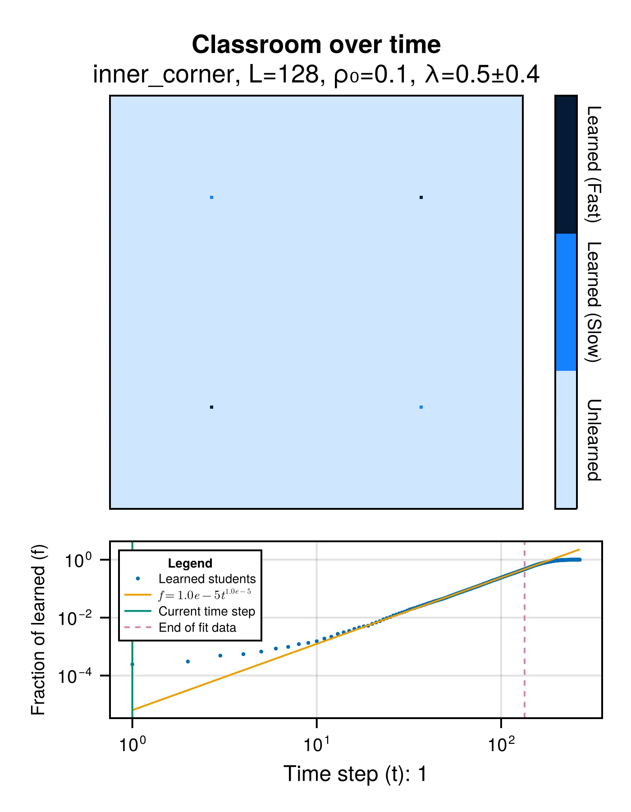
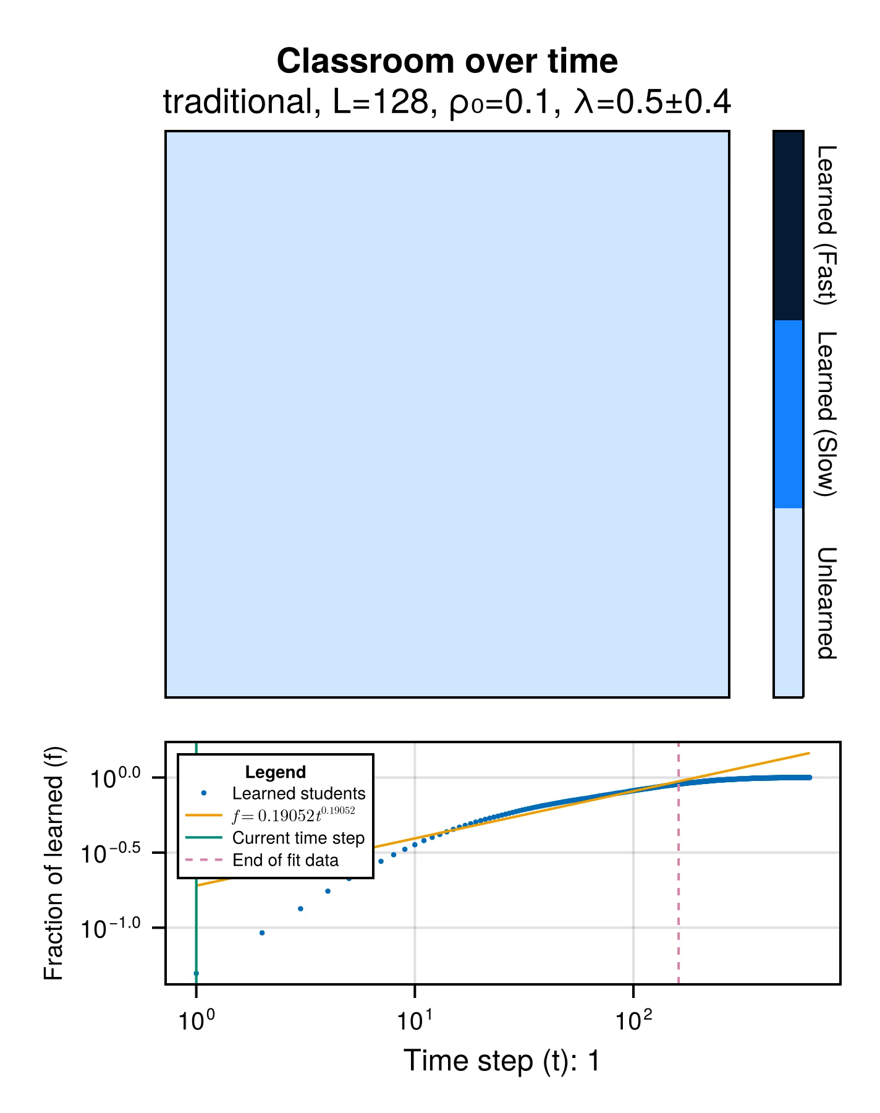


Heterogenous case

Slide 14
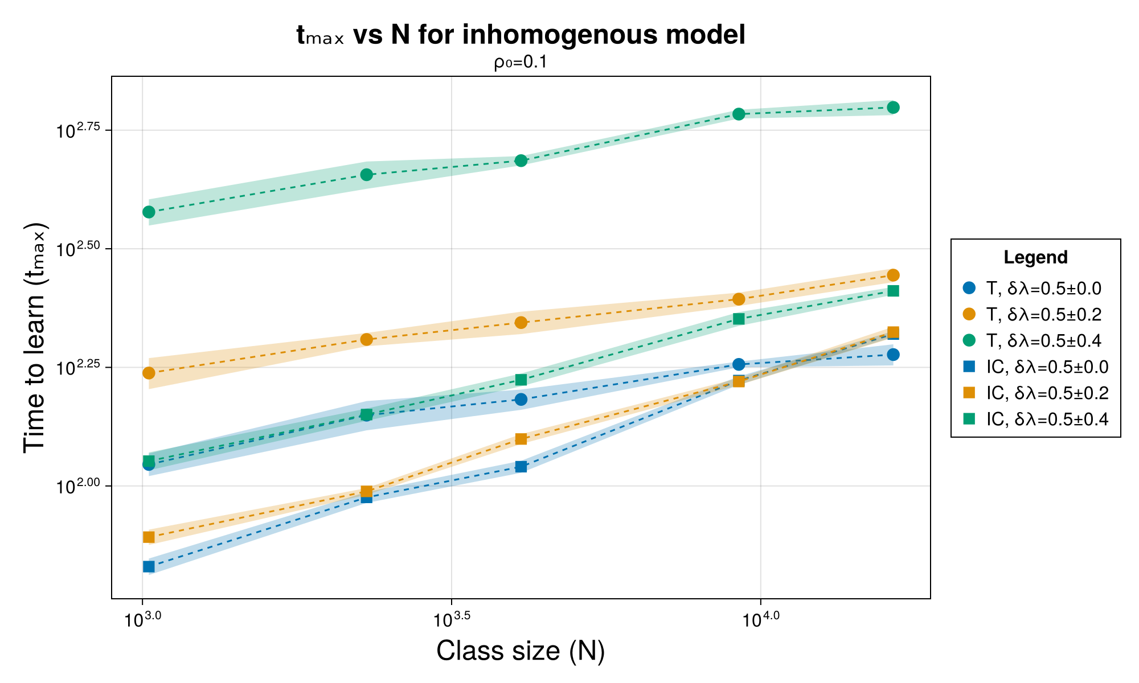
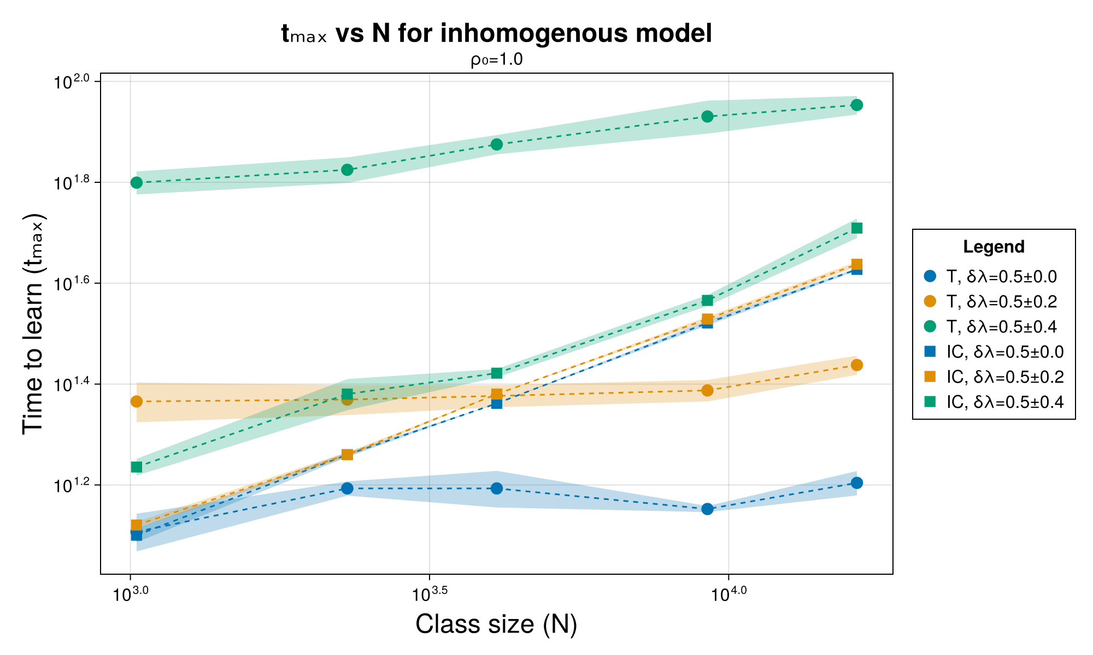

Time to learn ($t_{max}$) vs Class size ($N$)
Notes:
Similar trends with homogenous model – relatively flat trends for traditional, sloped trends for PI.
PI is better for smaller classrooms and slower students.

Slide 15
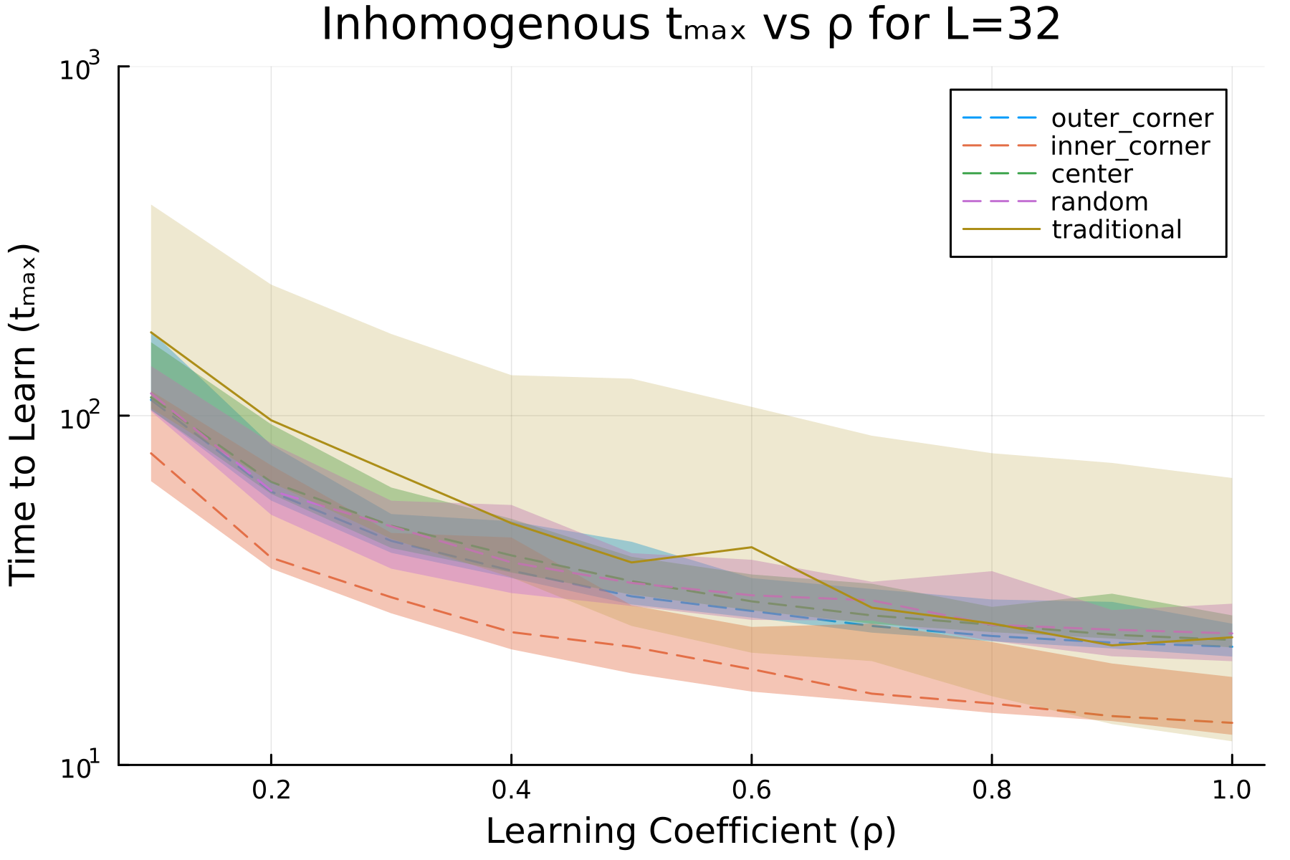
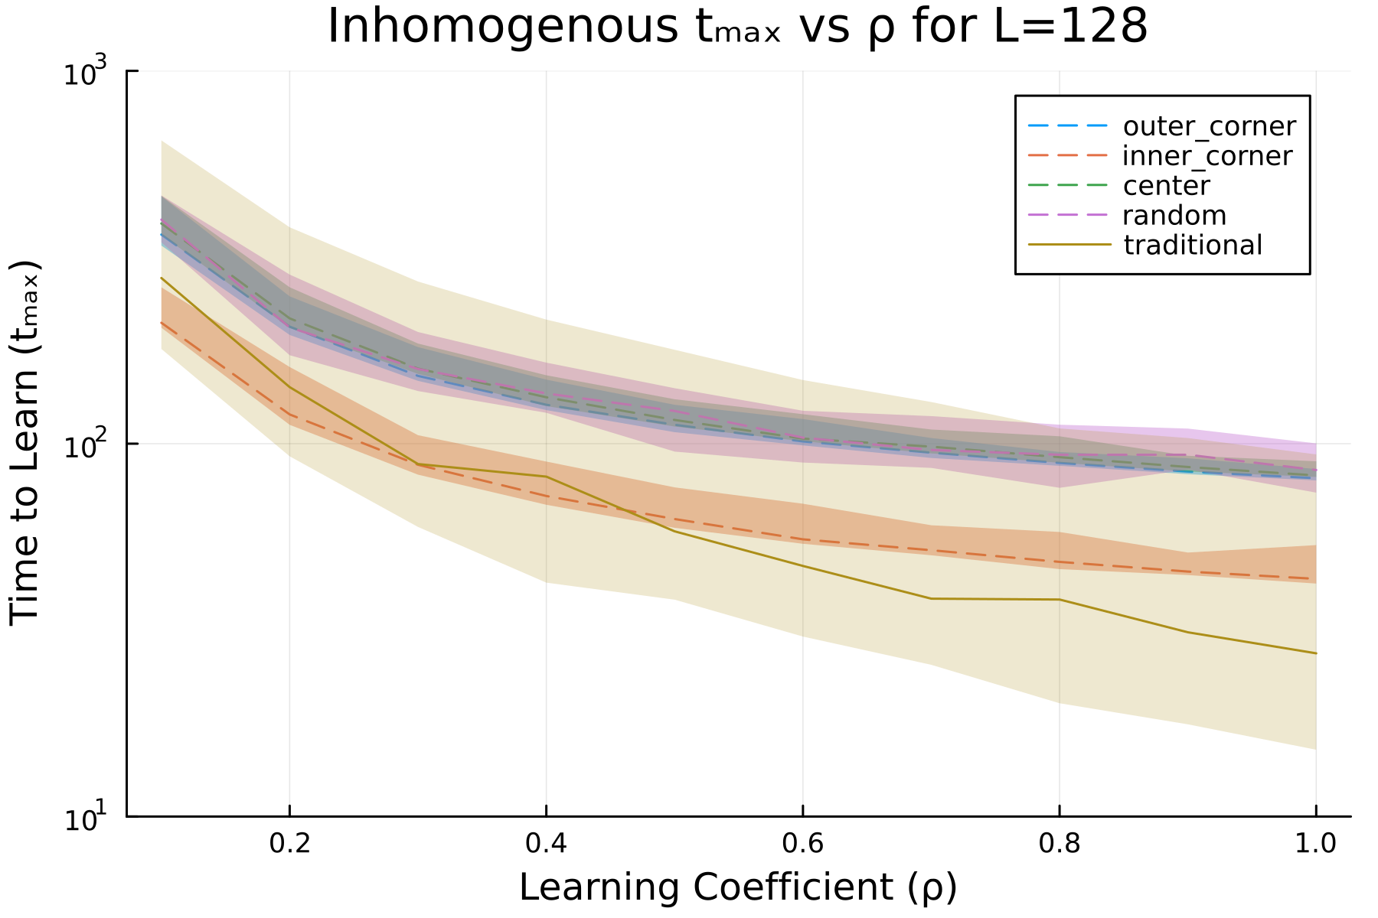
Time to learn ($t_{max}$) with learning coefficient ($ρ_{0}$)
Notes:
Trends are generally the same. Traditional is more affected by heterogeneity, hence better for homogenous classes.

Slide 16
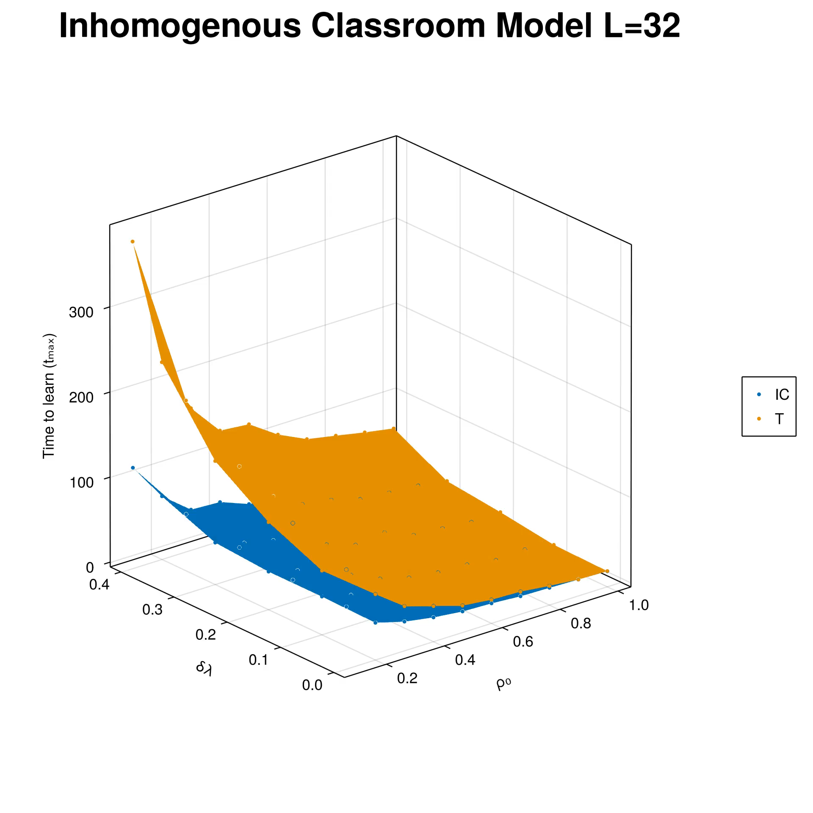
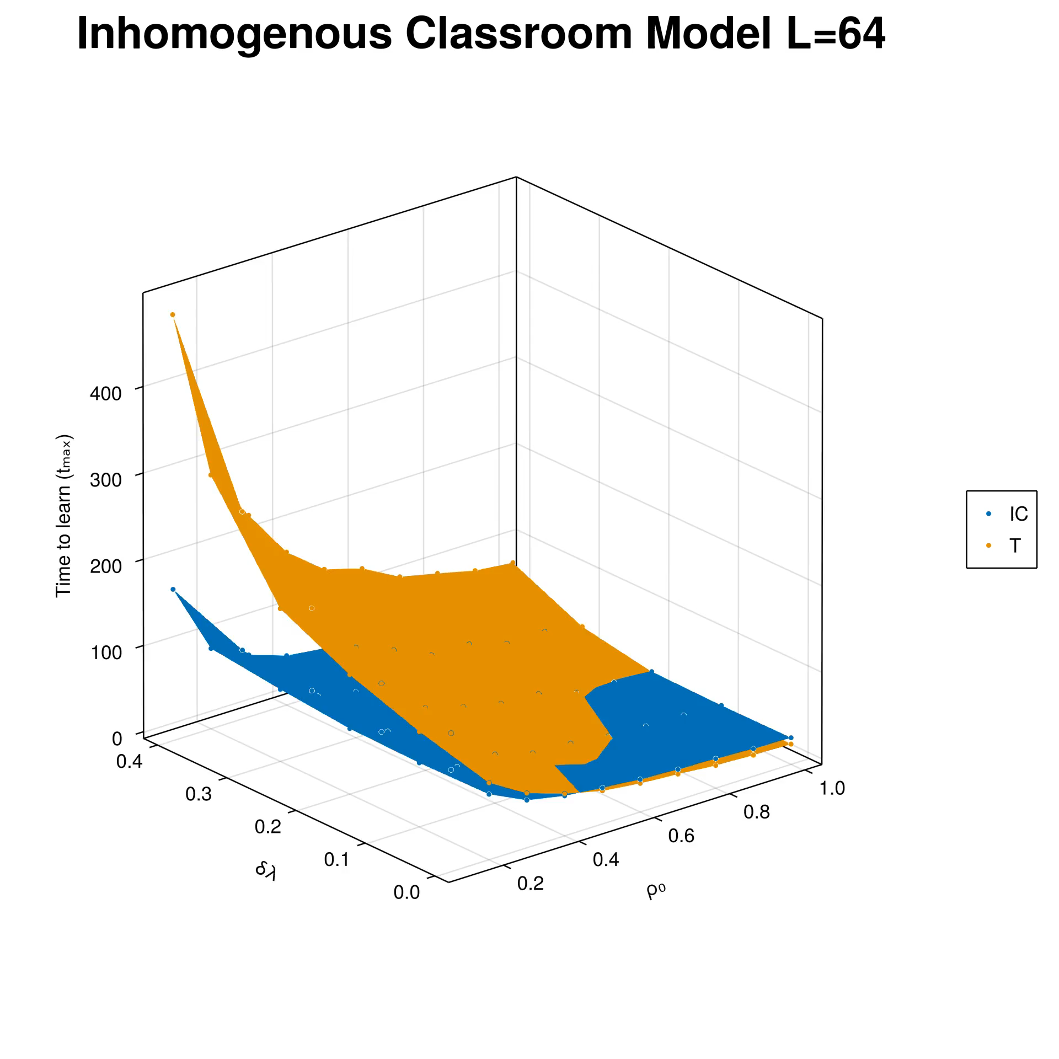
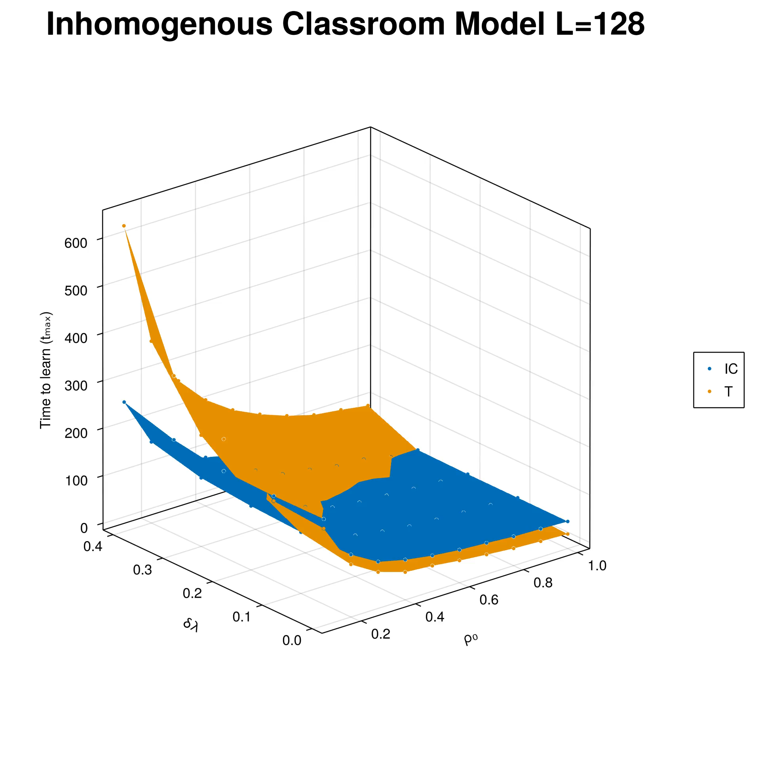
PI advantage can be very great
Notes:
Based on the different heterogeneity and positional learning coefficient, whenever PI is advantageous over traditional instruction, the advantage can be very large. In contrast, the advantage of traditional instruction over PI is generally smaller. Therefore, PI can serve as a safe option.

Slide 17

Conclusion: Traditional instruction
More sensitive to student learning rate heterogeneity.
Time to learn ($t_{max}$) dependent slow learners.
More students learn earlier compared to PI

Slide 18
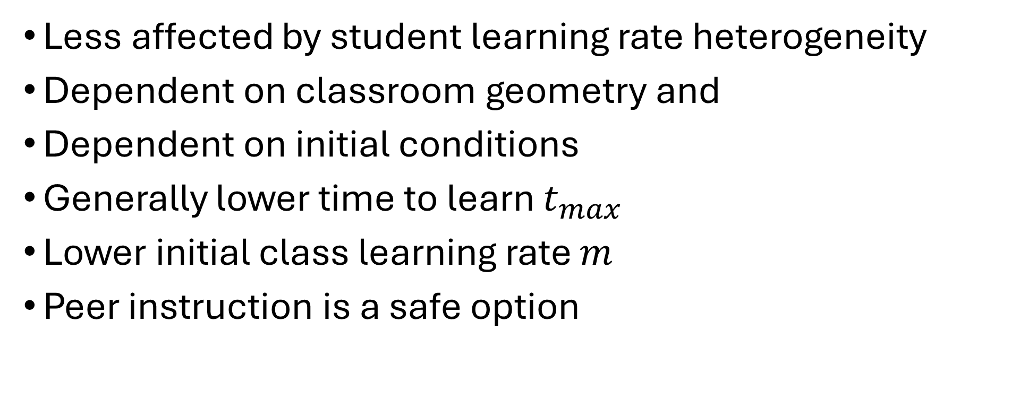
Conclusion: Peer Instruction
Less affected by student learning rate heterogeneity
Dependent on classroom geometry and
Dependent on initial conditions
Generally lower time to learn $t_{max}$
Lower initial class learning rate $m$
Peer instruction is a safe option
Notes:
Re: safe option - the performance advantage of traditional over PI is not as pronounced as the performance advantage of PI over traditional.

Slide 19
To do
Finalize thesis manuscript
NIP poster and video abstract
Defend thesis
SPP2025?

Slide 20
Classroom learning dynamics using a cellular automata spatiotemporal model comparing peer instruction and traditional instruction
Instrumentation Physics Laboratory
AY 2024-2025 1st Sem Progress Report
November 4, 2024
Sy, Clarence Ioakim T.
BS4+ Applied Physics
Adviser: Dr. Johnrob Bantang
Complexity Science Group

Slide 21
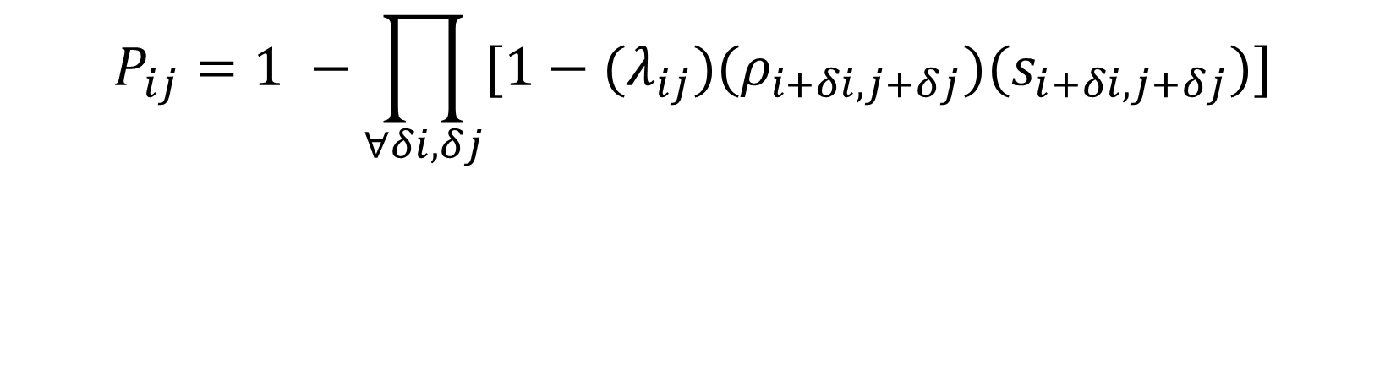
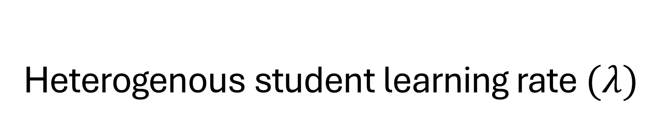
Heterogenous student learning rate $(λ)$
$$P_{ij}=1 −\prod_{∀δi,δj}{[1−{(λ}_{ij})(ρ_{i+δi, j+δj})(s_{i+δi, j+δj})]}$$
$λ_{ij}=λ_{0}$ $λ_{0}∈\{0.1, 0.2, …0.9, 1.0\}$

Slide 22
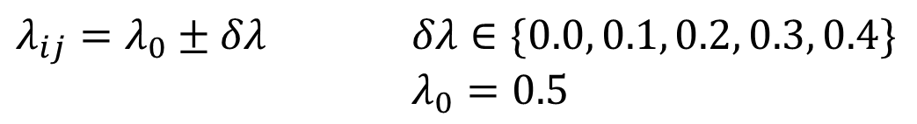
Heterogenous student learning rate $(λ)$
$$P_{ij}=1 −\prod_{∀δi,δj}{[1−{(λ}_{ij})(ρ_{i+δi, j+δj})(s_{i+δi, j+δj})]}$$
$λ_{ij}=λ_{0}±δλ$ $δλ∈\{0.0, 0.1, 0.2, 0.3, 0.4\}$
$λ_{0}=0.5$

Slide 23
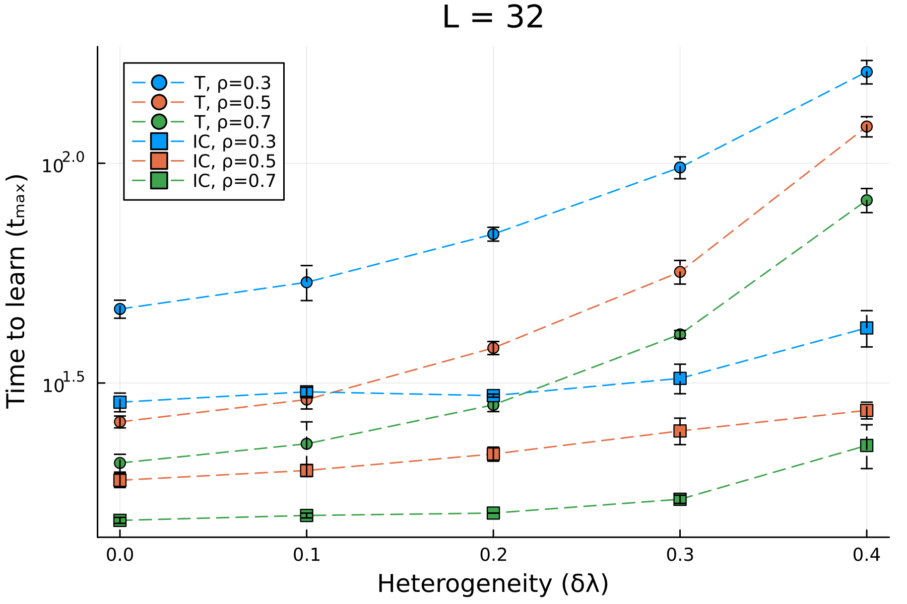
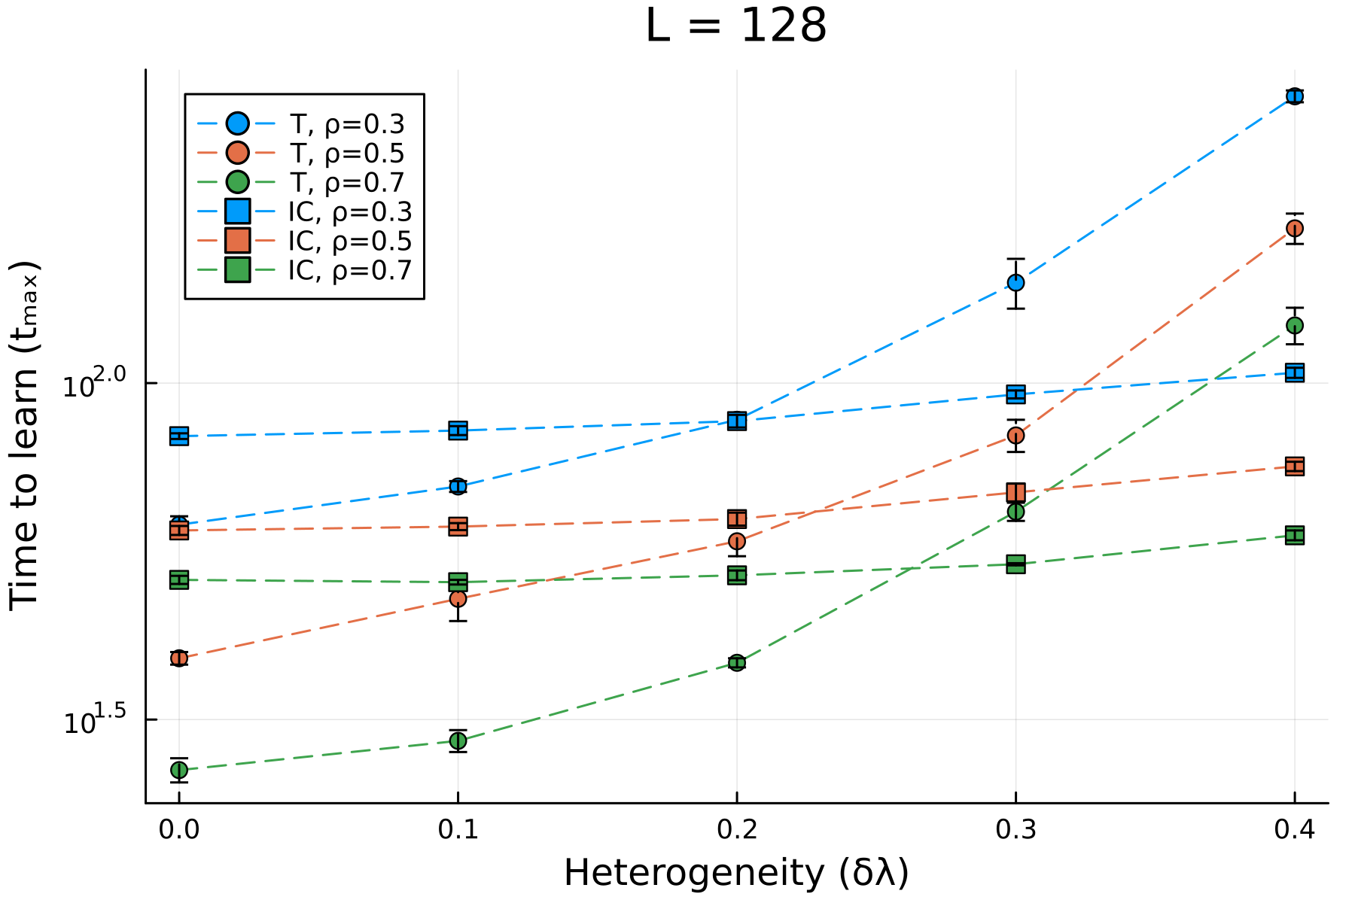
Time to learn ($t_{max}$) with learning coefficient ($ρ_{0}$)

