Slide 1
Learning dynamics in a cellular automata model of classroom peer-to-peer interactions
SPP-2024-1E-04
42nd Samahang Pisika ng Pilipinas Physics Conference
Batangas State University, Batangas City
03 July 2024
Clarence Ioakim T. Sy*, Reinier Xander A. Ramos and Johnrob Y. Bantang
Instrumentation Physics Laboratory
National Institute of Physics
University of the Philippines Diliman
*ctsy@up.edu.ph

Slide 2
Traditional instruction vs peer instruction
Traditional instruction | Peer instruction
The teacher delivers a lecture to the whole class for the duration of the class time. | Students are given the chance to learn from each other during class time after an initial lecture by the teacher.

Slide 3
Advantages of peer instruction (PI)
Improve students’ conceptual understanding and problem-solving skills compared to traditional instruction
Benefit groups even if no one in it initially knew the answer
Students with less background knowledge learn as much as students with more background knowledge (vs traditional instruction)

Slide 4
Research questions
How does the number of learned students develop over time?
Spatial position of high aptitude students in class
How does the positioning of learned students affect the learning rate of the class for peer instruction?
Learning rate
Traditional vs peer instruction
When is peer instruction better than traditional instruction?
Which factors lead to a difference in performance?

Slide 5
The classroom as a binary probabilistic CA model
The classroom is set to be a 2D square grid of varying lengths.
Students are either learned or not learned.
Simulations are initialized with 4 different seating arrangements (SA): inner corner, outer corner, center, random.
The simulation is considered done when all students are learned.

Slide 6
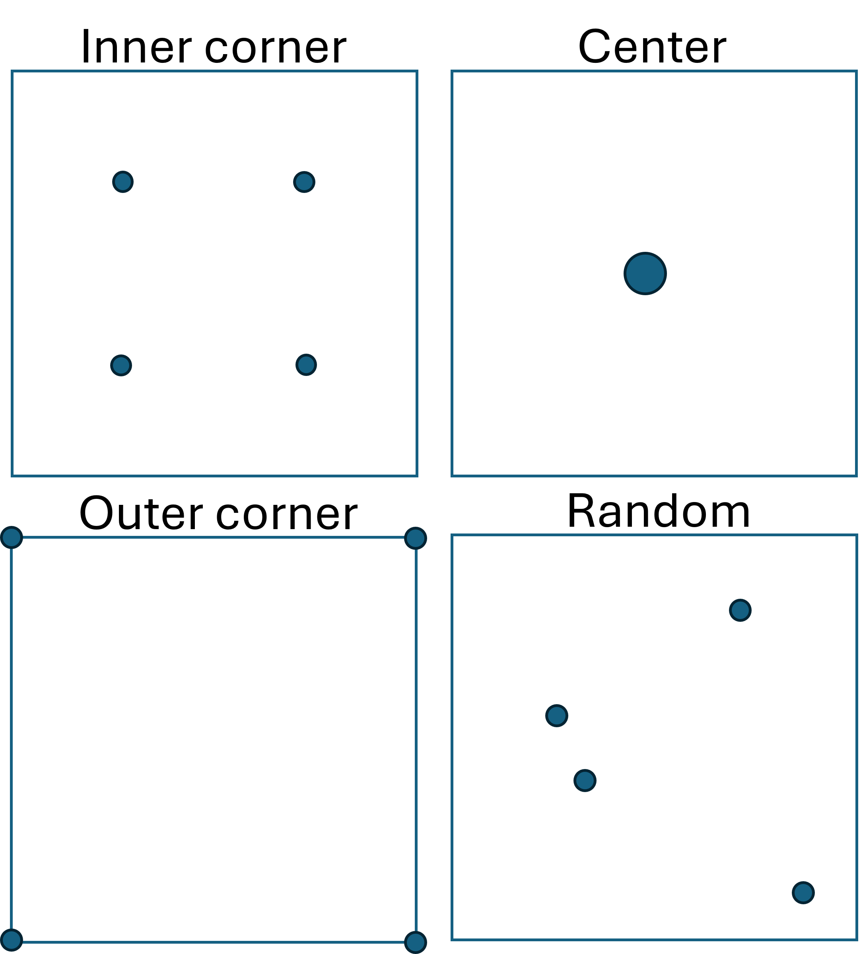
Different PI seating arrangements
- Circles indicate location of learned students

Slide 7
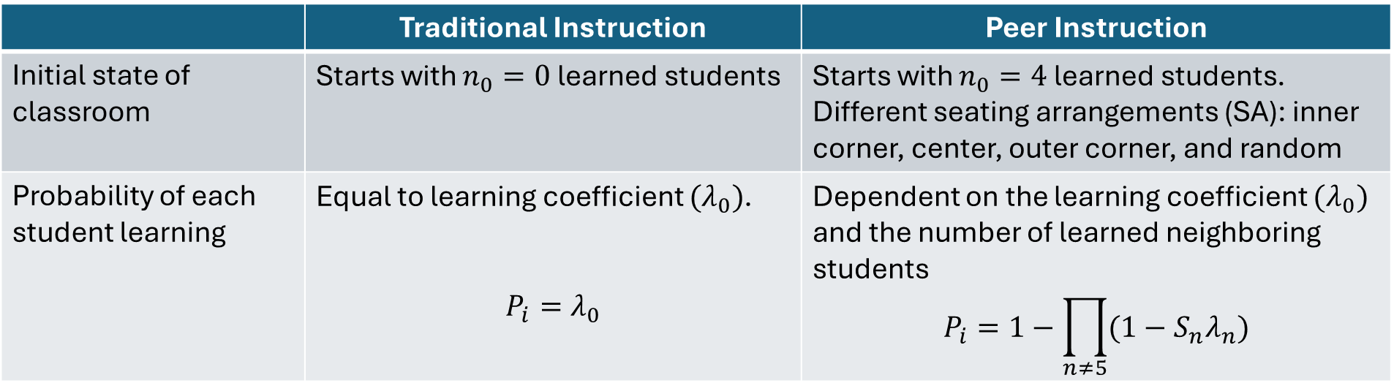
PCA rules for classroom simulation
 | Traditional Instruction | Peer Instruction
Initial state of classroom | Starts with $n_{0}=0$ learned students | Starts with $n_{0}=4$ learned students. Different seating arrangements (SA): inner corner, center, outer corner, and random
Probability of each student learning | Equal to learning coefficient $(λ_{0})$. $$P_{i}=λ_{0}$$ | Dependent on the learning coefficient $(λ_{0})$ and the number of learned neighboring students $$P_{i}=1−\prod_{n≠5}{(1−S_{n}λ_{n})}$$

Slide 8
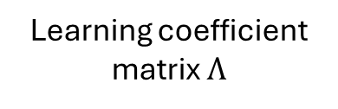
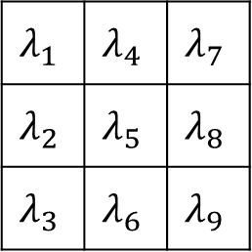
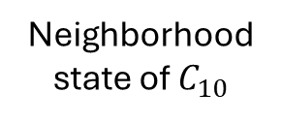
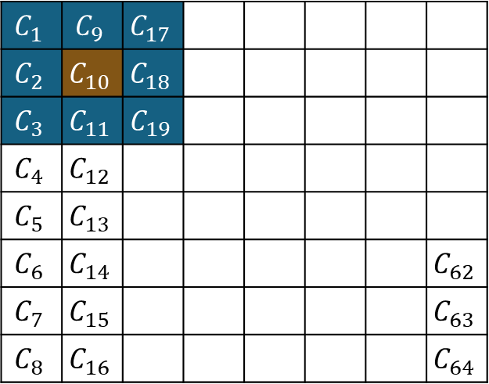

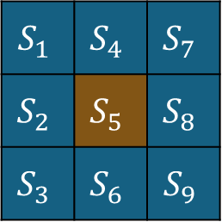
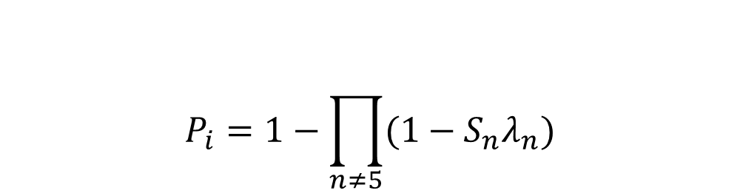
Determining learning probability per time step
$$S_{1}$$ | $$S_{4}$$ | $$S_{7}$$
$$S_{2}$$ | $$S_{5}$$ | $$S_{8}$$
$$S_{3}$$ | $$S_{6}$$ | $$S_{9}$$
$$λ_{1}$$ | $$λ_{4}$$ | $$λ_{7}$$
$$λ_{2}$$ | $$λ_{5}$$ | $$λ_{8}$$
$$λ_{3}$$ | $$λ_{6}$$ | $$λ_{9}$$
$$C_{1}$$ | $$C_{9}$$ | $$C_{17}$$
$$C_{2}$$ | $$C_{10}$$ | $$C_{18}$$
$$C_{3}$$ | $$C_{11}$$ | $$C_{19}$$
$$C_{4}$$ | $$C_{12}$$
$$C_{5}$$ | $$C_{13}$$
$$C_{6}$$ | $$C_{14}$$ |  |  |  |  |  | $$C_{62}$$
$$C_{7}$$ | $$C_{15}$$ |  |  |  |  |  | $$C_{63}$$
$$C_{8}$$ | $$C_{16}$$ |  |  |  |  |  | $$C_{64}$$
$$⊙$$
Neighborhood state of $C_{10}$
Learning coefficient matrix $Λ$
$$P_{i}=1−\prod_{n≠5}{(1−S_{n}λ_{n})}$$
Learning probability:
Classroom represented as lattice of cells

Slide 9



Sample progression of states
$$t=0$$
$$t=1$$
$$t=2$$
Previously learned students
Newly learned students

Slide 10
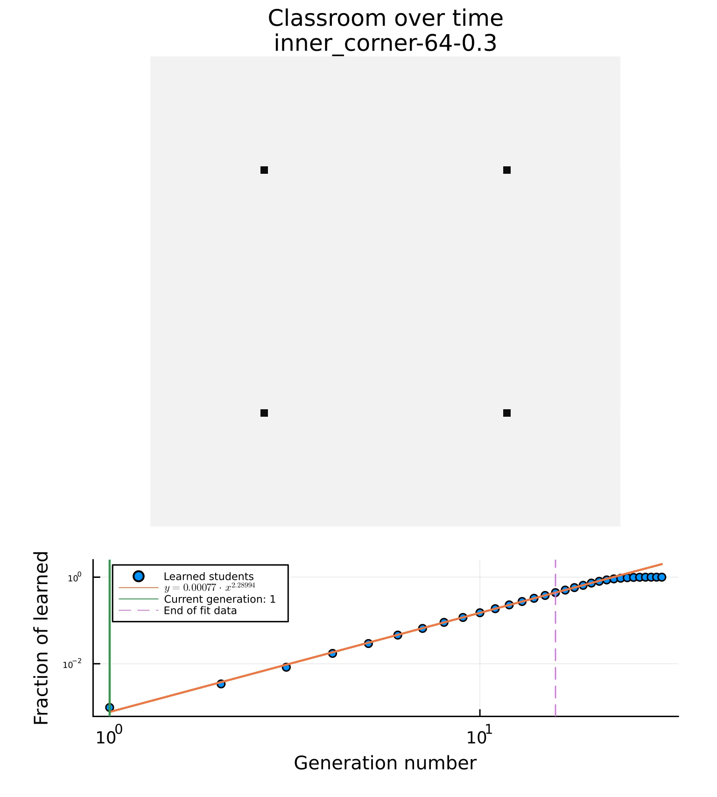
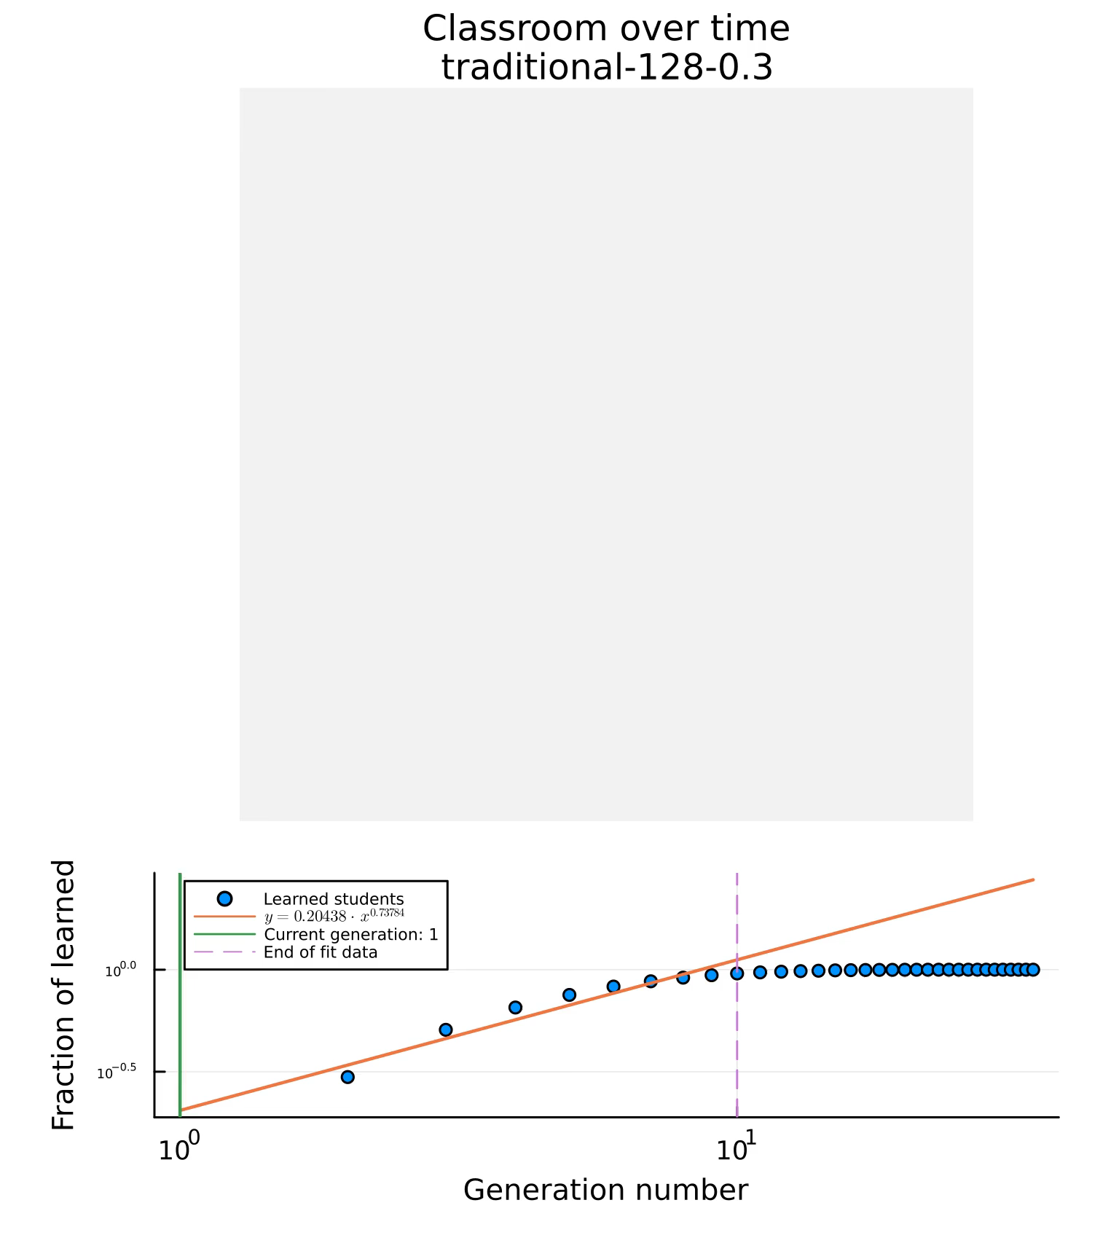

Learning rate $(m)$:
$fraction of learned=at^{m}$
Time to learn $(t_{max})$
Number of time steps for all students to learn
Time step
Time step

Slide 11
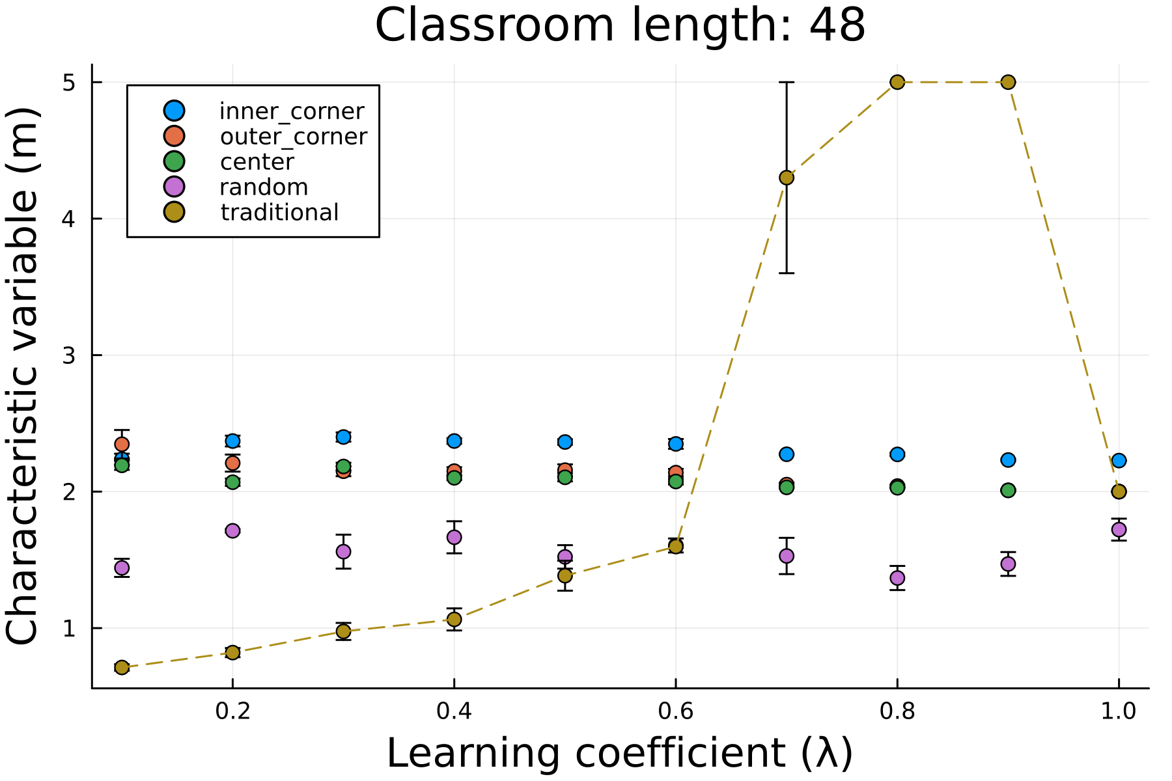
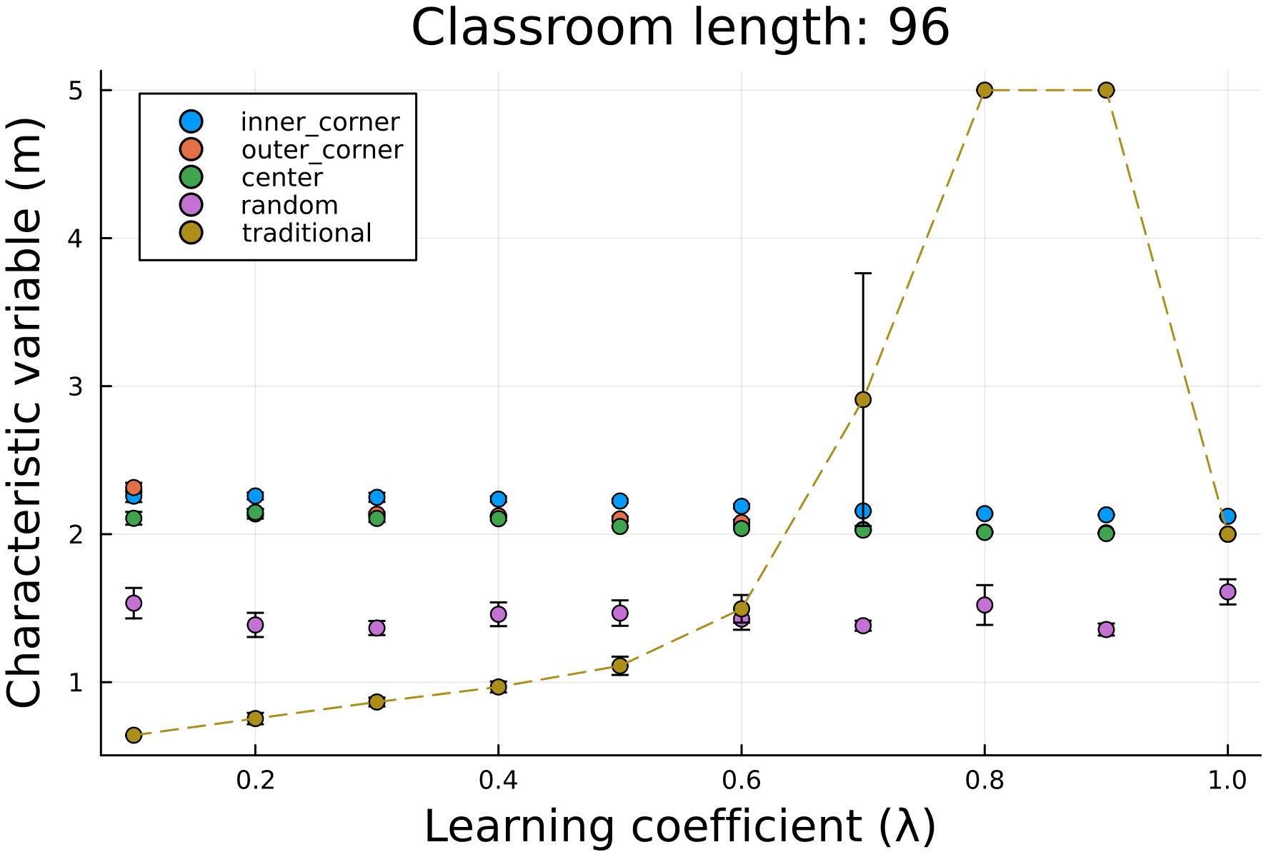

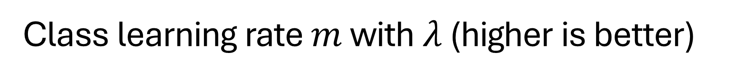

Class learning rate $m$ with $λ$ (higher is better)
Learning rate $(m)$
Learning rate $(m)$
For smaller learning coefficients $λ$, classrooms using PI have higher learning rates compared to their traditional counterparts

Slide 12
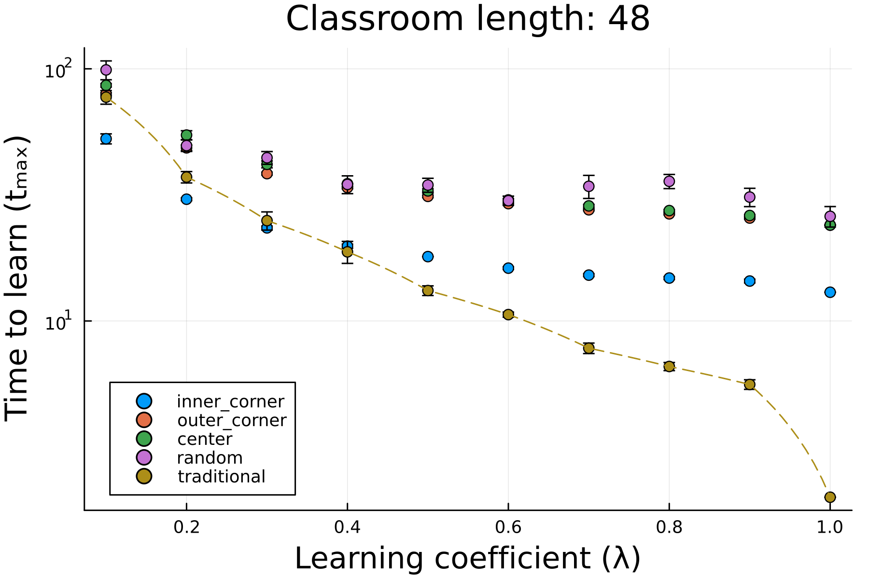
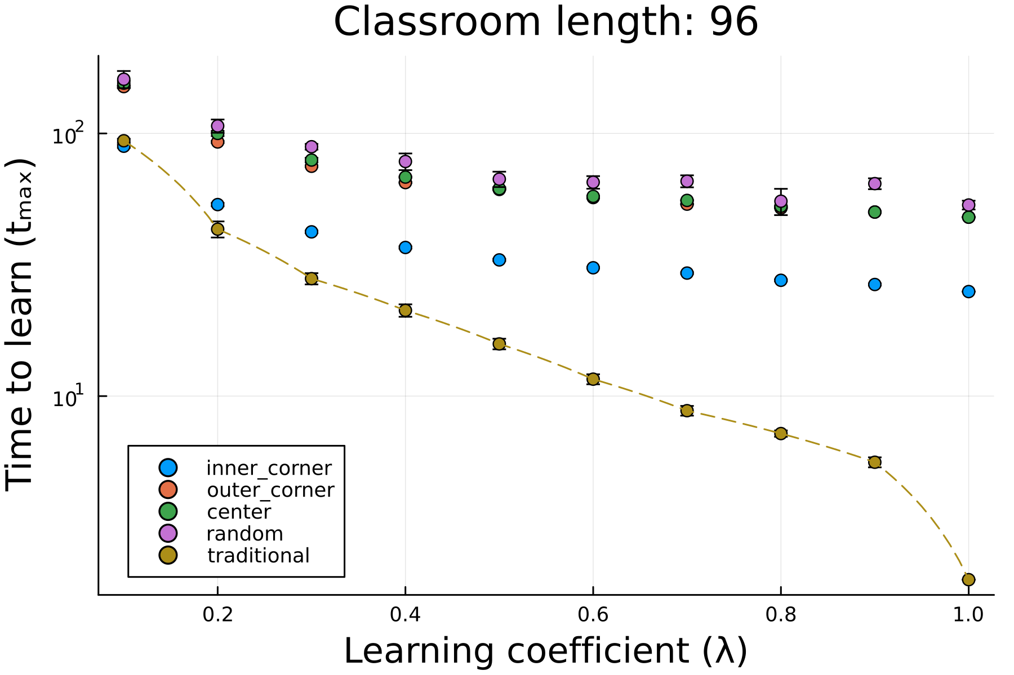
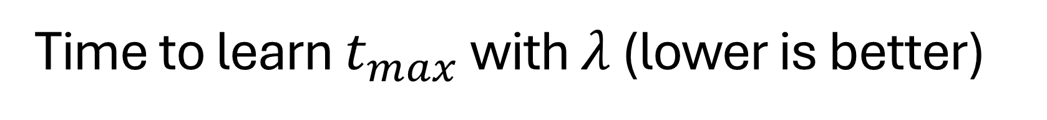
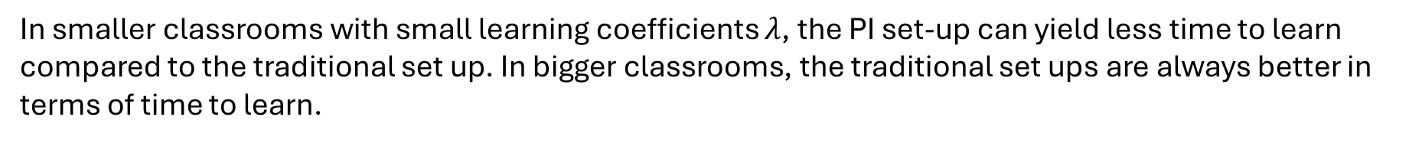
Time to learn $t_{max}$ with $λ$ (lower is better)
In smaller classrooms with small learning coefficients $λ$, the PI set-up can yield less time to learn compared to the traditional set up. In bigger classrooms, the traditional set ups are always better in terms of time to learn.

Slide 13
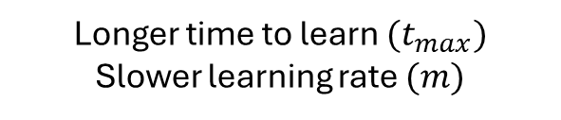

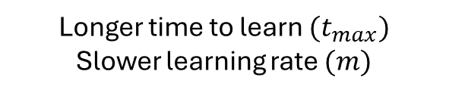
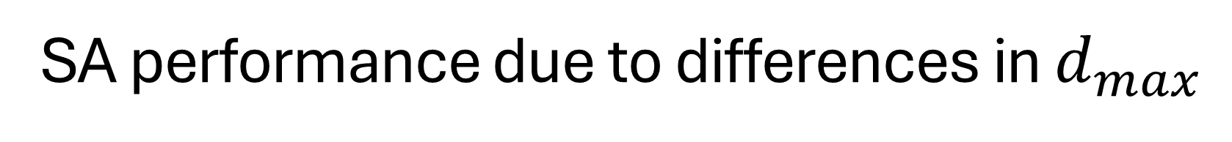
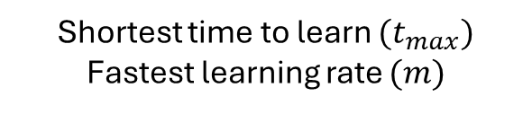


SA performance due to differences in $d_{max}$
Inner corner
Center
Outer corner
$$d_{max}=\frac{L⋅\sqrt{2}}{4}$$
$$d_{max}=\frac{L⋅\sqrt{2}}{2}$$
$$d_{max}=\frac{L⋅\sqrt{2}}{2}$$
Shortest time to learn $(t_{max})$ Fastest learning rate $(m)$
Longer time to learn $(t_{max})$ Slower learning rate $(m)$
Longer time to learn $(t_{max})$ Slower learning rate $(m)$

Slide 14
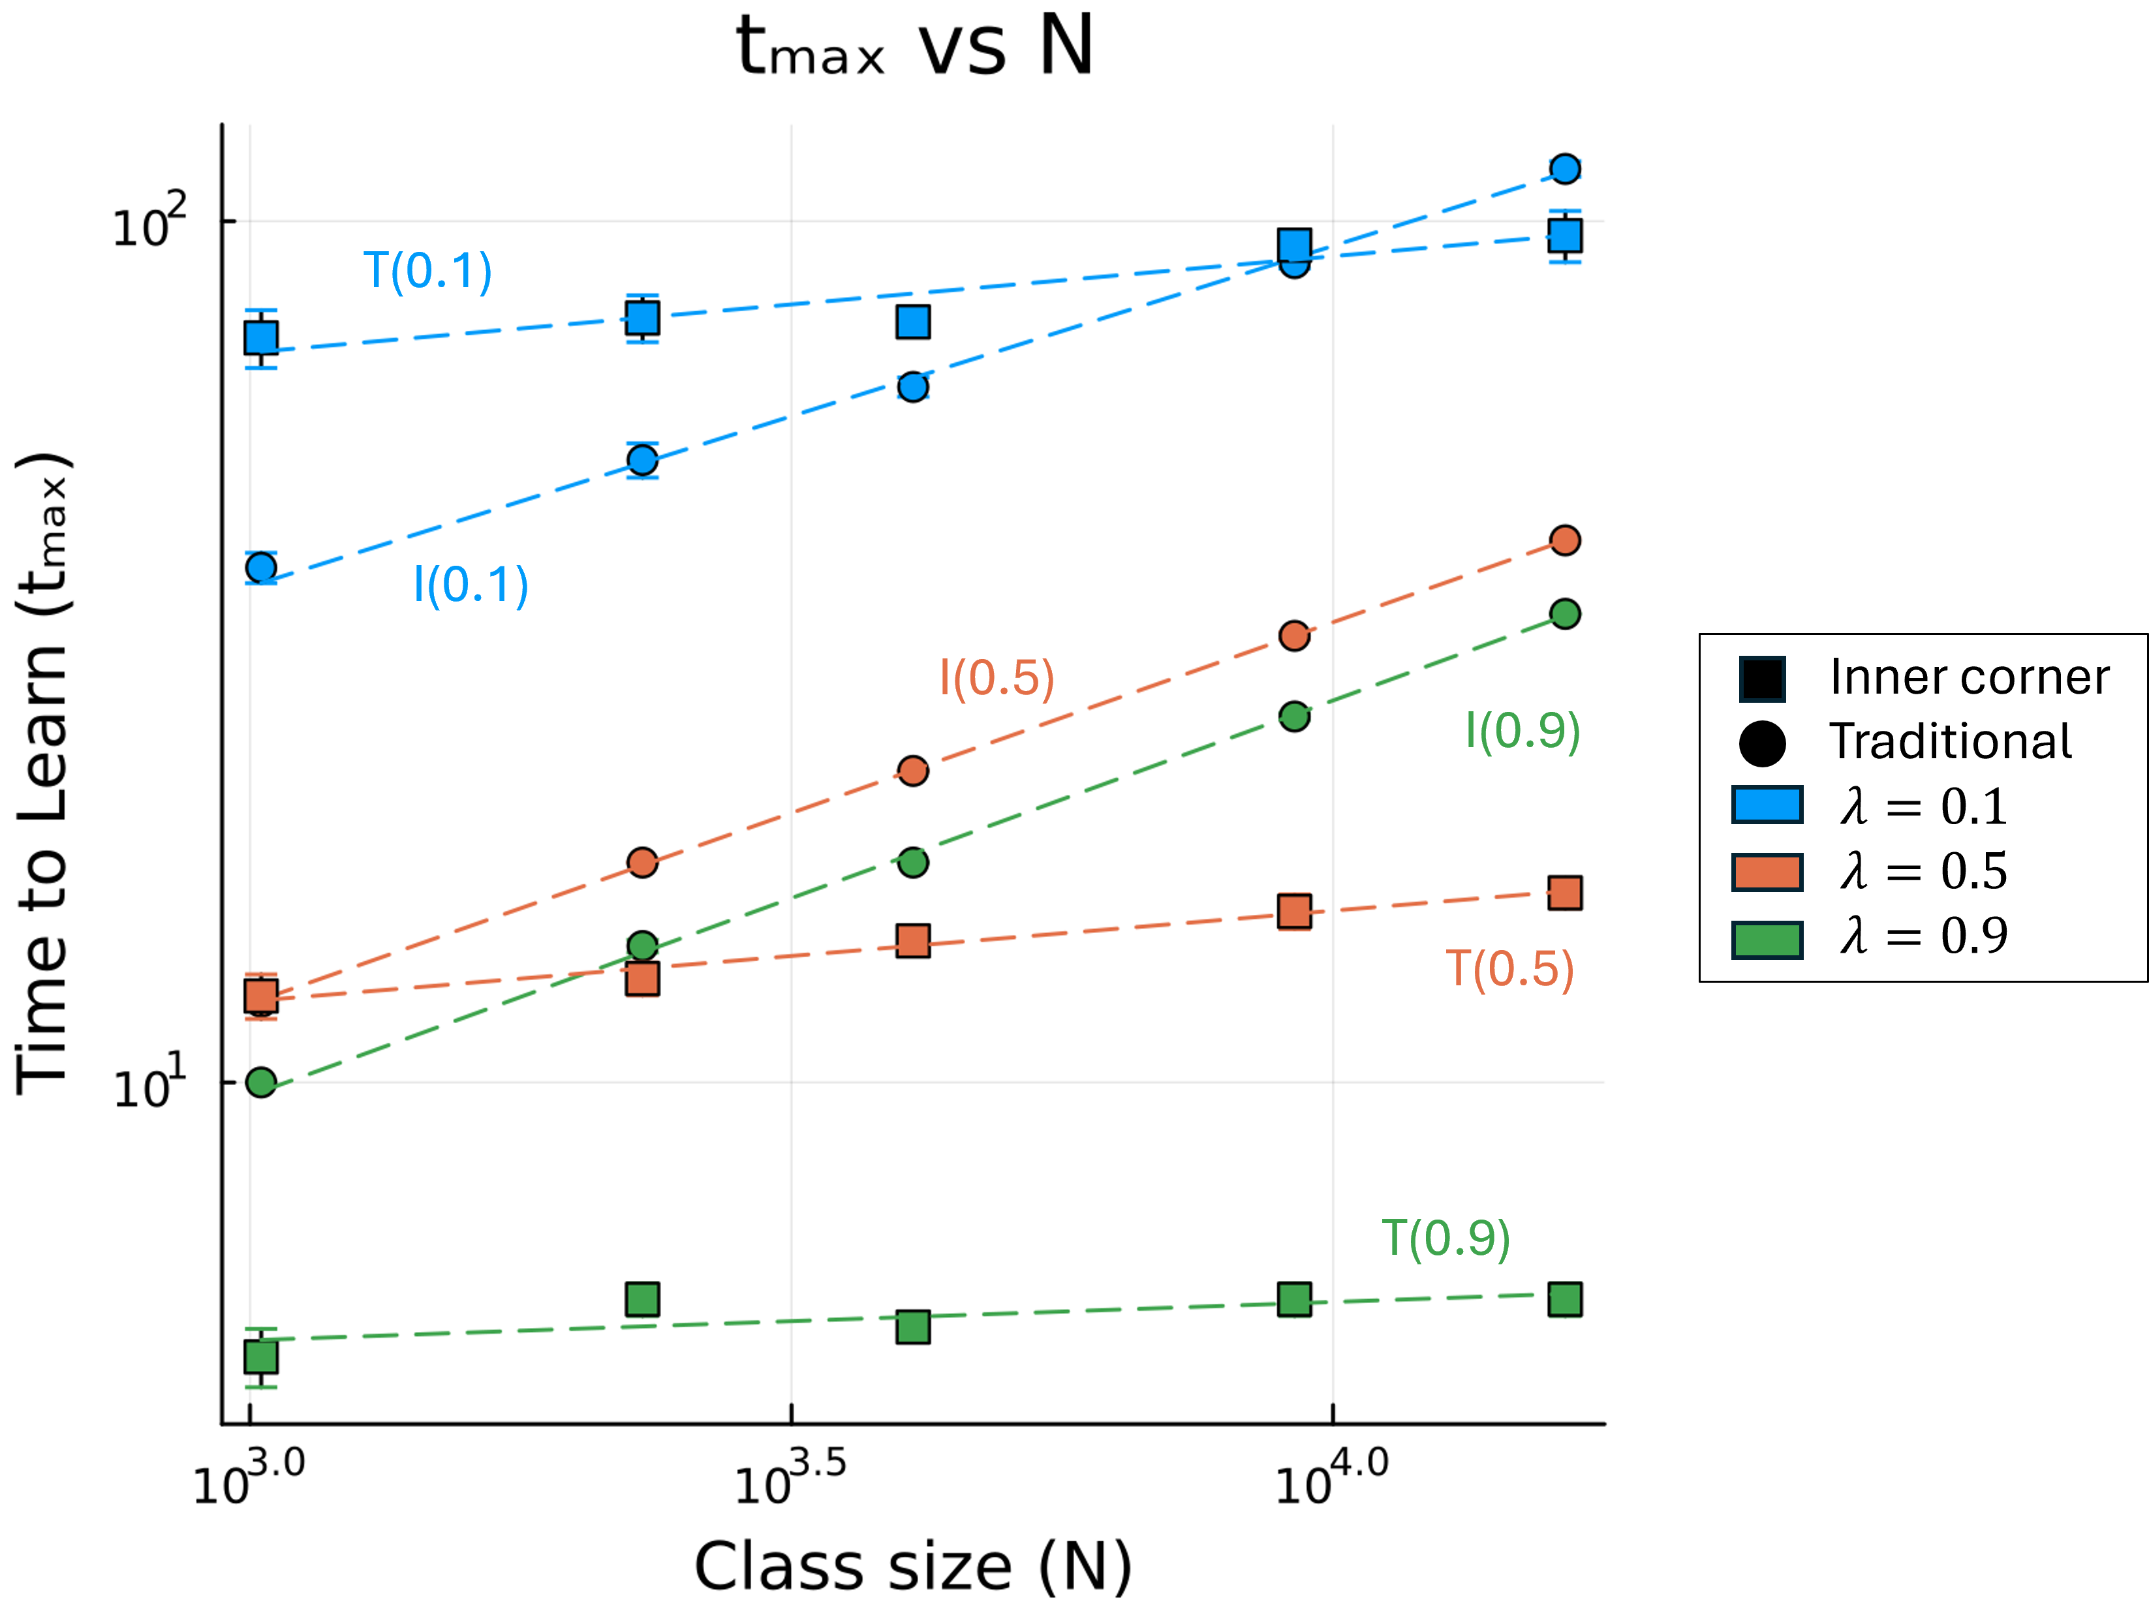
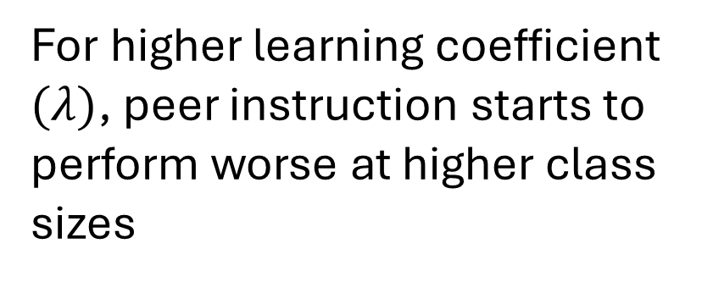
Time to learn $t_{max}$ with $N$ (PI vs. Traditional)
For higher learning coefficient $(λ)$, peer instruction starts to perform worse at higher class sizes
Traditional
PI (inner corner)

Slide 15
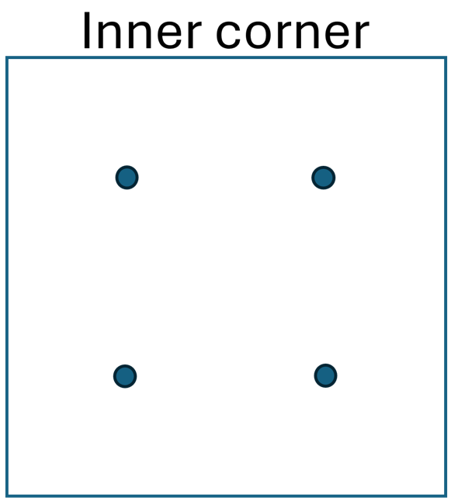
Conclusion
Traditional instruction is more scalable and is less dependent on class size.
Peer instruction (PI) performs better than traditional instruction for smaller classrooms with slow learners.
Among peer instruction seating arrangements (SA), the inner corner SA performs the best.
Similar findings with previous research: Students with less background knowledge learned as much with PI compared to students with more background knowledge with traditional instruction.

Slide 16
Learning dynamics in a cellular automata model of classroom peer-to-peer interactions
SPP-2024-1E-04
42nd Samahang Pisika ng Pilipinas Physics Conference
Batangas State University, Batangas City
03 July 2024
Thank you for listening!
Clarence Ioakim T. Sy*, Reinier Xander A. Ramos and Johnrob Y. Bantang
Instrumentation Physics Laboratory
National Institute of Physics
University of the Philippines Diliman
*ctsy@up.edu.ph

Slide 17

Derivation for learning probability
$$p+q=1$$
$$\prod_{∀e}{\left(p_{e}+q_{e}\right)}=1$$
$$\prod_{∀e}{\left(p_{e}\right)+…+\prod_{∀e}{\left(q_{e}\right)}=1}$$
$$P=1−\prod_{∀e}{\left(q_{e}\right)}=1−\prod_{∀e}{\left(1−p_{e}\right)}$$

Slide 18
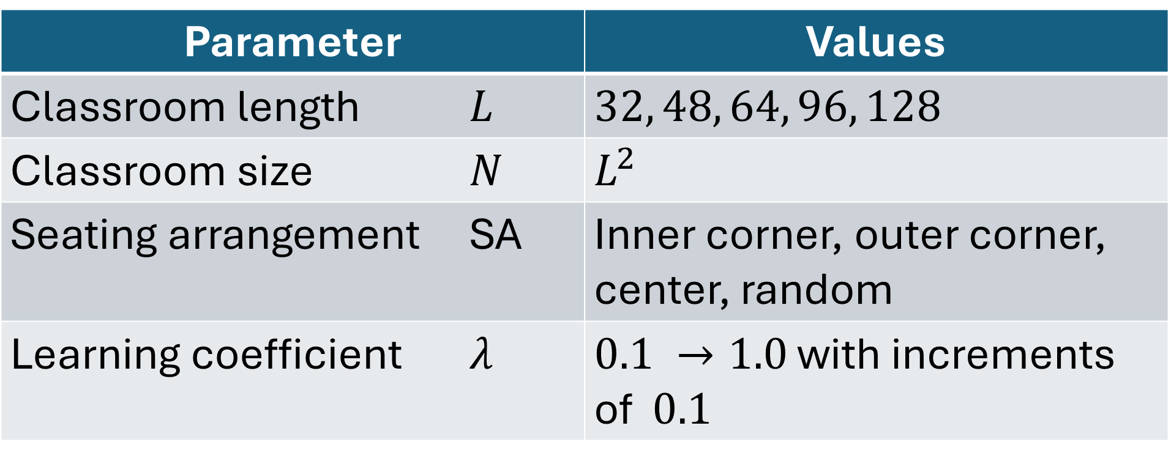
Summary of input parameters
Parameter | Values
Classroom length $L$ | $32, 48, 64, 96, 128$
Classroom size $N$ | $L^{2}$
Seating arrangement SA | Inner corner, outer corner, center, random
Learning coefficient $λ$ | $0.1 →1.0$ with increments of $0.1$

Slide 19
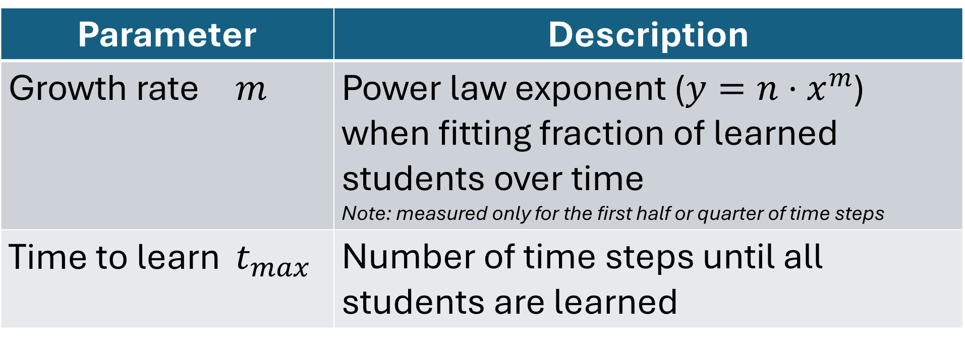
Summary of output parameters
Parameter | Description
Growth rate $m$ | Power law exponent ($y=n⋅x^{m}$) when fitting fraction of learned students over time Note: measured only for the first half or quarter of time steps
Time to learn $t_{max}$ | Number of time steps until all students are learned

