Slide 1
Learning dynamics in a cellular automata model of classroom peer-to-peer interactions
AY 2023-2024 Sem 2 RM Slides
Sy, Clarence Ioakim T.
BS4 Applied Physics
Adviser: Dr. Johnrob Bantang
Complexity Science Group

Slide 2
February 27, 2024
Motivation and previous studies
Research questions
Model descriptions
Current progress and results

Slide 3
Motivation:
Analyze peer-to-peer learning dynamics inside the classroom
Factors considered in literature:
Student aptitude
Seating arrangement
Aptitude homogeneity

Slide 4
Goals
Create a CA model appropriate for peer-to-peer learning inside the classroom
Incorporate factors discussed in literature
Student aptitude level
Seating arrangement (with respect to student aptitude)
Aptitude homogeneity

Slide 5
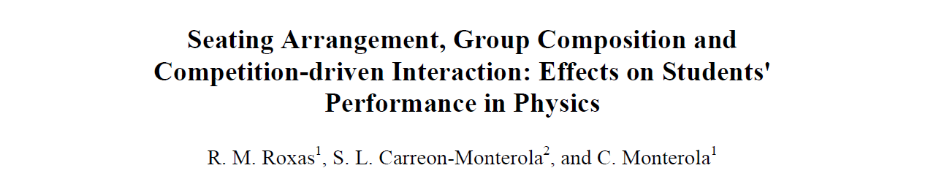
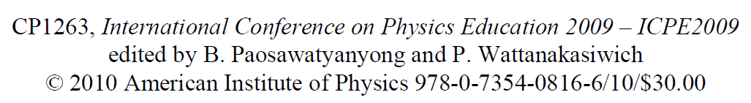
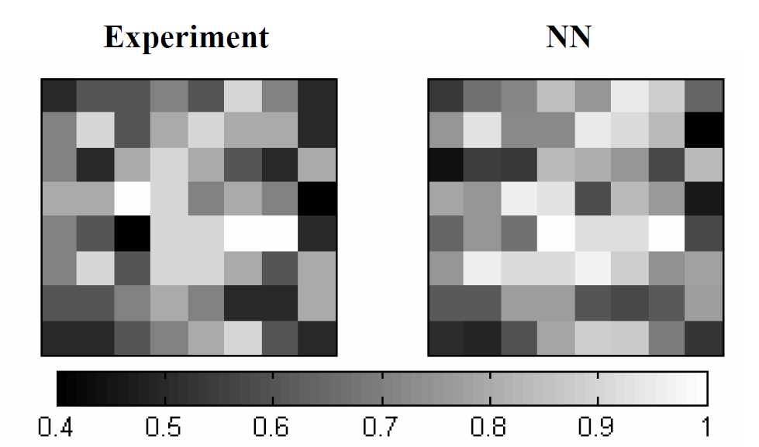
Previous study
Main findings:
Homogeneity (locally and globally) benefits learning of the classroom
Learning is not solely dependent on how high the aptitude level of the seatmates
Notes:
Uses a neural network to predict the outcome of the classroom based on the initial seating arrangement and aptitude levels of the students
Sample size: 68 classrooms, 9 schools/universities; 20 in college, 48 in hs

Slide 6
Research questions:
Learning rate
How does the number of learned students (binary states) or the class average (continuous states) evolve over time?
Nucleation sites position
How does the position of learned/high aptitude students affect the learning rate of the class?
Homogeneity
How does the spatial aptitude homogeneity affect the learning rate of the class?
How does the social aspect affect the classroom (Watts–Strogatz model) dynamics?

Slide 7
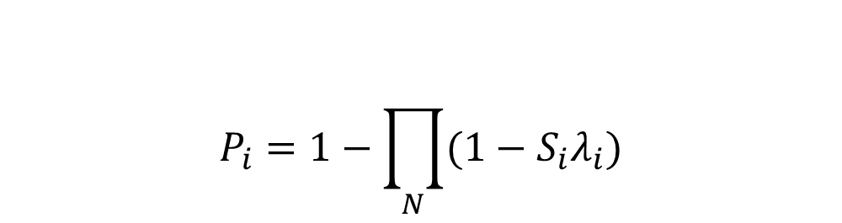
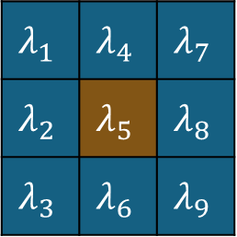
2D Binary Probabilistic CA Model
$$λ_{1}$$ | $$λ_{4}$$ | $$λ_{7}$$
$$λ_{2}$$ | $$λ_{5}$$ | $$λ_{8}$$
$$λ_{3}$$ | $$λ_{6}$$ | $$λ_{9}$$
1 | 9 | 17
2 | 10 | 18
3 | 11 | 19
4 | 12
5 | 13
6 | 14 |  |  |  |  |  | 62
7 | 15 |  |  |  |  |  | 63
8 | 16 |  |  |  |  |  | 64
Learning probability
$$P_{i}=1−\prod_{N}{(1−S_{i}λ_{i})}$$
Classroom
7

Slide 8
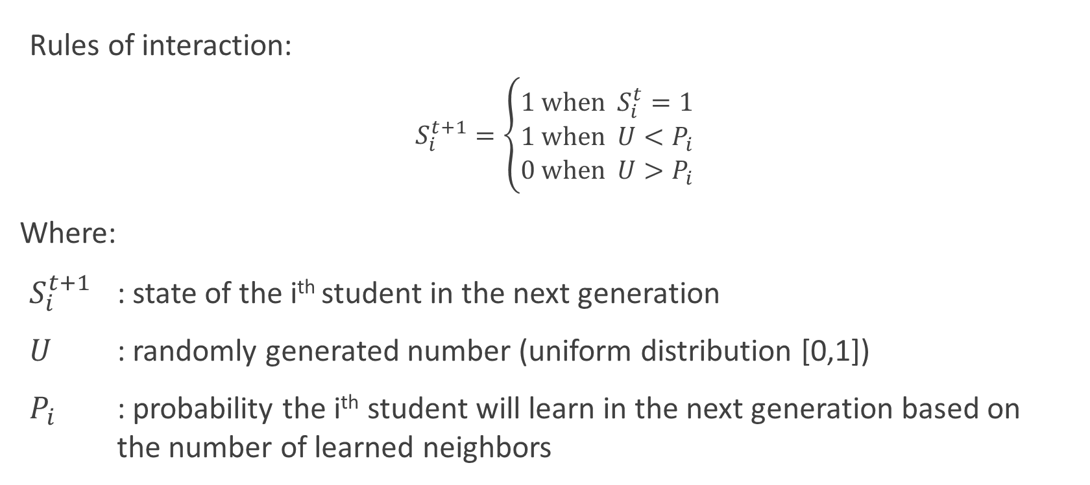
2D Binary Probabilistic CA Model
Rules of interaction:
$$S_{i}^{t+1}=\left\{\begin{aligned}1 \text{when} S_{i}^{t}=1 \\ 1 \text{when} U<P_{i} \\ 0 \text{when} U>P_{i}\end{aligned}\right.$$
Where:
$S_{i}^{t+1}$ : state of the i^{th} student in the next generation
$U$ : randomly generated number (uniform distribution [0,1])
$P_{i}$ : probability the i^{th} student will learn in the next generation based on the number of learned neighbors

Slide 9
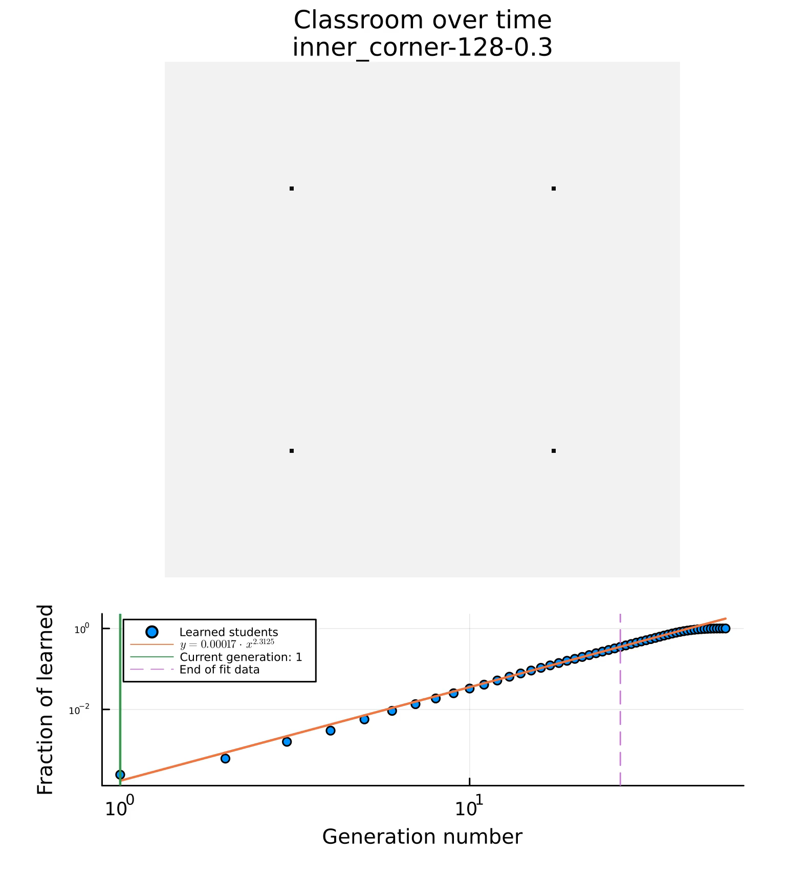
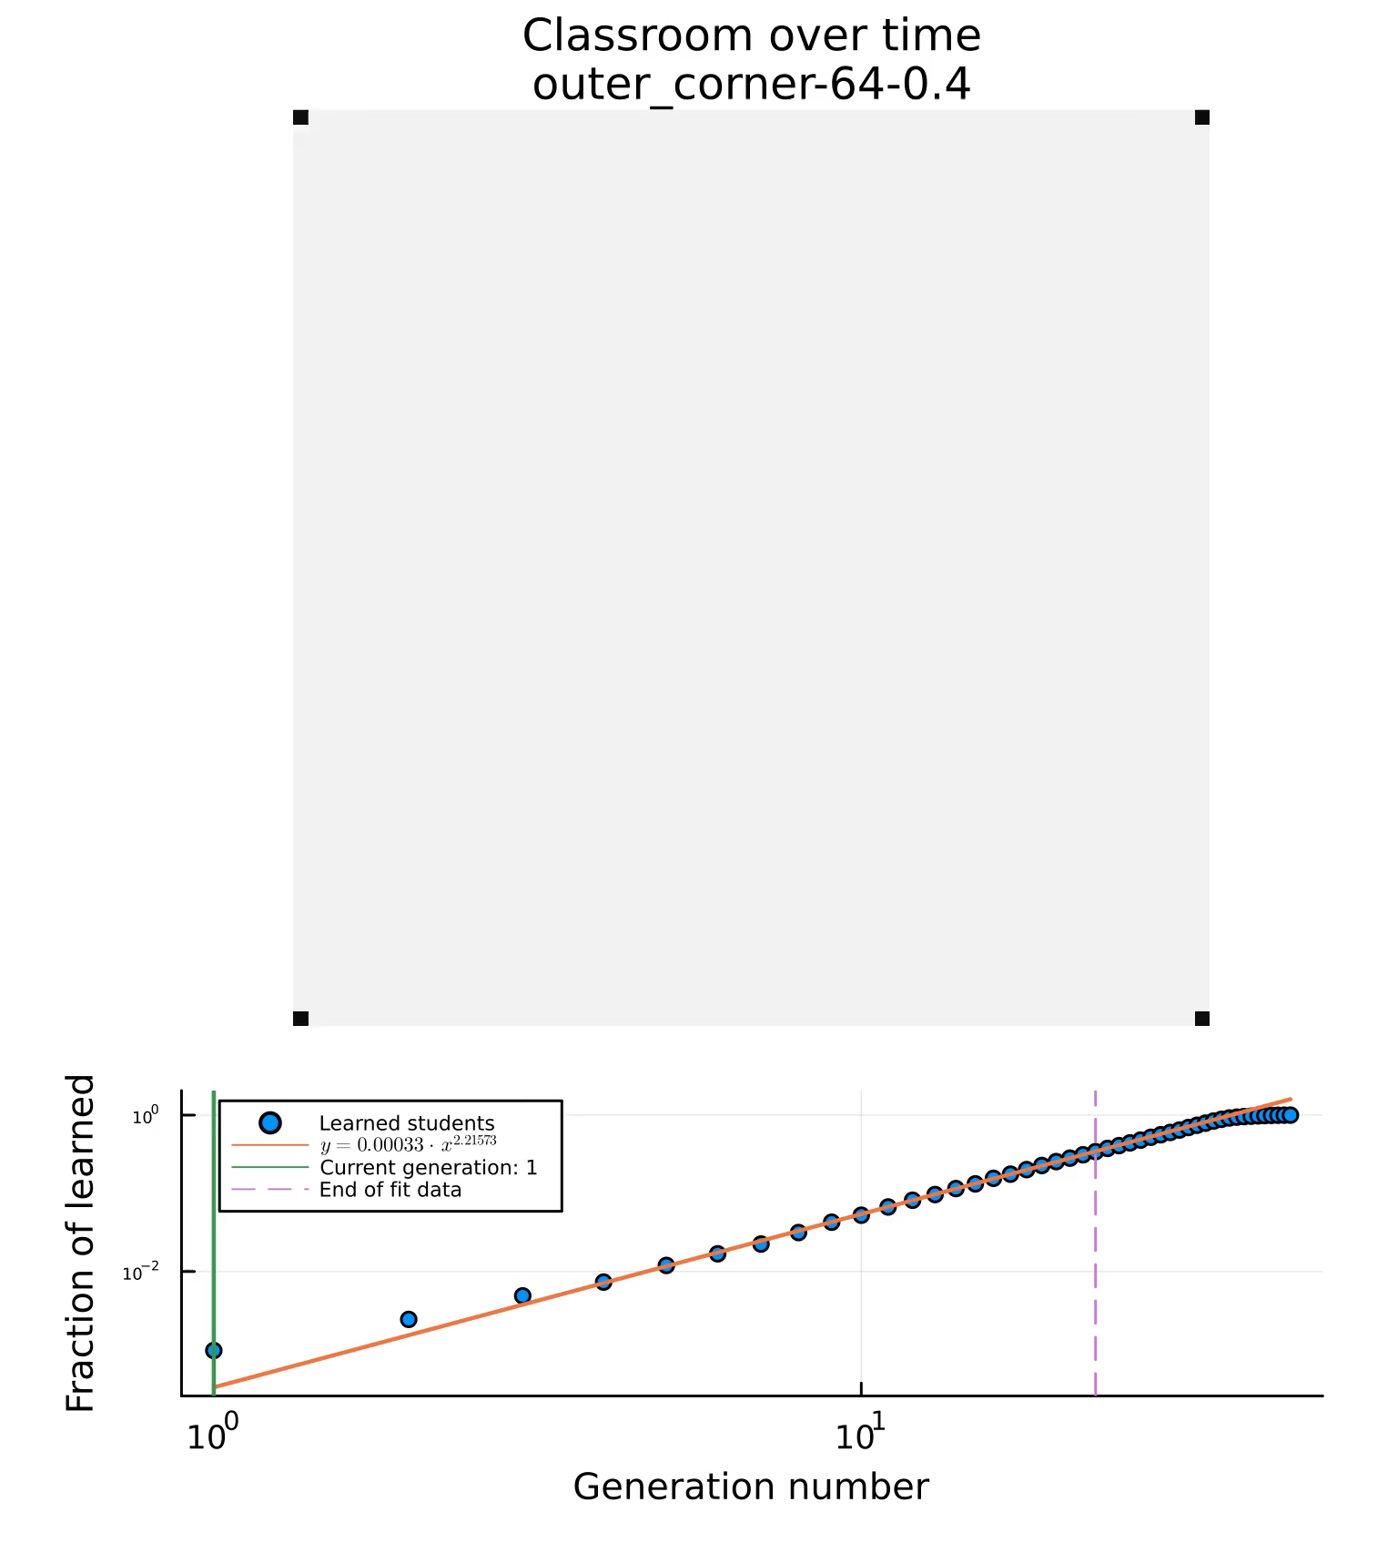
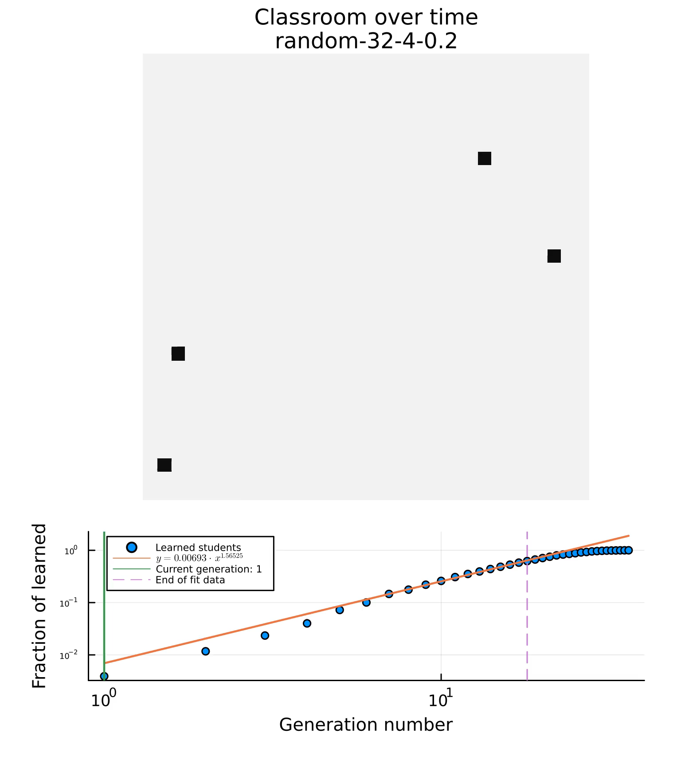
2D Binary Probabilistic CA Model
Notes:
Parameters we get from each simulation:
Number of generations to saturate the class (normalized to the number of students in the class): learned/max
Characteristic variable (m). Taken as the exponent of the fitted line y=ax^b
The fitting of the data ends at 50%, so that the it only measures the spreading before the finite size effects kicks in

Slide 10
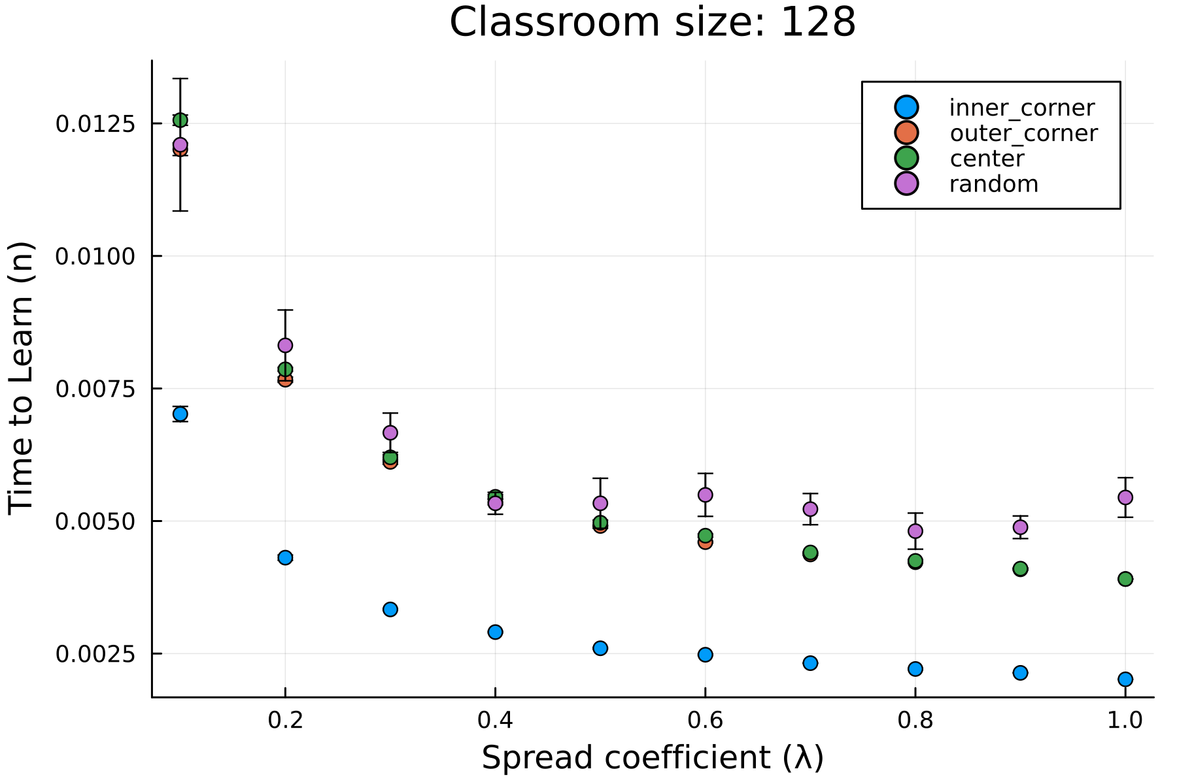
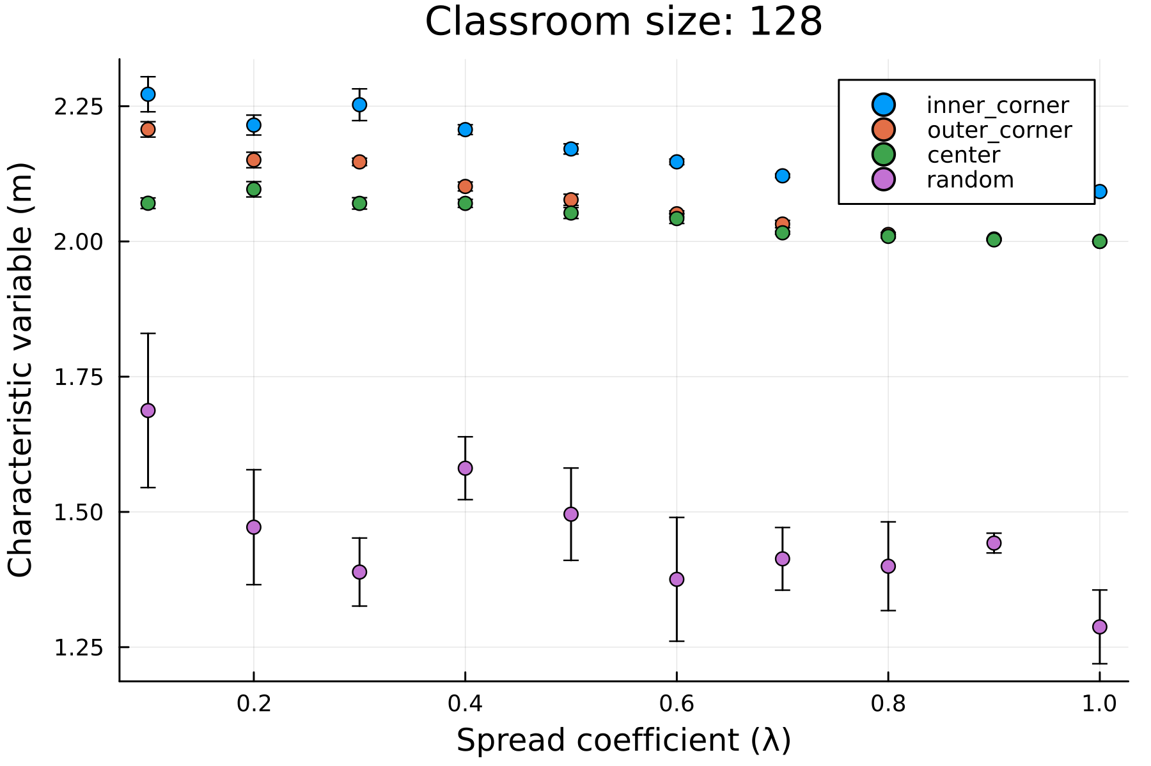
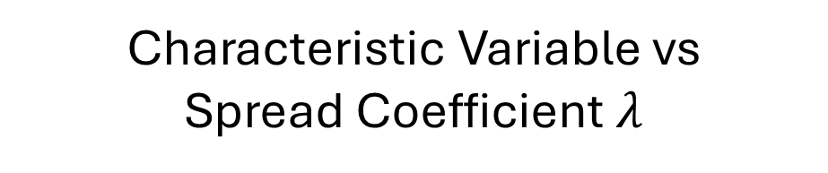
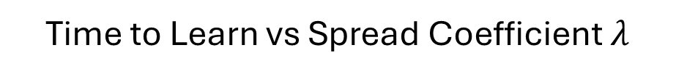
2D Binary PCA - Results
Time to Learn vs Spread Coefficient $λ$
Characteristic Variable vs Spread Coefficient $λ$
Notes:
Inner corner performs best
Outer corner and center perform similarly

Slide 11
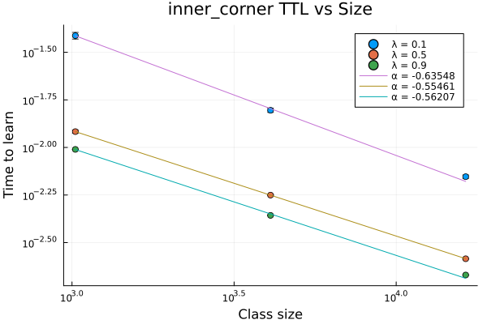
2D Binary PCA - Results
Notes:
Time to learn is dictated by power law (dependent on class size) -> normalizabe

Slide 12
To do: (analysis)
Normalize TTL vs Class size graph
Compare current data with theoretical TTL (see relevant plot slides for comments)
Normalize TTL vs lambda graphs

Slide 13
To do: (more model interactions)
Introduce orientation bias in the system (anisotropic system)
Introduce inhomogeneous individual learning rate
Model the benefit of local/neighborhood homogeneity
Introduce memory or unlearning to the system
Adjust model to accommodate continuous student states
Fit model parameters to existing data

Slide 14
March 5, 2024
Started on standardizing variable names

Slide 15
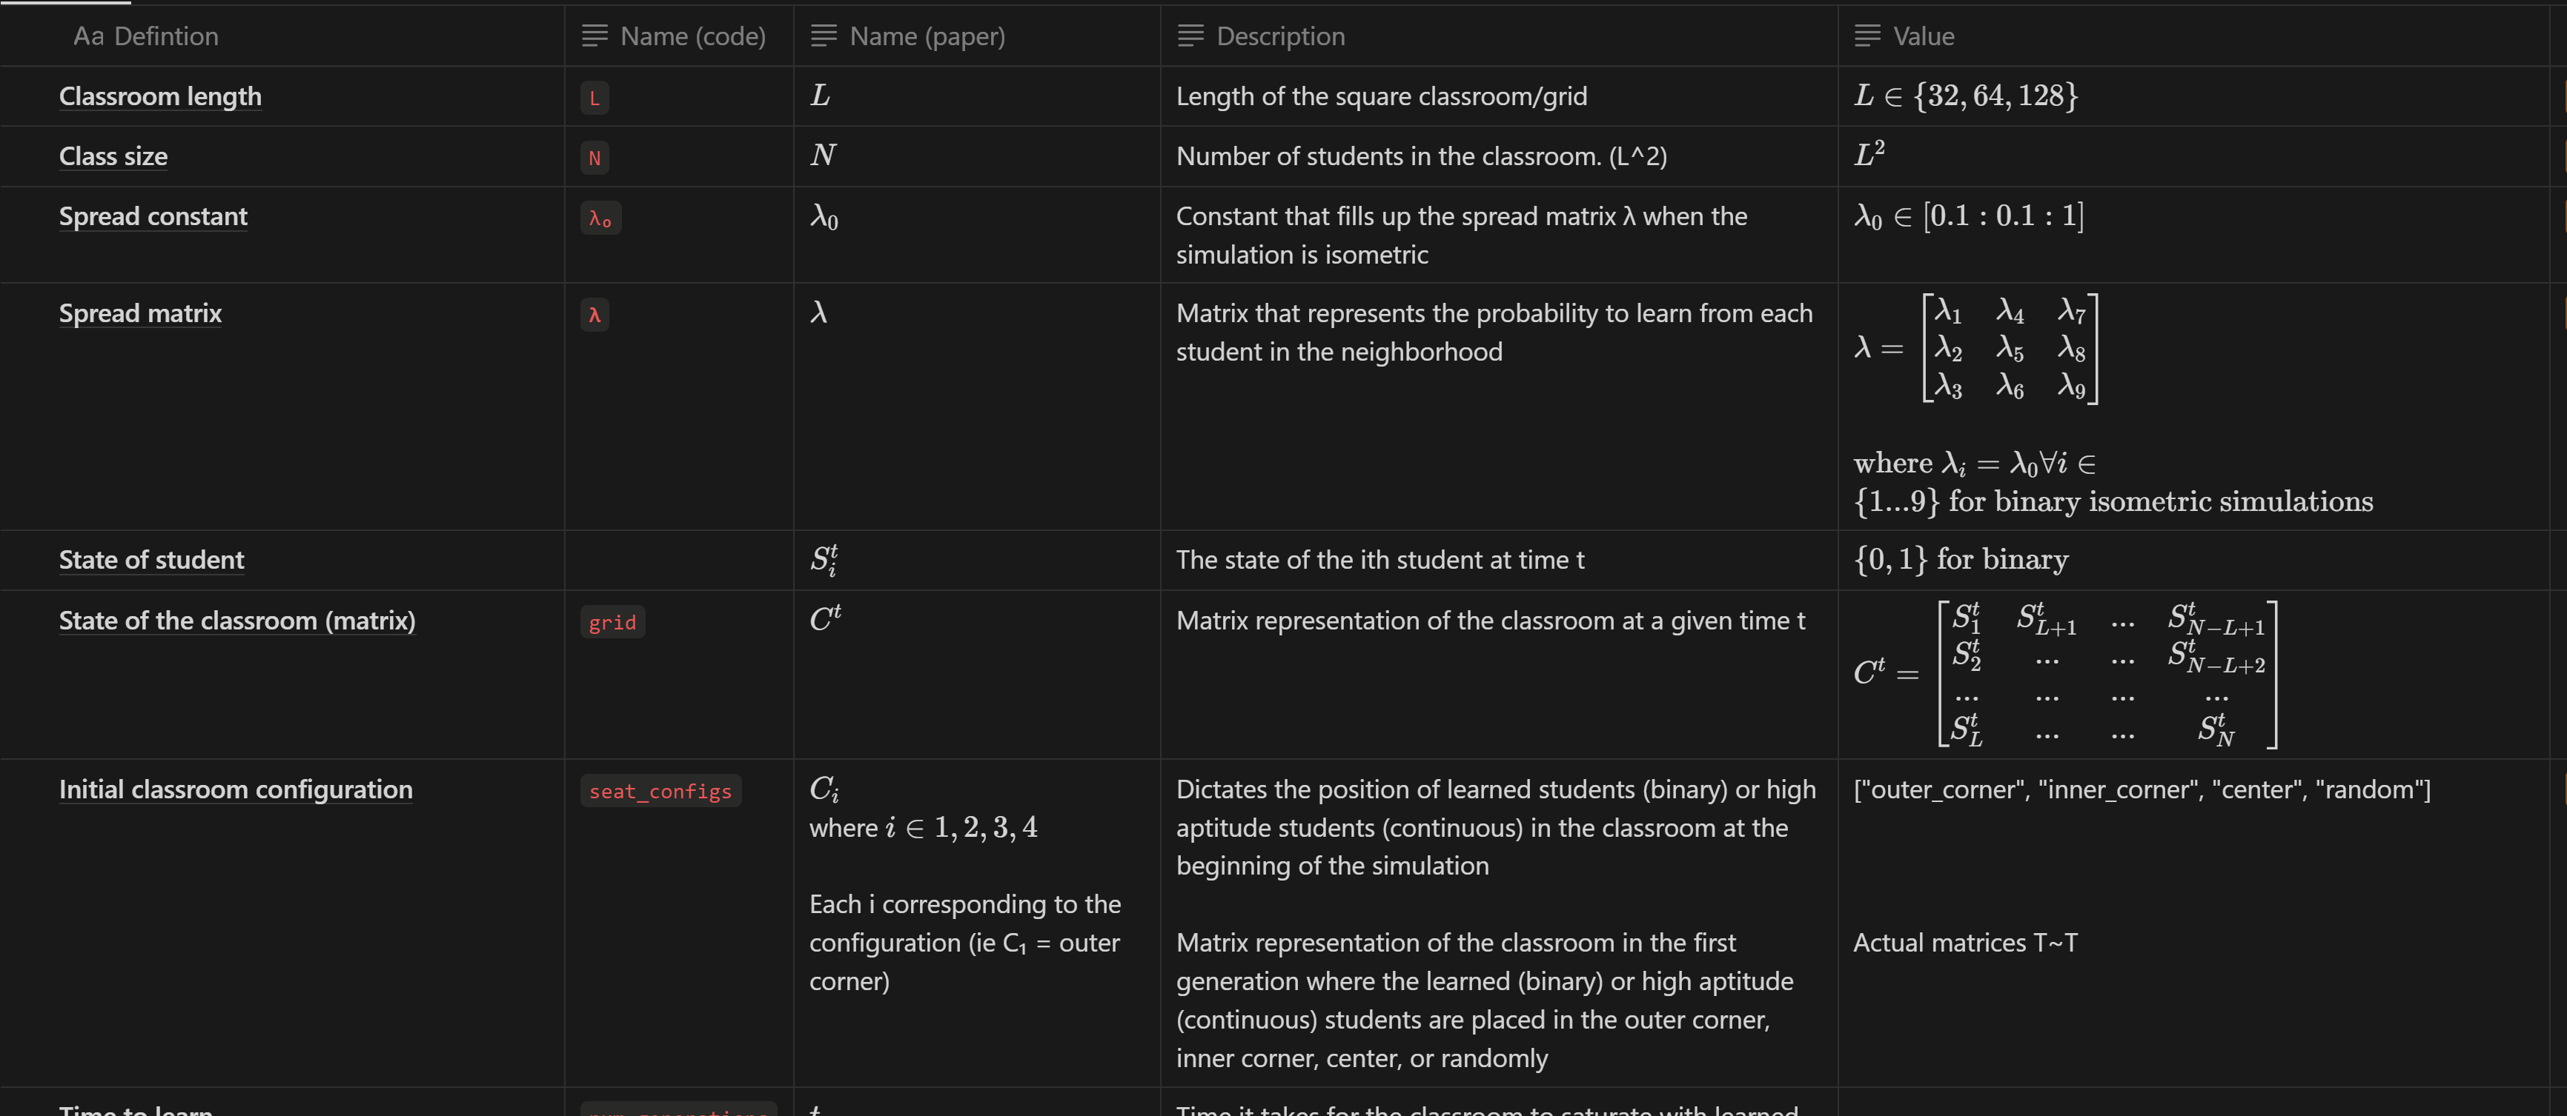

Slide 16
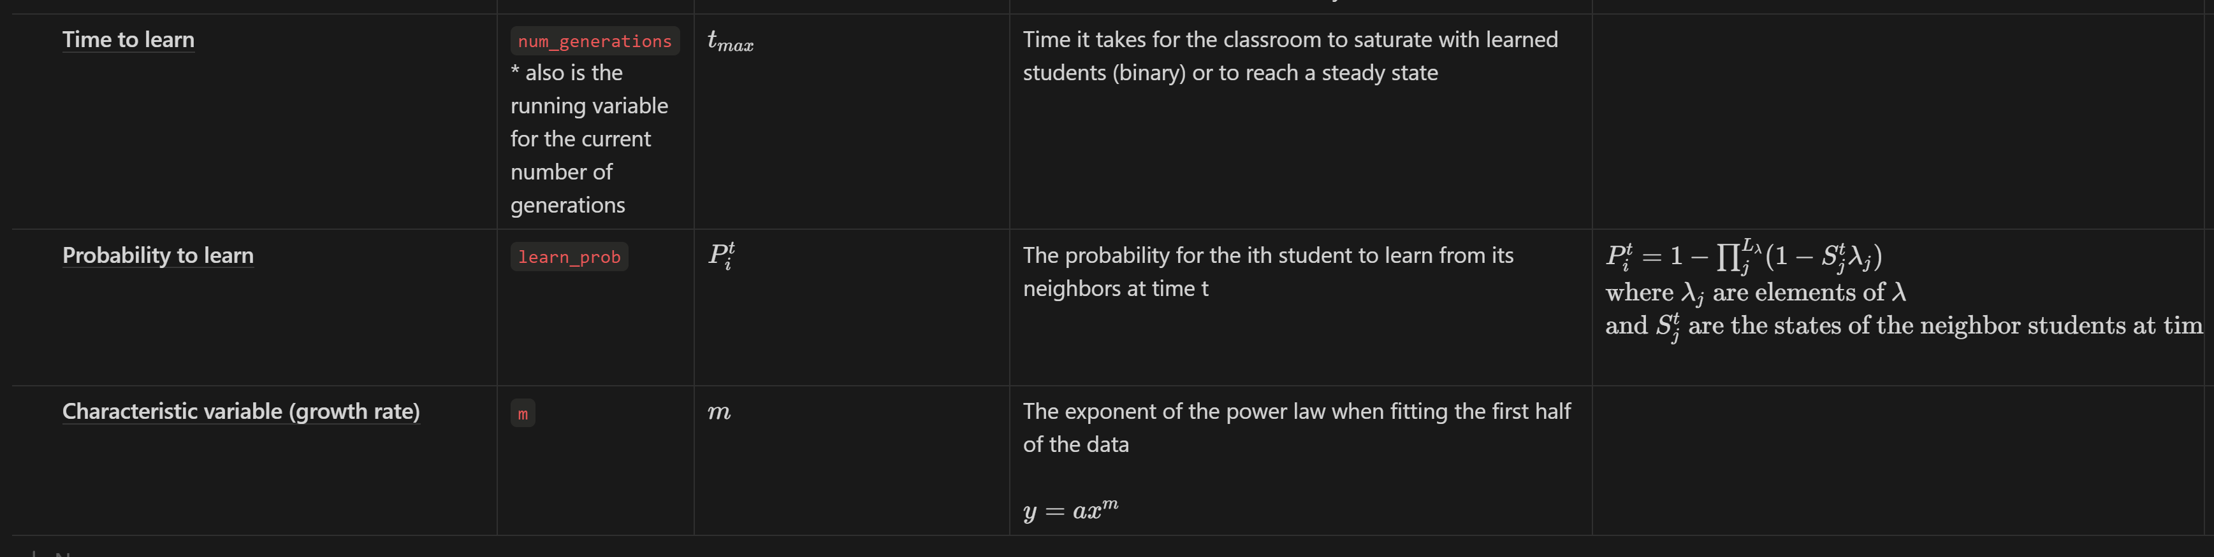

Slide 17
To do: (analysis)
Normalize TTL vs Class size graph
Compare current data with theoretical TTL (see relevant plot slides for comments)
Normalize TTL vs lambda graphs

Slide 18
To do: (more model interactions)
Introduce orientation bias in the system (anisotropic system)
Introduce inhomogeneous individual learning rate
Model the benefit of local/neighborhood homogeneity
Introduce memory or unlearning to the system
Adjust model to accommodate continuous student states
Fit model parameters to existing data

Slide 19
March 12, 2024
More data points for the T vs N plot

Slide 20
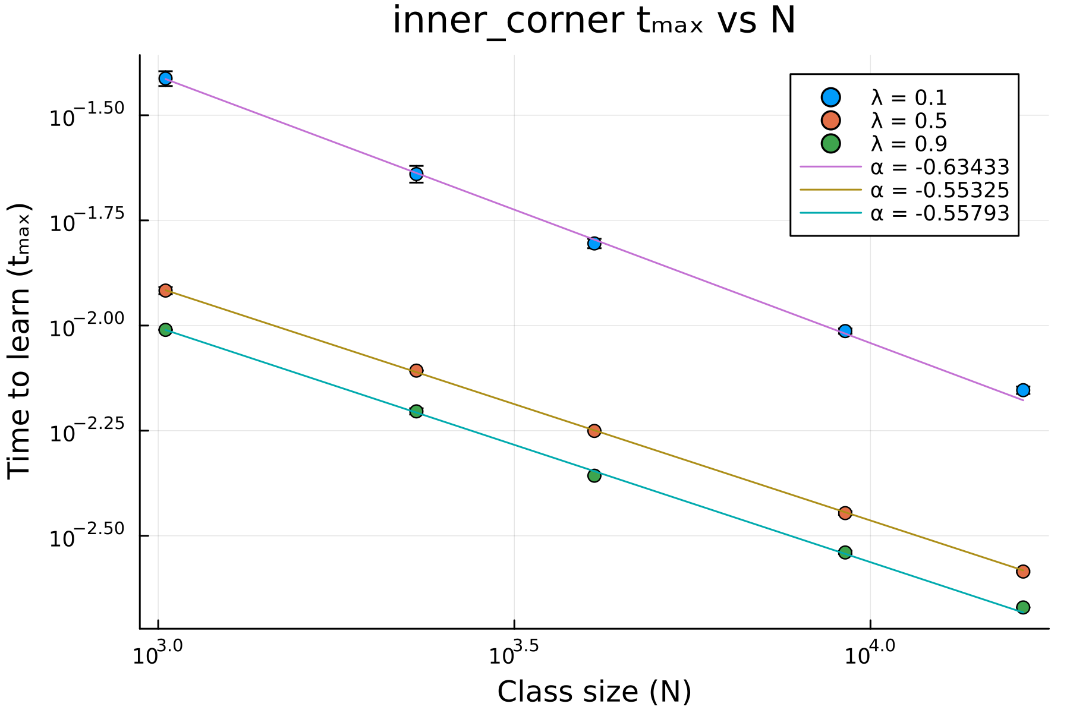

New $t_{max}$ vs $N$
Added more class sizes: 48 and 96
Linear in log-log scale
Follows power law
Expected
Not expected: pababa yung slope. Found the error in code

Slide 21
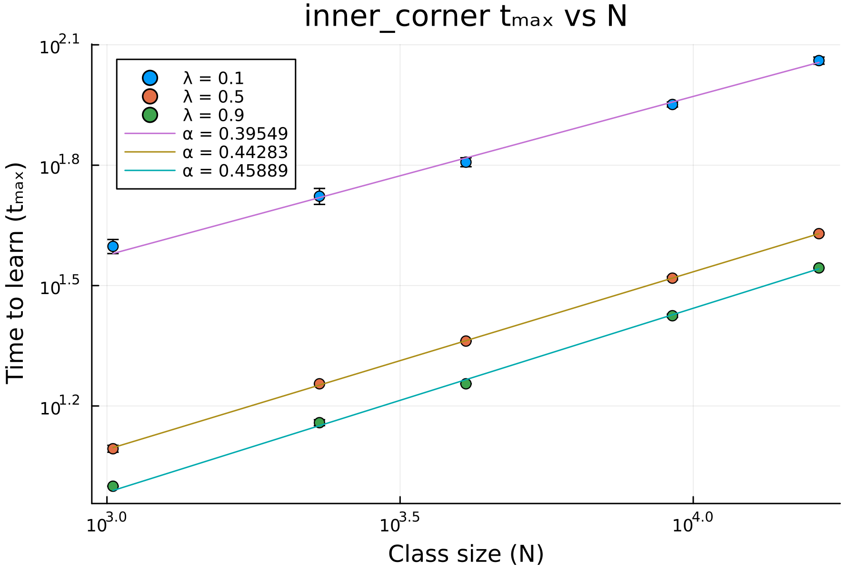
New $t_{max}$ vs $N$
Fixed code

Slide 22
New question
Can an isotropic lambda model an anisotropic lambda?
Is there an equivalent isotropic lambda to return similar results to an anisotropic
Discuss:
If we allow jumps, will learning speed up?

Slide 23
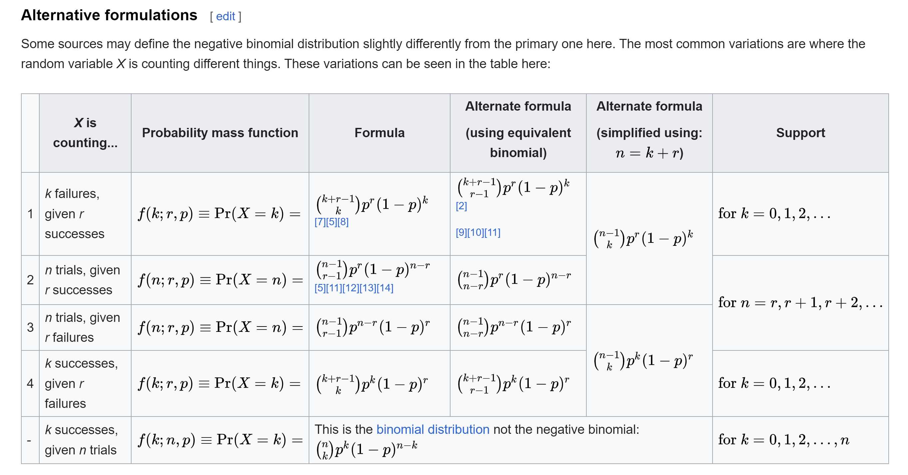

New simulation: traditional
Each student has a chance to flip $λ_{0}$
New set of analysis as benchmark
Does it follow #2 variation of the neg binomial dist?

Slide 24
March 19, 2024
Finished simulations of traditional classroom setting
Plotted a summary of the data

Slide 25
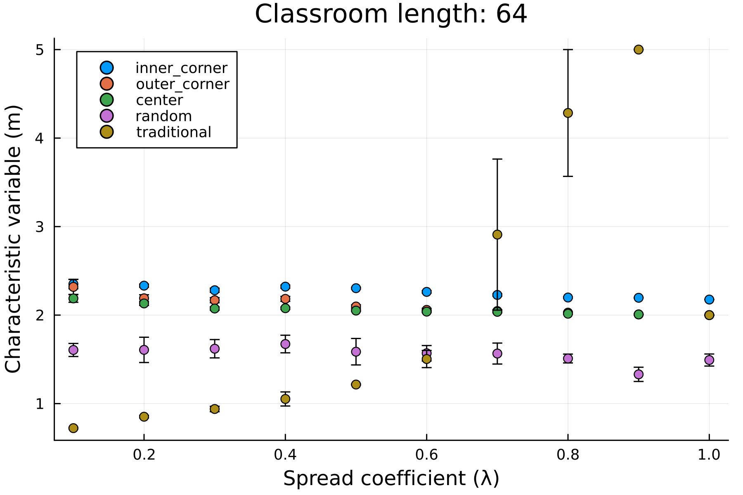
m vs lambda plot (higher is better)
There are break even points between traditional vs peer to peer

Slide 26
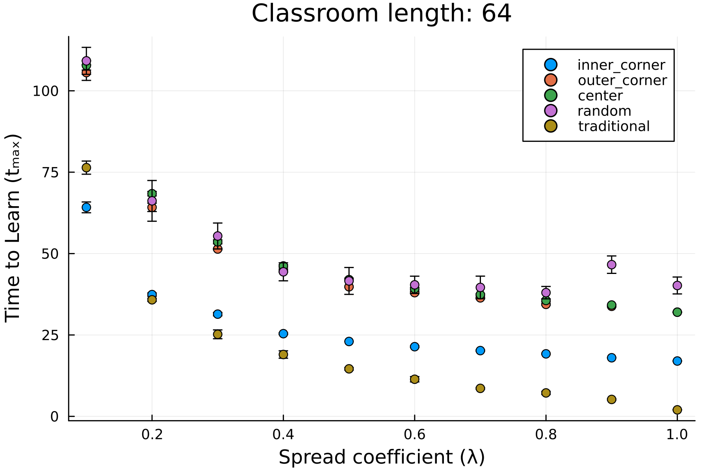
T_max vs lambda
There are also breakpoints between traditional vs peer to peer

Slide 27
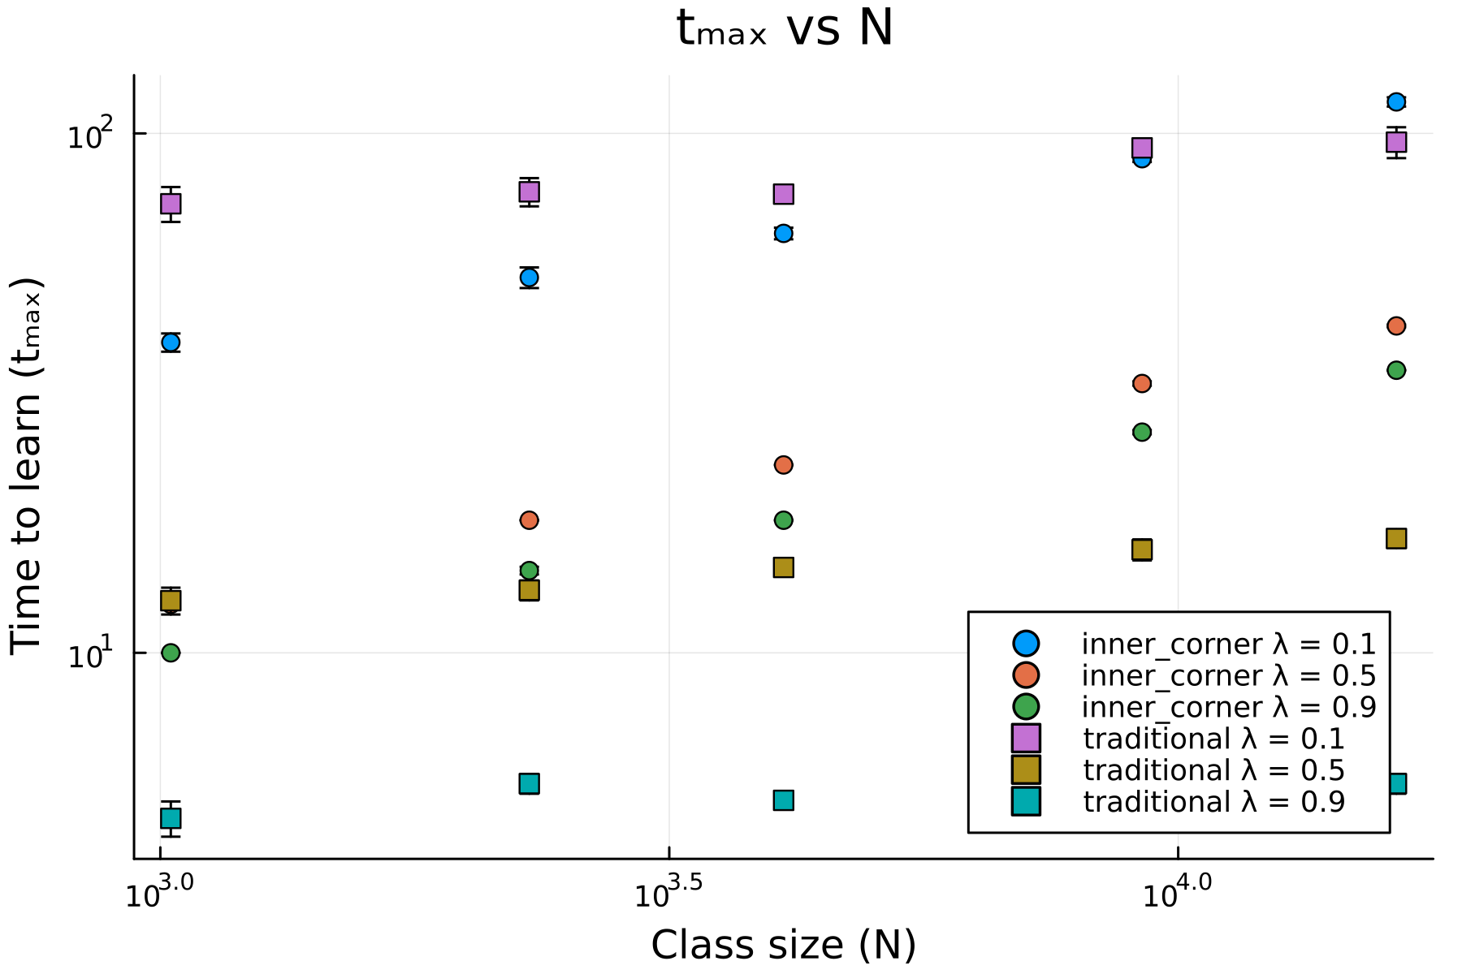
T_max vs N (lower is better)
For the same lambda’s, traditional is better at larger classes
The breakpoint is only present for low lambda’s

Slide 28
To do
Fit the data points to a line (y=ax^b)
Find the important constants to determine the breakpoints given the parameters (see next slides)
Legend is starting to get crowded, maybe it’s time to move back to makie…

Slide 29
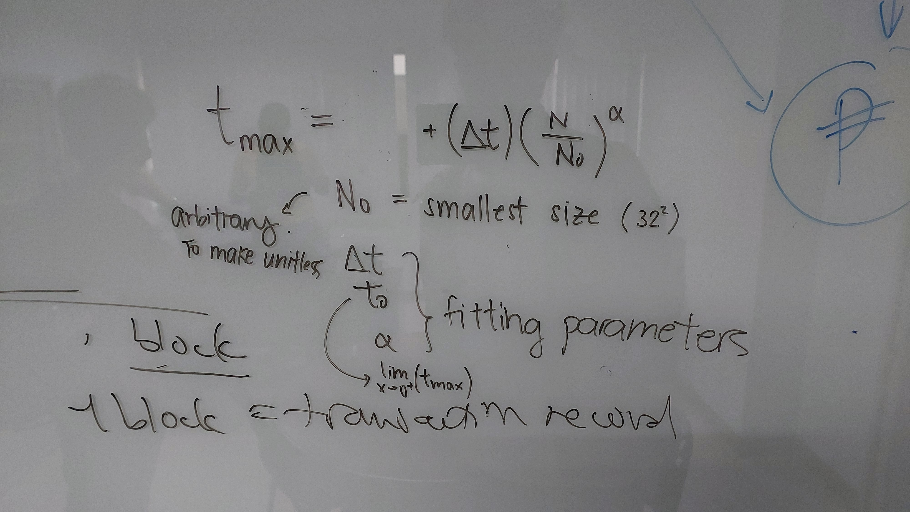
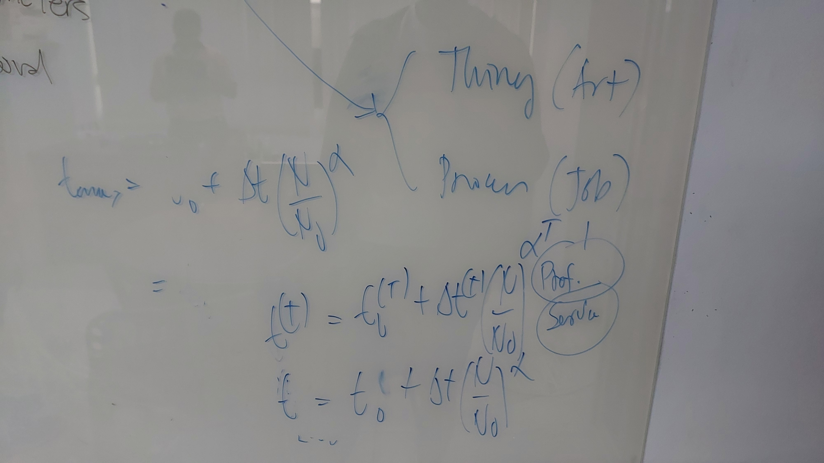
To do: constants and such

Slide 30
April 16, 2024
Added trendlines to N vs t_max plots
Moved legend outside of plot

Slide 31
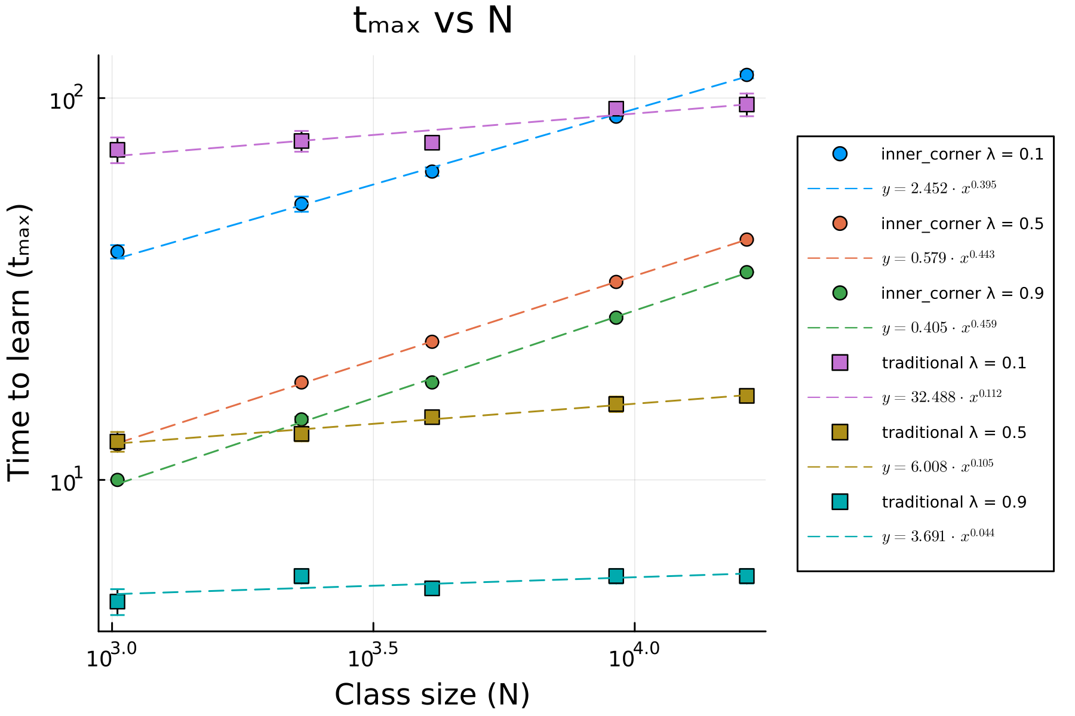
N vs T_max (lower is better)

Slide 32
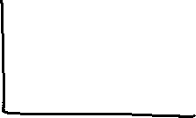
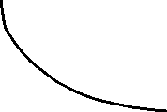

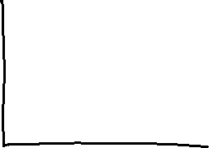

Slide 33
April 23, 2024

Slide 34
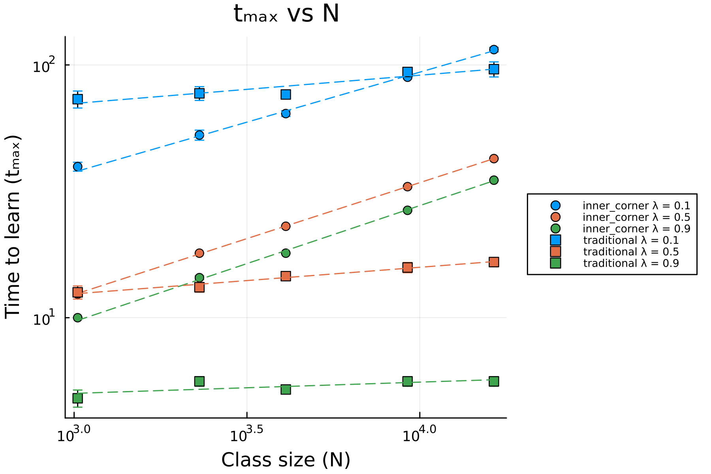
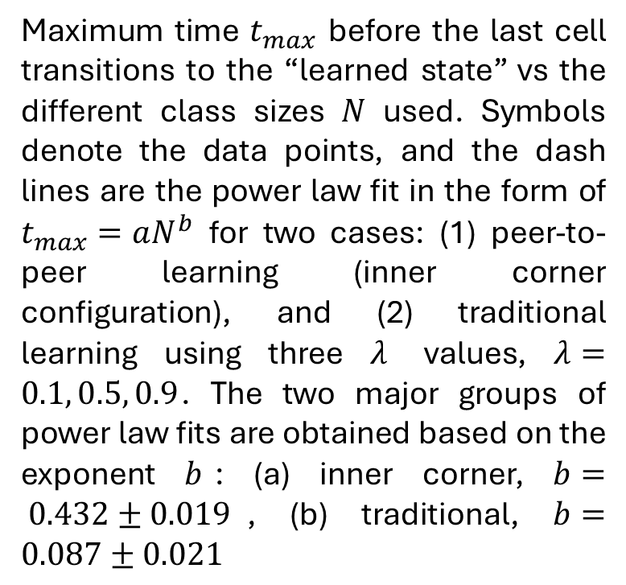
N vs Tmax (lower is better)
Maximum time $t_{max}$ before the last cell transitions to the “learned state” vs the different class sizes $N$ used. Symbols denote the data points, and the dash lines are the power law fit in the form of $t_{max}=aN^{b}$ for two cases: (1) peer-to-peer learning (inner corner configuration), and (2) traditional learning using three $λ$ values, $λ=0.1, 0.5, 0.9$. The two major groups of power law fits are obtained based on the exponent $b$: (a) inner corner, $b= 0.432±0.019$, (b) traditional, $b=0.087±0.021$

Slide 35
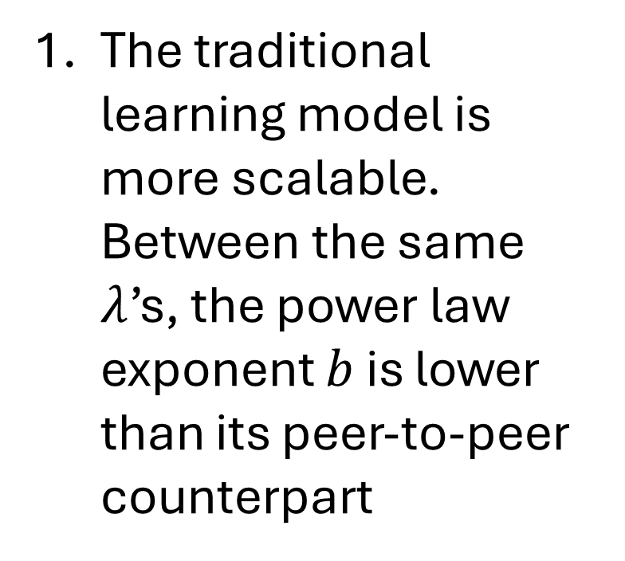
Conclusions on traditional vs P2P
The traditional learning model is more scalable. Between the same $λ$’s, the power law exponent $b$ is lower than its peer-to-peer counterpart

Slide 36
Conclusions on traditional vs P2P
Inner corner configurations have higher b-values, while the traditional configurations have lower b-values

Slide 37
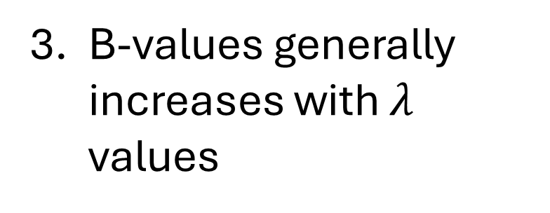
Conclusions on traditional vs P2P
B-values generally increases with $λ$ values

Slide 38
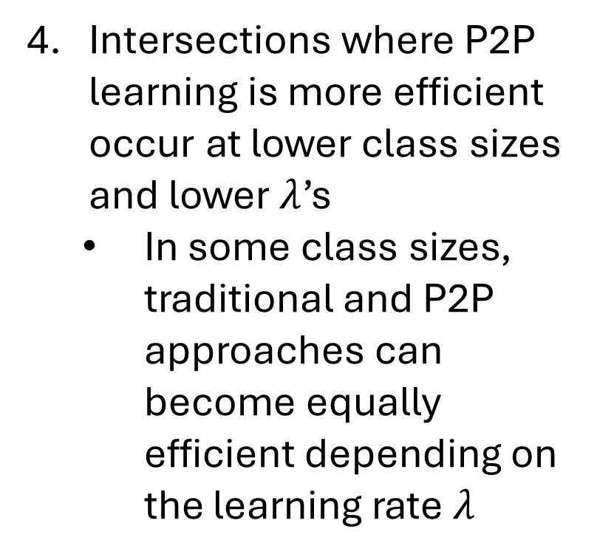
Conclusions on traditional vs P2P
Intersections where P2P learning is more efficient occur at lower class sizes and lower $λ$’s
In some class sizes, traditional and P2P approaches can become equally efficient depending on the learning rate $λ$

Slide 39
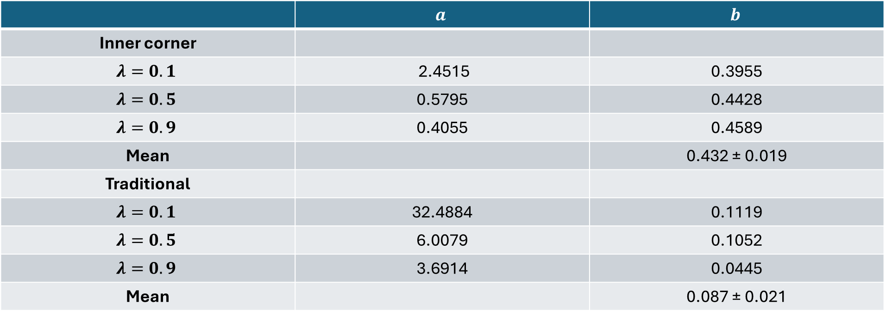
Table of power law parameters
 | $$a$$ | $$b$$
Inner corner
$$λ=0.1$$ | 2.4515 | 0.3955
$$λ=0.5$$ | 0.5795 | 0.4428
$$λ=0.9$$ | 0.4055 | 0.4589
Mean |  | 0.432 ± 0.019
Traditional
$$λ=0.1$$ | 32.4884 | 0.1119
$$λ=0.5$$ | 6.0079 | 0.1052
$$λ=0.9$$ | 3.6914 | 0.0445
Mean |  | 0.087 ± 0.021

Slide 40
May 16, 2024
Lots of writing
Figure edits

Slide 41
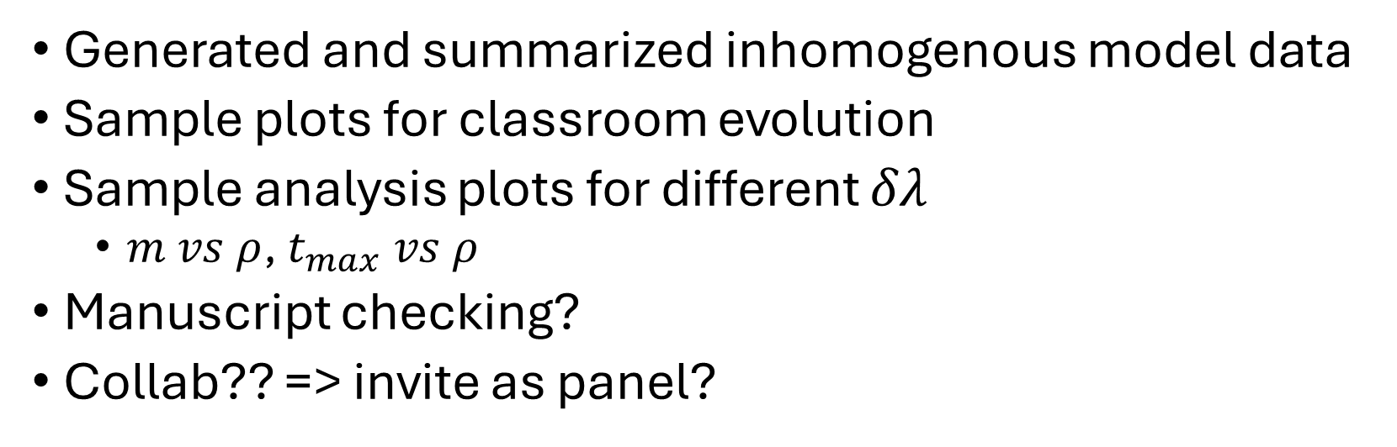
August 7, 2024
Generated and summarized inhomogenous model data
Sample plots for classroom evolution
Sample analysis plots for different $δλ$
$m vs ρ$, $t_{max} vs ρ$
Manuscript checking?
Collab?? => invite as panel?

Slide 42


Inhomogenous/heterogenous model
$$P_{ij}=\prod_{∀δi,δj}{\left[1−\left(λ_{ij}\right)\left(ρ_{i+δi,j+δj}\right)\left(s_{i+δi,j+δj}\right)\right]}$$
$$λ_{ij}=λ_{0}±δλ$$
$$λ_{0}=0.5$$

Slide 43
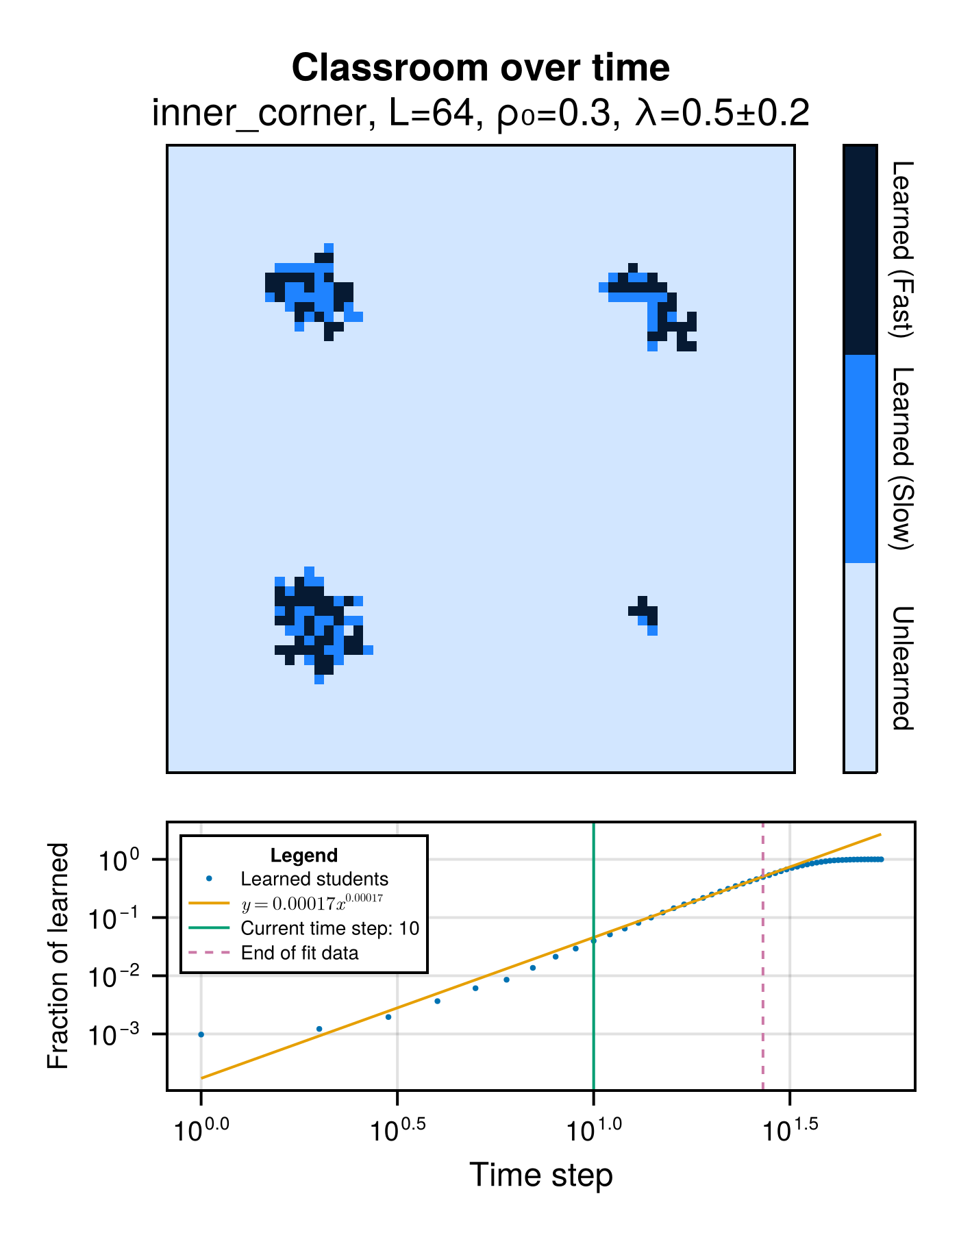
Sample plots of classroom evolution
Don’t know how to change the bottom plot colors
Using Makie.jl
Plots.jl (GR backend) does not have categorical legends
Tried to do symbols as student markers but was difficult to scale

Slide 44
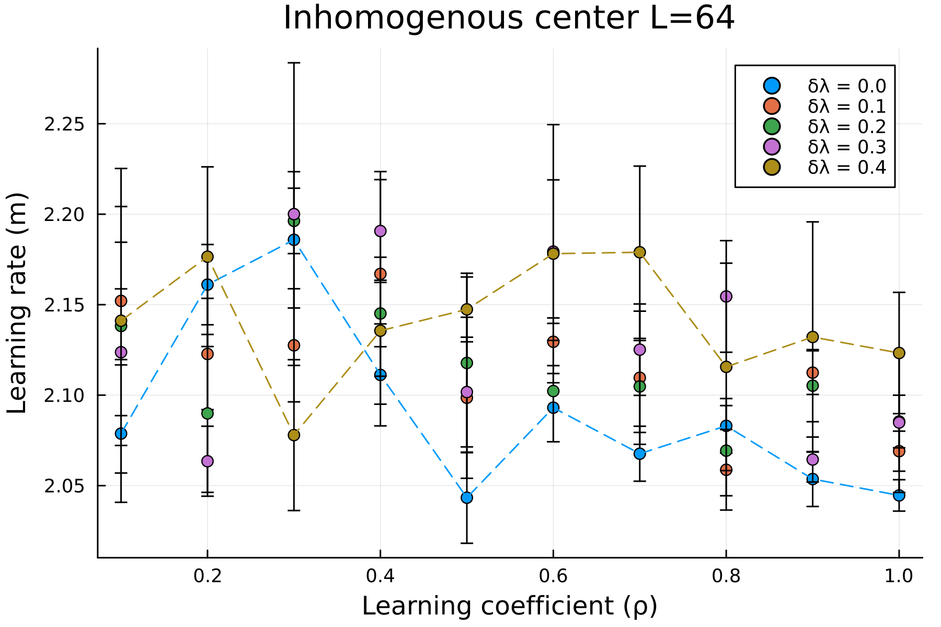
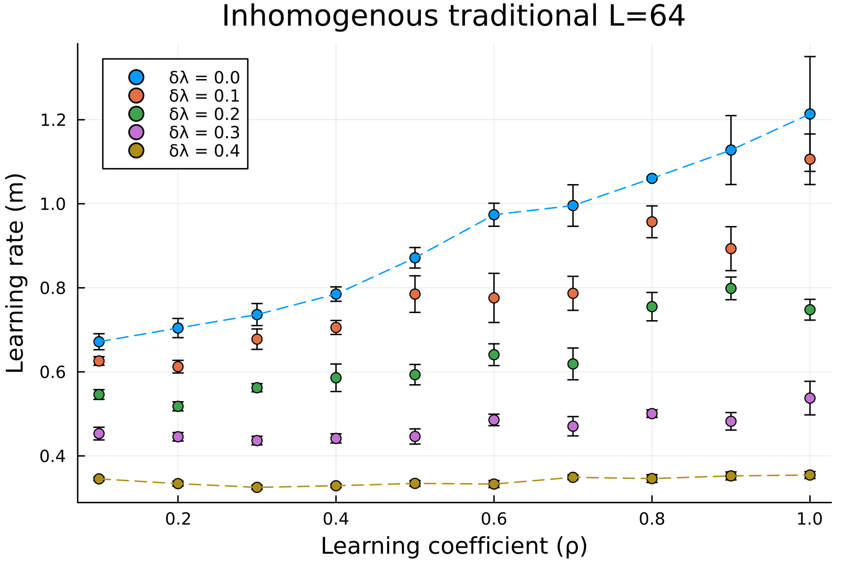
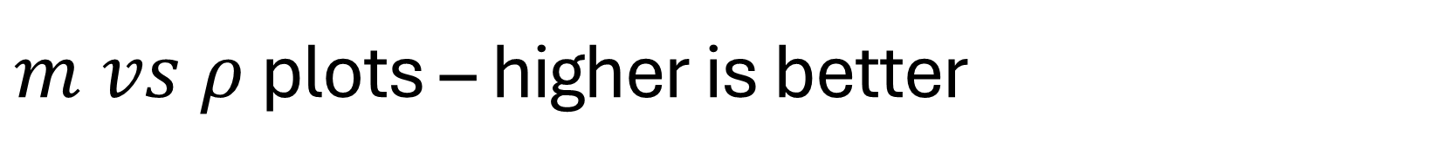
$m vs ρ$ plots – higher is better

Slide 45
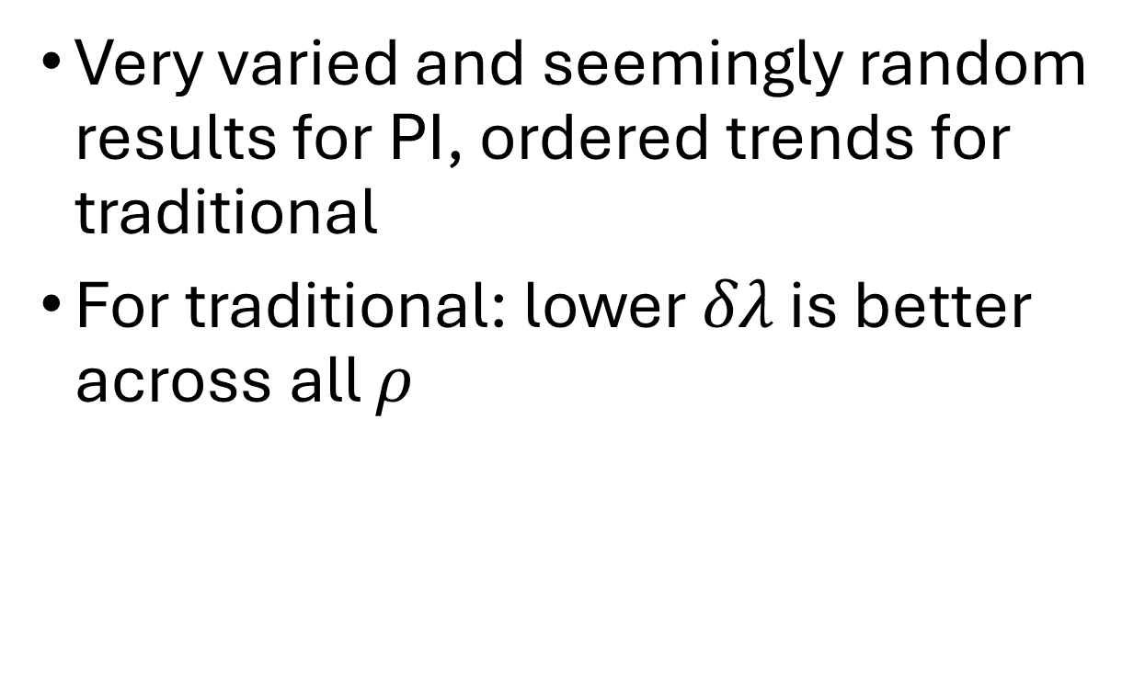
$m vs ρ$ plots – higher is better
Very varied and seemingly random results for PI, ordered trends for traditional
For traditional: lower $δλ$ is better across all $ρ$

Slide 46
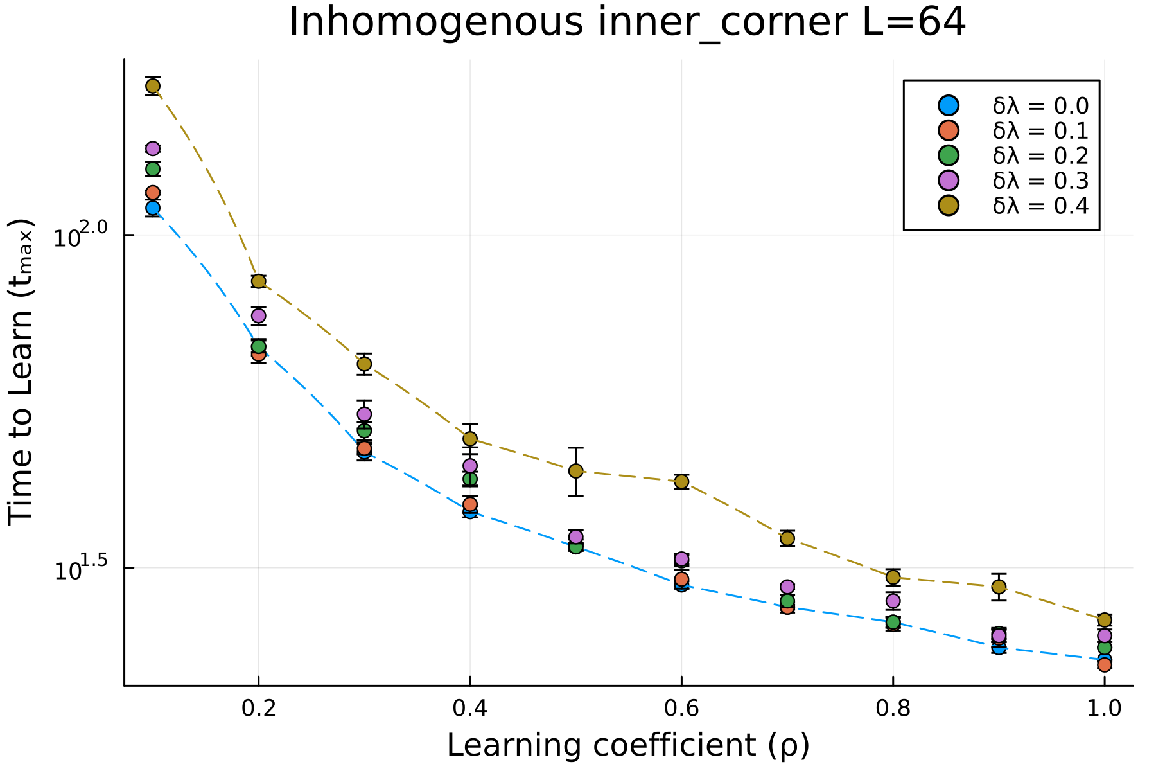
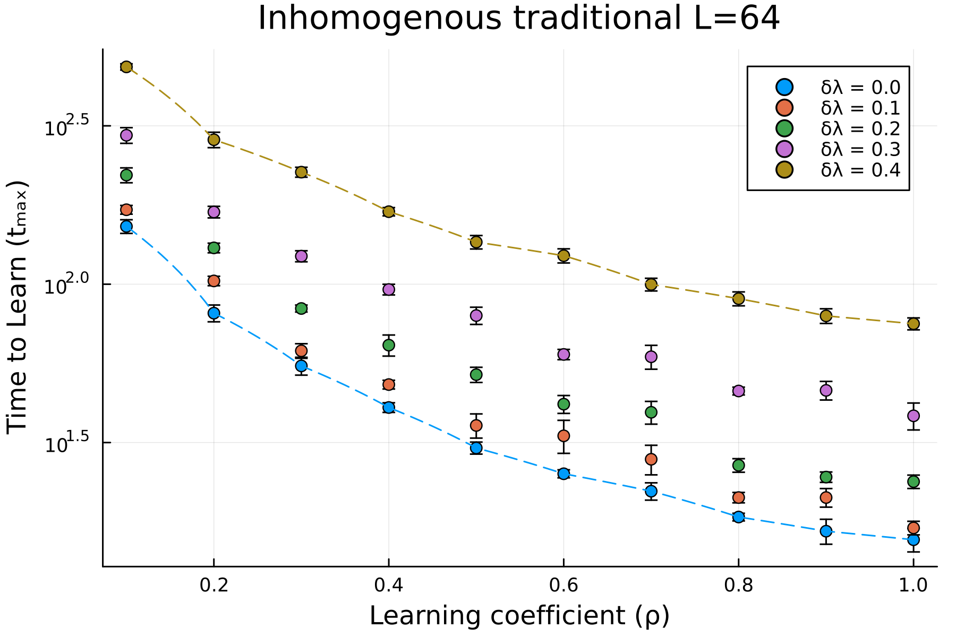
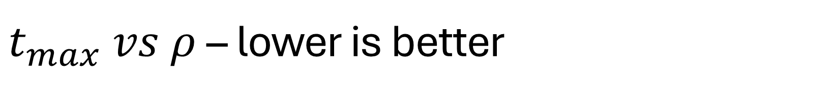
$t_{max} vs ρ$ – lower is better

Slide 47
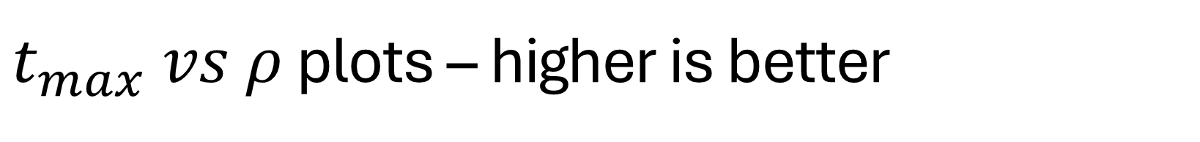
$t_{max} vs ρ$ plots – higher is better
Smaller differences in time to learn for PI compared to traditional set ups

