Slide 1
Classroom learning dynamics using a cellular automata spatiotemporal model comparing peer instruction and traditional instruction
AY 2024-2025 Sem 1
RM Slides
Sy, Clarence Ioakim T.
BS4+ Applied Physics
Adviser: Dr. Johnrob Bantang
Complexity Science Group

Slide 2
Research questions
How does the number of learned students develop over time?
Spatial position of high aptitude students in class
How does the positioning of learned students affect the learning rate of the class for peer instruction?
Learning rate
Traditional vs peer instruction
When is peer instruction better than traditional instruction?
Which factors lead to a difference in performance?

Slide 3
The classroom as a binary probabilistic CA model
The classroom is set to be a 2D square grid of varying lengths.
Students are either learned or not learned.
Simulations are initialized with 4 different seating arrangements (SA): inner corner, outer corner, center, random.
The simulation is considered done when all students are learned.

Slide 4
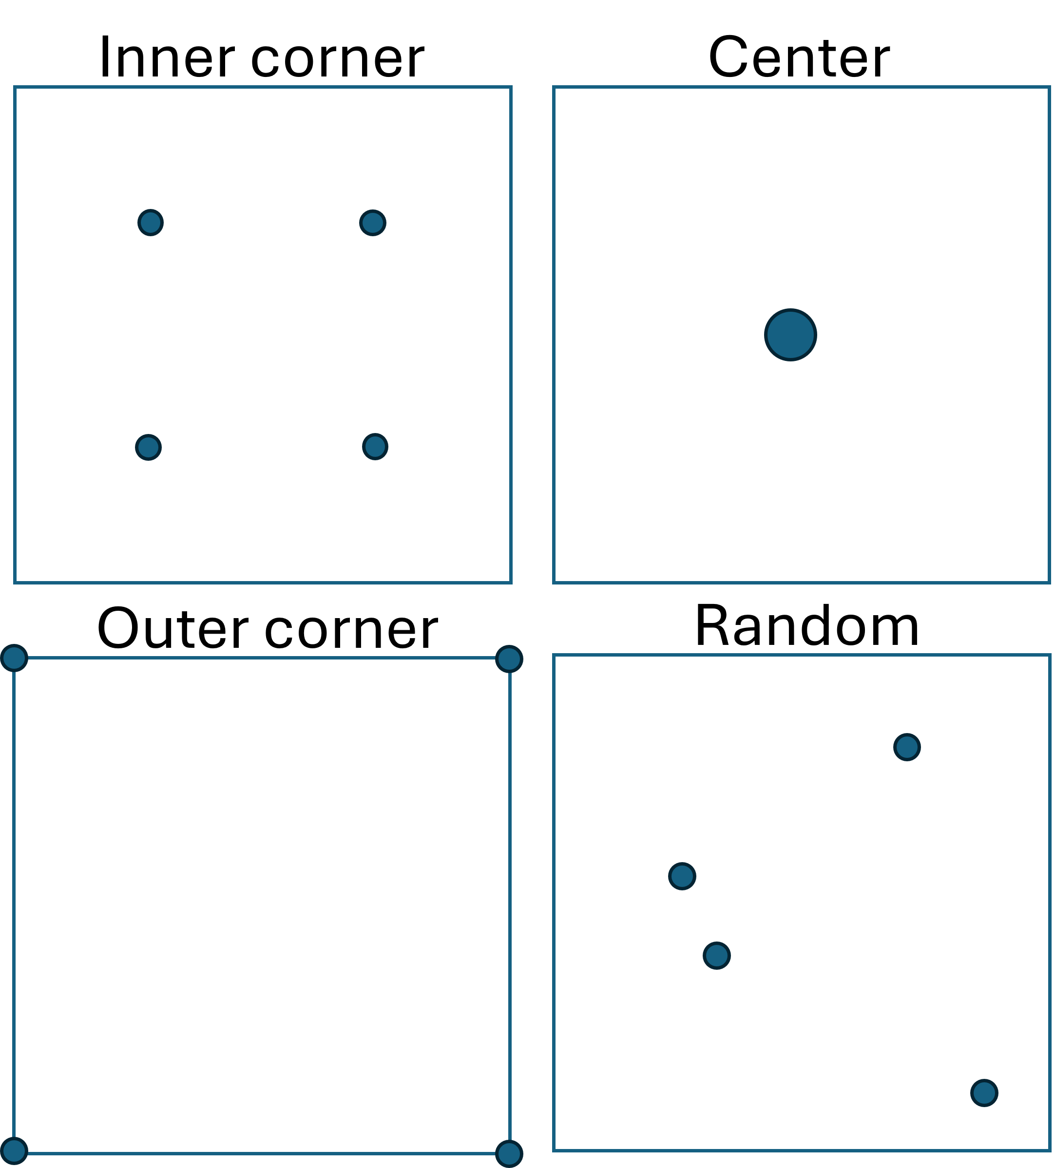
Different PI seating arrangements
- Circles indicate location of learned students

Slide 5
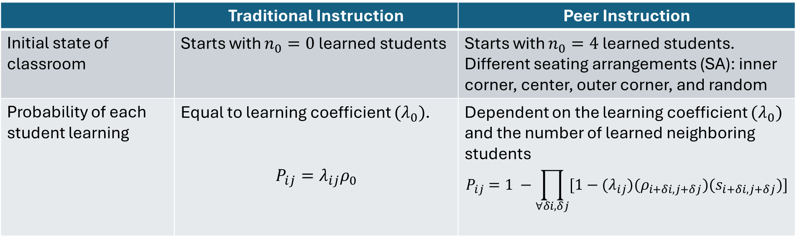
PCA rules for classroom simulation
 | Traditional Instruction | Peer Instruction
Initial state of classroom | Starts with $n_{0}=0$ learned students | Starts with $n_{0}=4$ learned students. Different seating arrangements (SA): inner corner, center, outer corner, and random
Probability of each student learning | Equal to learning coefficient $(λ_{0})$. $$P_{ij}=λ_{ij}ρ_{0}$$ | Dependent on the learning coefficient $(λ_{0})$ and the number of learned neighboring students $$P_{ij}=1 −\prod_{∀δi,δj}{[1−{(λ}_{ij})(ρ_{i+δi, j+δj})(s_{i+δi, j+δj})]}$$

Slide 6
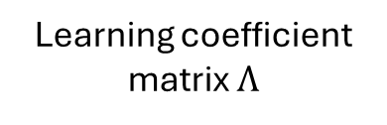
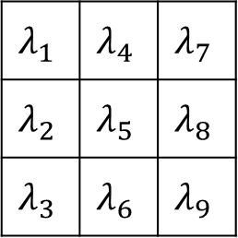
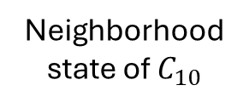
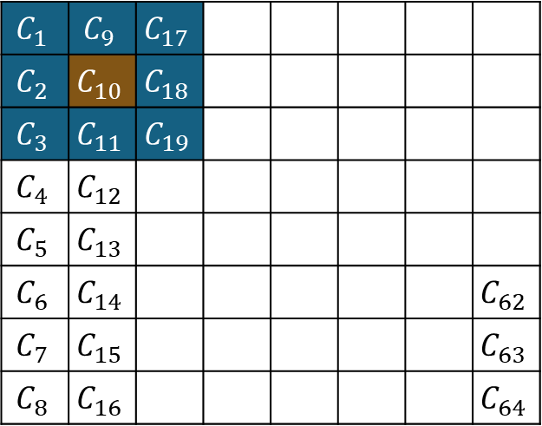

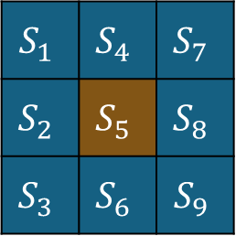
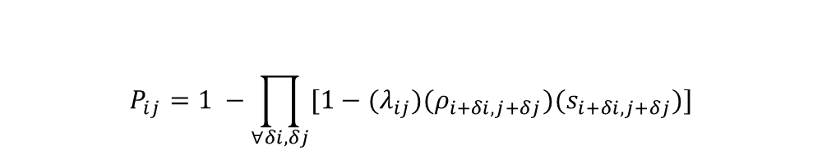
Determining learning probability per time step
$$S_{1}$$ | $$S_{4}$$ | $$S_{7}$$
$$S_{2}$$ | $$S_{5}$$ | $$S_{8}$$
$$S_{3}$$ | $$S_{6}$$ | $$S_{9}$$
$$λ_{1}$$ | $$λ_{4}$$ | $$λ_{7}$$
$$λ_{2}$$ | $$λ_{5}$$ | $$λ_{8}$$
$$λ_{3}$$ | $$λ_{6}$$ | $$λ_{9}$$
$$C_{1}$$ | $$C_{9}$$ | $$C_{17}$$
$$C_{2}$$ | $$C_{10}$$ | $$C_{18}$$
$$C_{3}$$ | $$C_{11}$$ | $$C_{19}$$
$$C_{4}$$ | $$C_{12}$$
$$C_{5}$$ | $$C_{13}$$
$$C_{6}$$ | $$C_{14}$$ |  |  |  |  |  | $$C_{62}$$
$$C_{7}$$ | $$C_{15}$$ |  |  |  |  |  | $$C_{63}$$
$$C_{8}$$ | $$C_{16}$$ |  |  |  |  |  | $$C_{64}$$
$$⊙$$
Neighborhood state of $C_{10}$
Learning coefficient matrix $Λ$
$$P_{ij}=1 −\prod_{∀δi,δj}{[1−{(λ}_{ij})(ρ_{i+δi, j+δj})(s_{i+δi, j+δj})]}$$
Learning probability:
Classroom represented as lattice of cells

Slide 7
To do
Asphericity
Representative cases: yung nasa manuscript
Find the most –aspherical for all time steps
Traditional set up: find another fitting function
Add github/gdrive links for animations sa manuscript
Add a readme “map” in github
Re: some cases in PI IH model that does not fit the power law. Discuss why
Slow down on learning because of asymmetry, “shape,’ and heterogeneity

Slide 8
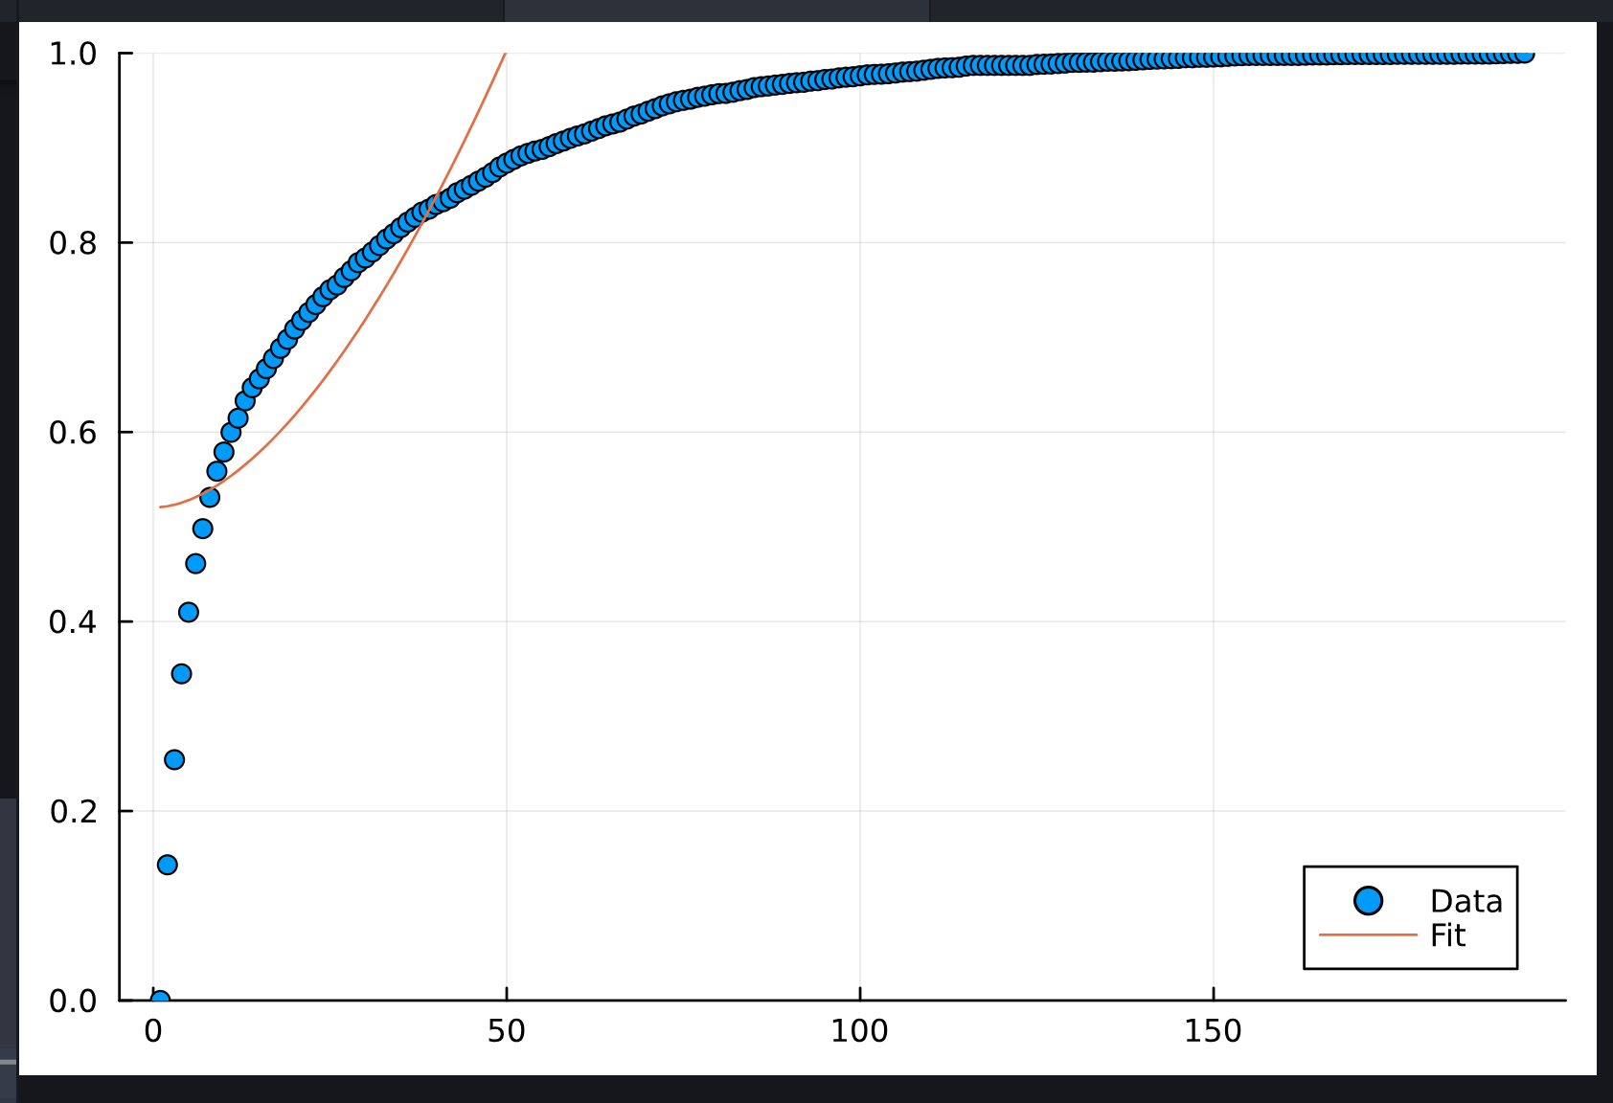
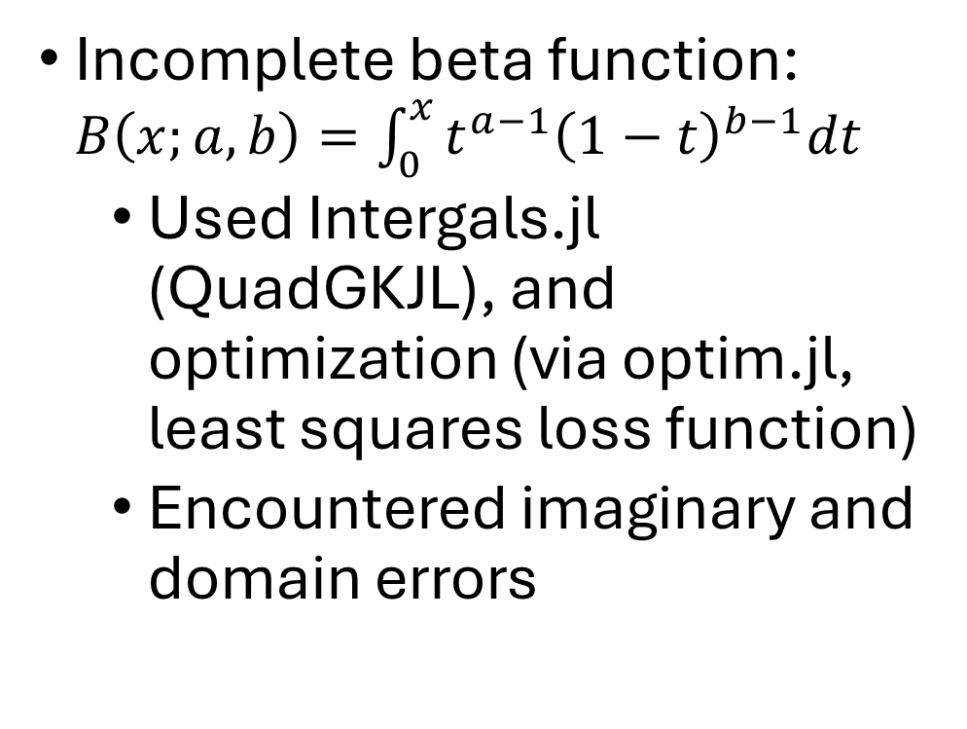
Traditional fitting function
Incomplete beta function: $B\left(x;a,b\right)=\int_{0}^{x}{t^{a−1}{\left(1−t\right)}^{b−1}dt}$
Used Intergals.jl (QuadGKJL), and optimization (via optim.jl, least squares loss function)
Encountered imaginary and domain errors

Slide 9
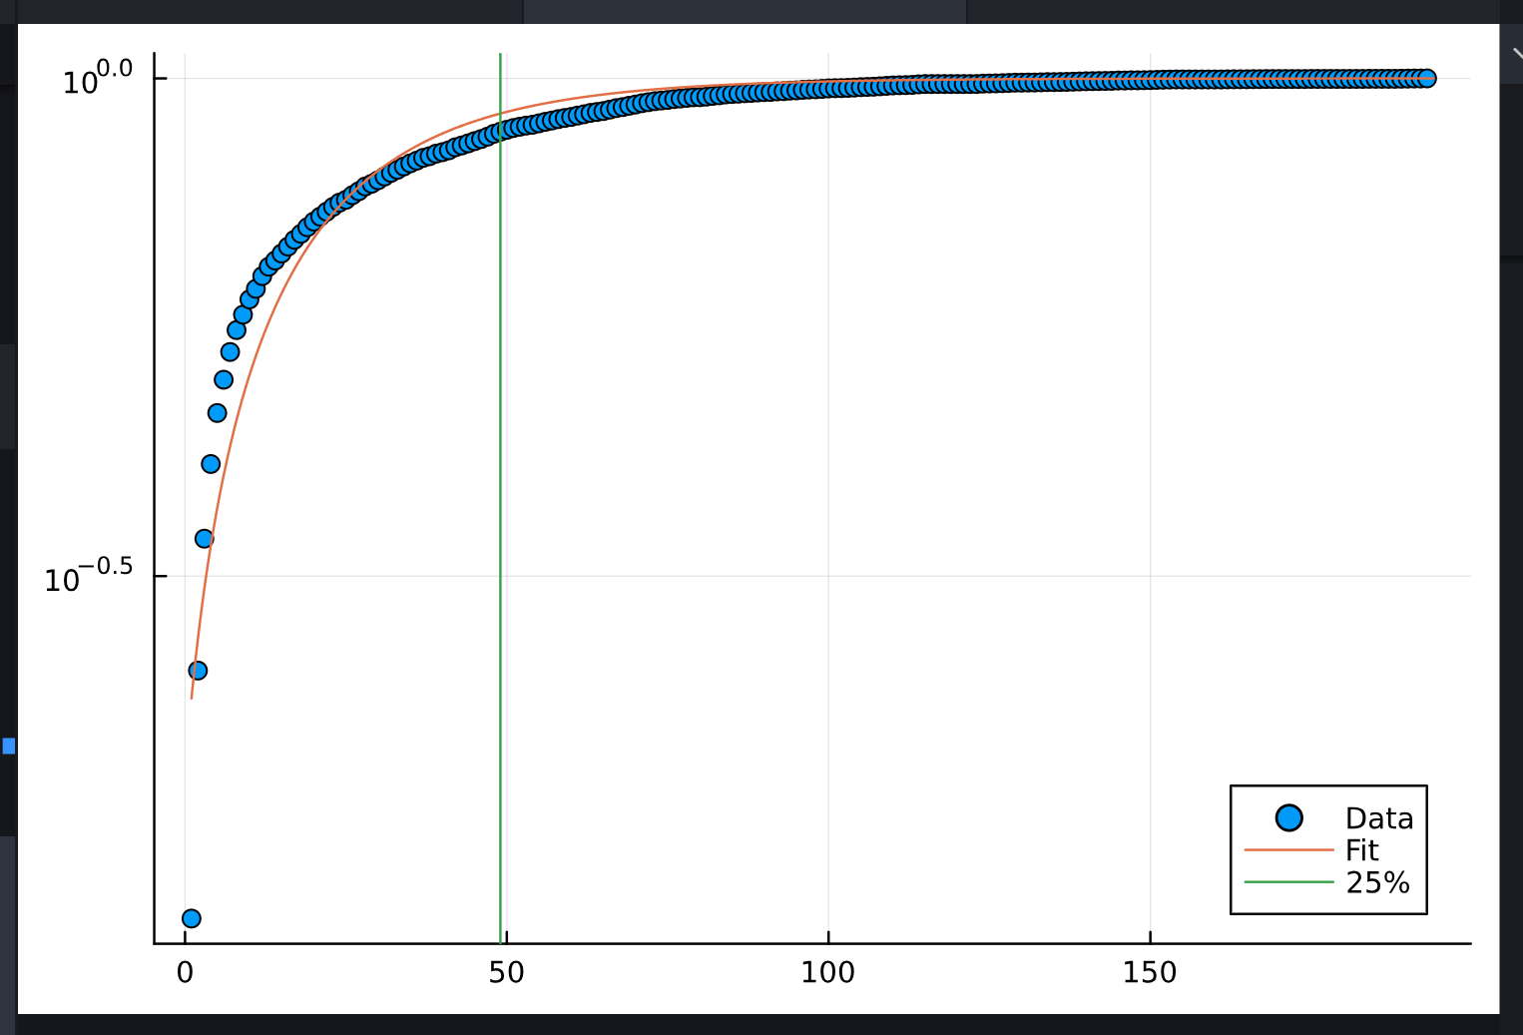
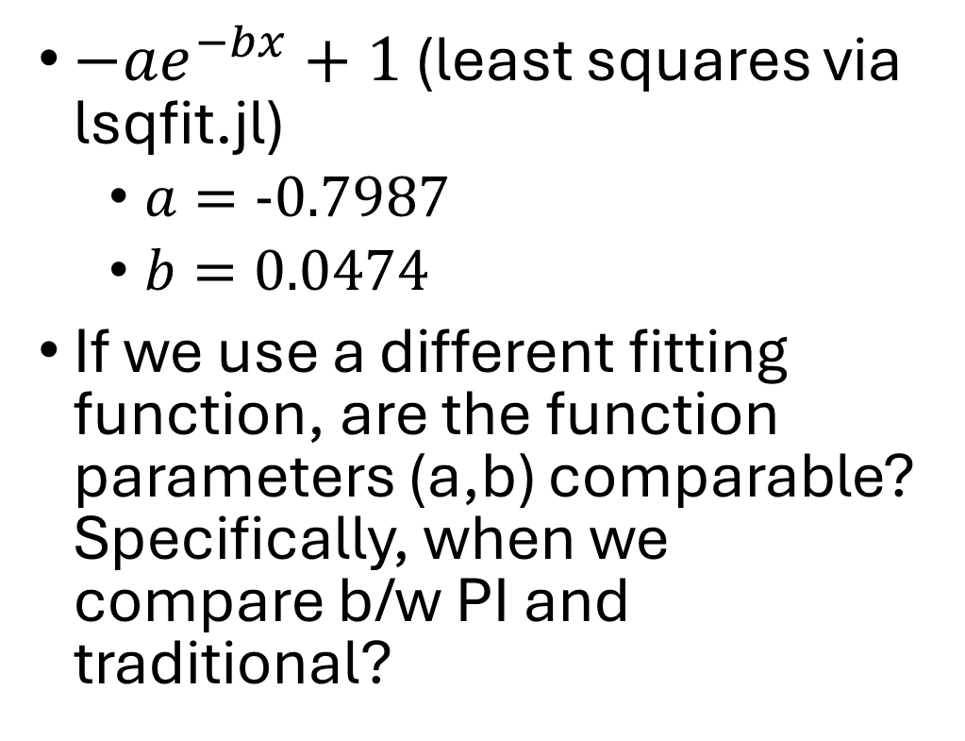
Traditional fitting function
$−ae^{−bx}+1$ (least squares via lsqfit.jl)
$a=−0.7987$
$b=0.0474$
If we use a different fitting function, are the function parameters (a,b) comparable? Specifically, when we compare b/w PI and traditional?

Slide 10
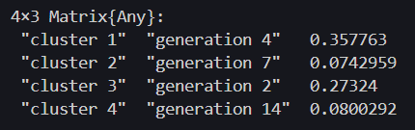
Circularities
Flow: cluster via labels > centroid > find max radius > max area > compare w actual pixel size (1 – pixel/area) > minimum per cluster

Slide 11
Progress
Abstract

Slide 12

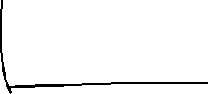
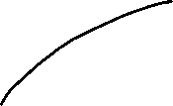
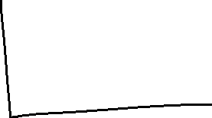

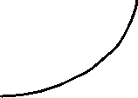

Slide 13
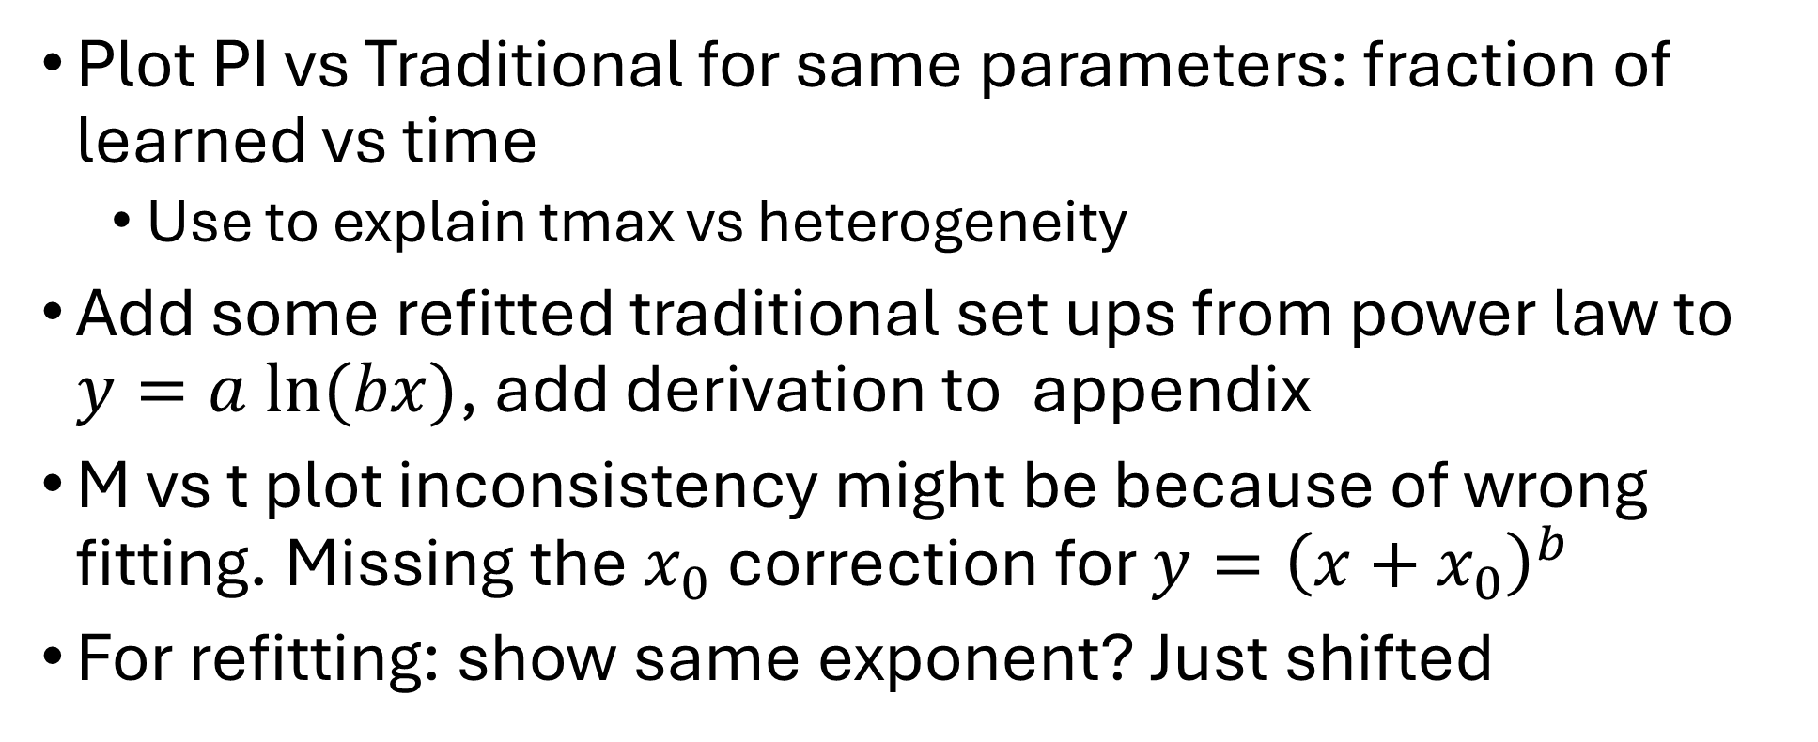
To do
Plot PI vs Traditional for same parameters: fraction of learned vs time
Use to explain tmax vs heterogeneity
Add some refitted traditional set ups from power law to $y=a ln⁡(bx)$, add derivation to appendix
M vs t plot inconsistency might be because of wrong fitting. Missing the $x_{0}$ correction for $y={\left(x+x_{0}\right)}^{b}$
For refitting: show same exponent? Just shifted

Slide 14
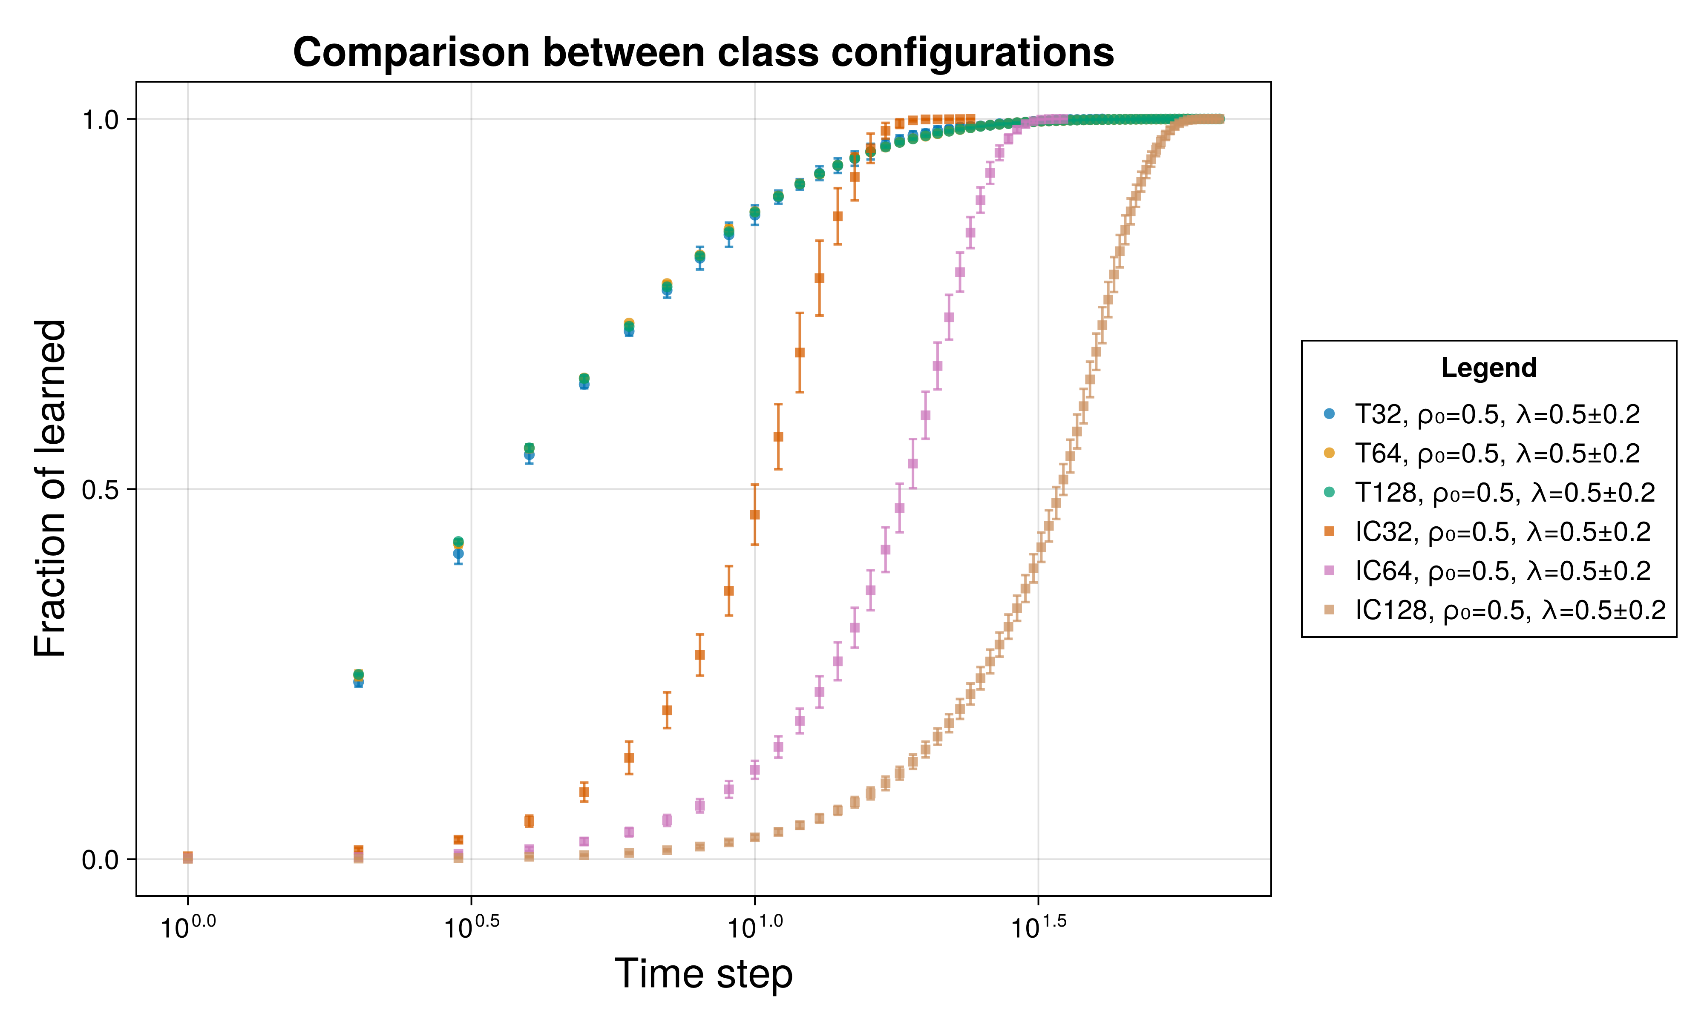
Comparison plots - size

Slide 15
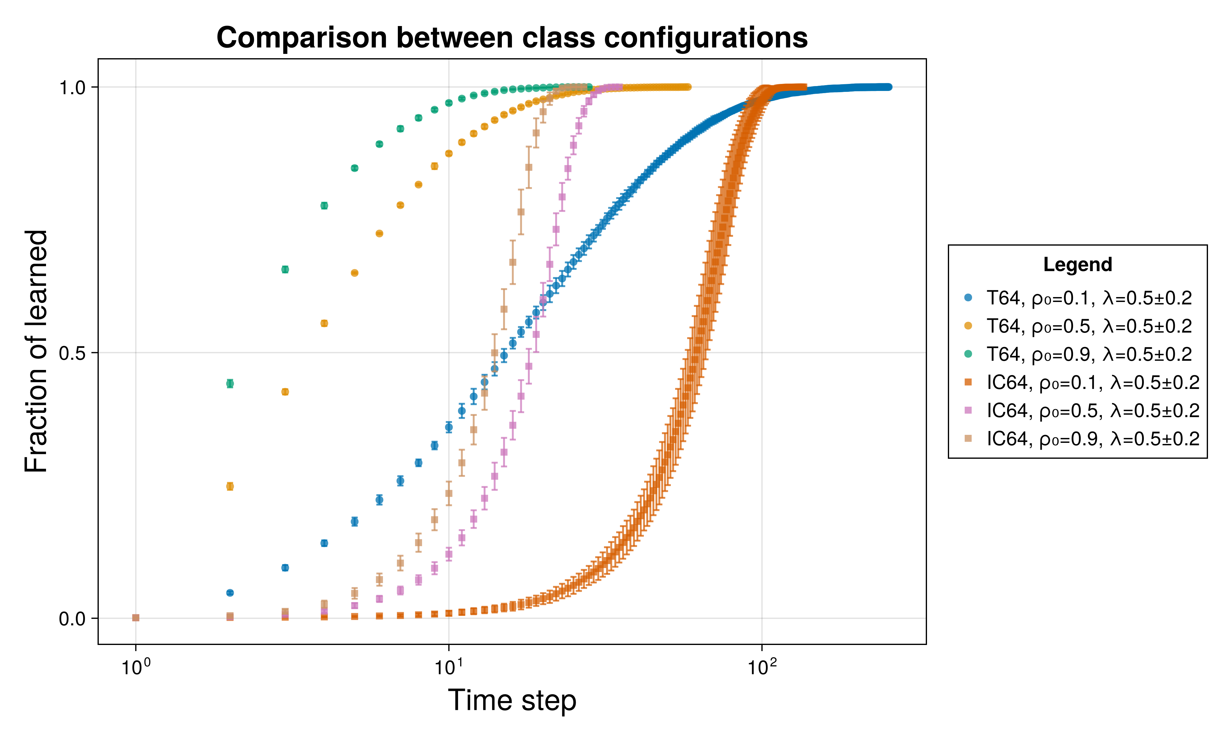
Comparison plots - rho

Slide 16
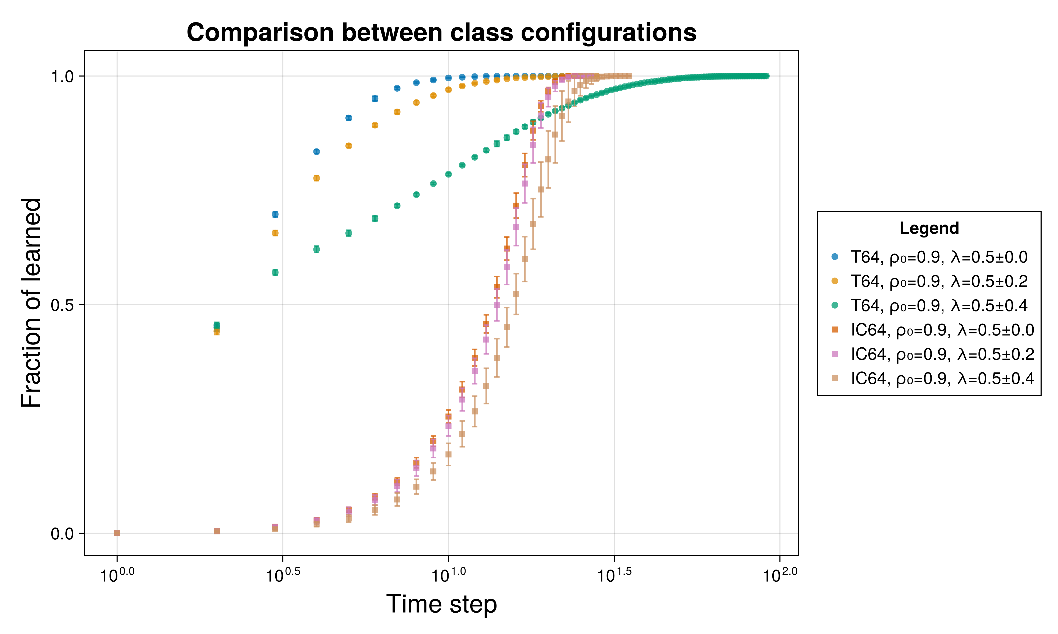
Comparison plots - delta

Slide 17
Parameter effects
 | Traditional | PI
size | Lengthens the tail length near completion (t_max) | Shift horizontal– more time delay before speed up
rho | Scaling – lengthening and shortening of curves. Earlier is affected more but bec it’s in log scale
delta | How fast the derivative/slope changes | Minimal shifting

