Slide 1
Classroom learning dynamics using a cellular automata spatiotemporal model comparing peer instruction and traditional instruction
AY 2024-2025 Sem 2
RM Slides
Sy, Clarence Ioakim T.
BS4+ Applied Physics
Adviser: Dr. Johnrob Bantang
Complexity Science Group

Slide 2
Research questions
How does the number of learned students develop over time?
Spatial position of high aptitude students in class
How does the positioning of learned students affect the learning rate of the class for peer instruction?
Learning rate
Traditional vs peer instruction
When is peer instruction better than traditional instruction?
Which factors lead to a difference in performance?

Slide 3
The classroom as a binary probabilistic CA model
The classroom is set to be a 2D square grid of varying lengths.
Students are either learned or not learned.
Simulations are initialized with 4 different seating arrangements (SA): inner corner, outer corner, center, random.
The simulation is considered done when all students are learned.

Slide 4
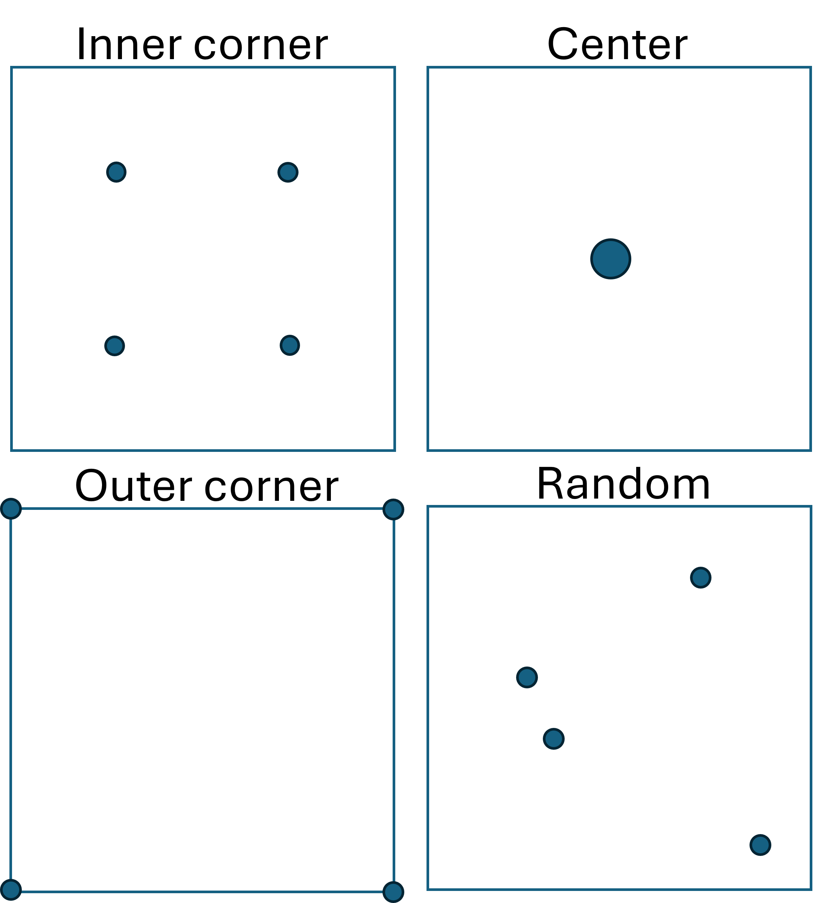
Different PI seating arrangements
- Circles indicate location of learned students

Slide 5
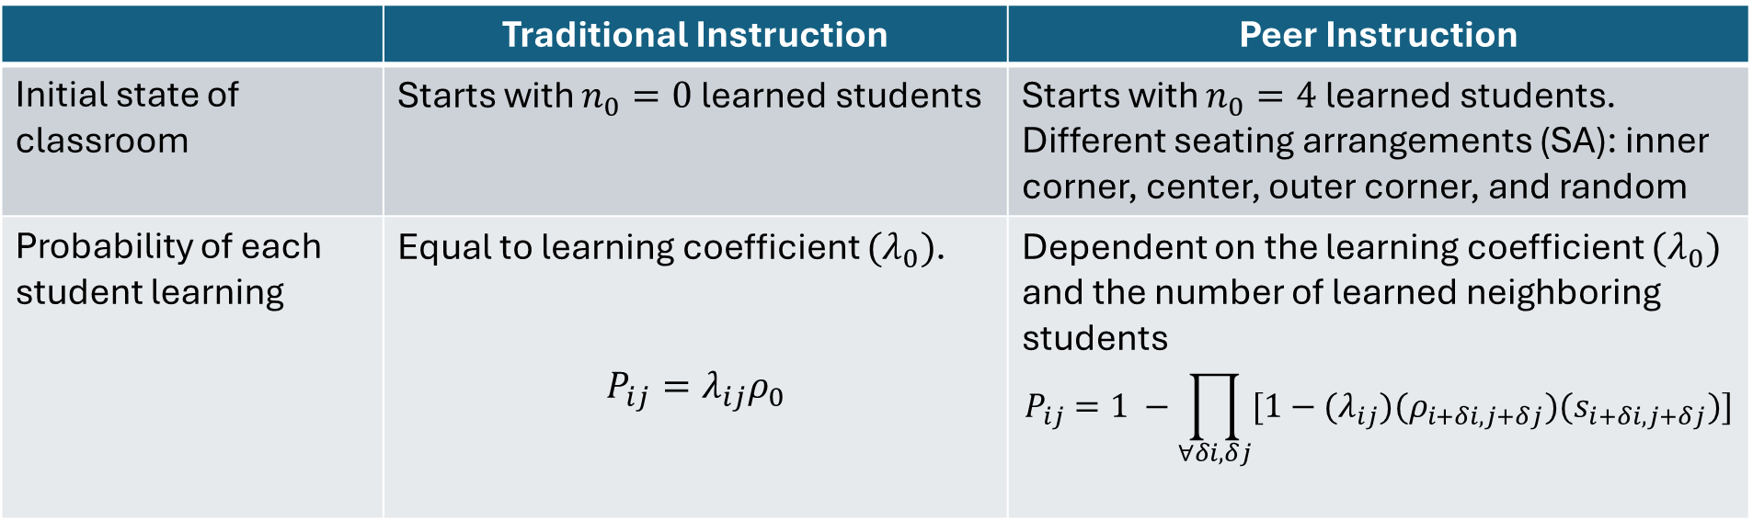
PCA rules for classroom simulation
 | Traditional Instruction | Peer Instruction
Initial state of classroom | Starts with $n_{0}=0$ learned students | Starts with $n_{0}=4$ learned students. Different seating arrangements (SA): inner corner, center, outer corner, and random
Probability of each student learning | Equal to learning coefficient $(λ_{0})$. $$P_{ij}=λ_{ij}ρ_{0}$$ | Dependent on the learning coefficient $(λ_{0})$ and the number of learned neighboring students $$P_{ij}=1 −\prod_{∀δi,δj}{[1−{(λ}_{ij})(ρ_{i+δi, j+δj})(s_{i+δi, j+δj})]}$$

Slide 6
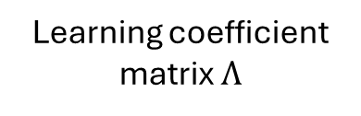
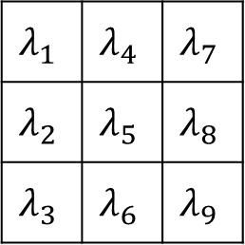
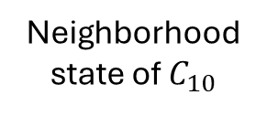
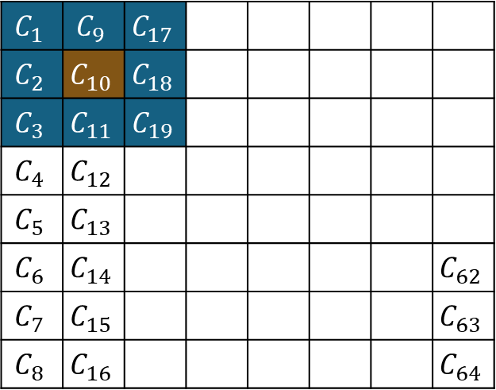

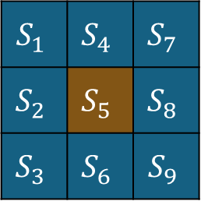
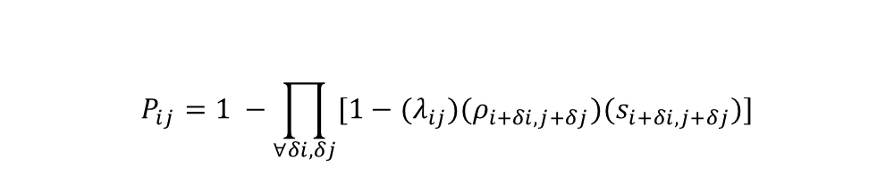
Determining learning probability per time step
$$S_{1}$$ | $$S_{4}$$ | $$S_{7}$$
$$S_{2}$$ | $$S_{5}$$ | $$S_{8}$$
$$S_{3}$$ | $$S_{6}$$ | $$S_{9}$$
$$λ_{1}$$ | $$λ_{4}$$ | $$λ_{7}$$
$$λ_{2}$$ | $$λ_{5}$$ | $$λ_{8}$$
$$λ_{3}$$ | $$λ_{6}$$ | $$λ_{9}$$
$$C_{1}$$ | $$C_{9}$$ | $$C_{17}$$
$$C_{2}$$ | $$C_{10}$$ | $$C_{18}$$
$$C_{3}$$ | $$C_{11}$$ | $$C_{19}$$
$$C_{4}$$ | $$C_{12}$$
$$C_{5}$$ | $$C_{13}$$
$$C_{6}$$ | $$C_{14}$$ |  |  |  |  |  | $$C_{62}$$
$$C_{7}$$ | $$C_{15}$$ |  |  |  |  |  | $$C_{63}$$
$$C_{8}$$ | $$C_{16}$$ |  |  |  |  |  | $$C_{64}$$
$$⊙$$
Neighborhood state of $C_{10}$
Learning coefficient matrix $Λ$
$$P_{ij}=1 −\prod_{∀δi,δj}{[1−{(λ}_{ij})(ρ_{i+δi, j+δj})(s_{i+δi, j+δj})]}$$
Learning probability:
Classroom represented as lattice of cells

Slide 7
Comparison with Nitta model (2010)
Observations:
Close to Nitta for favorable conditions of PI
Small, fast, homogenous
TI does not conform at all (positive concavity)
Pls see /output/analysis/return-map for plots

Slide 8
PRPE paper conclusions
Results of modelling PI as CA are consistent with current findings
PI yields better or similar results to TI (3D plots, multiple)
PI is better for classes with slower learners than TI (3D plots)
Heterogeneity is bad
Current best practices validated
New?:
Different dynamics (2-stage learning for TI, S-curve evolution for PI)
Different optimal seating arrangement

Slide 9
PRPE reminders:
Cite SPP and Ma’am Ianne
Ask ma’am Ianne to help review, middle author
March 15, 2025 deadline to submit

Slide 10
March 25, 2025
Potential new fitting function to keep comparability but has better interpretability

Slide 11
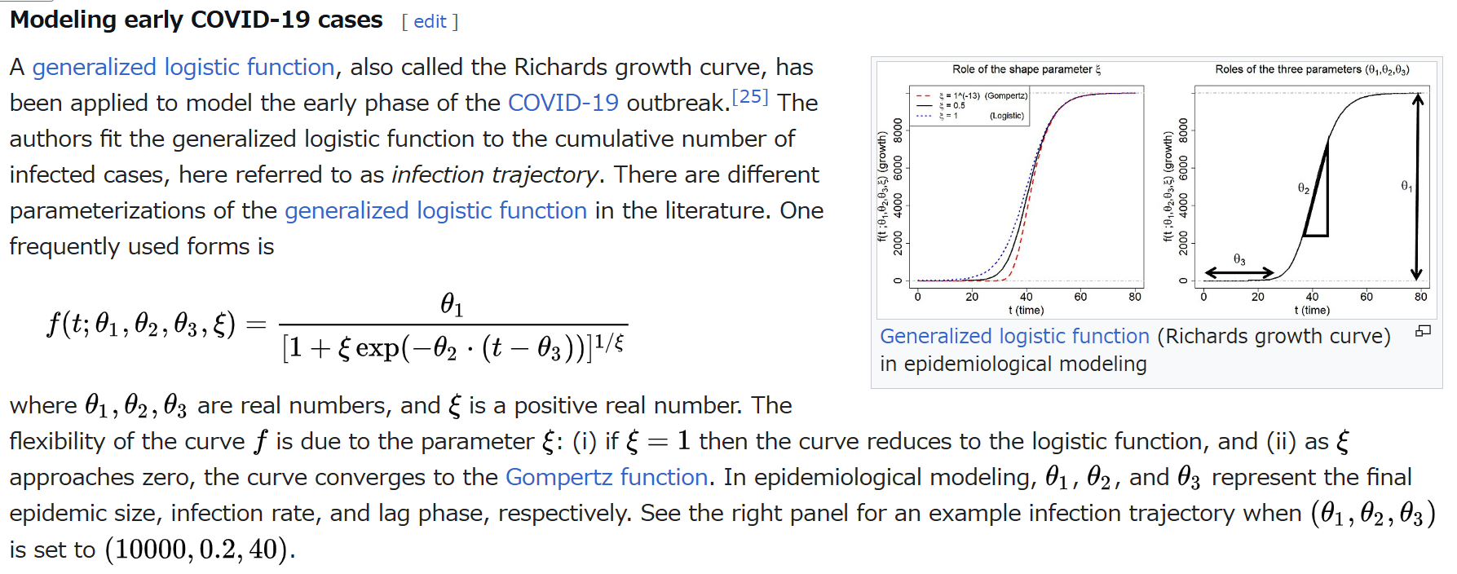
Generalized logistic function/Richard’s growth curve

Slide 12
Idea: DynamicalSystems.jl
Not sure if I can apply built-in analysis to my system/data
For observed/measured data: ComplexityMeasures.jl
Probabilities, info measures, complexity measures
!! Don’t really understand docs

Slide 13
