Slide 1
Classroom learning dynamics using a cellular automata spatiotemporal model comparing peer instruction and traditional instruction
Clarence Ioakim T. Sy
Adviser: Johnrob Y. Bantang, Ph.D.
Instrumentation Physics Laboratory
National Institute of Physics
University of the Philippines Diliman
Notes:
Hi, I’m Clarence and my research is all about classroom dynamics using a cellular automata spatiotemporal model comparing peer instruction and traditional instruction.

Slide 2


Traditional instruction vs peer instruction
Traditional instruction | Peer instruction
The instructor delivers a lecture to the whole class for the duration of the class time. | Students are given the chance to learn from each other during class time after an initial lecture by the instructor.
Notes:
What is peer instruction and how does it differ from traditional instruction?
Traditional instruction is done usually via a lecture delivered by the instructor for the duration of the class’s time
As for peer instruction, the most popular way to do it is for the instructor to deliver a short lecture to be followed by giving a concept test to prompt student discussion which provides students the opportunity to learn from each other

Slide 3
Advantages of peer instruction
Improve students’ conceptual understanding and problem-solving skills compared to traditional instruction
Benefit groups even if no one in it initially fully understood the lesson
Students under peer instruction can perform as good as or better than those under traditional instruction regardless of background knowledge
Notes:
Why should peer instruction matter?
Peer instruction has shown to improve both conceptual understanding and problem solving-skills
It also benefits groups even if no one in the group fully understood the lesson
Furthermore, its success in the classroom does not rely on the students’ background knowledge

Slide 4
Research questions
How does the number of learned students develop over time?
Spatial position of high aptitude students in class
How does the positioning of learned students affect the learning rate of the class for peer instruction?
Learning rate
Traditional vs peer instruction
When is peer instruction better than traditional instruction?
Which factors lead to a difference in performance?
Notes:
What do I want to find out specifically?
First, I want to find out how learning develops in the classroom over time
Second, I want to find out when peer instruction performs better than traditional instruction and what factors can sway the advantage
Last, I want to find out how different seating arrangements can affect peer instruction

Slide 5
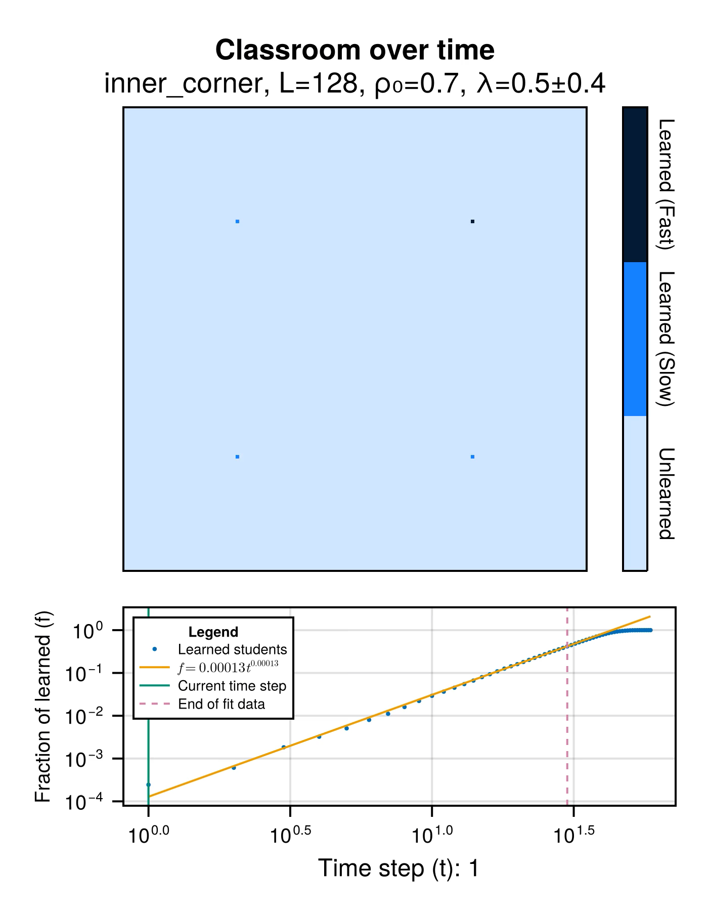
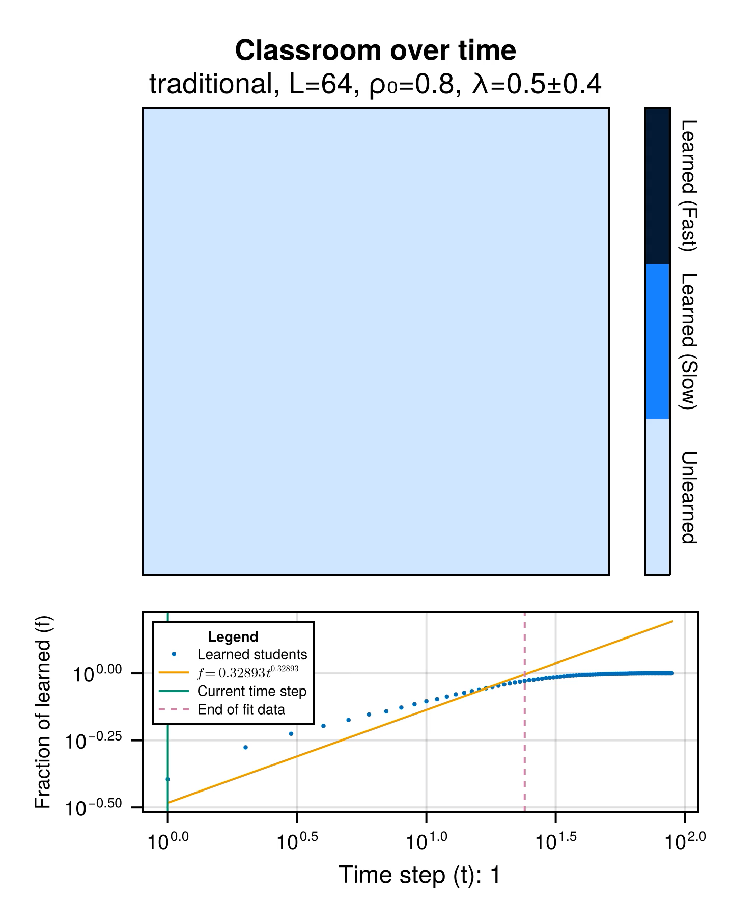


The classroom as a probabilistic cellular automata
Notes:
To answer these questions, we modelled the classroom as a binary-state probabilistic cellular automata model where each cell represents a student, who can then be learned or not learned. This is what that looks like for both peer instruction and traditional instruction.

Slide 6
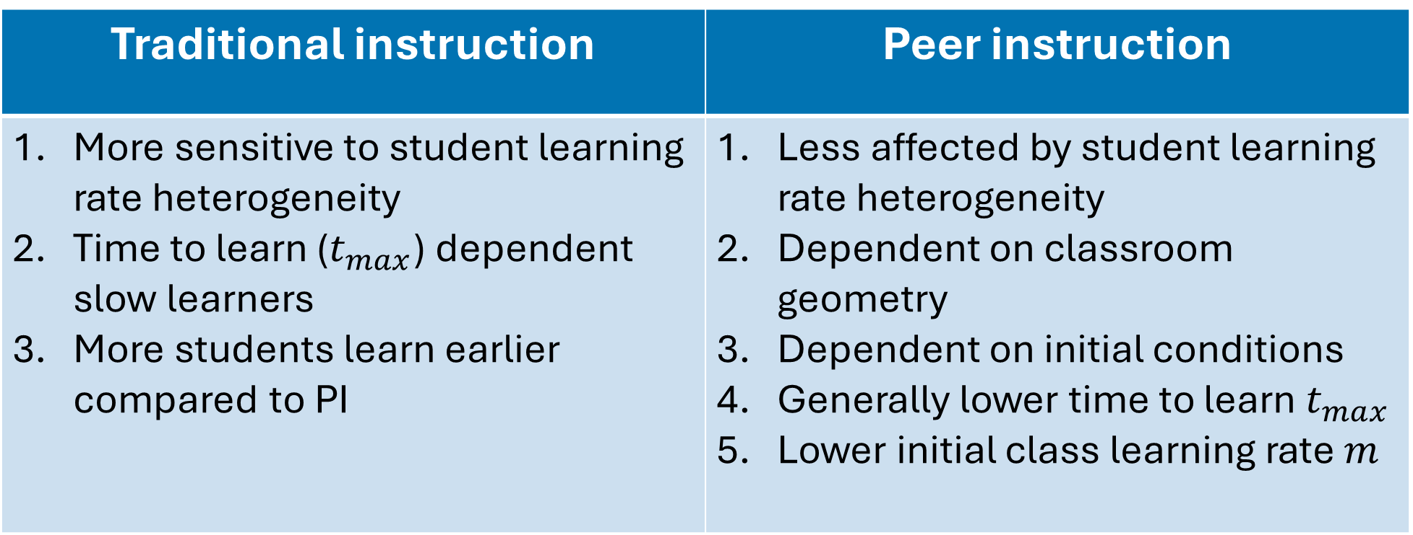
Key findings
Traditional instruction | Peer instruction
More sensitive to student learning rate heterogeneity Time to learn ($t_{max}$) dependent slow learners More students learn earlier compared to PI | Less affected by student learning rate heterogeneity Dependent on classroom geometry Dependent on initial conditions Generally lower time to learn $t_{max}$ Lower initial class learning rate $m$
Notes:
We found that
Traditional instruction is more sensitive to variations in the students’ individual learning rate
Traditional instruction has more students learning earlier but takes more time to get all the students in class to learn
Peer instruction is not so dependent on students’ individual learning rate but is dependent on initial conditions and classroom geometry
Peer instruction has a lower class learning rate but takes less time to get all the students in the class to learn

Slide 7
Classroom learning dynamics using a cellular automata spatiotemporal model comparing peer instruction and traditional instruction
Undergraduate Thesis Defense
December 12, 2024, 10:30 AM to 11:30 AM
National Institute of Physics R211
Clarence Ioakim T. Sy
Adviser: Johnrob Y. Bantang, Ph.D.
Instrumentation Physics Laboratory
National Institute of Physics
University of the Philippines Diliman
Notes:
If you want to find out more, I invite you to attend my undergraduate thesis defense where I’ll discuss my study in more detail

Slide 8
Modelling learning in different modes of instruction
Traditional instruction | Peer instruction
Students’ learning rate Instructor’s teaching rate | Students’ learning rate Relative position from a learned student
Notes:
The factors that we made to affect learning in different set ups.
Relative position from a learned student includes seating arrangement and the neighborhood

