Slide 1
Learning dynamics in a cellular automata model of classroom peer-to-peer interactions
Sy, Clarence Ioakim T.
Ramos, Reinier Xander A.
Bantang, Johnrob Y.
CIT Sy, RXA Ramos, and JY Bantang, Learning dynamics in a cellular automata model of classroom peer-to-peer interactions, Proceedings of the Samahang Pisika ng Pilipinas 42, SPP-2024-1E-04 (2024). URL: https://proceedings.spp-online.org/article/view/SPP-2024-1E-04.
42nd Samahang Pisika ng Pilipinas (SPP) Physics Conference and Annual Meeting
July 3, 2024, Parallel Session 1E
Batangas State University, Batangas City

Slide 2
Traditional Instruction vs Peer Instruction
Traditional instruction | Peer instruction
The teacher delivers a lecture to the whole class for the duration of the class’s time | Students are given the chance to learn from each other during class time after an initial lecture by the teacher

Slide 3
Benefits of peer instruction (PI)
Shown to improve students’ conceptual understanding and problem-solving skills compared to traditional instruction.
Can still benefit groups even if no one in it initially knew the answer.
Students with less background knowledge learned as much as from PI as students with more background knowledge taught through traditional instruction.

Slide 4
Research questions:
How does the number of learned students (binary states) evolve over time?
Position of high aptitude students
How does the position of learned students affect the learning rate of the class for peer instruction set ups?
Learning rate
Traditional vs peer instruction
When is peer instruction better than traditional instruction?
What factors lead to a difference in performance?

Slide 5
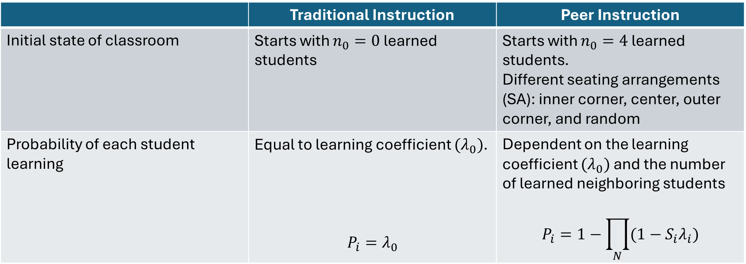
PCA Rules
 | Traditional Instruction | Peer Instruction
Initial state of classroom | Starts with $n_{0}=0$ learned students | Starts with $n_{0}=4$ learned students. Different seating arrangements (SA): inner corner, center, outer corner, and random
Probability of each student learning | Equal to learning coefficient $(λ_{0})$. $$P_{i}=λ_{0}$$ | Dependent on the learning coefficient $(λ_{0})$ and the number of learned neighboring students $$P_{i}=1−\prod_{N}{(1−S_{i}λ_{i})}$$

Slide 6
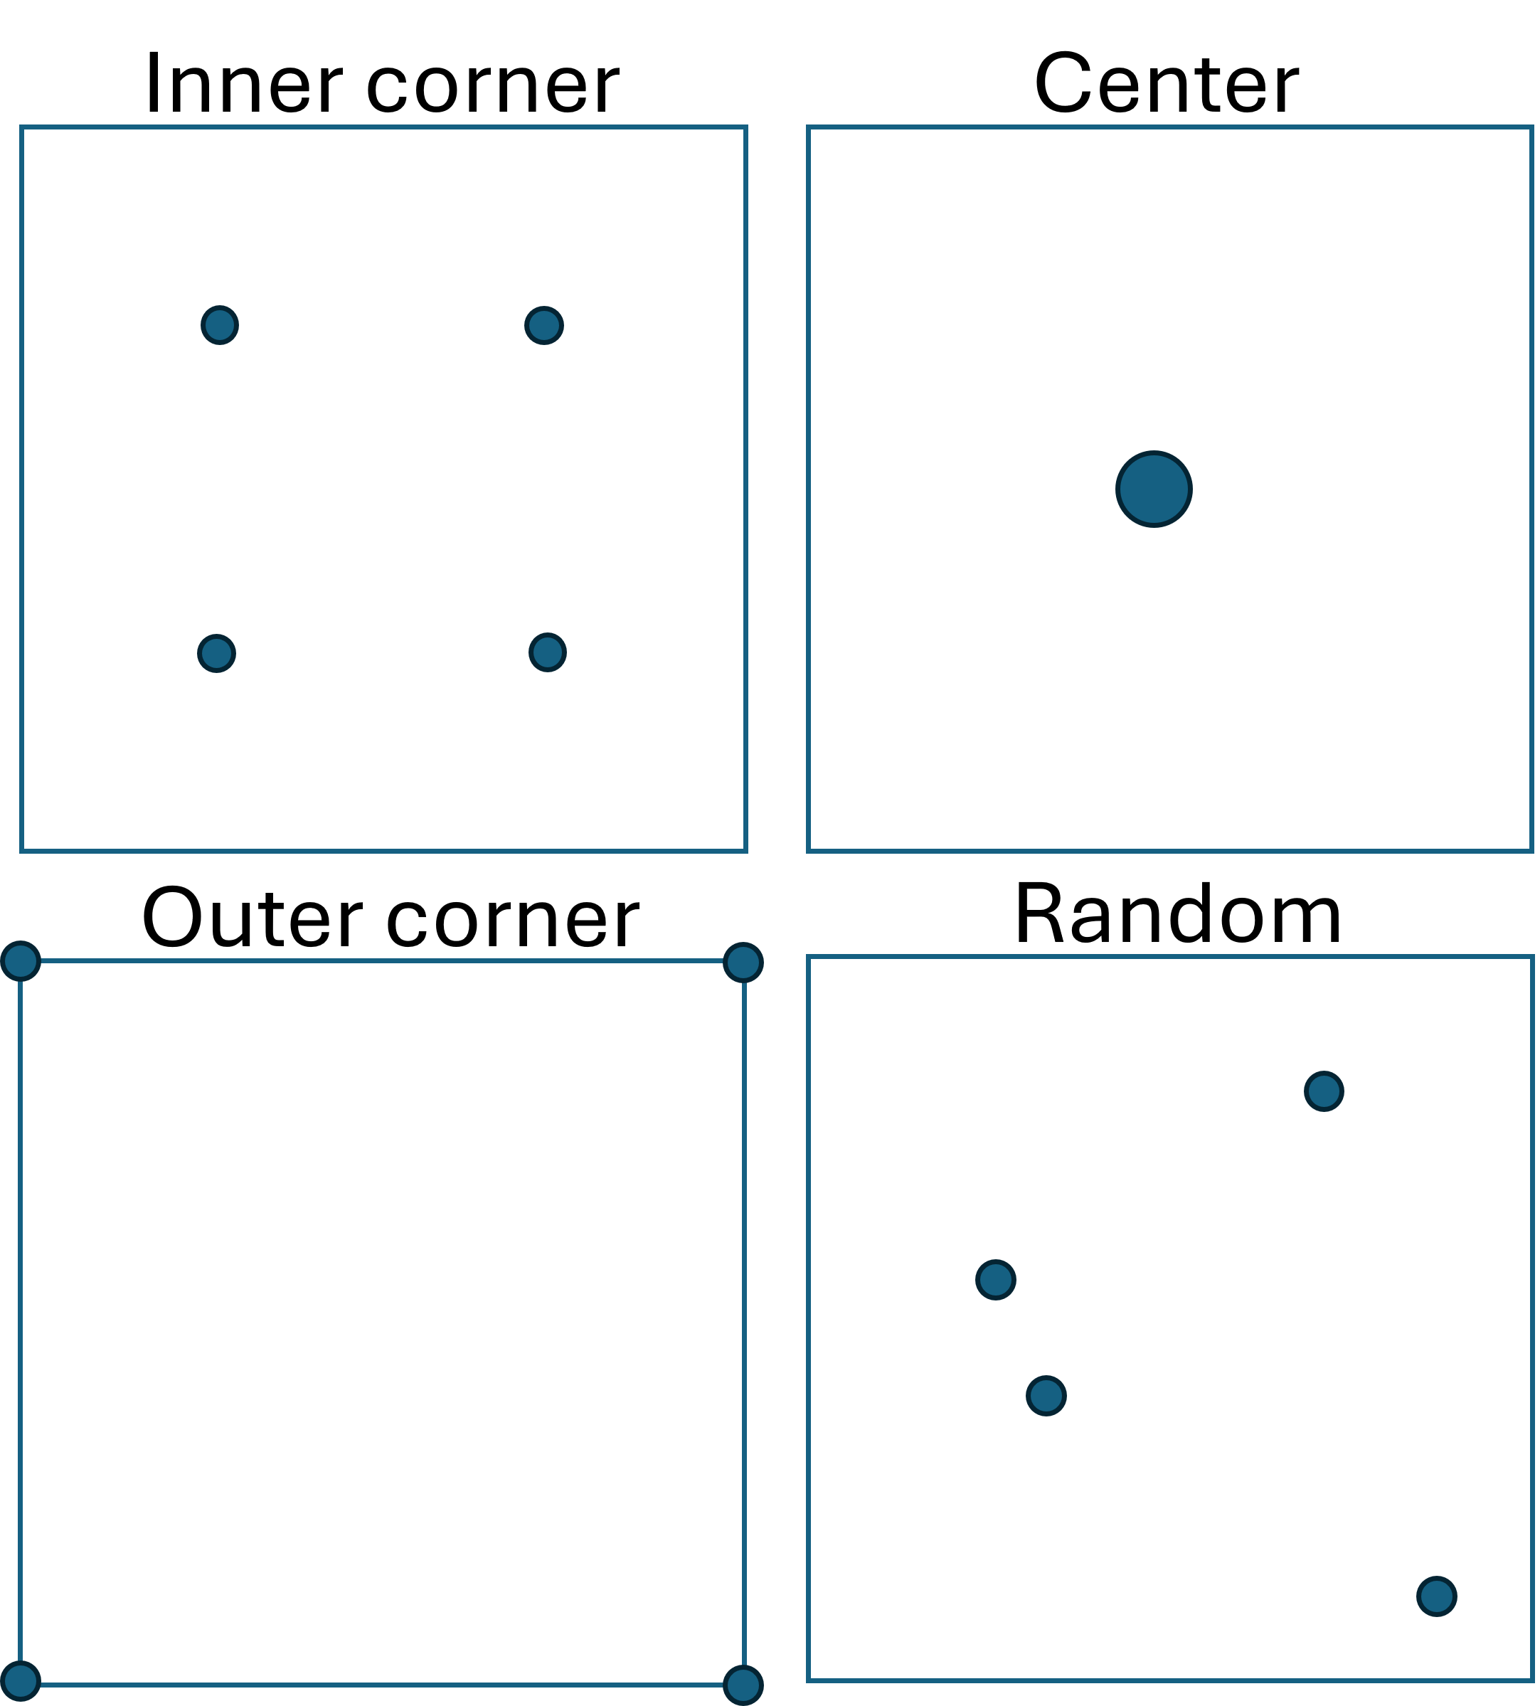
Different PI Seating Arrangements

Slide 7

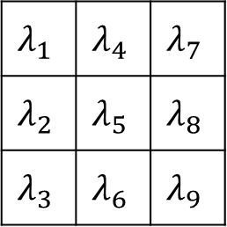

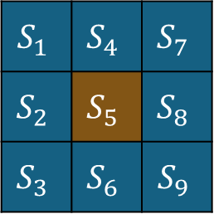
PCA Rules for Peer Instruction
$$S_{1}$$ | $$S_{4}$$ | $$S_{7}$$
$$S_{2}$$ | $$S_{5}$$ | $$S_{8}$$
$$S_{3}$$ | $$S_{6}$$ | $$S_{9}$$
$$λ_{1}$$ | $$λ_{4}$$ | $$λ_{7}$$
$$λ_{2}$$ | $$λ_{5}$$ | $$λ_{8}$$
$$λ_{3}$$ | $$λ_{6}$$ | $$λ_{9}$$
1 | 9 | 17
2 | 10 | 18
3 | 11 | 19
4 | 12
5 | 13
6 | 14 |  |  |  |  |  | 62
7 | 15 |  |  |  |  |  | 63
8 | 16 |  |  |  |  |  | 64
$$⊙$$
$$P_{i}=1−\prod_{N}{(1−S_{i}λ_{i})}$$
Learning probability:
Classroom

Slide 8



PCA Rules for Peer Instruction
$$t=0$$
$$t=1$$
$$t=2$$

Slide 9
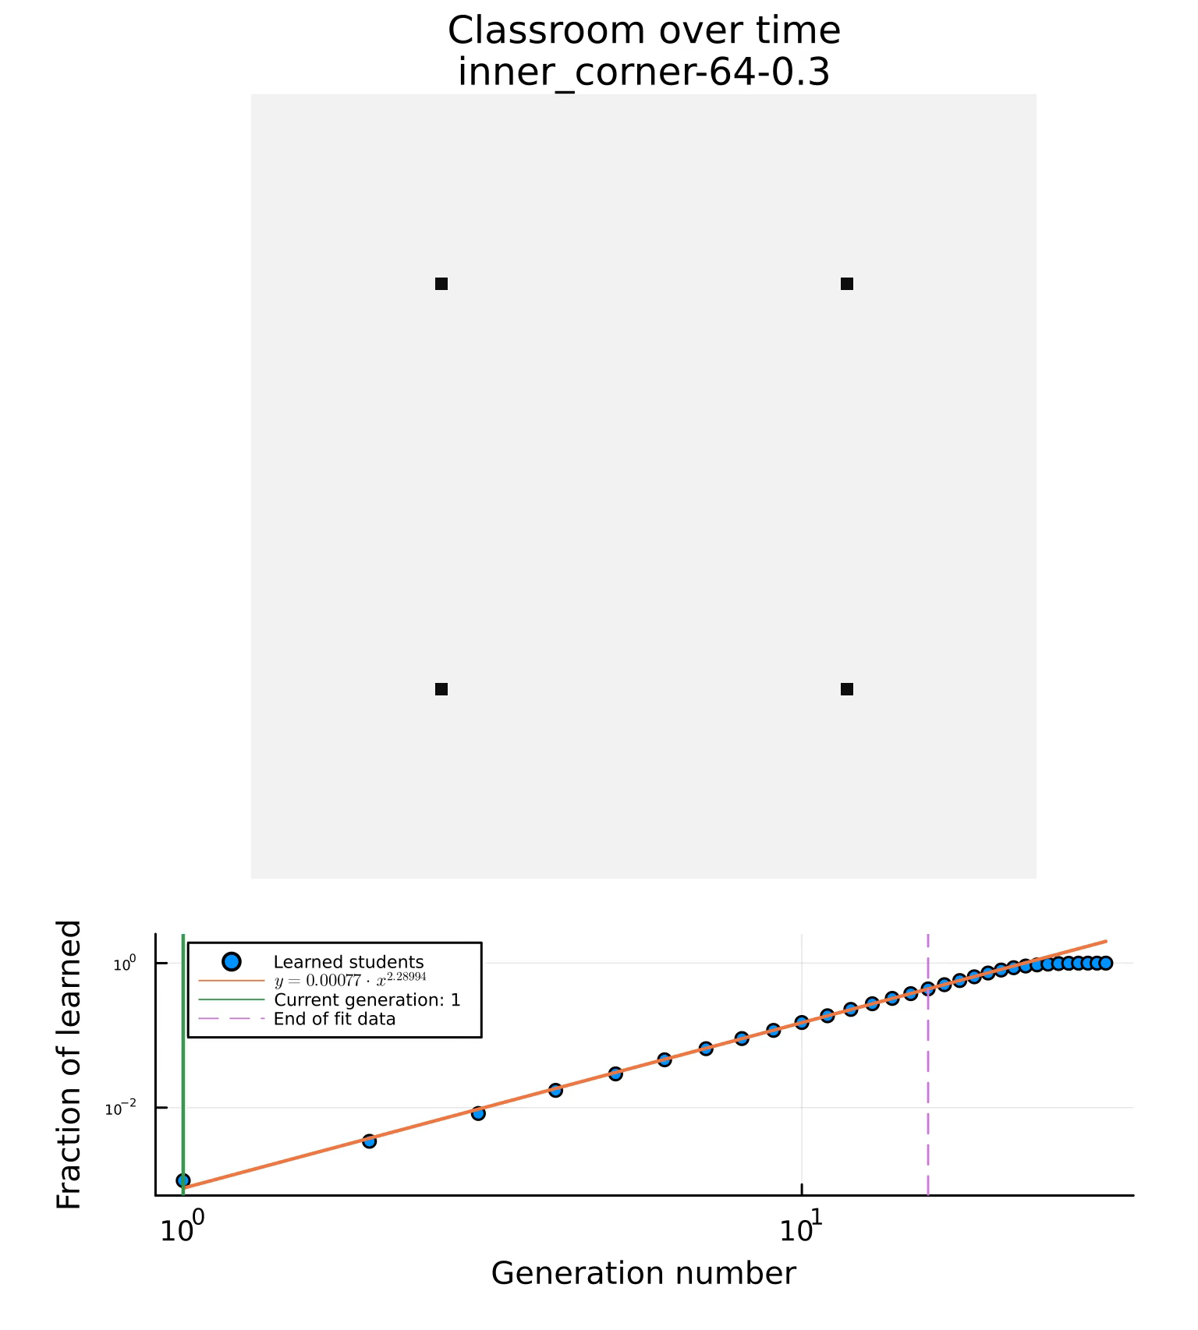
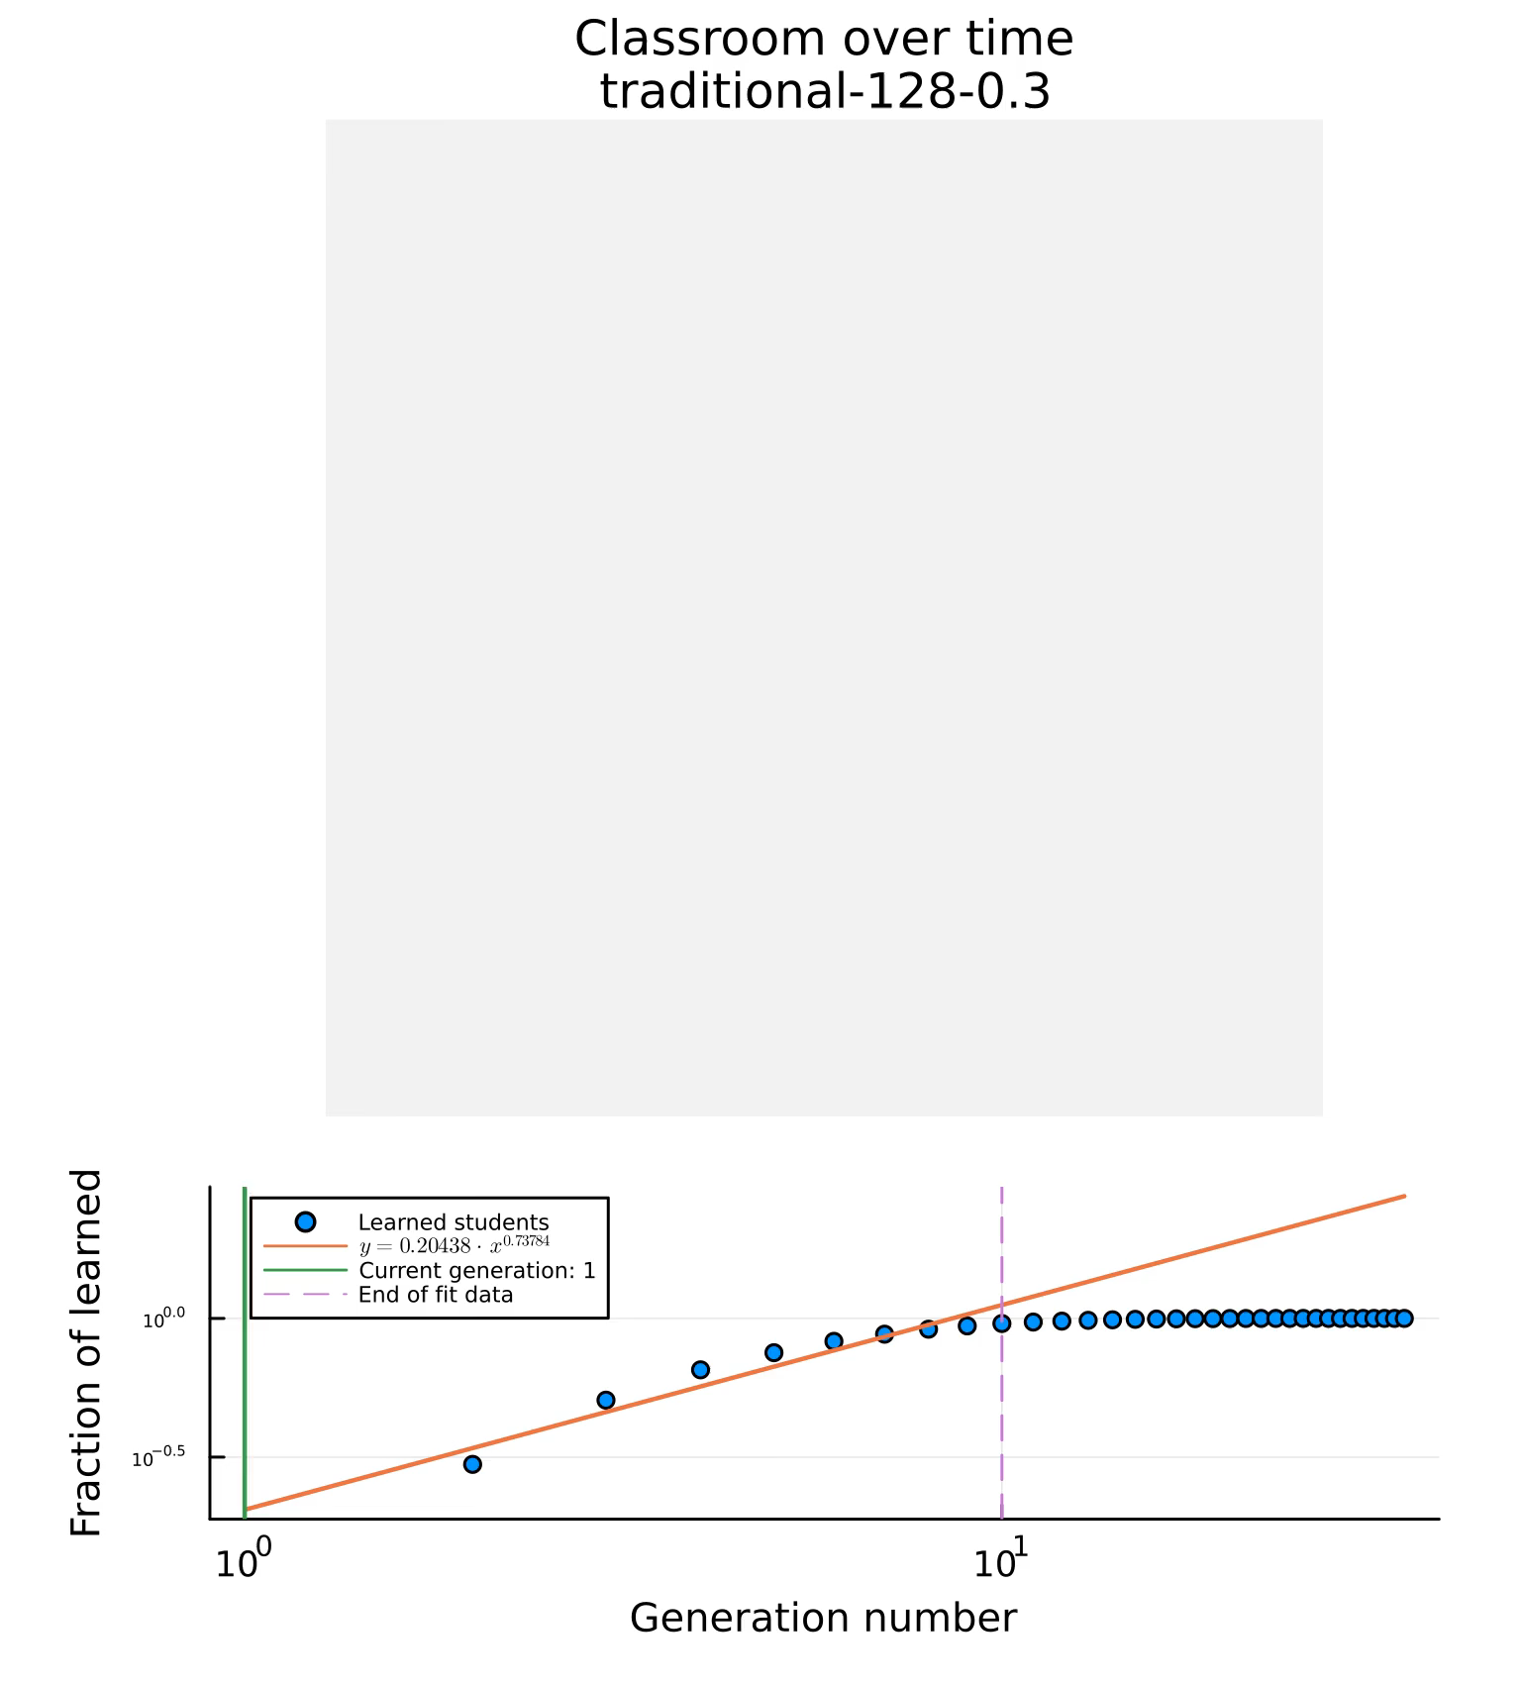

Slide 10
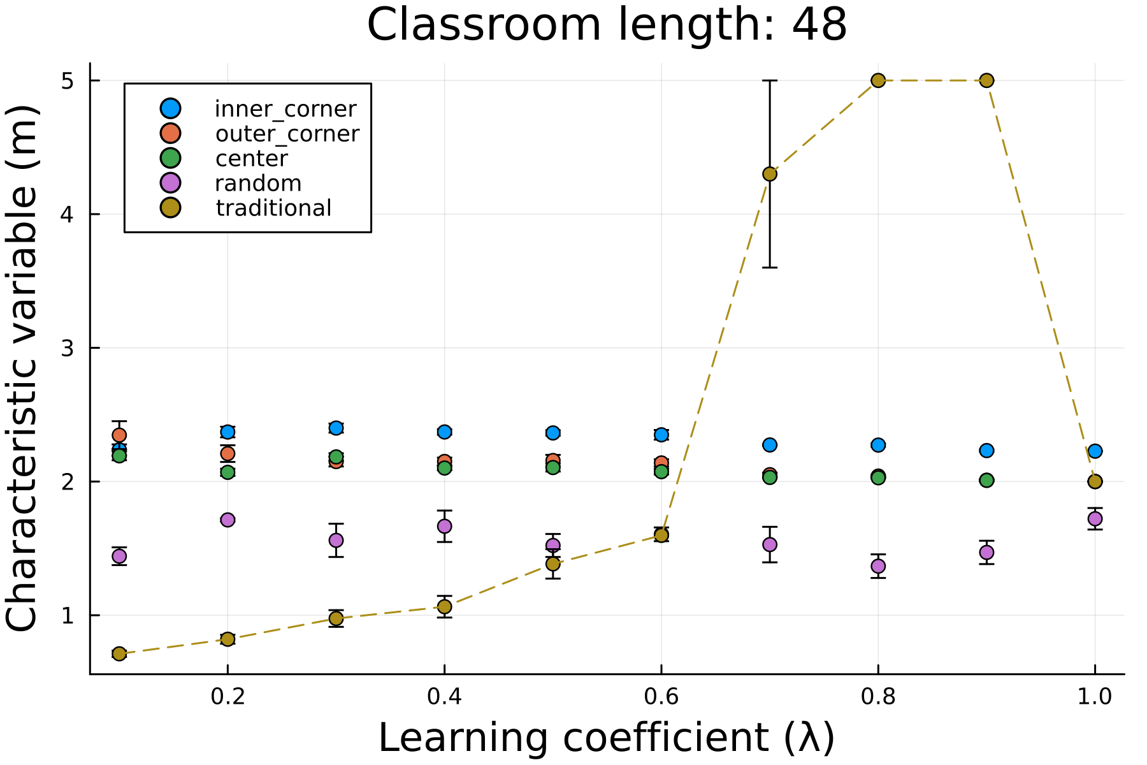
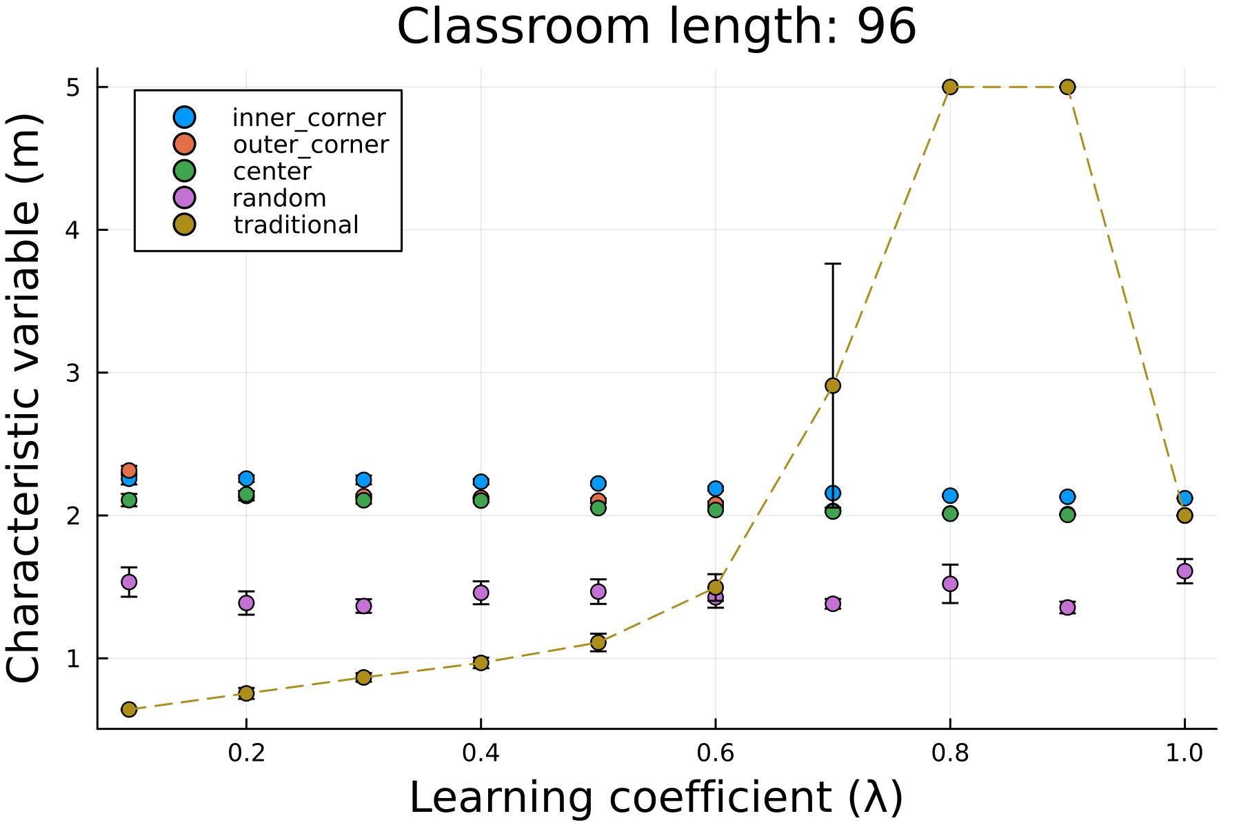
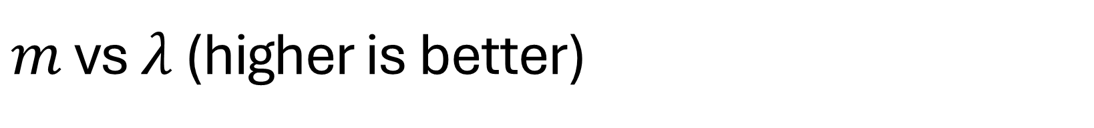
$m$ vs $λ$ (higher is better)

Slide 11
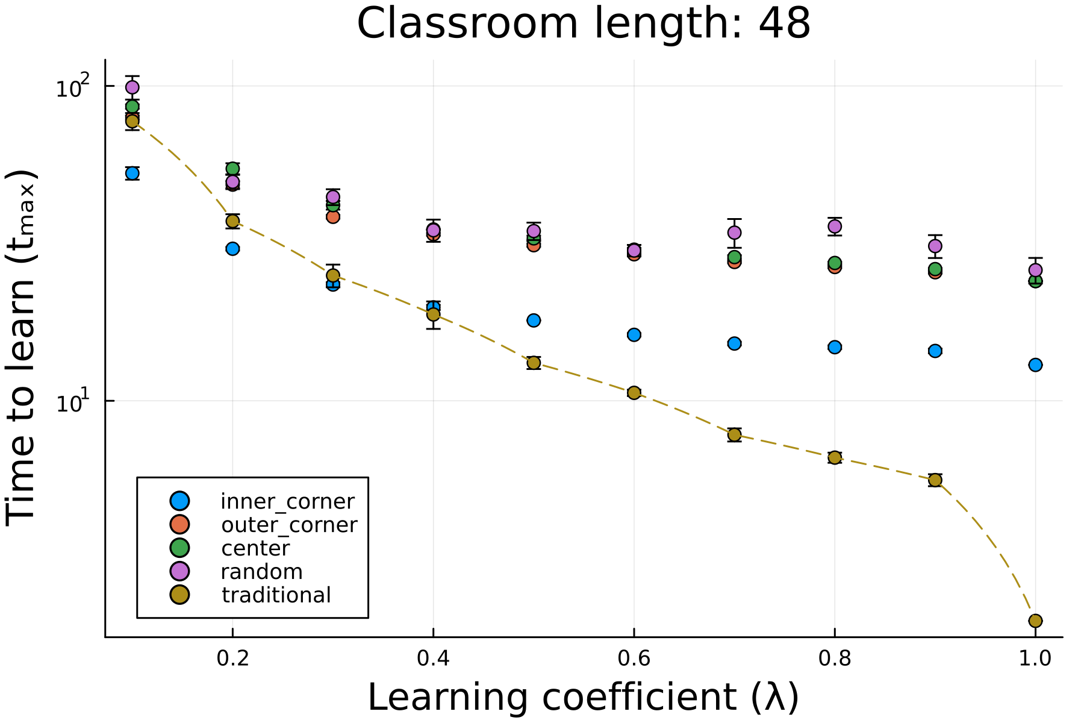
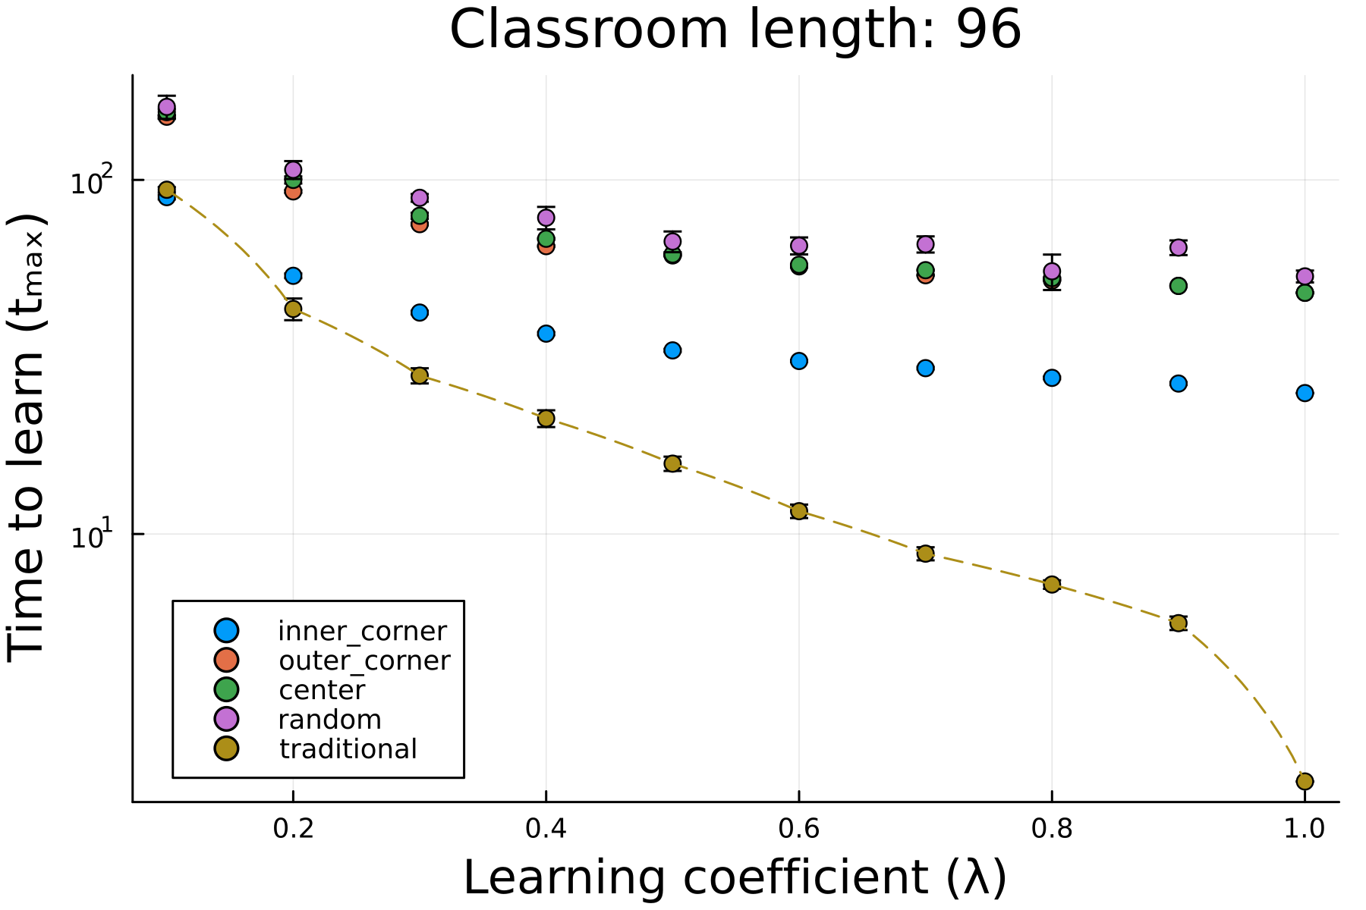
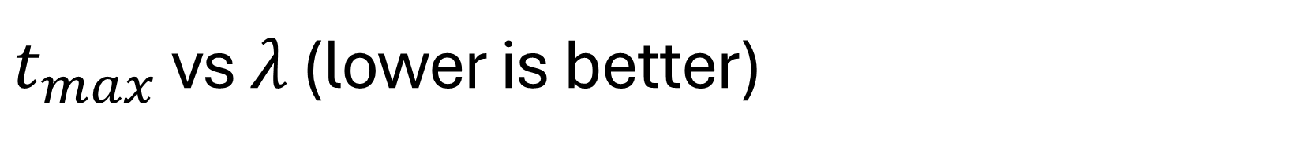
$t_{max}$ vs $λ$ (lower is better)

Slide 12



Analytic explanation
$$d_{max}=\frac{L⋅\sqrt{2}}{4}$$
$$d_{max}=\frac{L⋅\sqrt{2}}{2}$$
$$d_{max}=\frac{L⋅\sqrt{2}}{2}$$

Slide 13
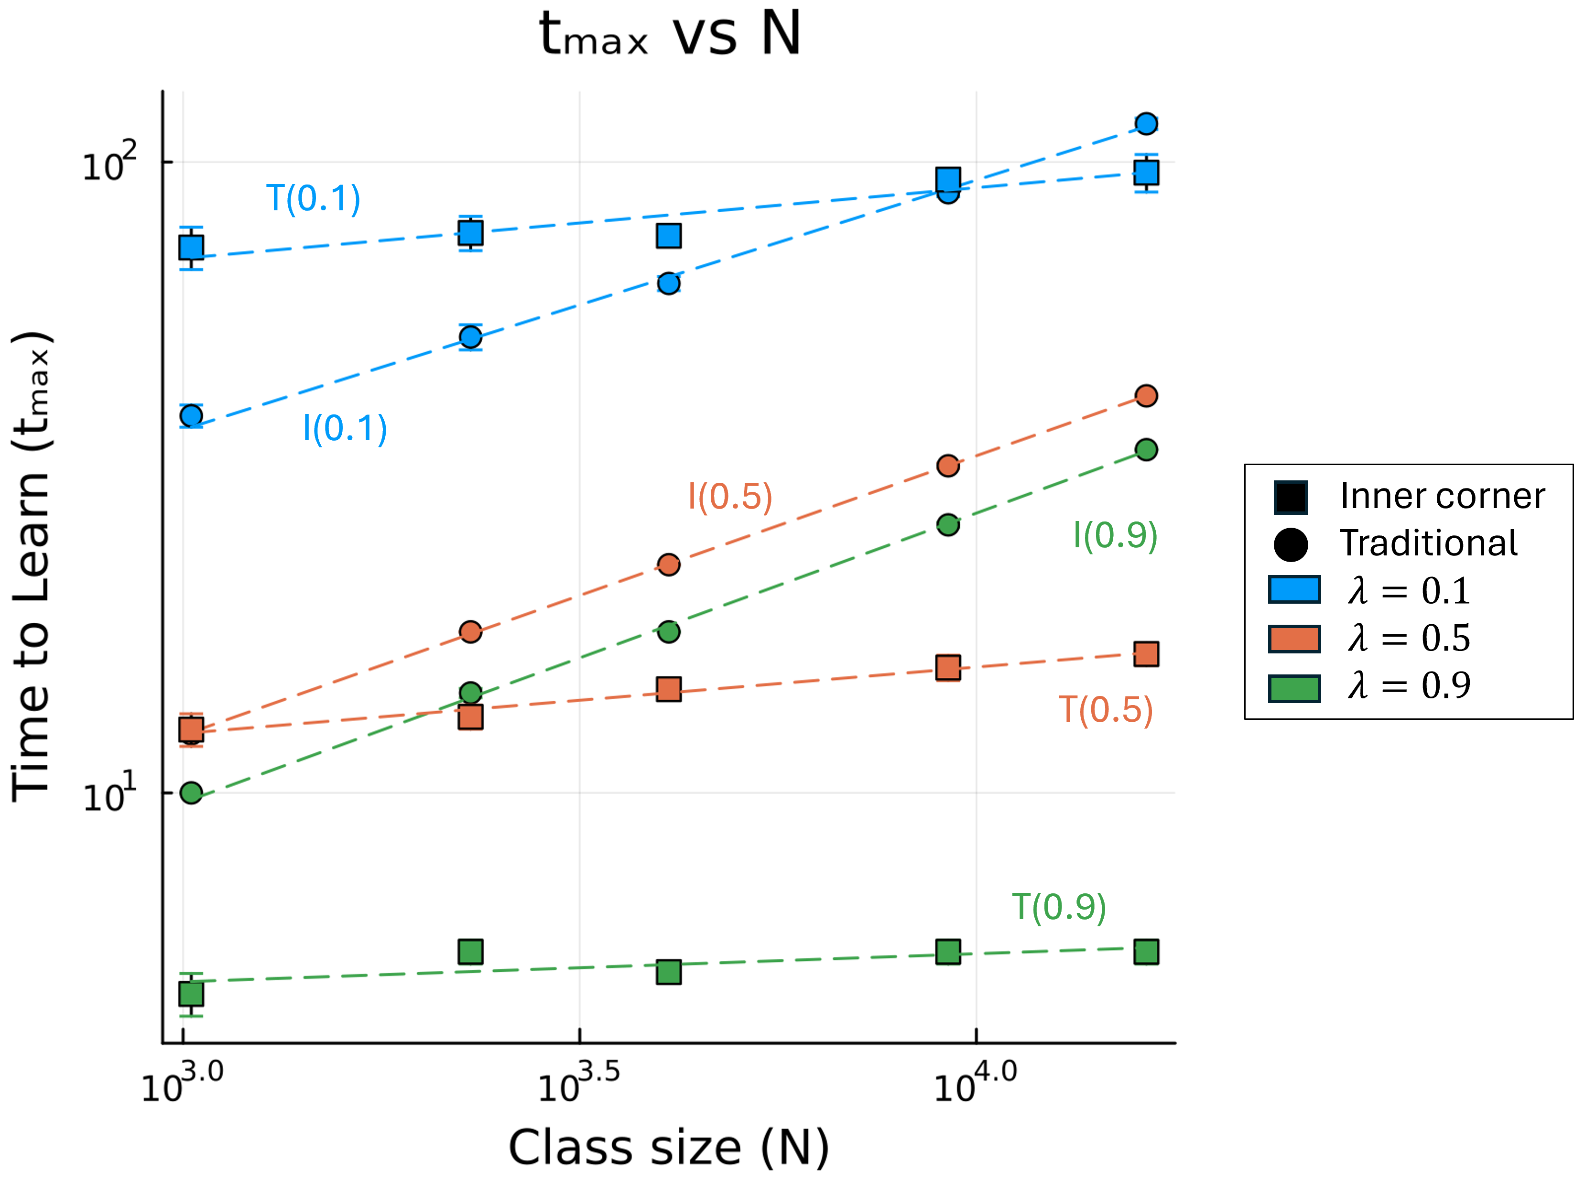
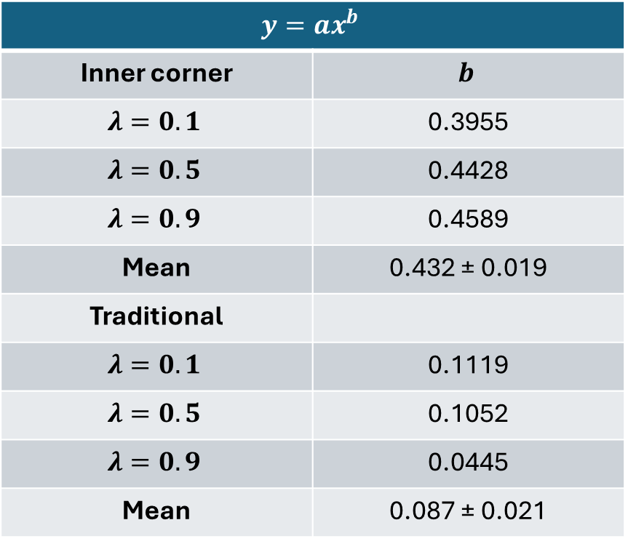
$t_{max}$ vs $N$ between PI and Traditional
$$y=ax^{b}$$
Inner corner | $$b$$
$$λ=0.1$$ | 0.3955
$$λ=0.5$$ | 0.4428
$$λ=0.9$$ | 0.4589
Mean | 0.432 ± 0.019
Traditional
$$λ=0.1$$ | 0.1119
$$λ=0.5$$ | 0.1052
$$λ=0.9$$ | 0.0445
Mean | 0.087 ± 0.021

Slide 14
Conclusions
Traditional instruction is more scalable and is less dependent on class size
Peer instruction performs better than traditional instruction for smaller classrooms and slower students.
Among PI SA, the inner corner SA performs the best
Similar findings with previous research: students with less background knowledge learned as much with PI compared to students with more background knowledge with traditional instruction.

Slide 15

Appendix slides: prob derivation
$$p+q=1$$
$$\prod_{∀e}{\left(p_{e}+q_{e}\right)}=1$$
$$\prod_{∀e}{\left(p_{e}\right)+…+\prod_{∀e}{\left(q_{e}\right)}=1}$$
$$P=1−\prod_{∀e}{\left(q_{e}\right)}=1−\prod_{∀e}{\left(1−p_{e}\right)}$$

