Slide 1
Learning dynamics in a cellular automata model of classroom peer-to-peer interactions
AY 2023-2024 Sem 2 RM Slides
Sy, Clarence Ioakim T.
BS4 Applied Physics
Adviser: Dr. Johnrob Bantang
Complexity Science Group

Slide 2
February 27, 2024
Motivation and previous studies
Research questions
Model descriptions
Current progress and results

Slide 3
Motivation:
Analyze peer-to-peer learning dynamics inside the classroom
Factors considered in literature:
Student aptitude
Seating arrangement
Aptitude homogeneity

Slide 4
Goals
Create a CA model appropriate for peer-to-peer learning inside the classroom
Incorporate factors discussed in literature
Student aptitude level
Seating arrangement (with respect to student aptitude)
Aptitude homogeneity

Slide 5
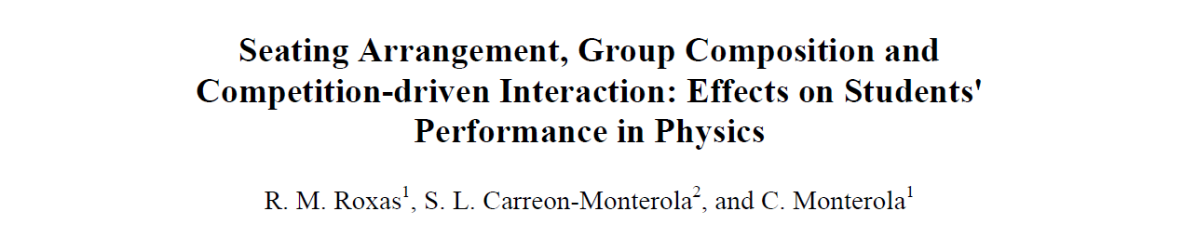
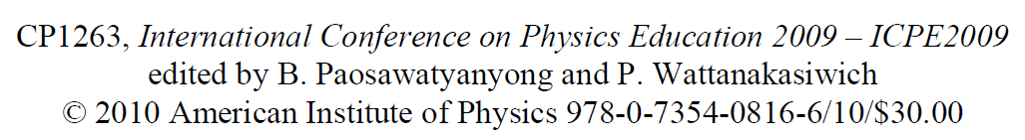
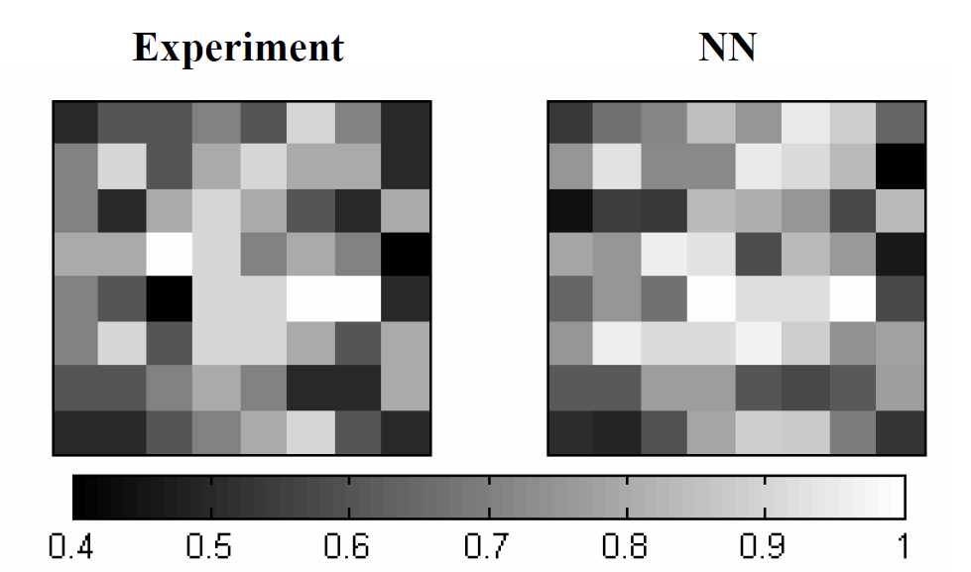
Previous study
Main findings:
Homogeneity (locally and globally) benefits learning of the classroom
Learning is not solely dependent on how high the aptitude level of the seatmates
Notes:
Uses a neural network to predict the outcome of the classroom based on the initial seating arrangement and aptitude levels of the students
Sample size: 68 classrooms, 9 schools/universities; 20 in college, 48 in hs

Slide 6
Research questions:
Learning rate
How does the number of learned students (binary states) or the class average (continuous states) evolve over time?
Nucleation sites position
How does the position of learned/high aptitude students affect the learning rate of the class?
Homogeneity
How does the spatial aptitude homogeneity affect the learning rate of the class?
How does the social aspect affect the classroom (Watts–Strogatz model) dynamics?

Slide 7
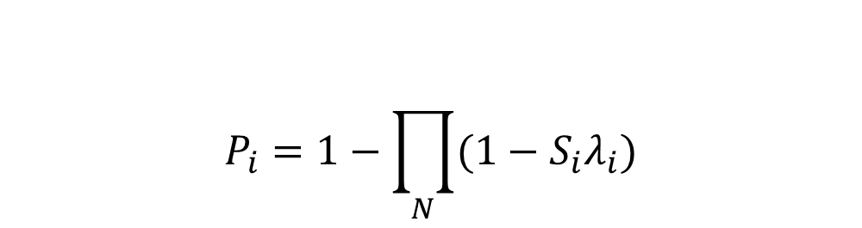
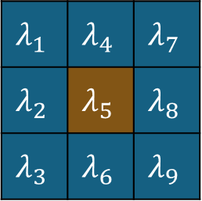
2D Binary Probabilistic CA Model
$$λ_{1}$$ | $$λ_{4}$$ | $$λ_{7}$$
$$λ_{2}$$ | $$λ_{5}$$ | $$λ_{8}$$
$$λ_{3}$$ | $$λ_{6}$$ | $$λ_{9}$$
1 | 9 | 17
2 | 10 | 18
3 | 11 | 19
4 | 12
5 | 13
6 | 14 |  |  |  |  |  | 62
7 | 15 |  |  |  |  |  | 63
8 | 16 |  |  |  |  |  | 64
Learning probability
$$P_{i}=1−\prod_{N}{(1−S_{i}λ_{i})}$$
Classroom
7

Slide 8
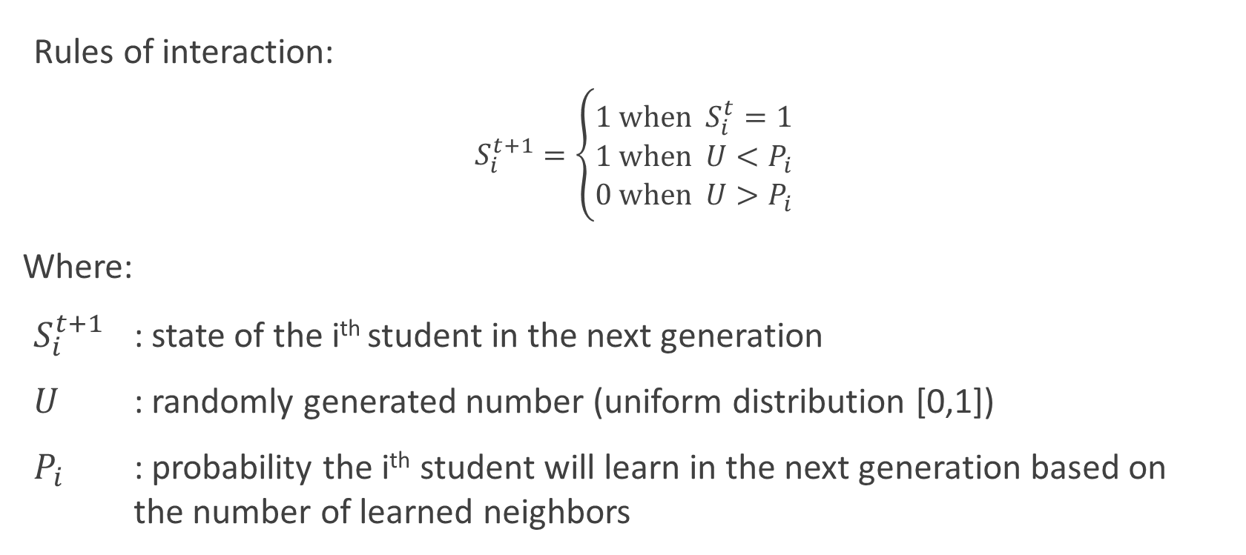
2D Binary Probabilistic CA Model
Rules of interaction:
$$S_{i}^{t+1}=\left\{\begin{aligned}1 \text{when} S_{i}^{t}=1 \\ 1 \text{when} U<P_{i} \\ 0 \text{when} U>P_{i}\end{aligned}\right.$$
Where:
$S_{i}^{t+1}$ : state of the i^{th} student in the next generation
$U$ : randomly generated number (uniform distribution [0,1])
$P_{i}$ : probability the i^{th} student will learn in the next generation based on the number of learned neighbors

Slide 9
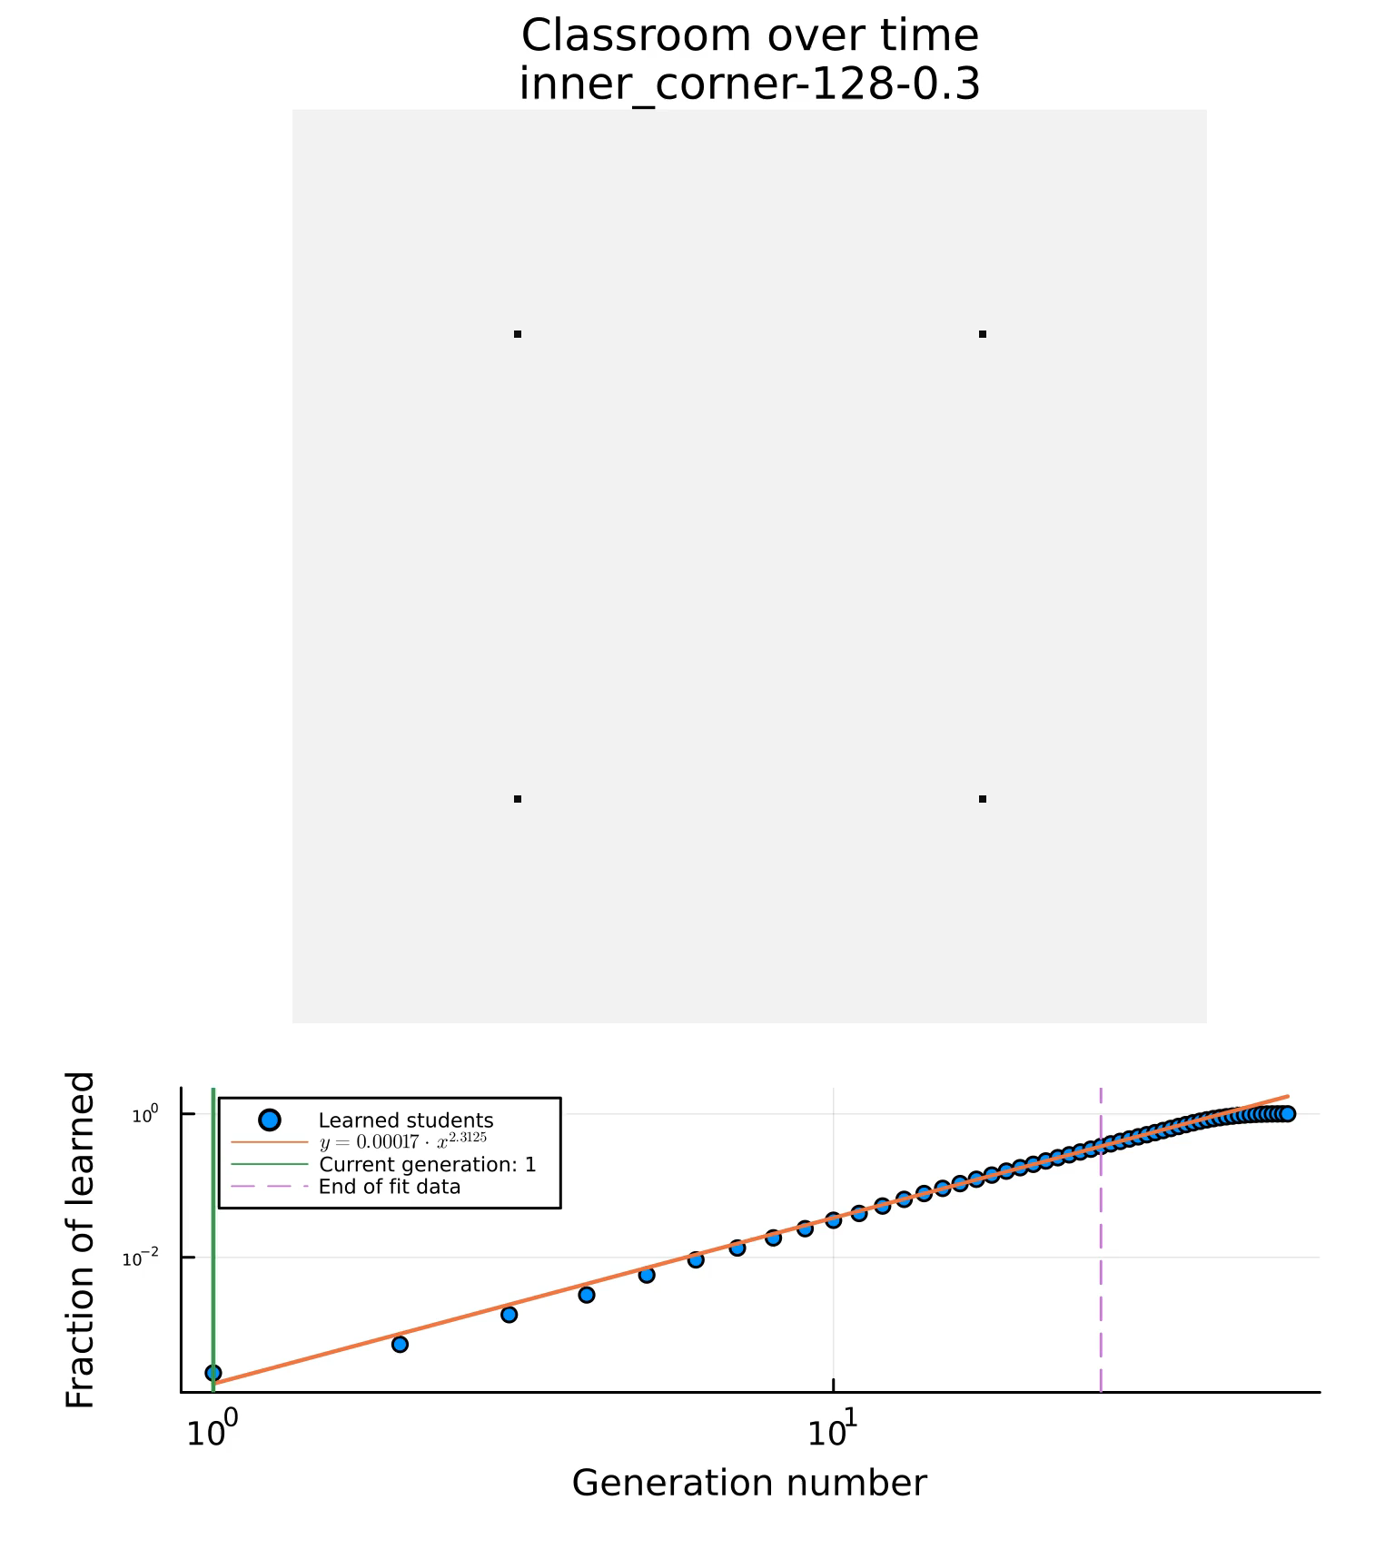
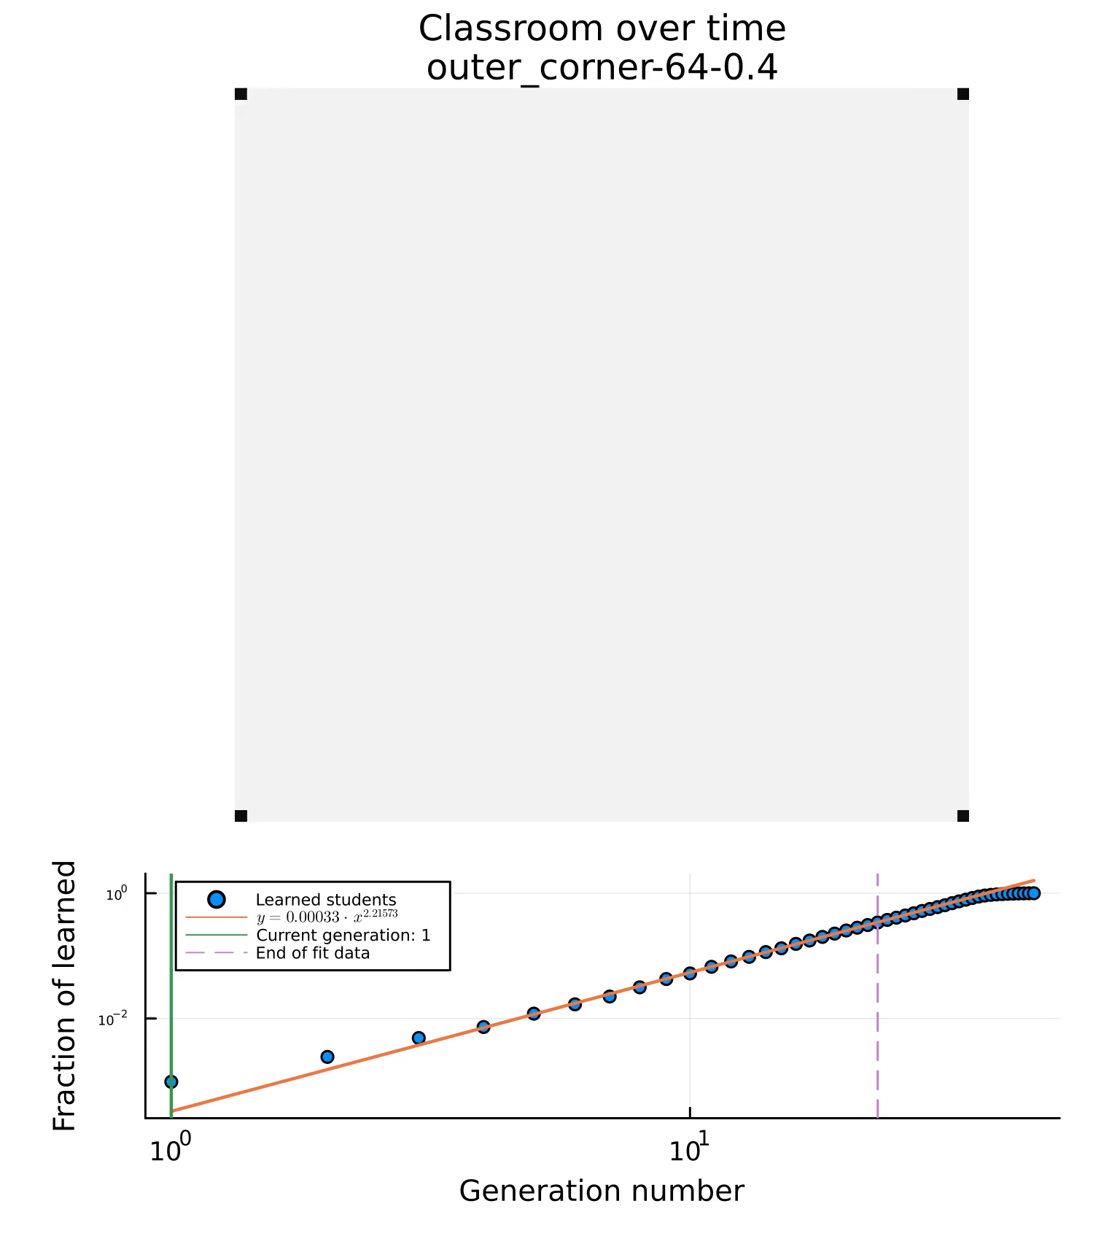
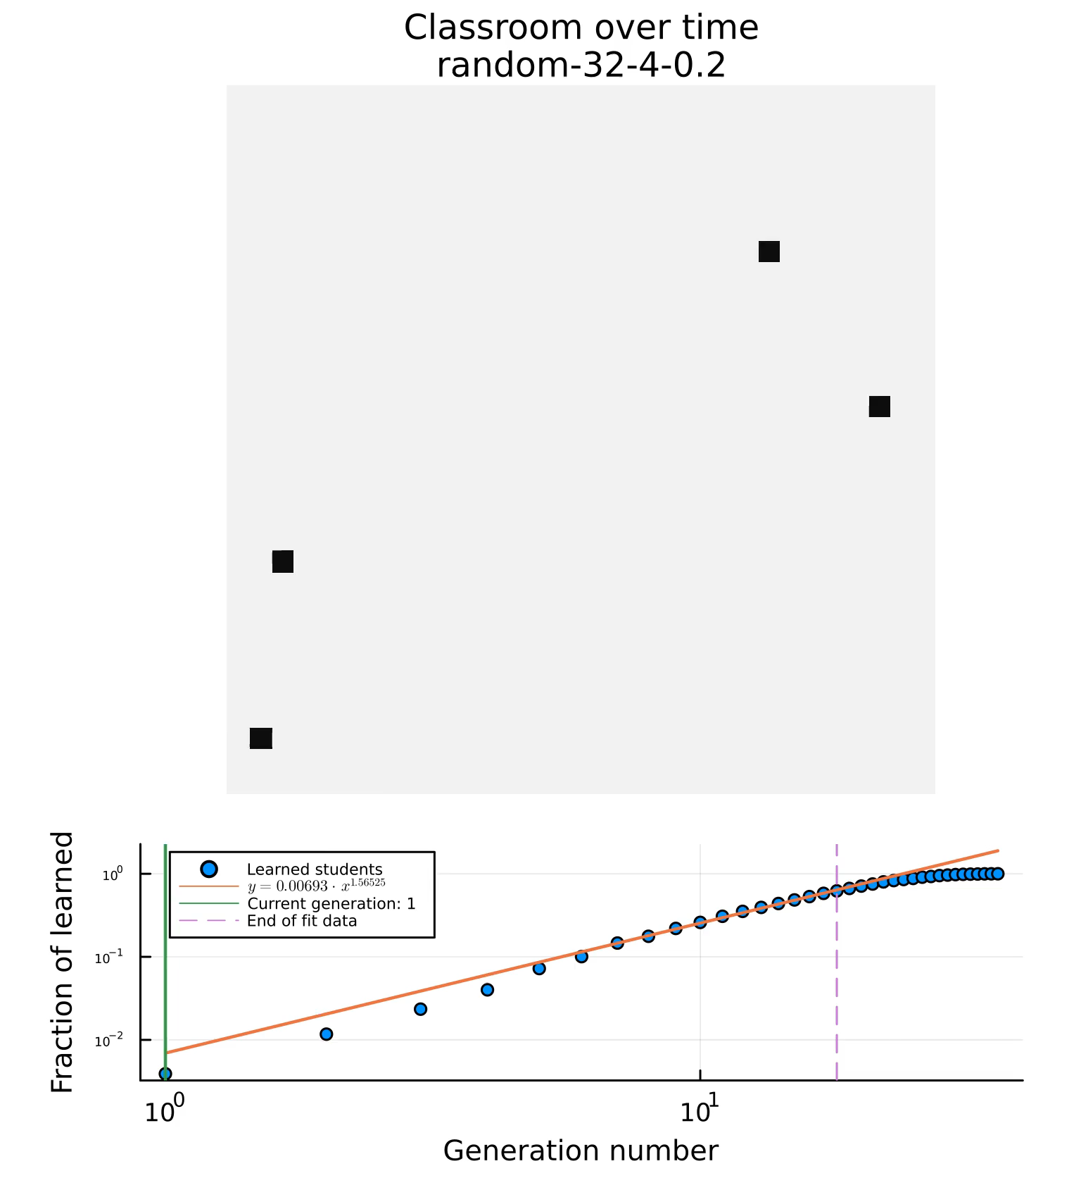
2D Binary Probabilistic CA Model
Notes:
Parameters we get from each simulation:
Number of generations to saturate the class (normalized to the number of students in the class): learned/max
Characteristic variable (m). Taken as the exponent of the fitted line y=ax^b
The fitting of the data ends at 50%, so that the it only measures the spreading before the finite size effects kicks in

Slide 10
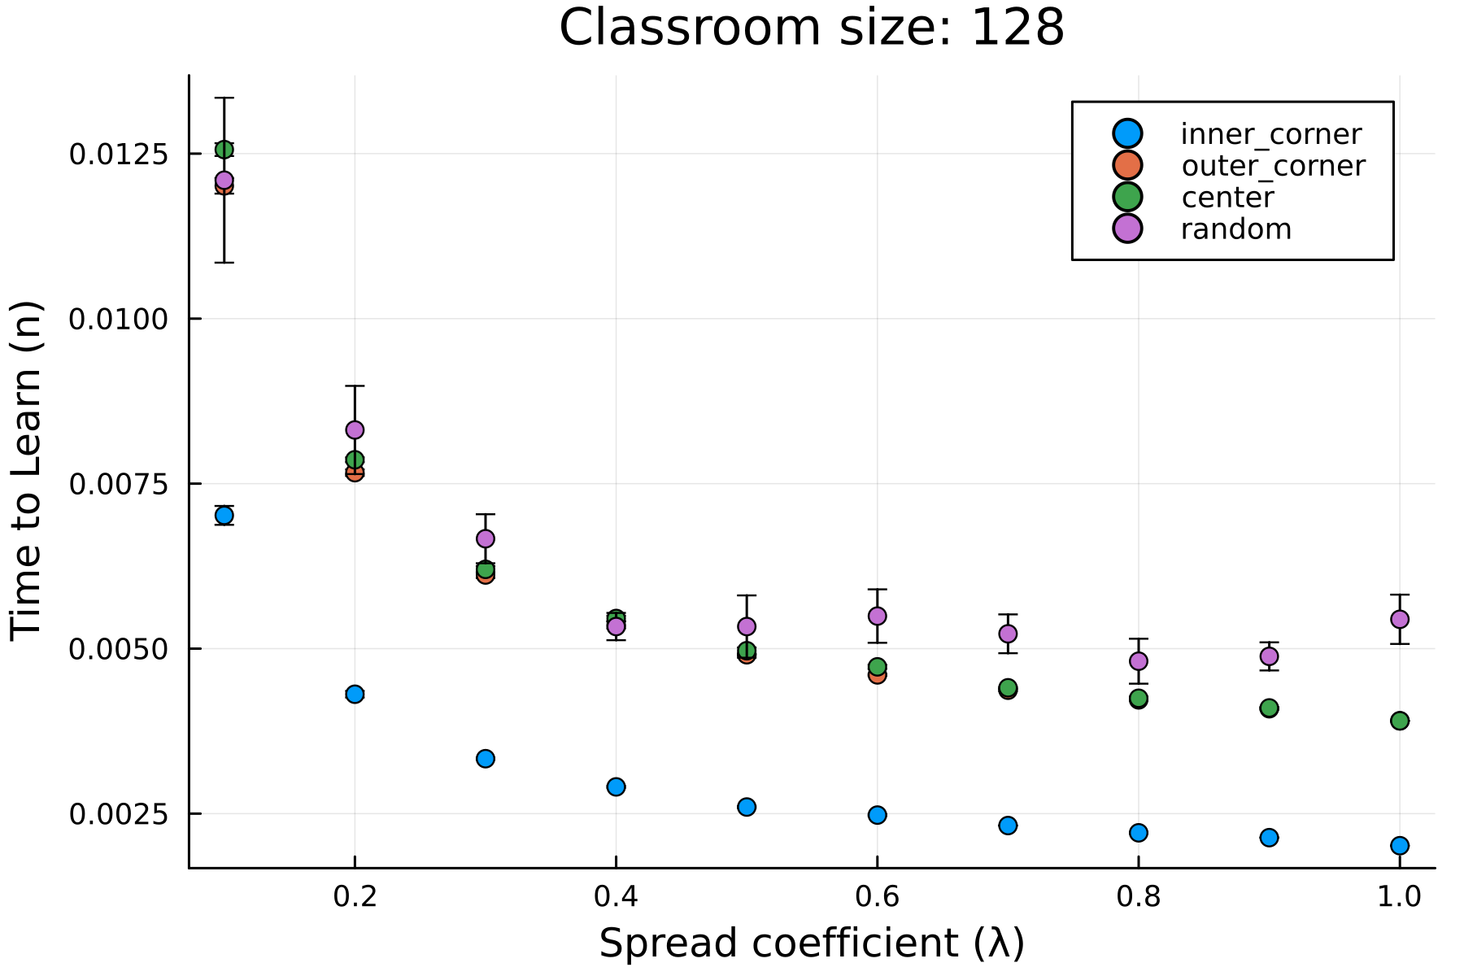
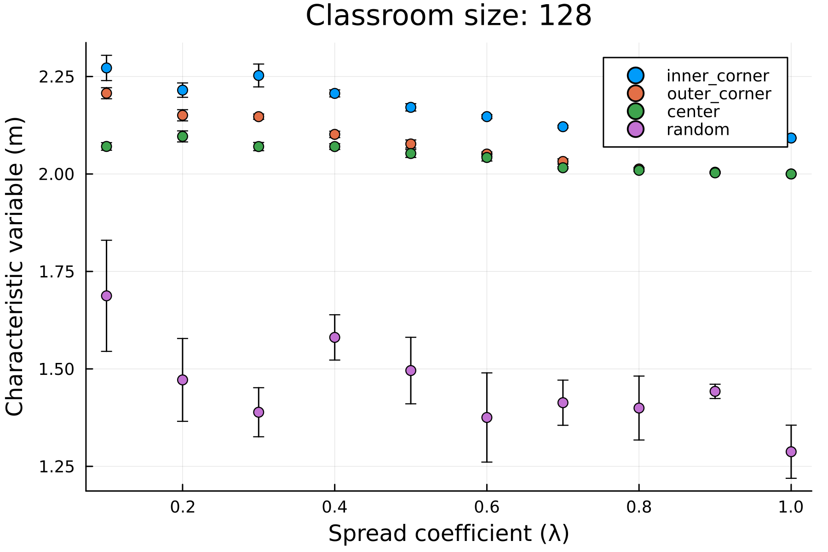
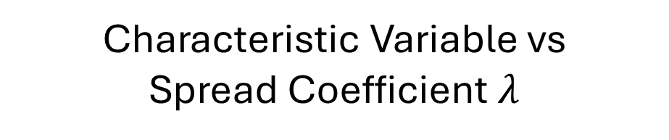
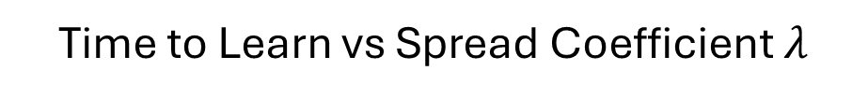
2D Binary PCA - Results
Time to Learn vs Spread Coefficient $λ$
Characteristic Variable vs Spread Coefficient $λ$
Notes:
Inner corner performs best
Outer corner and center perform similarly

Slide 11
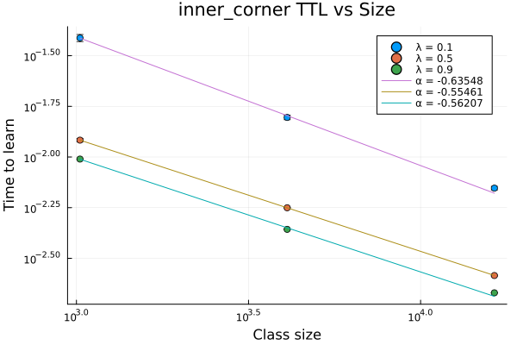
2D Binary PCA - Results
Notes:
Time to learn is dictated by power law (dependent on class size) -> normalizabe

Slide 12
To do: (analysis)
Normalize TTL vs Class size graph
Compare current data with theoretical TTL (see relevant plot slides for comments)
Normalize TTL vs lambda graphs

Slide 13
To do: (more model interactions)
Introduce orientation bias in the system (anisotropic system)
Introduce inhomogeneous individual learning rate
Model the benefit of local/neighborhood homogeneity
Introduce memory or unlearning to the system
Adjust model to accommodate continuous student states
Fit model parameters to existing data

Slide 14
March 5, 2024
Started on standardizing variable names

Slide 15
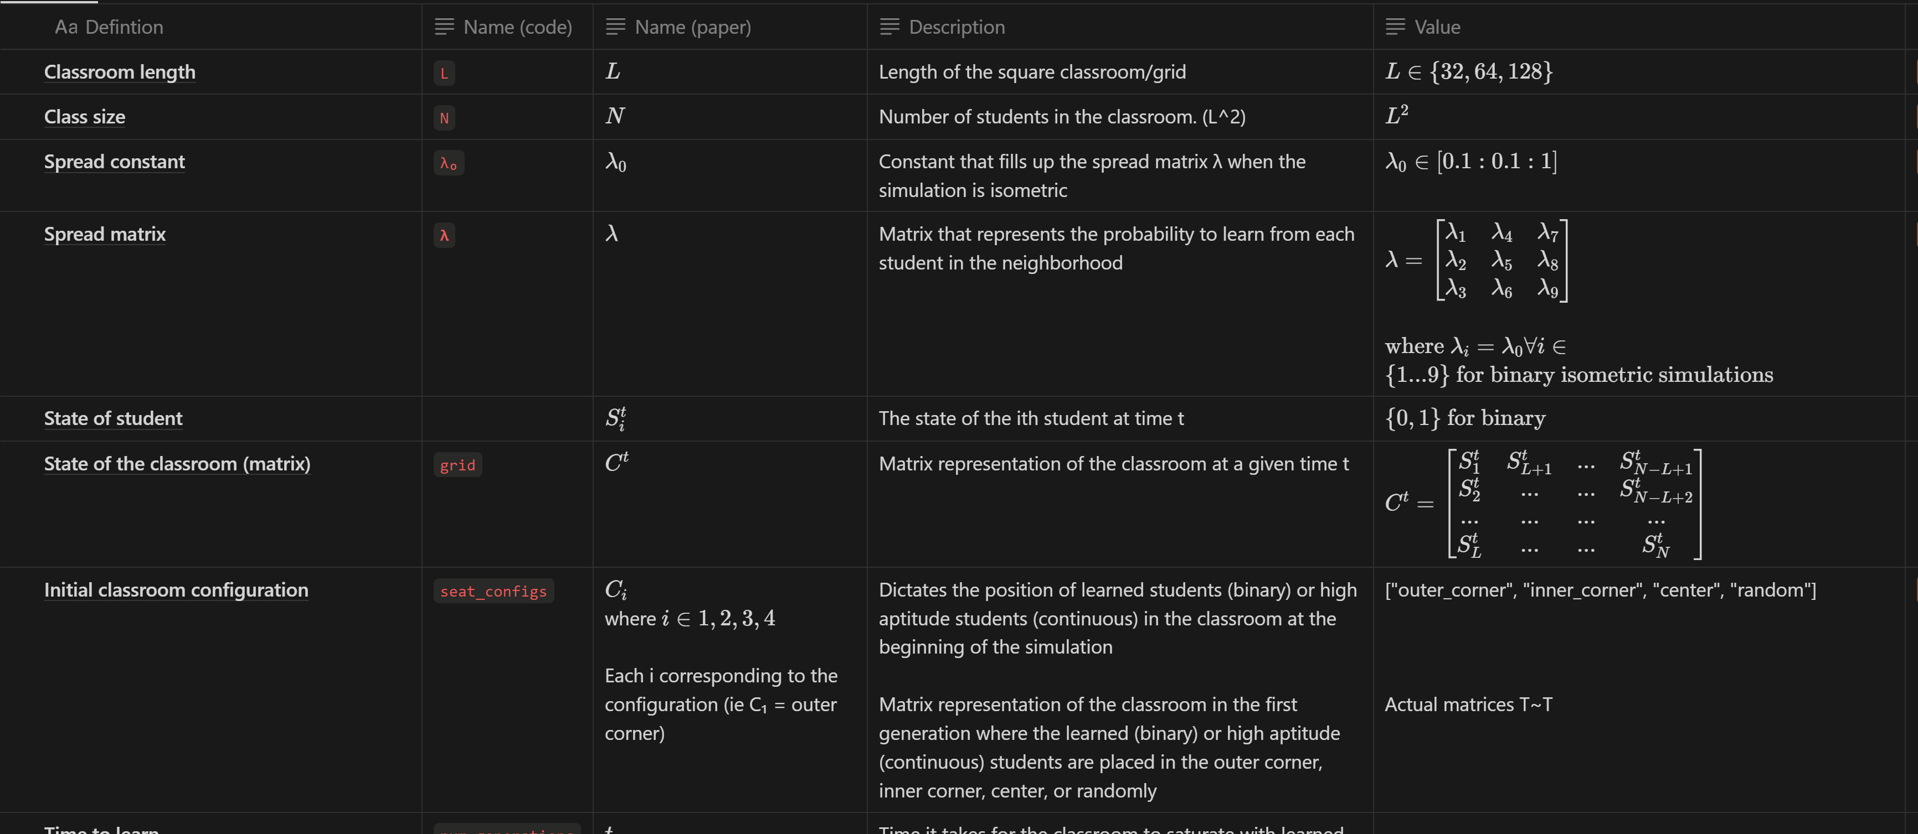

Slide 16
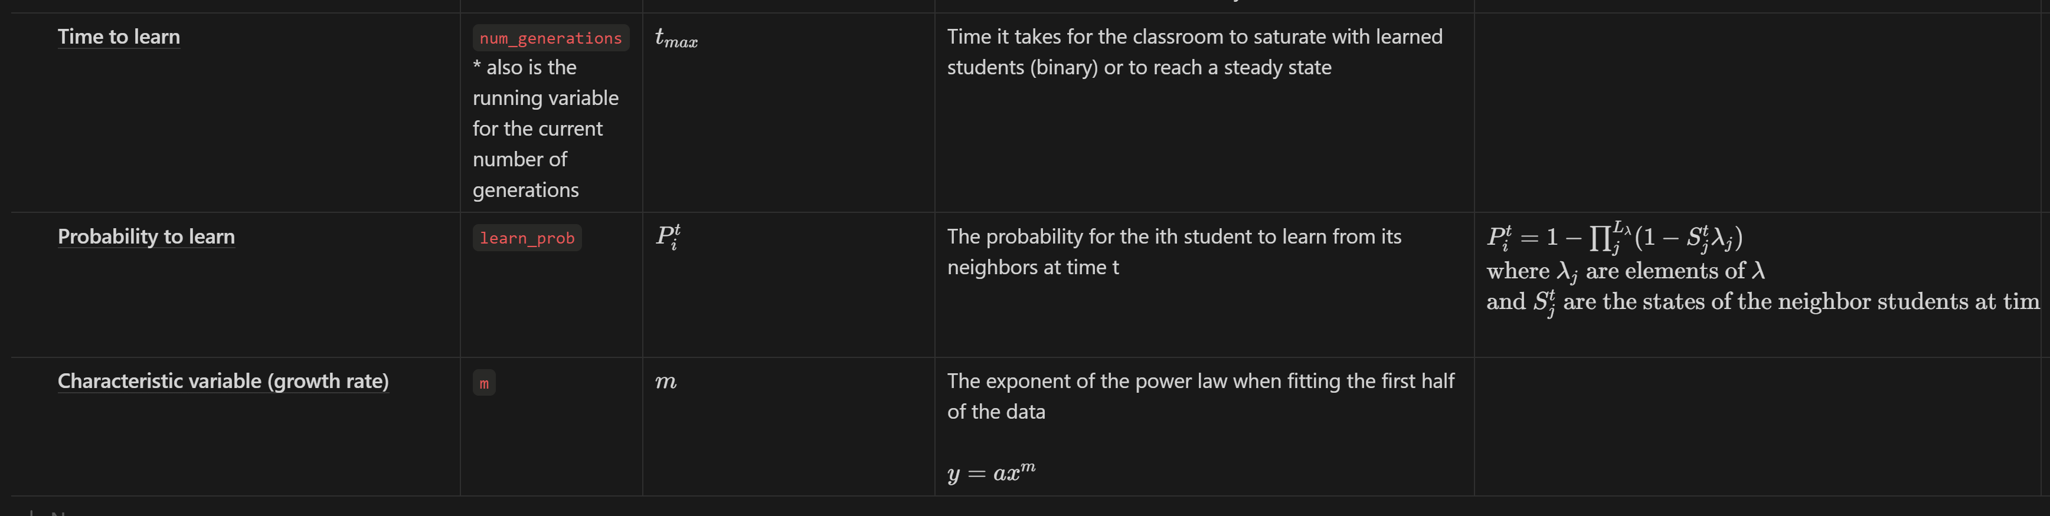

Slide 17
To do: (analysis)
Normalize TTL vs Class size graph
Compare current data with theoretical TTL (see relevant plot slides for comments)
Normalize TTL vs lambda graphs

Slide 18
To do: (more model interactions)
Introduce orientation bias in the system (anisotropic system)
Introduce inhomogeneous individual learning rate
Model the benefit of local/neighborhood homogeneity
Introduce memory or unlearning to the system
Adjust model to accommodate continuous student states
Fit model parameters to existing data

Slide 19
March 12, 2024
More data points for the T vs N plot

Slide 20
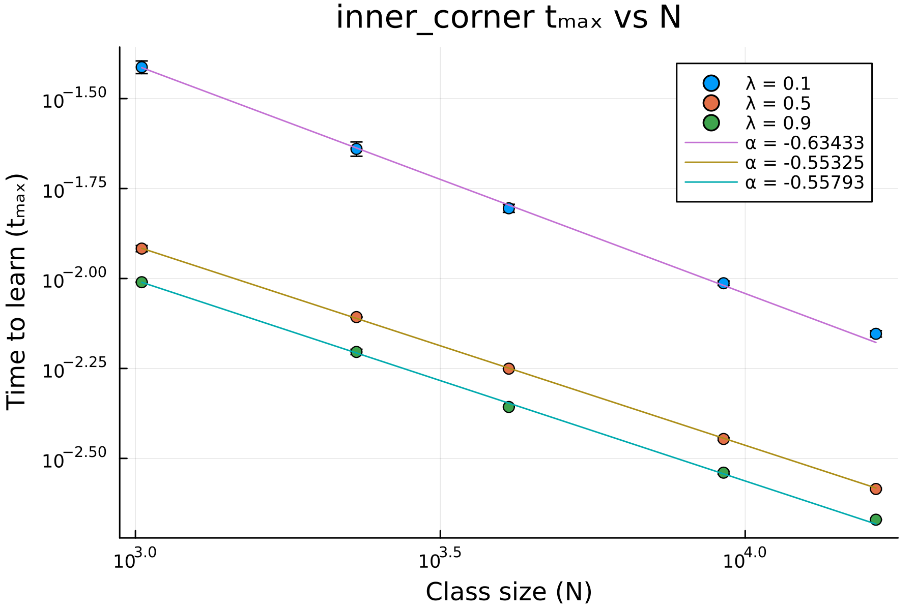

New $t_{max}$ vs $N$
Added more class sizes: 48 and 96
Linear in log-log scale
Follows power law
Expected
Not expected: pababa yung slope. Found the error in code

Slide 21
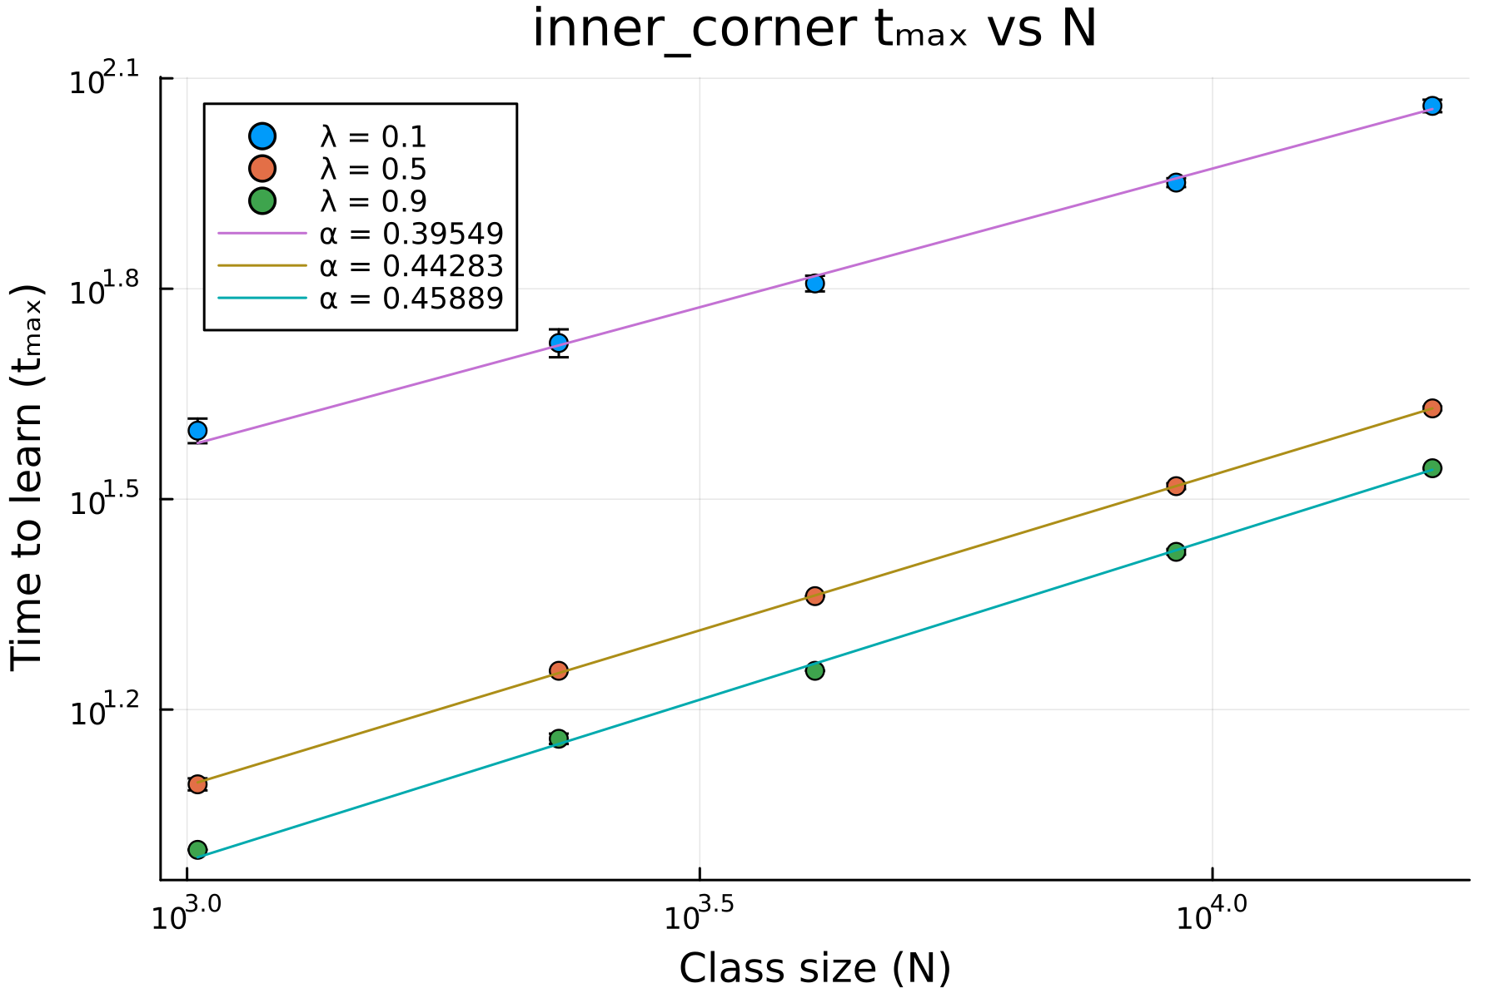
New $t_{max}$ vs $N$
Fixed code

Slide 22
New question
Can an isotropic lambda model an anisotropic lambda?
Is there an equivalent isotropic lambda to return similar results to an anisotropic
Discuss:
If we allow jumps, will learning speed up?

Slide 23
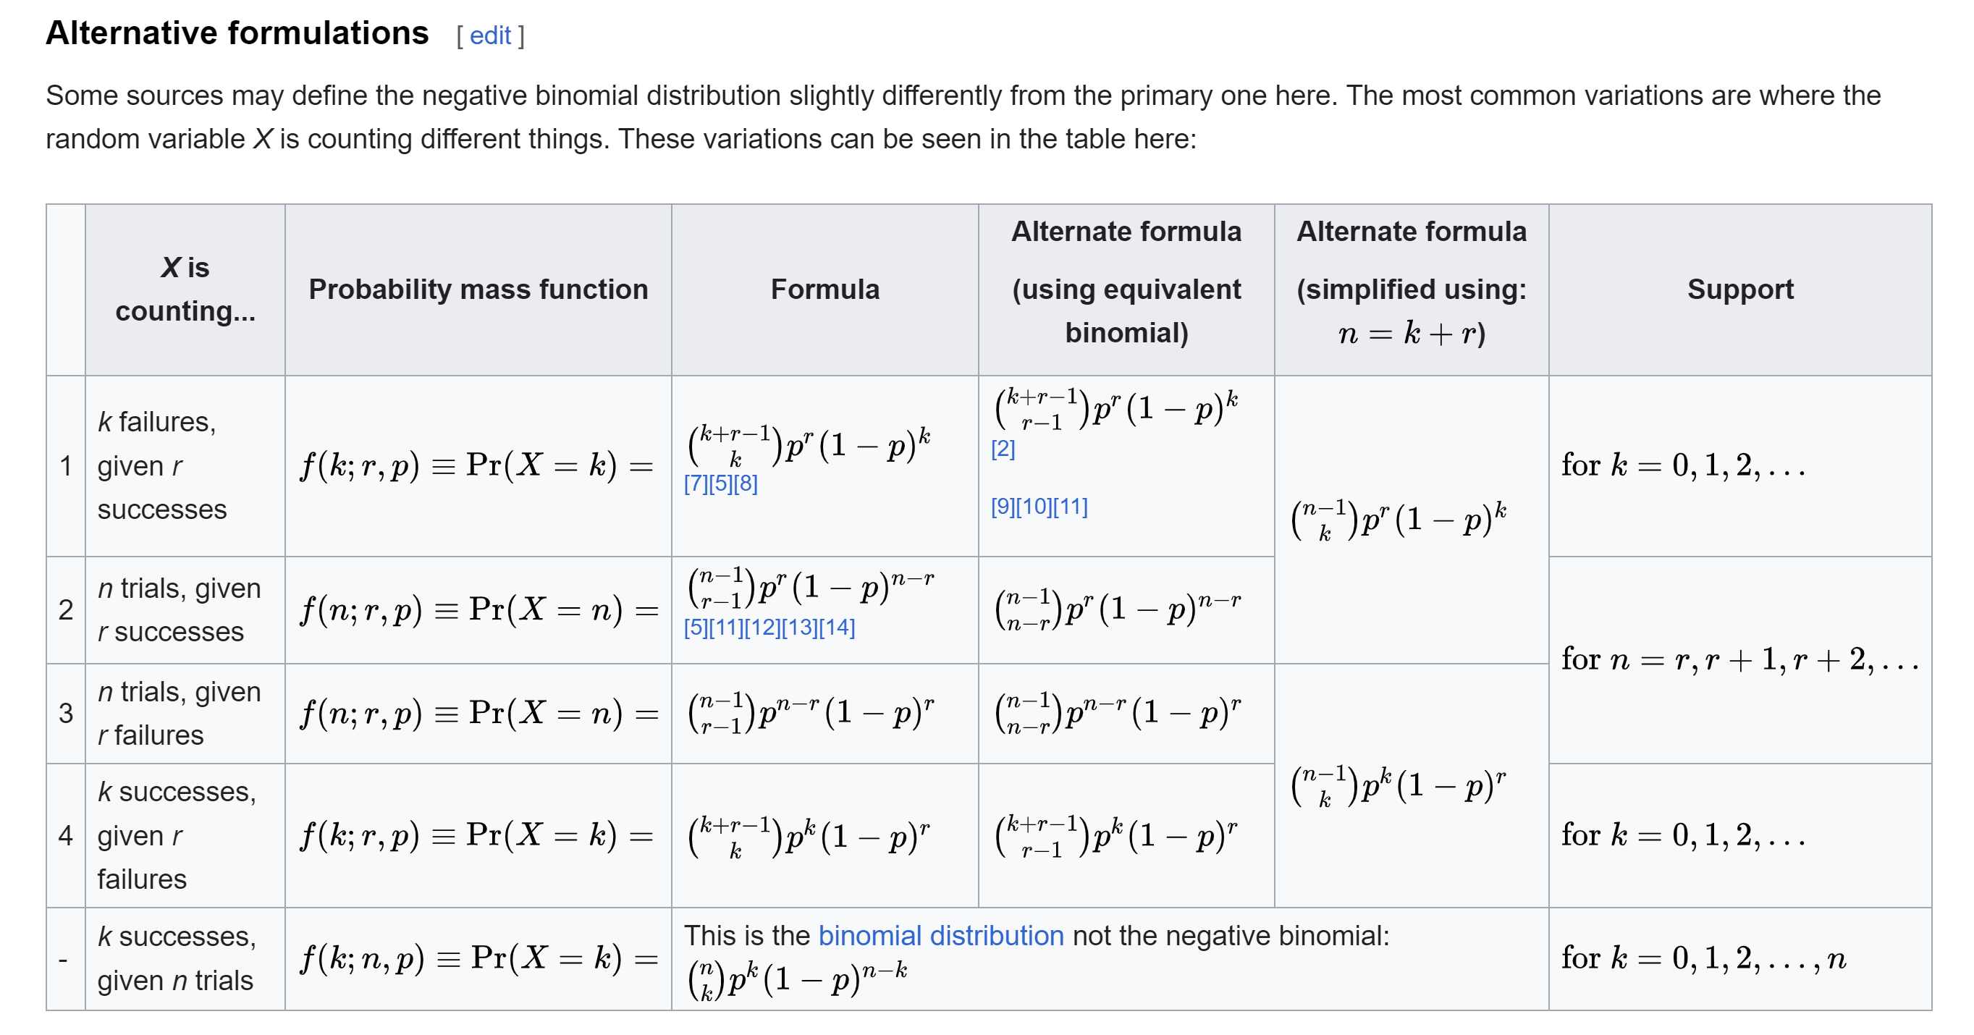

New simulation: traditional
Each student has a chance to flip $λ_{0}$
New set of analysis as benchmark
Does it follow #2 variation of the neg binomial dist?

