Slide 1
Learning dynamics in a cellular automata model of classroom peer-to-peer interactions
Progress Report
1st Semester, AY 2024-2025
16 September 2024
Sy, Clarence Ioakim T.
BS4+ Applied Physics
Adviser: Dr. Johnrob Bantang
Complexity Science Group

Slide 2
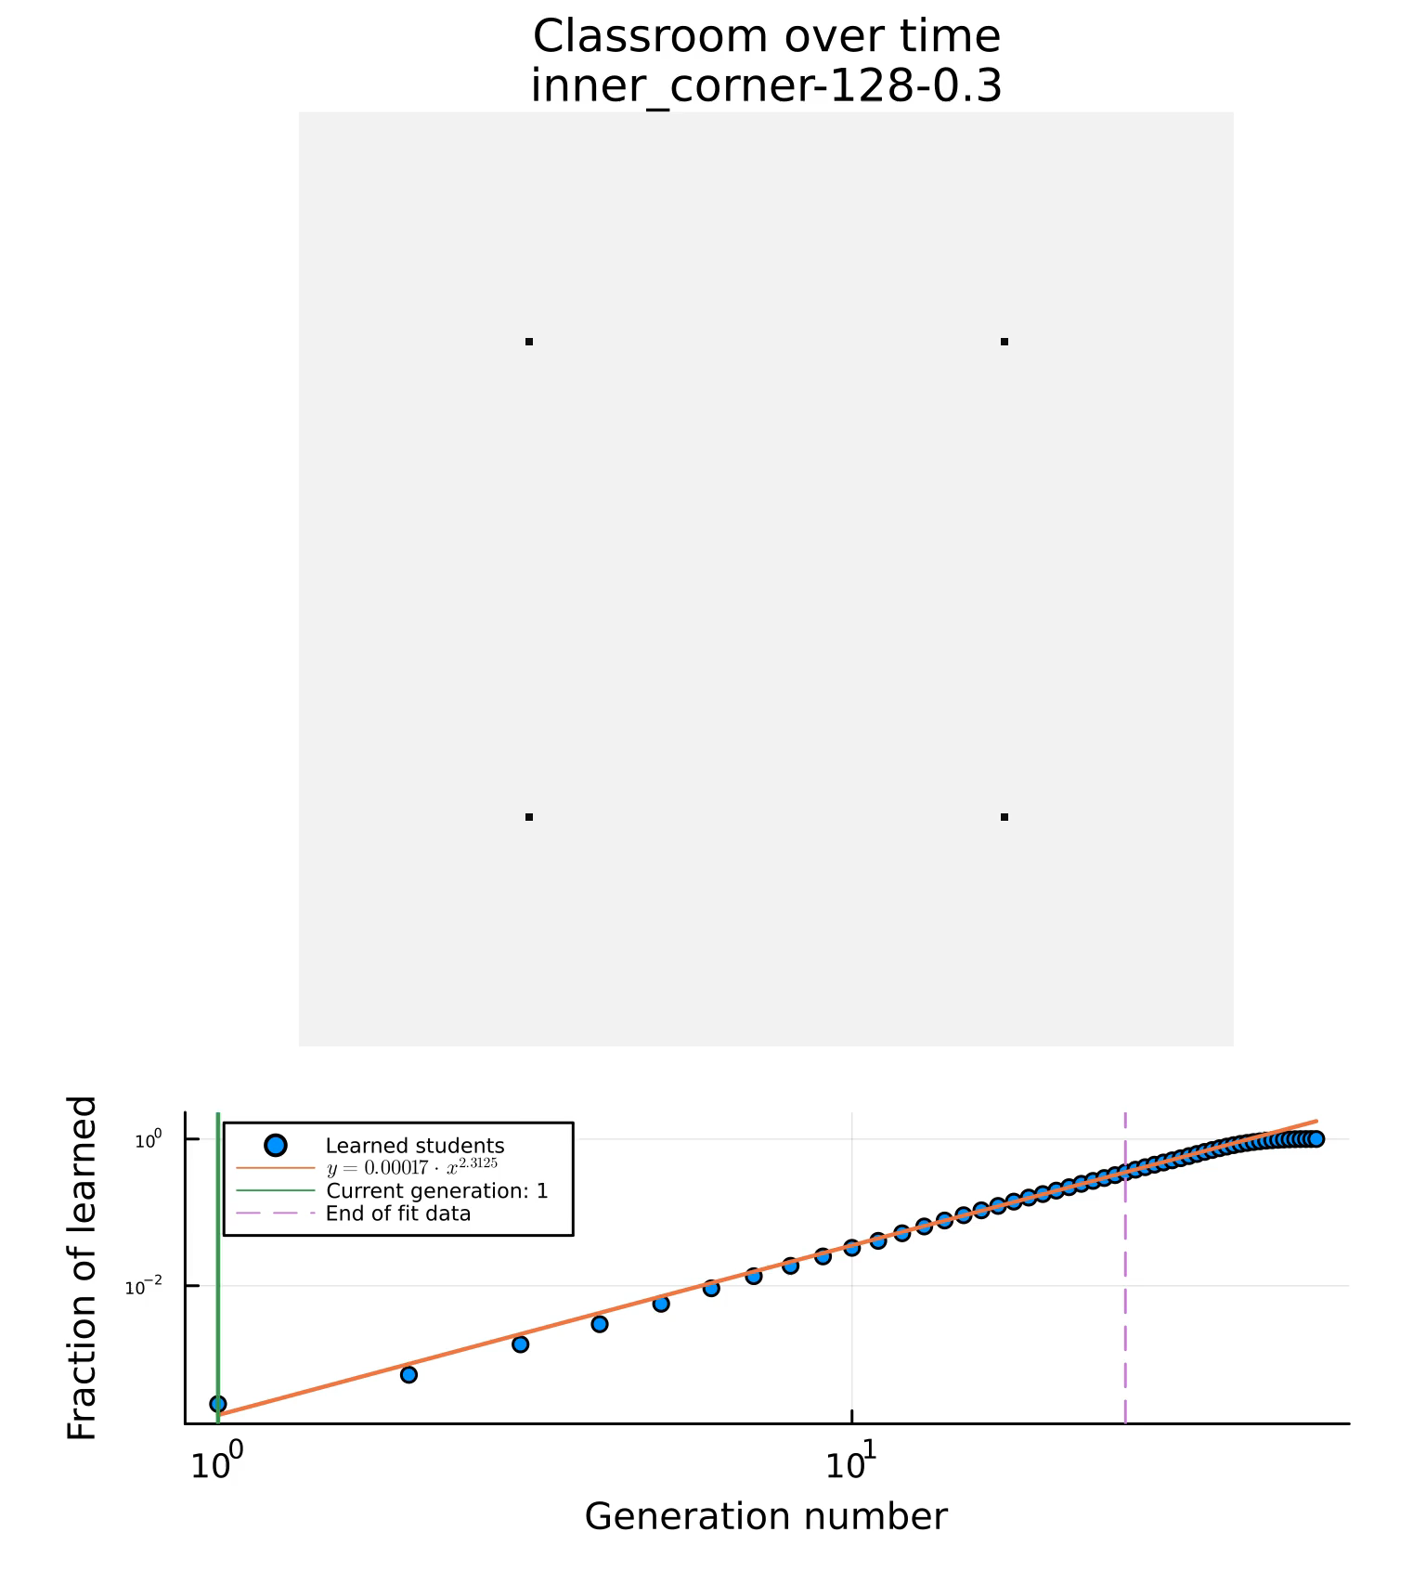
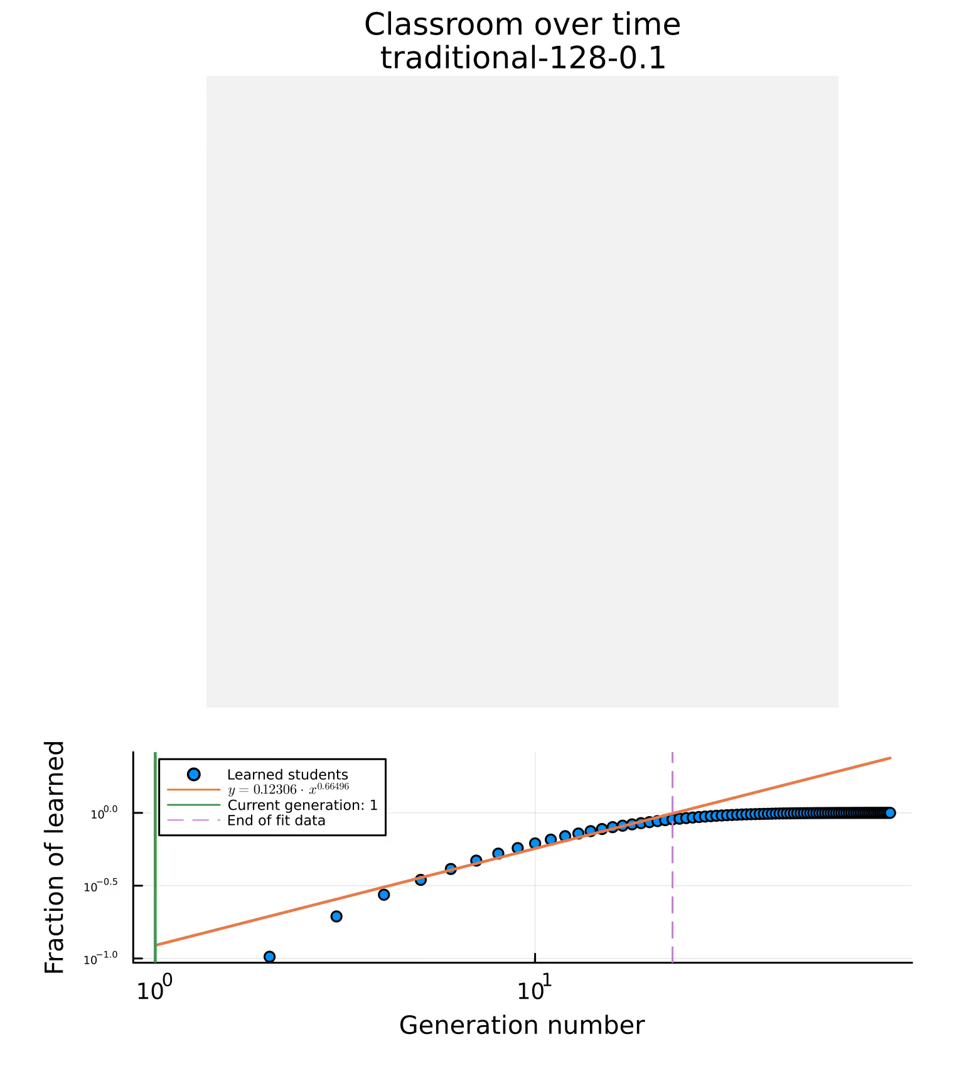
Recap: Classroom dynamics
Simulations:
Done via PCA
Traditional vs PI
Different seating arrangements
Time to learn and class learning rate metrics

Slide 3
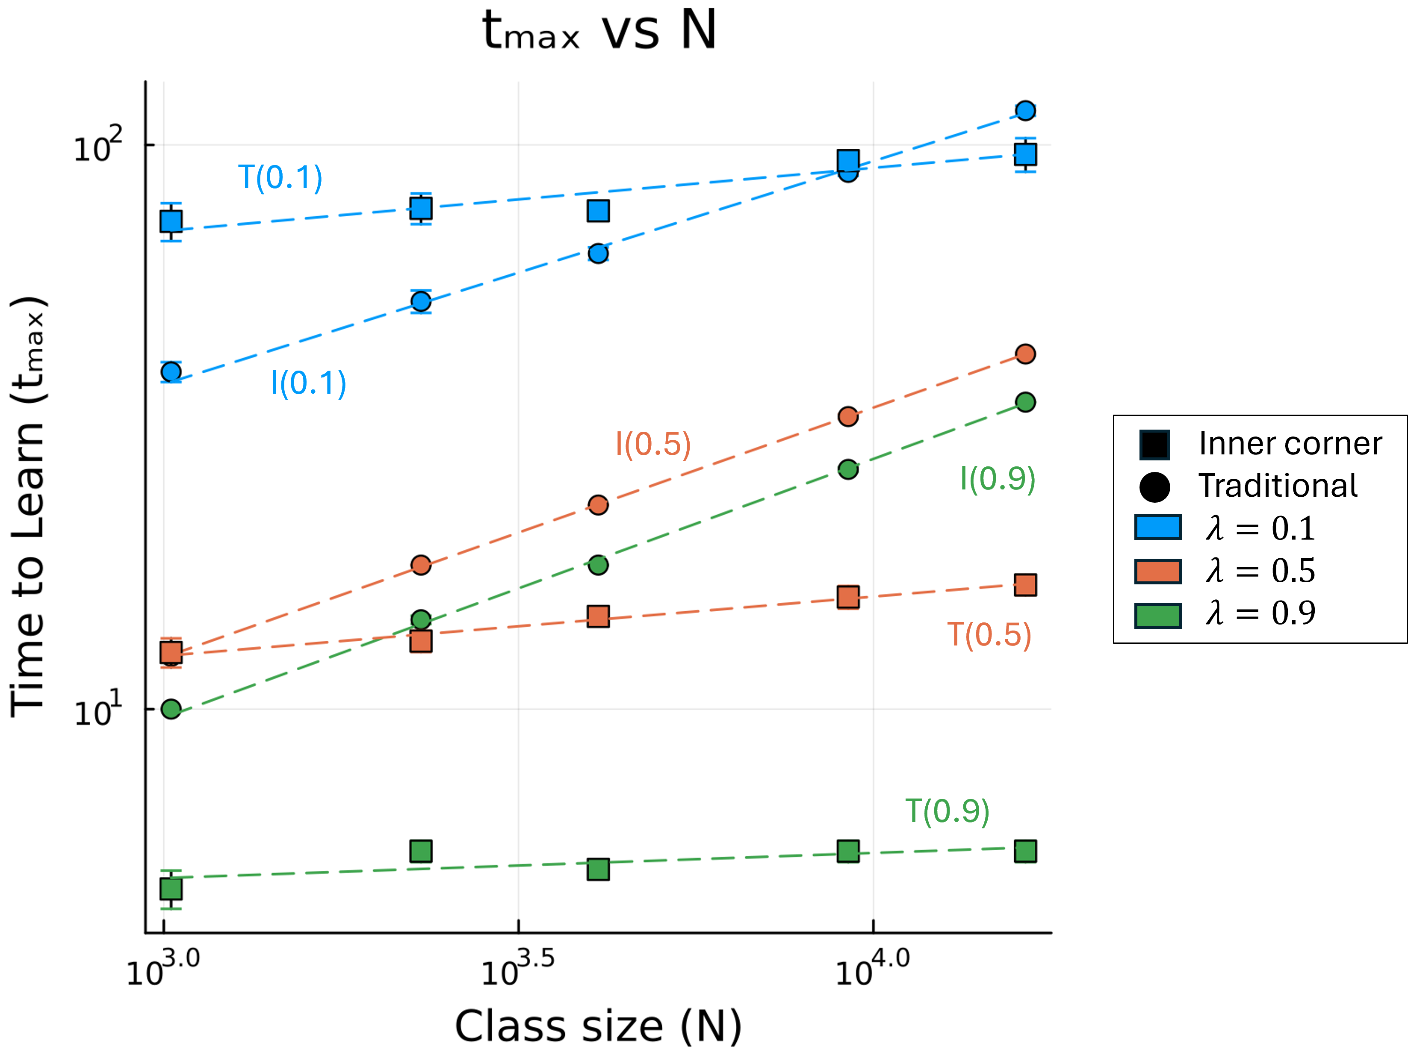
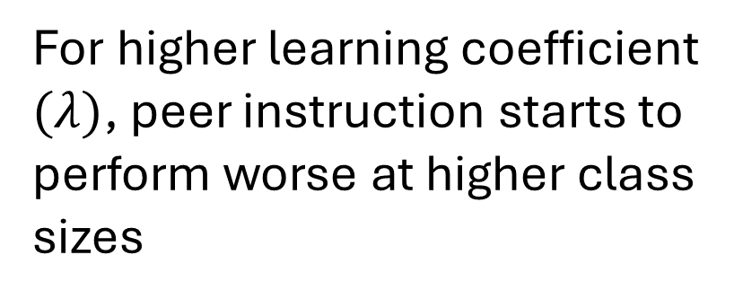
Recap: Basic model results
For higher learning coefficient $(λ)$, peer instruction starts to perform worse at higher class sizes
Traditional
PI (inner corner)

Slide 4
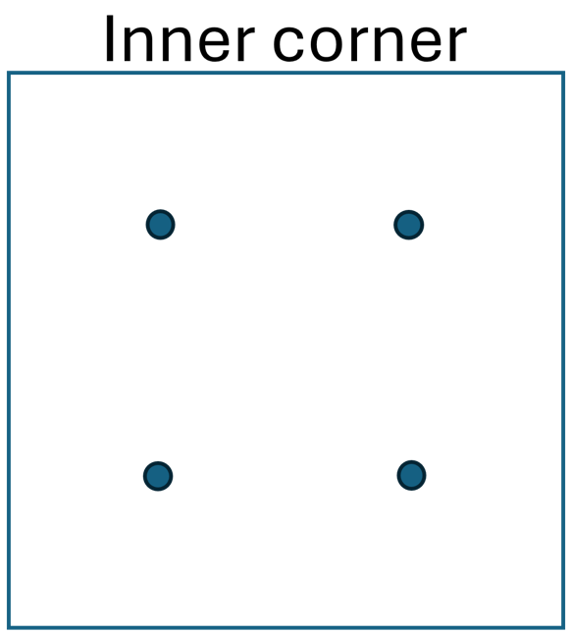
Recap: Basic model conclusions
Traditional instruction is more scalable and is less dependent on class size.
Peer instruction (PI) performs better than traditional instruction for smaller classrooms with slow learners.
Among peer instruction seating arrangements (SA), the inner corner SA performs the best.
Similar findings with previous research: Students with less background knowledge learned as much with PI compared to students with more background knowledge with traditional instruction.

Slide 5
Progress, actually
SPP :))
New model: heterogenous models
Effects of heterogeneity on:
Classroom evolution
Learning metrics
PI vs traditional breakpoints
Manuscript progress

Slide 6

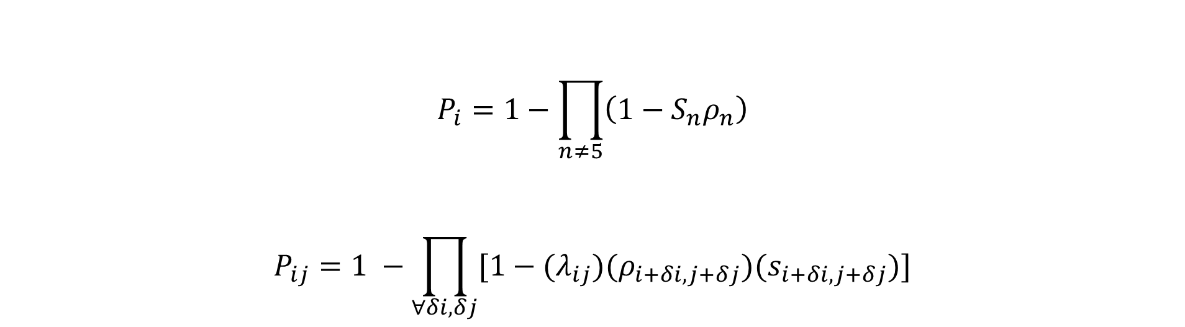
Individual learning rates and Heterogeneity
$$P_{i}=1−\prod_{n≠5}{\left(1−S_{n}ρ_{n}\right)}$$
$$P_{ij}=1 −\prod_{∀δi,δj}{[1−{(λ}_{ij})(ρ_{i+δi, j+δj})(s_{i+δi, j+δj})]}$$
$$λ_{ij}=λ_{0}±δλ$$

Slide 7
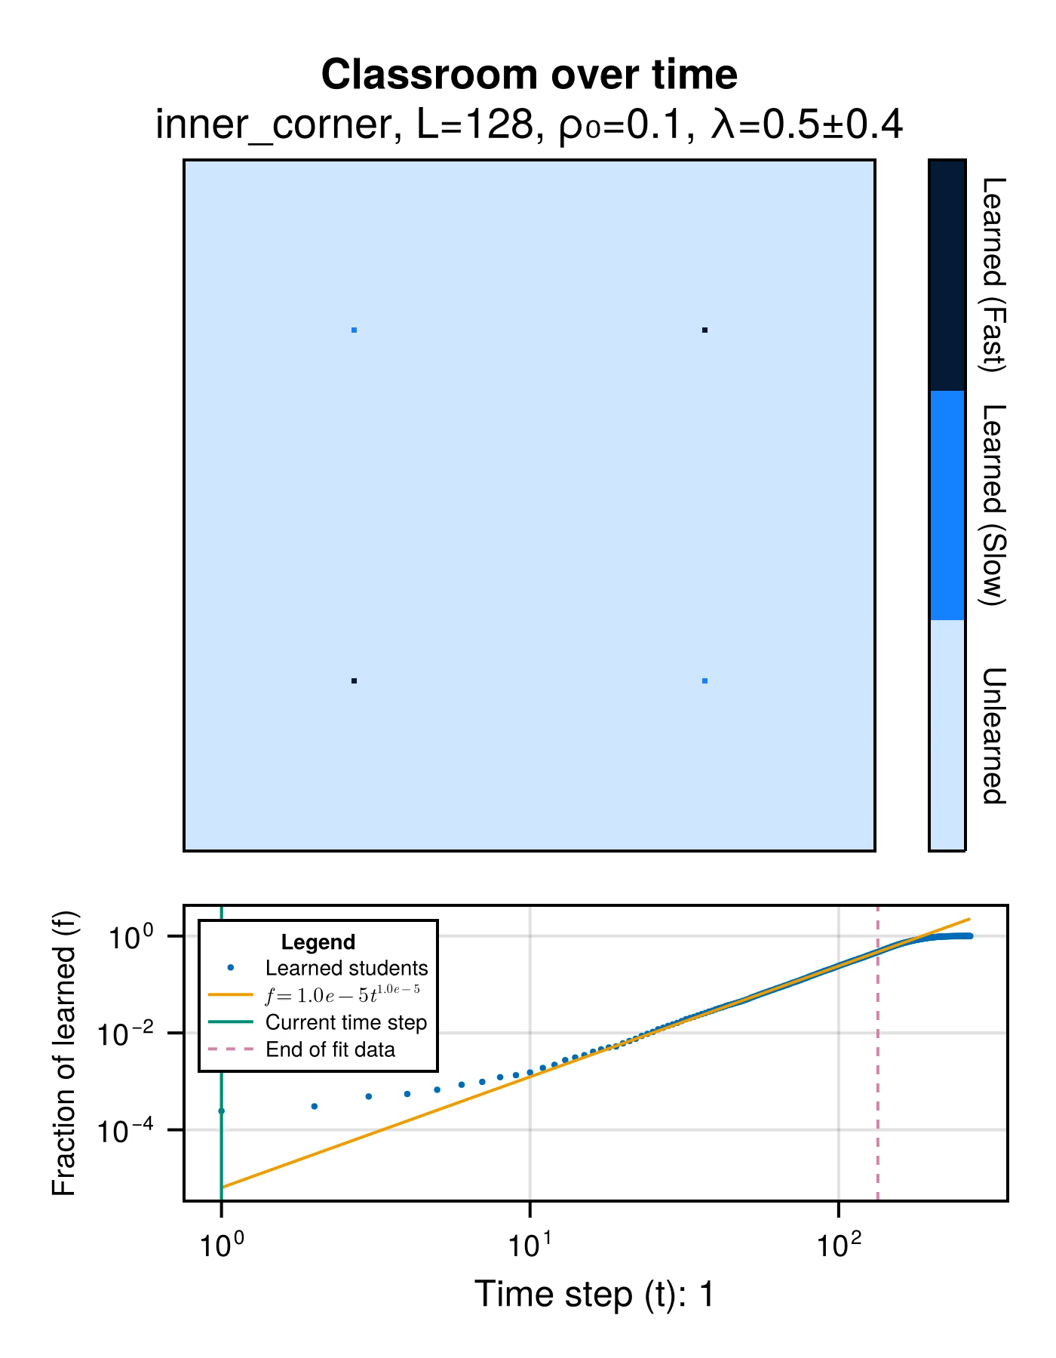


Heterogenous model evolution
Notes:
Low rho, high delta – irregular
High rho, low delta – very regular
High rho, high delta – still regular
At high rho, irregularity caused by high delta, disappears quicker. Higher rho, faster disappearance
Wala pang traditional kasi di ko pa naplot hehe

Slide 8
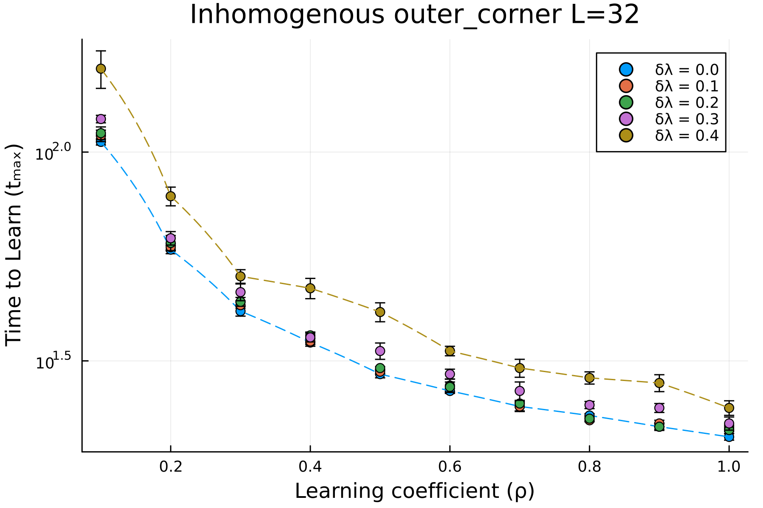
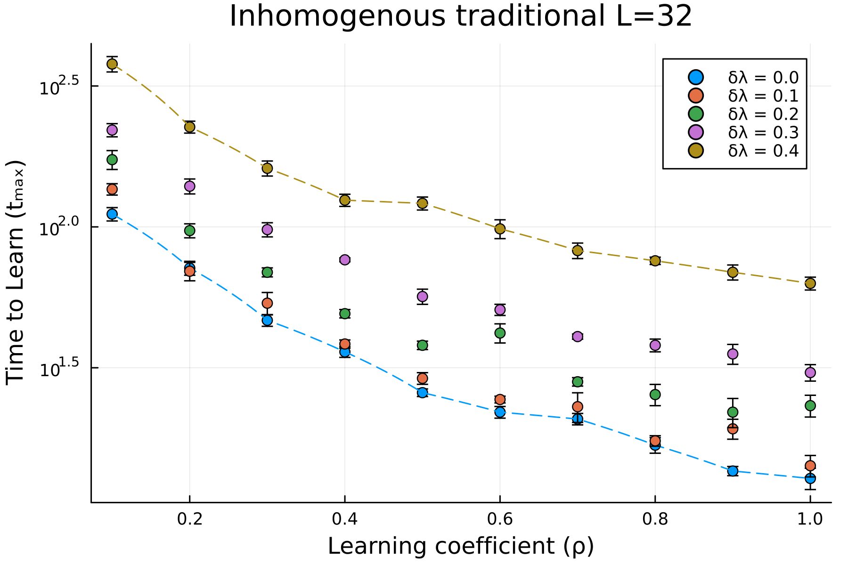
Effects of heterogeneity on $t_{max}$(lower is better)
Notes:
Traditional models are more affected by heterogeneity

Slide 9
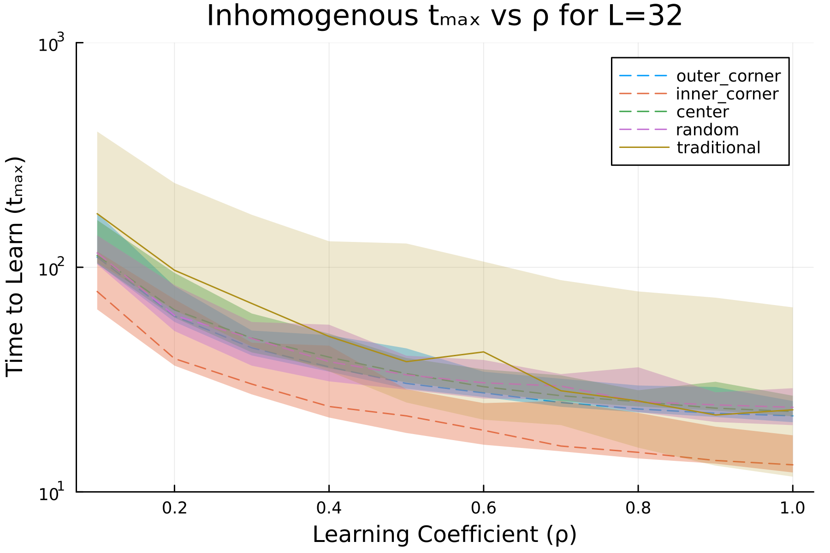
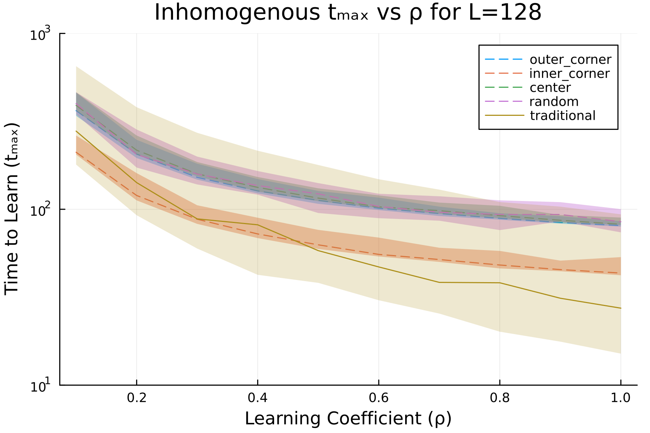
Heterogenous results: $t_{max} vs ρ_{0}$ (lower is better)
Notes:
Generally, previous findings hold:
Small and slow classrooms lends itself to PI
Heterogeneity can make or break when PI > traditional, especially in larger classrooms

Slide 10
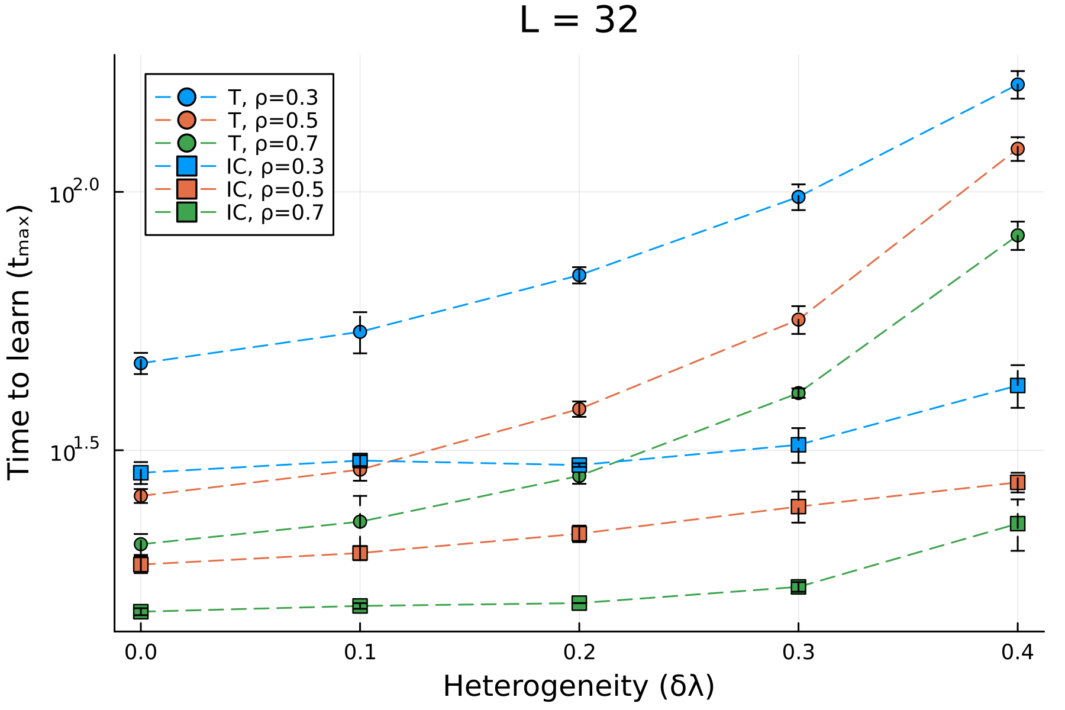
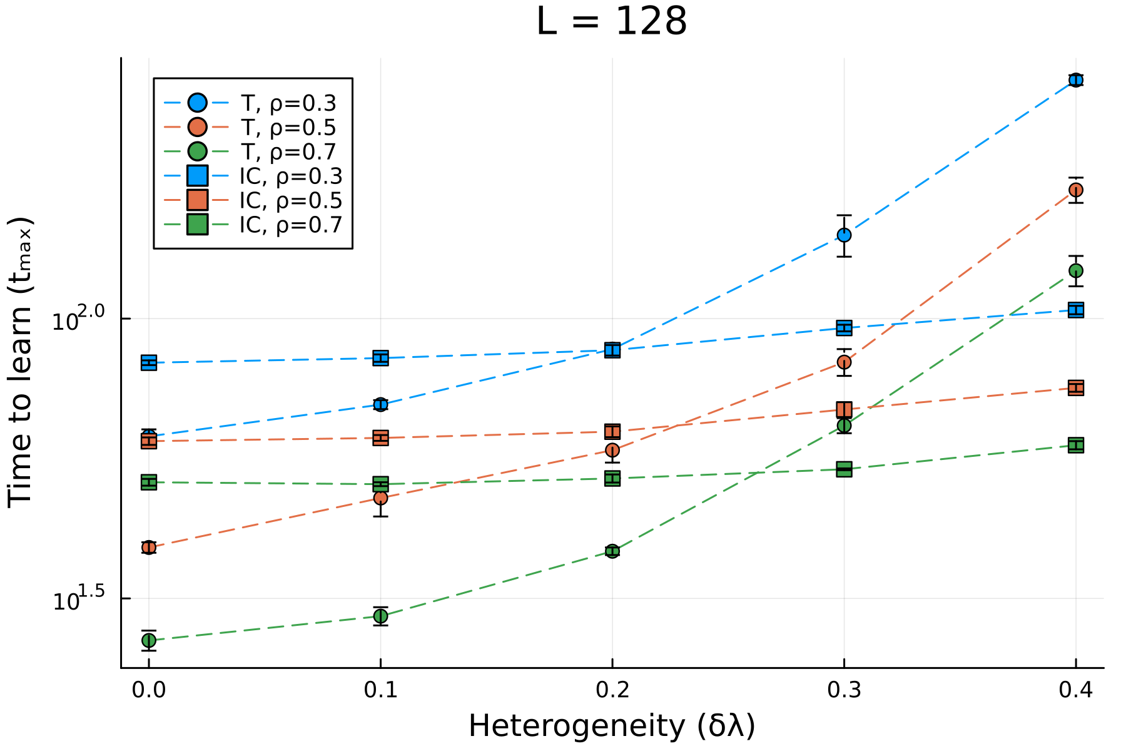
A better visualization of breakpoints (lower is better)
Notes:
Still, PI is better for lower class sizes
At high heterogeneity, PI set ups generally perform better than traditional set ups, even when the traditional classrooms have higher rho’s
Classroom size effect: makes traditional better, more pronounced in homogenous classes

Slide 11
Things left to do
Research, data, analysis
Plot the rest of the heterogenous model SAs
Figure out class learning rate weirdness
Anisotropic model and analysis
Papers
Abstract
Manuscript drafts
Defend, I guess

Slide 12
Learning dynamics in a cellular automata model of classroom peer-to-peer interactions
Progress Report
1st Semester, AY 2024-2025
16 September 2024
Sy, Clarence Ioakim T.
BS4+ Applied Physics
Adviser: Dr. Johnrob Bantang
Complexity Science Group

