Slide 1
IN4331 Web Data Management Assignment outcomes
Ioana Jivet (4259610)
Nidhi Singh (4242246)

Slide 2
Assignment 1 Tree Pattern Evaluation
Notes:
No documentation: user- and developer-wise. We shaped our aim over the quarter: to provide documentation for developers. Whenever contributors want to get involved with the project, they have a starting point.
Project quality: After patching and patching the system, the quality of the system will be affected =>
Coding standards: As it is an open source project, with lots of contributors, the code has a lot of styles. They somewhat adopted some coding conventions, but they don’t seem that strict.
Maintenance: Easier for the core-team to identify what changes a contributor did: via pull requests: if the classes changed are the right ones, if they affect the architecture of the system

Slide 3
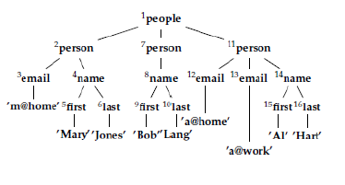

Tree pattern evaluation
Purpose: obtain query results from XML files

Slide 4
Tree pattern evaluation
Purpose: obtain query results from XML files

Slide 5
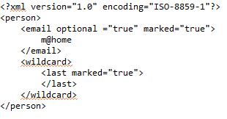
Input
Two XML files
Support for tree patterns: marked nodes, optional nodes, wildcards and value predicates

Slide 6
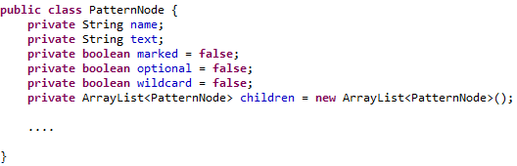
Query representation
Tree pattern SAX parser

Slide 7
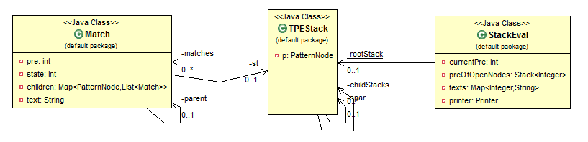
The evaluation algorithm

Slide 8
The evaluation algorithm
Implemented using a SAX parser
startDocument(), endDocument()
startElement(), endElement(), characters()
Tags are manipulated through a stack
Checks for valid matches
Ancestor relations

Slide 9
Match extraction
After the run, the results are stored in the root TPEStack
Results are extracted recursively, in a depth-first manner

Slide 10
Extensions Wildcards
Create a Match for every opening tag encountered
Checks are done only on descendants
Optional nodes
Validate matches in the endElement() method

Slide 11
Extensions Value predicates
Texts are saved in a map and checked against the value predicate stored in the pattern node

Slide 12
Assignment 2 Large-Scale Data Management with HADOOP
Notes:
No documentation: user- and developer-wise. We shaped our aim over the quarter: to provide documentation for developers. Whenever contributors want to get involved with the project, they have a starting point.
Project quality: After patching and patching the system, the quality of the system will be affected =>
Coding standards: As it is an open source project, with lots of contributors, the code has a lot of styles. They somewhat adopted some coding conventions, but they don’t seem that strict.
Maintenance: Easier for the core-team to identify what changes a contributor did: via pull requests: if the classes changed are the right ones, if they affect the architecture of the system

Slide 13
MapReduce jobs

Slide 14
Combiner functions Exercise 1

Slide 15
XML processing with HADOOP Exercise 2
Input file : movies.xml
MAPREDUCE job
Use of XmlInputFormat class to extract text and tags between <movie></movie> tag

Slide 16
XML processing with HADOOP Exercise 2
Mapper
The map function receives input value of <movie> </movie> tag
Uses SAX parser to parse the content of this tag
Fills and returns MovieSet class object with movie details, title, year, genre, summary, director details and actor details.
Calls context.write for two key values
Reducer
Uses MutipleOutputs object to write content based on keys.

Slide 17
PIGLATIN scripts Exercise 3
Input: Output files of previous exercise
Query 1
title_and_actor = LOAD 'wdm-pig/content/TitleAndActor.txt' USING PigStorage('\t') AS (TITLE:chararray,ACTOR_NAME:chararray,
BIRTH_DATE:int,ROLE:chararray);
grouped_by_title = GROUP title_and_actor BY TITLE;
result = FOREACH grouped_by_title GENERATE $0, $1.(ACTOR_NAME, ROLE);
STORE result INTO 'wdm-pig/pig-results/ex1';

Slide 18
PIGLATIN scripts Exercise 3
Query 2
dir_and_title = LOAD 'wdm-pig/content/DirAndTitle.txt' USING PigStorage('\t') AS (
DIR_NAME:chararray,
TITLE:chararray,
REL_YEAR:int);
grouped_by_dir = GROUP dir_and_title BY DIR_NAME;
result = FOREACH grouped_by_dir GENERATE $0, $1.TITLE;
STORE result INTO 'wdm-pig/pig-results/ex2';

Slide 19
PIGLATIN scripts Exercise 3
Query 3
A = LOAD 'wdm-pig/content/TitleAndActor.txt' USING PigStorage('\t') AS (TITLE:chararray,ACTOR_NAME:chararray,BIRTH_DATE:int,
ROLE:chararray);
D = LOAD 'wdm-pig/content/DirAndTitle.txt' USING PigStorage('\t') AS (DIR_NAME:chararray,TITLE:chararray,REL_YEAR:int);
X = COGROUP A by TITLE, D BY TITLE;
result = FOREACH X GENERATE $0, $2.DIR_NAME, $1.ACTOR_NAME;
STORE result INTO 'wdm-pig/pig-results/ex3';

Slide 20
PIGLATIN scripts Exercise 3
Query 4
A = LOAD 'wdm-pig/content/TitleAndActor.txt' USING PigStorage('\t') AS (TITLE:chararray,ACTOR_NAME:chararray,
BIRTH_DATE:int,ROLE:chararray);
D = LOAD 'wdm-pig/content/DirAndTitle.txt' USING PigStorage('\t') AS (DIR_NAME:chararray,TITLE:chararray,REL_YEAR:int);
X = COGROUP A by ACTOR_NAME INNER, D BY DIR_NAME INNER;
result = FOREACH X GENERATE $0, $1.TITLE, $2.TITLE;
STORE result INTO 'wdm-pig/pig-results/ex4';

Slide 21
PIGLATIN scripts Exercise 3
Query 5
A = LOAD 'wdm-pig/content/TitleAndActor.txt' USING PigStorage('\t') AS (TITLE:chararray,ACTOR_NAME:chararray,BIRTH_DATE:int,
ROLE:chararray);
D = LOAD 'wdm-pig/content/DirAndTitle.txt' USING PigStorage('\t') AS (DIR_NAME:chararray,TITLE:chararray,REL_YEAR:int);
X = JOIN A by TITLE, D BY TITLE;
F = FILTER X BY $1==$4;
result = FOREACH F GENERATE $1;
STORE result INTO 'wdm-pig/pig-results/ex5';

Slide 22
Inverted file project Exercise 4

Slide 23
IN4331 Web Data Management Assignment outcomes
Ioana Jivet (4259610)
Nidhi Singh (4242246)

