Slide 1
IN4331 Web Data Management Assignment outcomes
Ioana Jivet (4259610)
Nidhi Singh (4242246)

Slide 2
Assignment 1 Tree Pattern Evaluation

Slide 3
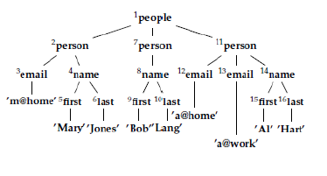

Tree pattern evaluation
Purpose: obtain query results from XML files

Slide 4
Tree pattern evaluation
Purpose: obtain query results from XML files

Slide 5
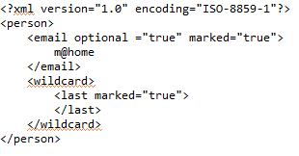
Input
Two XML files
Support for tree patterns: marked nodes, optional nodes, wildcards and value predicates

Slide 6
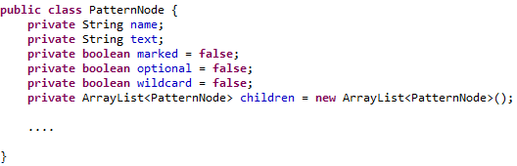
Query representation
Tree pattern SAX parser

Slide 7
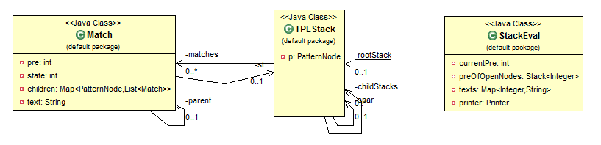
The evaluation algorithm

Slide 8
The evaluation algorithm
Implemented using a SAX parser
startDocument(), endDocument()
startElement(), endElement(), characters()
Tags are manipulated through a stack
Checks for valid matches
Ancestor relations

Slide 9
Match extraction
After the run, the results are stored in the root TPEStack
Results are extracted recursively, in a depth-first manner

Slide 10
Extensions Wildcards
Create a Match for every opening tag encountered
Checks are done only on descendants
Optional nodes
Validate matches in the endElement() method

Slide 11
Extensions Value predicates
Texts are saved in a map and checked against the value predicate stored in the pattern node

Slide 12
Assignment 2 Large-Scale Data Management with HADOOP

Slide 13
MapReduce jobs

Slide 14
XML processing with HADOOP Exercise 2
Input file : movies.xml
MAPREDUCE job
Use of XmlInputFormat class to extract text and tags between <movie></movie> tag

Slide 15
XML processing with HADOOP Exercise 2
Mapper
The map function receives input value of <movie> </movie> tag
Uses SAX parser to parse the content of this tag
Fills and returns MovieSet class object with movie details, title, year, genre, summary, director details and actor details.
Calls context.write for two key values
Reducer
Uses MutipleOutputs object to write content based on keys.

Slide 16
PIGLATIN scripts Exercise 3
Input: Output files of previous exercise
Query 1
title_and_actor = LOAD 'wdm-pig/content/TitleAndActor.txt' USING PigStorage('\t') AS (TITLE:chararray,ACTOR_NAME:chararray,
BIRTH_DATE:int,ROLE:chararray);
grouped_by_title = GROUP title_and_actor BY TITLE;
result = FOREACH grouped_by_title GENERATE $0, $1.(ACTOR_NAME, ROLE);
STORE result INTO 'wdm-pig/pig-results/ex1';

Slide 17
PIGLATIN scripts Exercise 3
Query 2
dir_and_title = LOAD 'wdm-pig/content/DirAndTitle.txt' USING PigStorage('\t') AS (
DIR_NAME:chararray,
TITLE:chararray,
REL_YEAR:int);
grouped_by_dir = GROUP dir_and_title BY DIR_NAME;
result = FOREACH grouped_by_dir GENERATE $0, $1.TITLE;
STORE result INTO 'wdm-pig/pig-results/ex2';

Slide 18
PIGLATIN scripts Exercise 3
Query 3
A = LOAD 'wdm-pig/content/TitleAndActor.txt' USING PigStorage('\t') AS (TITLE:chararray,ACTOR_NAME:chararray,BIRTH_DATE:int,
ROLE:chararray);
D = LOAD 'wdm-pig/content/DirAndTitle.txt' USING PigStorage('\t') AS (DIR_NAME:chararray,TITLE:chararray,REL_YEAR:int);
X = COGROUP A by TITLE, D BY TITLE;
result = FOREACH X GENERATE $0, $2.DIR_NAME, $1.ACTOR_NAME;
STORE result INTO 'wdm-pig/pig-results/ex3';

Slide 19
PIGLATIN scripts Exercise 3
Query 4
A = LOAD 'wdm-pig/content/TitleAndActor.txt' USING PigStorage('\t') AS (TITLE:chararray,ACTOR_NAME:chararray,
BIRTH_DATE:int,ROLE:chararray);
D = LOAD 'wdm-pig/content/DirAndTitle.txt' USING PigStorage('\t') AS (DIR_NAME:chararray,TITLE:chararray,REL_YEAR:int);
X = COGROUP A by ACTOR_NAME INNER, D BY DIR_NAME INNER;
result = FOREACH X GENERATE $0, $1.TITLE, $2.TITLE;
STORE result INTO 'wdm-pig/pig-results/ex4';

Slide 20
PIGLATIN scripts Exercise 3
Query 5
A = LOAD 'wdm-pig/content/TitleAndActor.txt' USING PigStorage('\t') AS (TITLE:chararray,ACTOR_NAME:chararray,BIRTH_DATE:int,
ROLE:chararray);
D = LOAD 'wdm-pig/content/DirAndTitle.txt' USING PigStorage('\t') AS (DIR_NAME:chararray,TITLE:chararray,REL_YEAR:int);
X = JOIN A by TITLE, D BY TITLE;
F = FILTER X BY $1==$4;
result = FOREACH F GENERATE $1;
STORE result INTO 'wdm-pig/pig-results/ex5';

Slide 21
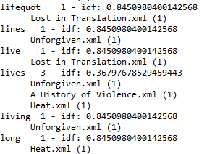
Inverted file project Exercise 4
Purpose: build an inverted file using a MapReduce jobs
Input: XML files.
Output:

Slide 22
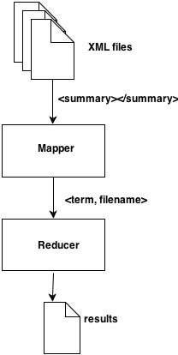
Inverted file project Exercise 4

Slide 23
IN4331 Web Data Management Assignment outcomes
Ioana Jivet (4259610)
Nidhi Singh (4242246)

