Slide 1
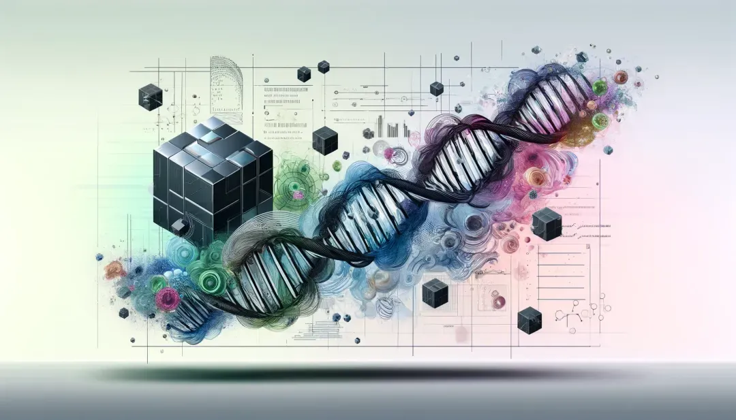
Machine Learning in Bioinformatics
Supervised, Unsupervised, and Semi-Supervised Learning
Applications in Bioinformatics and Healthcare
AlphaFold and Federated Learning with Quantum Computing

Slide 2
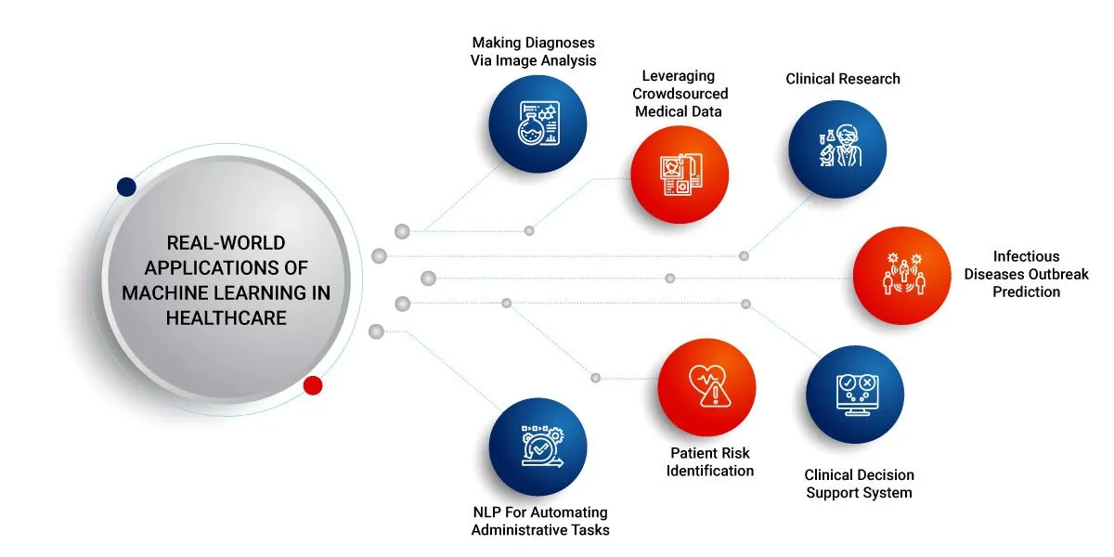
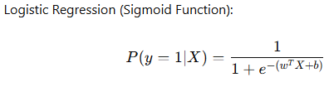
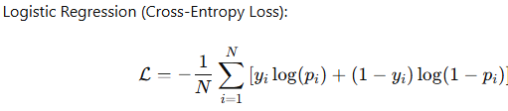
Supervised Learning: Foundations
Supervised learning relies on labeled datasets (inputs and outcomes)
Models optimize by minimizing a loss function
Applications: Disease classification, risk prediction, biomarker discovery

Slide 3
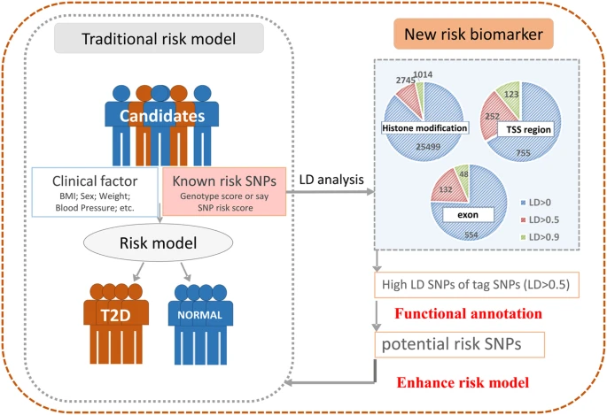
Logistic Regression Applications
Binary classification of diseases: cancer vs. healthy.
Key components: weights, features, bias, sigmoid function
Example: Predicting Type 2 diabetes risk using SNP data
From: https://doi.org/10.1038/srep43709

Slide 4
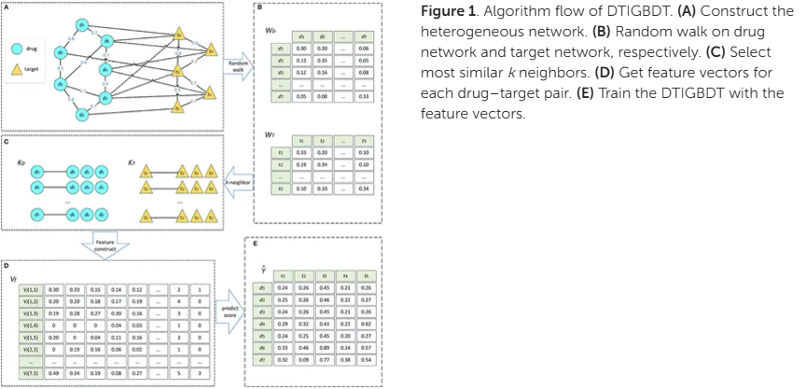
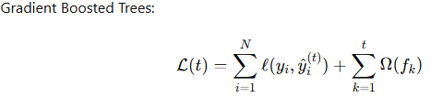
Gradient Boosted Trees
From: https://doi.org/10.3389/fgene.2019.00459
Ensemble models refine decision trees iteratively
Combine loss function and regularization for complex relationships
Example: Predicting protein-protein interactions

Slide 5
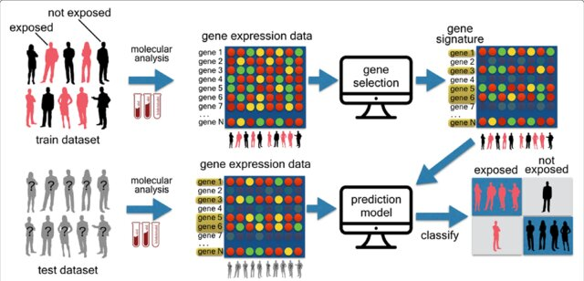
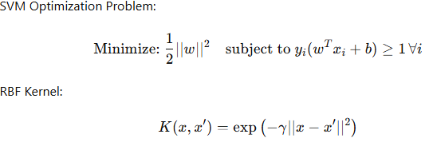
Support Vector Machines (SVMs)
Effective for high-dimensional datasets like gene expression
Separates data with a hyperplane, maximizing margins
Applications: Cancer classification, functional genomic elements, SNP risk prediction

Slide 6
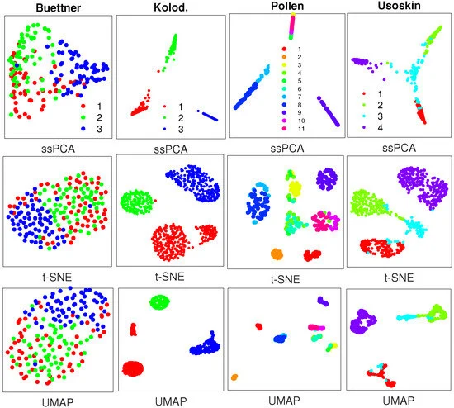
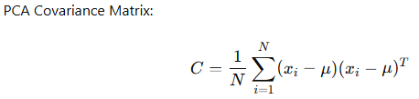
Unsupervised Learning: PCA and t-SNE
Identifies hidden patterns without predefined labels
PCA reduces dimensionality, t-SNE visualizes complex data
Example: Revealing tumor heterogeneity in single-cell RNA-Seq

Slide 7
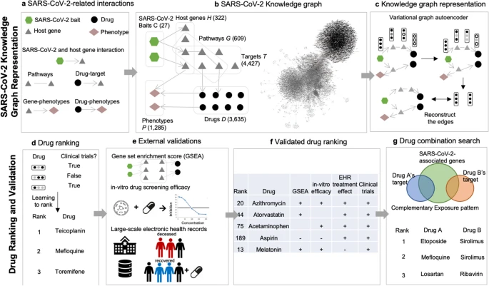

Semi-Supervised Learning: Graph Neural Networks
Semi supervised learning combines labeled and unlabeled data for learning
Graph Neural Networks (GNNs): Nodes as data points, edges as relationships.
Example: Drug repurposing for Alzheimer’s using GNNs
From: https://doi.org/10.1038/s41598-021-02353-5

Slide 8
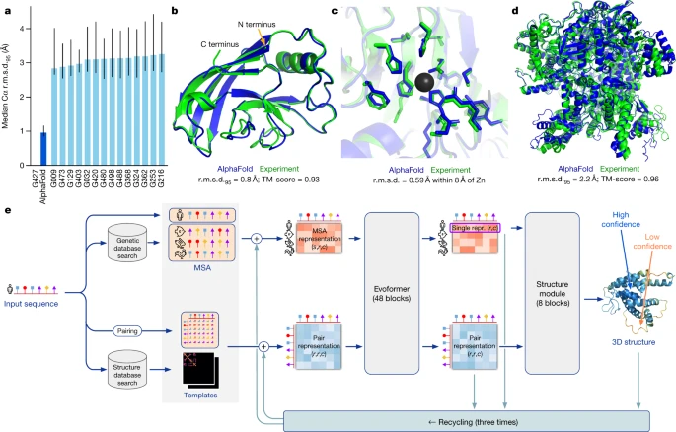
AlphaFold: Revolutionizing Protein Folding
Process by which a linear chain of amino acids folds into a specific three-dimensional structure
Predicted protein structures from sequences with near-experimental accuracy.
Combines MSAs, neural networks, and structural modules
Application: Alzheimer’s and cancer target identification.
From: https://doi.org/10.1038/s41586-021-03819-2

Slide 9
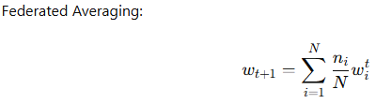
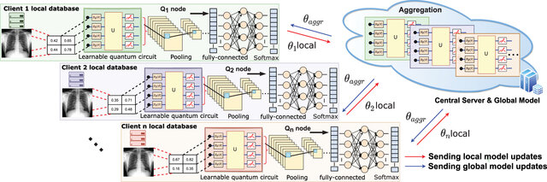
Federated Learning with Quantum Computing
Collaborative training without data sharing—privacy-preserving AI
Quantum computing accelerates optimization, enhancing performance
Applications: GWAS, drug discovery, multi-center clinical studies
Example of a quantum federated learning framework based on quanvolutional neural network for an identification of chest related diseases collaboratively in healthcare sector Comprising n-quantum training models on their local data, and an aggregator (central server) receiving local model updates and producing a global model
From: https://iopscience.iop.org/article/10.1088/2058-9565/acfc61

Slide 10
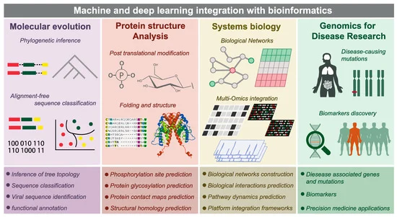
Shaping the Future of Bioinformatics
From clustering to supervised and semi-supervised learning
Integrating AlphaFold, federated learning, and quantum computing.
Redefining biology and healthcare with machine learning
Next week: Networks based approaches in Drug Repositioning

