Slide 1
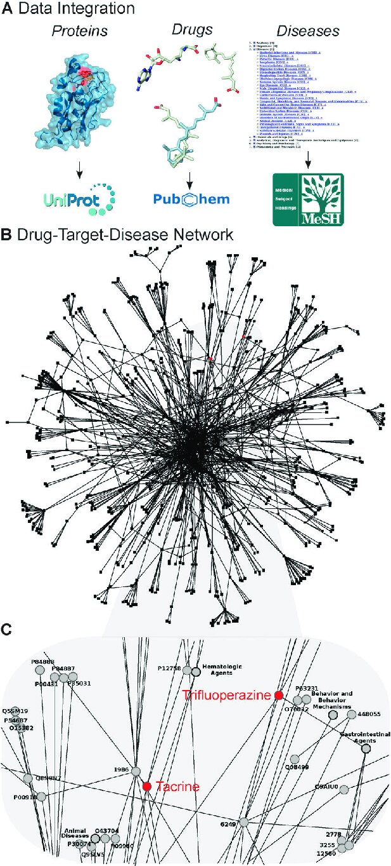
Network-Based Approaches in Drug Discovery and Repurposing
From Single-Layer Graphs to Multi-Layered Insights
As. univ. drd. ing. Bozdog Alexandru
Big Data în Health and Bioinformatics Lab 8

Slide 2
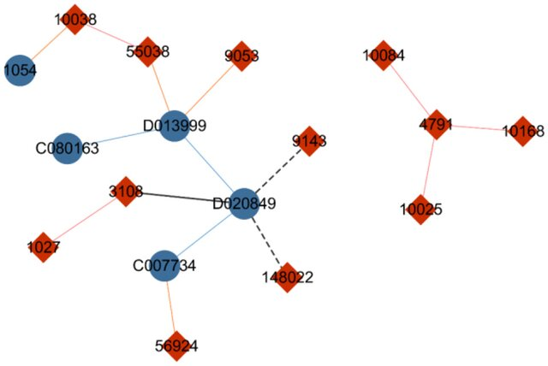
Networks in Bioinformatics
What are Networks?
Group of components that model relationships and interactions (within biological systems).
Common applications: drug-target interactions, disease-gene associations, protein-protein interactions.
Why Networks Matter in Drug Discovery:
Holistic view of biological complexity.
Enable discovery of hidden links between drugs, diseases, and targets.
Key Goal: Uncover actionable insights for drug repurposing.
Diagram of drug–gene network. The blue nodes indicate drugs, and the red nodes indicate genes. The solid lines represent drug–gene interactions, with the blue lines indicating a similarity between two drugs, and the red lines indicating a similarity between two genes. The black line means that the nodes are selected as candidate labels of drug “D020849,” and the dotted line indicates that the node on the end side of the line is a sampled label.

Slide 3
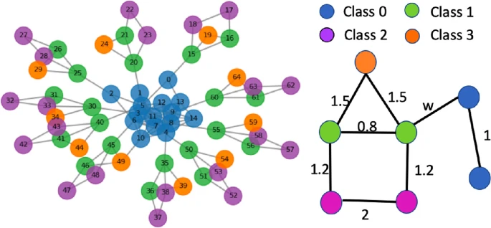
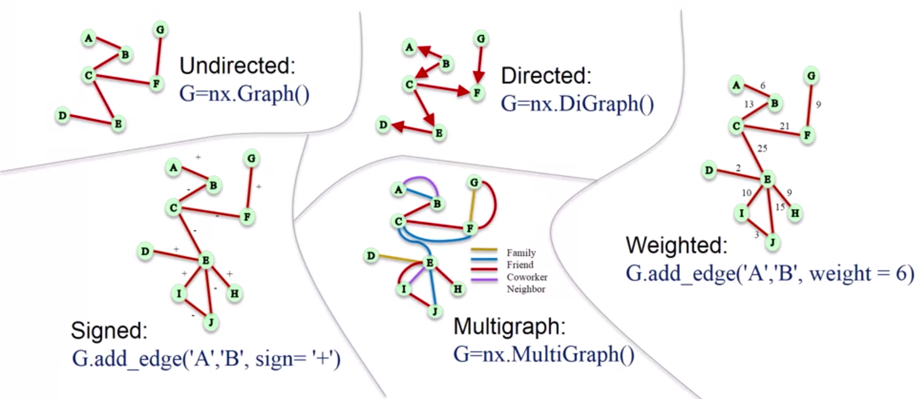
Key Components of Networks
Nodes and Edges:
Nodes: Represent entities like drugs, proteins, or genes.
Edges: Represent relationships (e.g., drug binds protein).
Network Types:
Weighted vs. Unweighted: Edges may carry interaction strength.
Directed vs. Undirected: Directionality indicates causality.
Applications in Bioinformatics:
Drug-target networks for identifying candidates.
Protein-protein interaction (PPI) networks to study pathways.
Disease-gene networks for genetic insights.

Slide 4


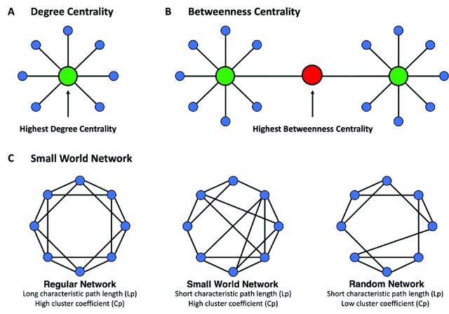

Key Metrics in Network Analysis
Clustering Coefficient: Highlights localized clusters (e.g., protein complexes).
Shortest Path Length: Quantifies proximity between nodes, useful for drug-disease association.
Degree Centrality: Measures node connectivity. Hubs are highly connected nodes (e.g., essential proteins).
Betweenness Centrality: Identifies bottlenecks critical for network flow.

Slide 5
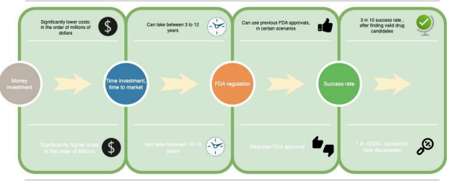
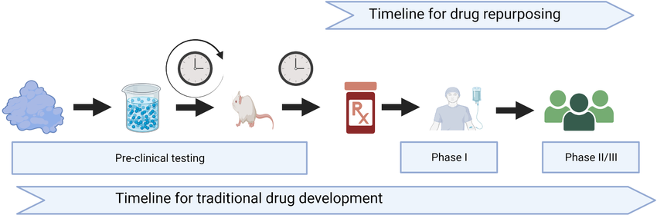
Drug Repurposing: Concept and Importance
What is Drug Repurposing?
Identifying new therapeutic uses for existing drugs.
Why It’s Important:
Reduces time and cost of drug development.
Leverages existing safety and efficacy data.
Example:
Baricitinib for COVID-19 (anti-inflammatory properties repurposed for SARS-CoV-2 pathways).

Slide 6


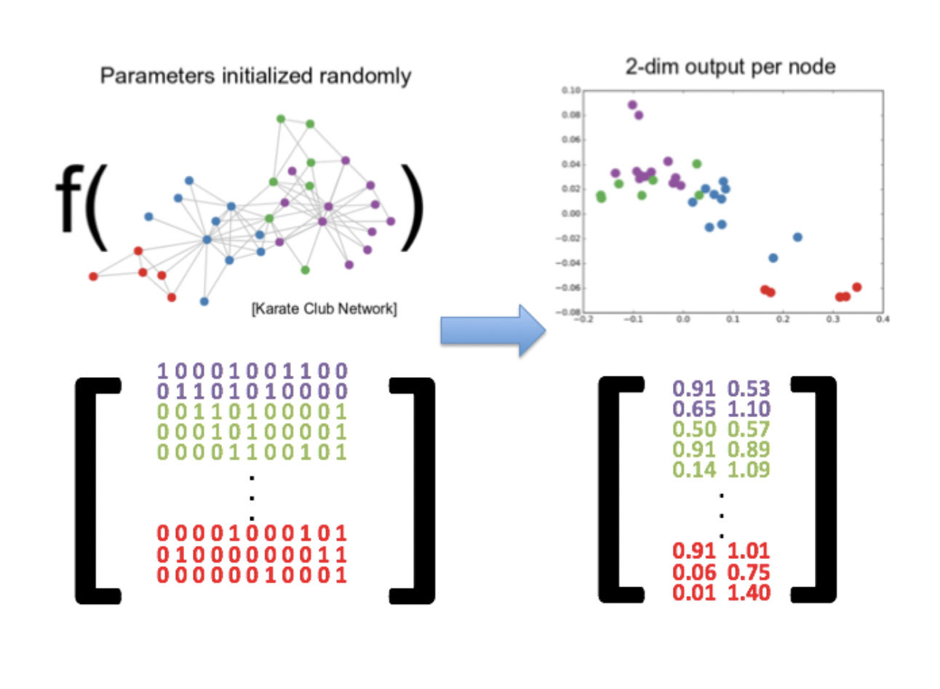
Mathematical Models in Drug Repurposing
Proximity-Based Models:
Measure network distance between drugs and disease nodes.
Random Walk with Restart (RWR):
Simulates navigation in a network to rank nodes by relevance.
Graph Embeddings:
Transforms nodes into vectors for predictive modeling.

Slide 7
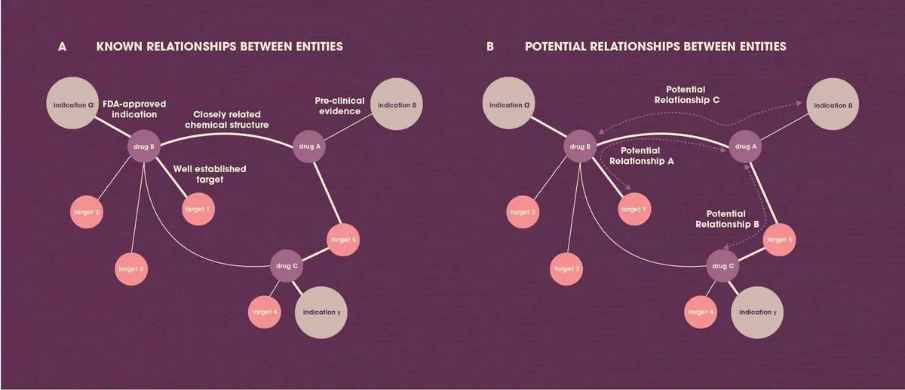
Research Applications
Cancer Drug Repurposing:
Example: Aspirin for pancreatic cancer (KRAS signaling).
Infectious Diseases:
Example: Baricitinib for COVID-19.
Neurodegenerative Diseases:
Example: Ibuprofen for Alzheimer’s pathways.
Rare Diseases:
Example: Statins for Niemann-Pick disease.

Slide 8
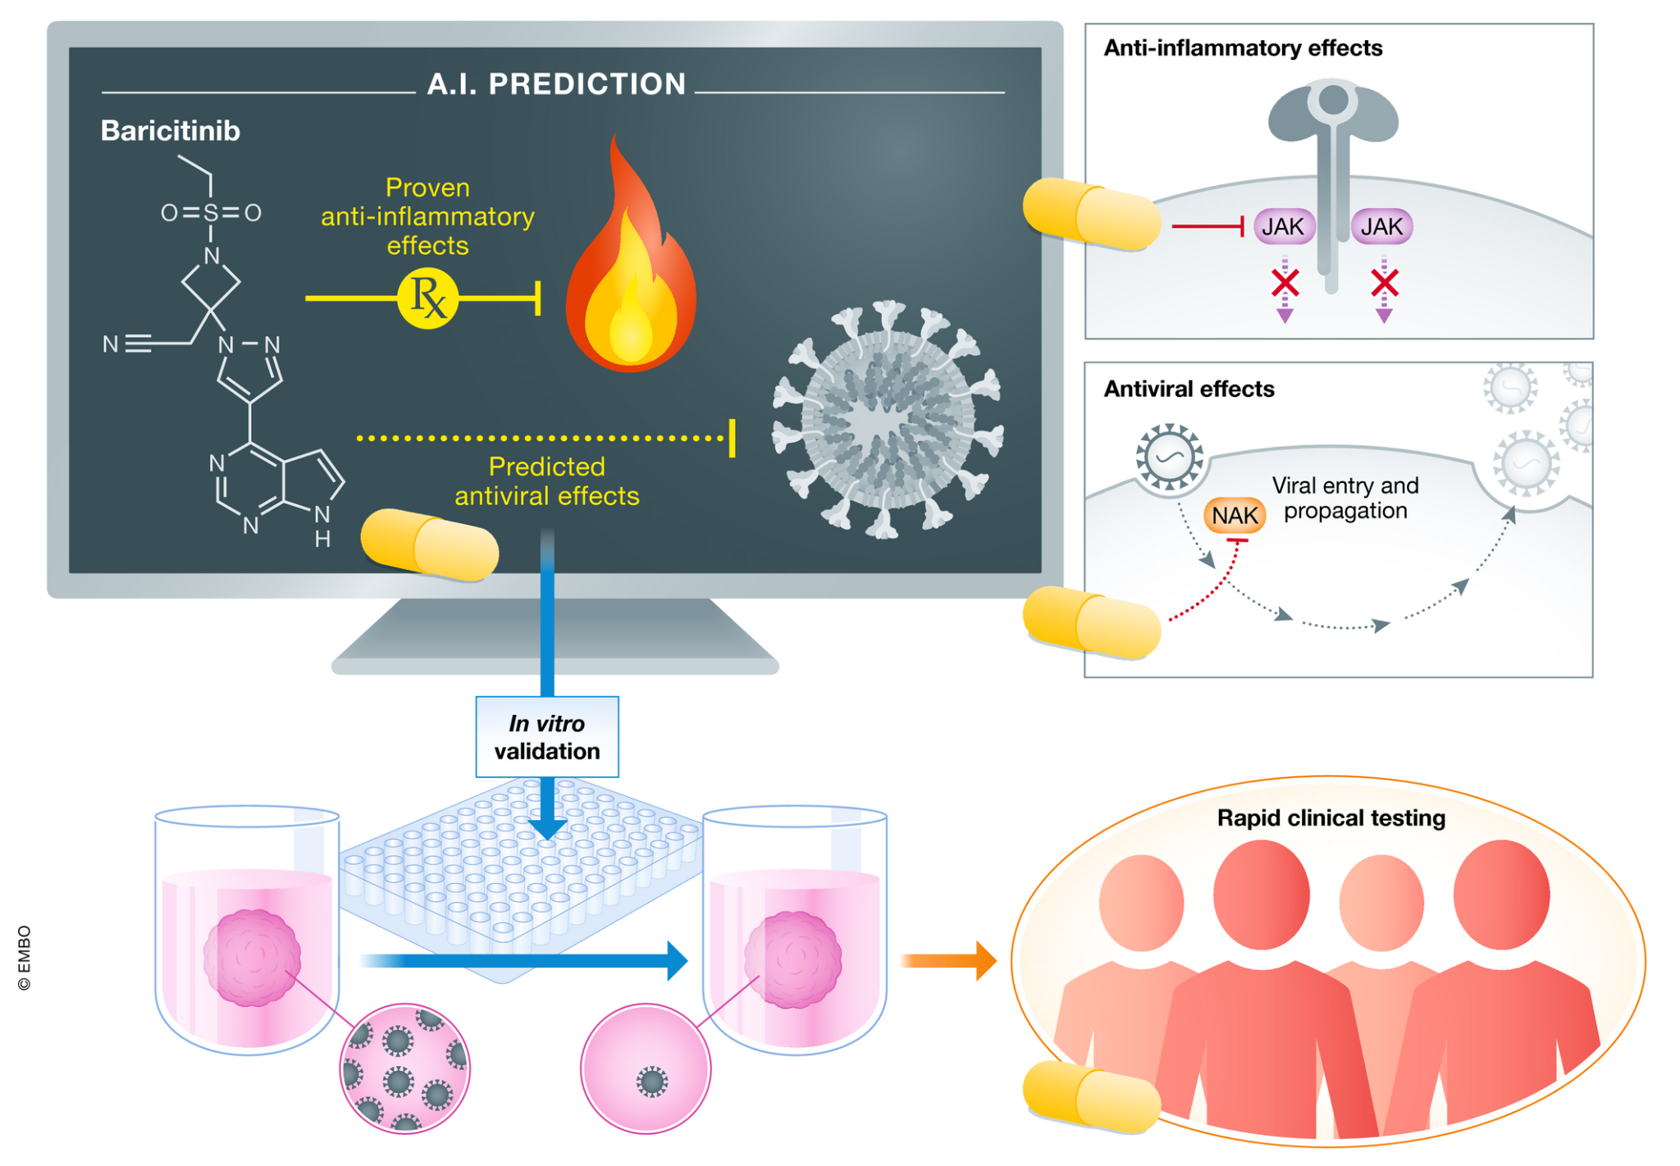
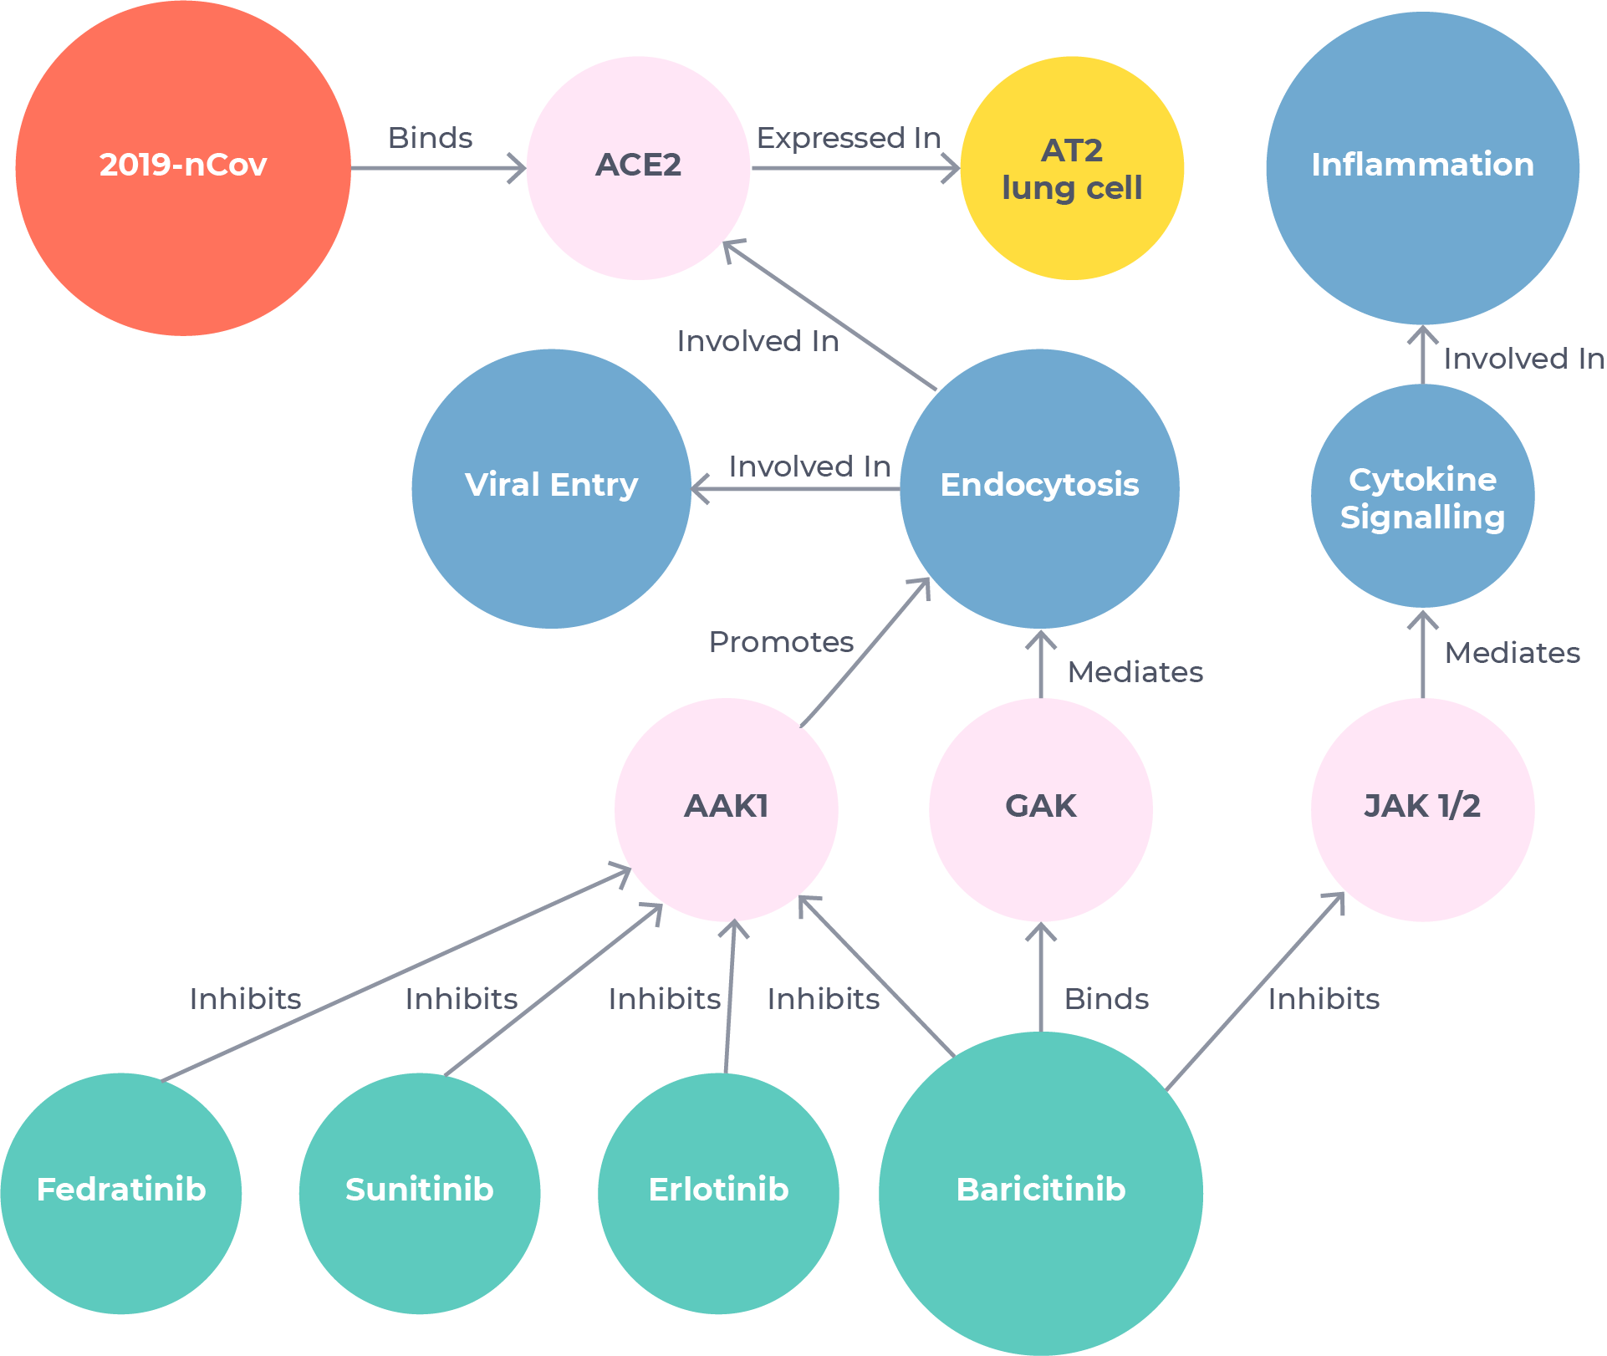
Industry Adoption
Pharmaceuticals:
Pfizer: Network models for polypharmacology.
Novartis: NerveNet project for drug-target interactions.
AI Startups:
BenevolentAI: Identified baricitinib for COVID-19 in weeks.
Atomwise: Small molecule discovery using PPI networks.
Collaborative Platforms:
Open Targets: Integrates GWAS and drug-disease networks.

Slide 9
Conclusions and Next Steps
Key Takeaways:
Networks are powerful tools for modeling biological complexity.
Metrics like centrality and shortest paths help uncover actionable insights.
Drug repurposing leverages these insights for cost-effective therapeutic innovation.
Next Week (Lab 9):
Multi-layered networks integrating genomics, transcriptomics, and proteomics.
Predicting drug efficacy and identifying biomarkers.

