Slide 1
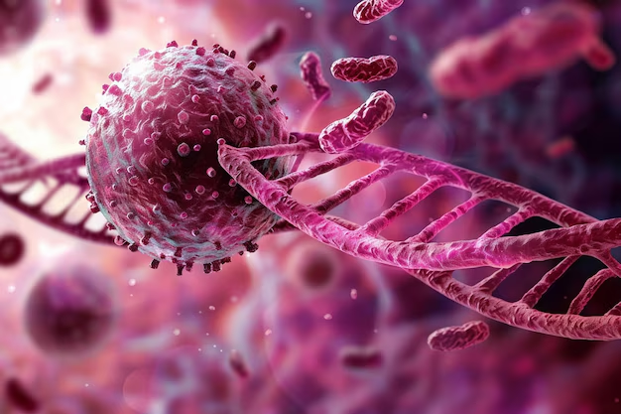
Integrative Genomics Approaches for Precision Oncology
Big Data in Health and Bioinformatics lab 9
As. univ. drd. ing. Bozdog Alexandru Cristian
10.12.2025

Slide 2
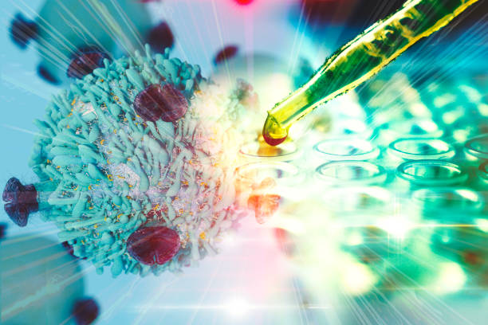
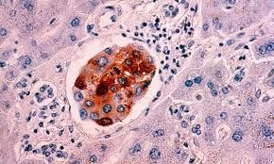
Introduction & Real-World Problem
Aggressive breast cancer scenario
Standard therapies often fail
Integrative genomics needed to understand treatment response

Slide 3
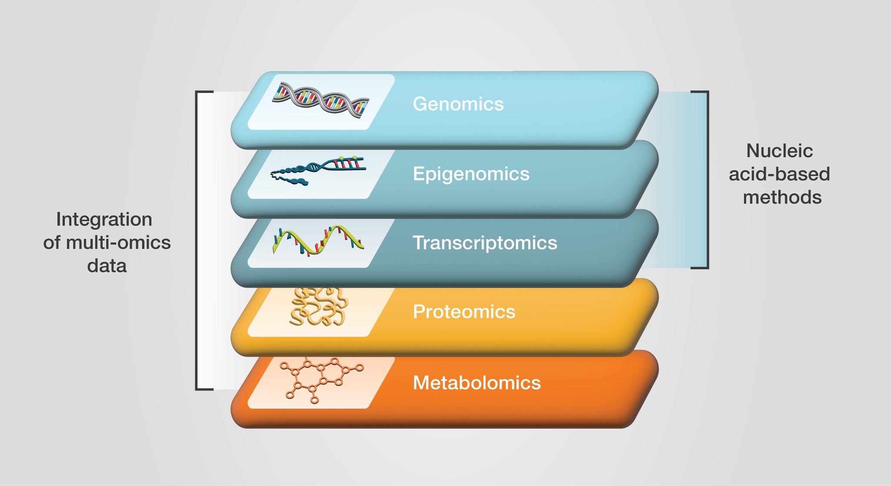
Why Integrate? The Case for Multi-Omics
Diseases are multi-dimensional
Integrative genomics captures complexity
Identifies hidden relationships & enables precision medicine

Slide 4
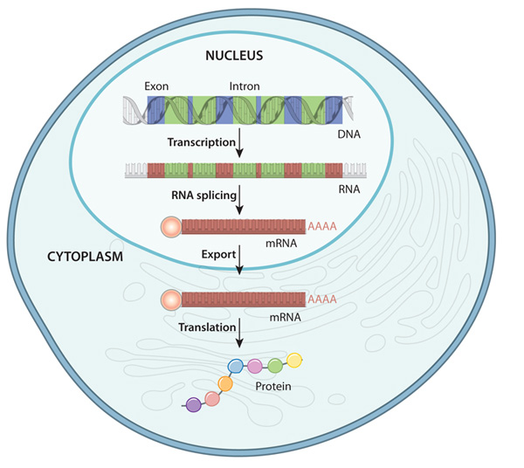
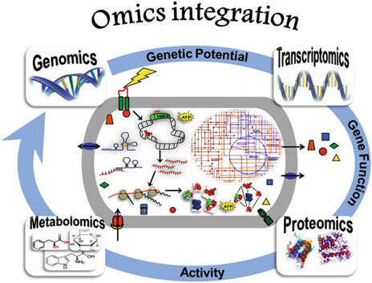
The Layers of Integration
Genomics (DNA)
Transcriptomics (RNA)
Epigenomics (Chromatin)
Proteomics (Proteins)

Slide 5
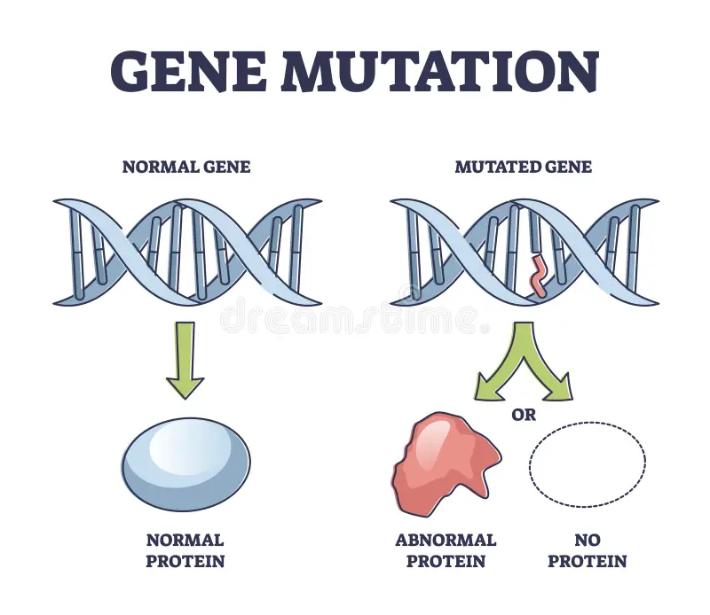
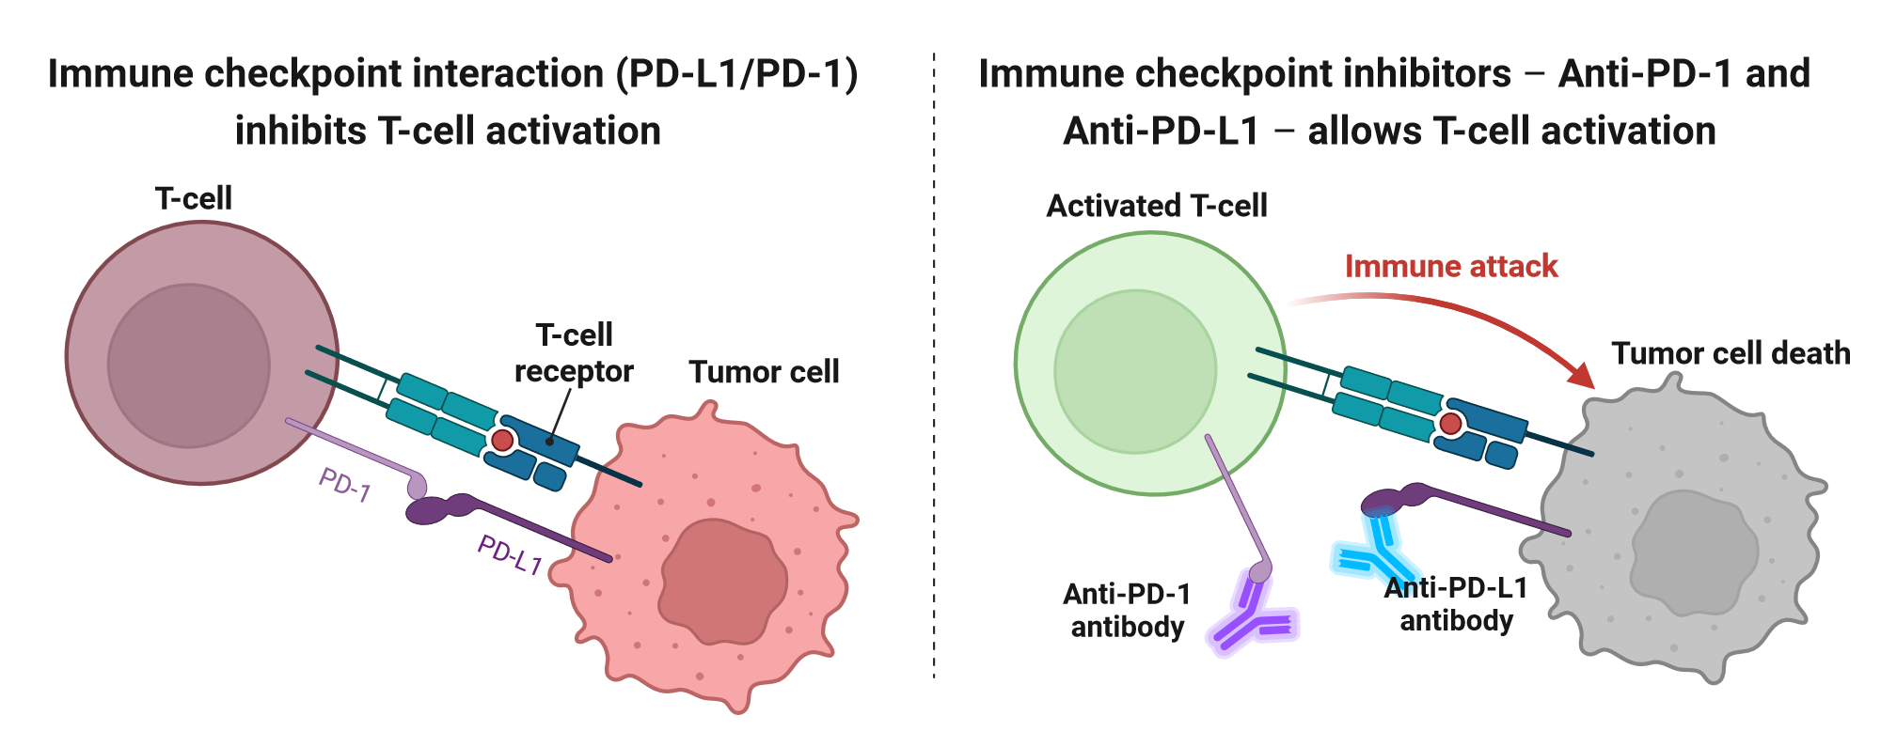
Genomics & Transcriptomics Insights
Transcriptomics: PD-L1 expression -> immunotherapy response
Genomics: BRCA1/2 mutations -> cancer risk

Slide 6
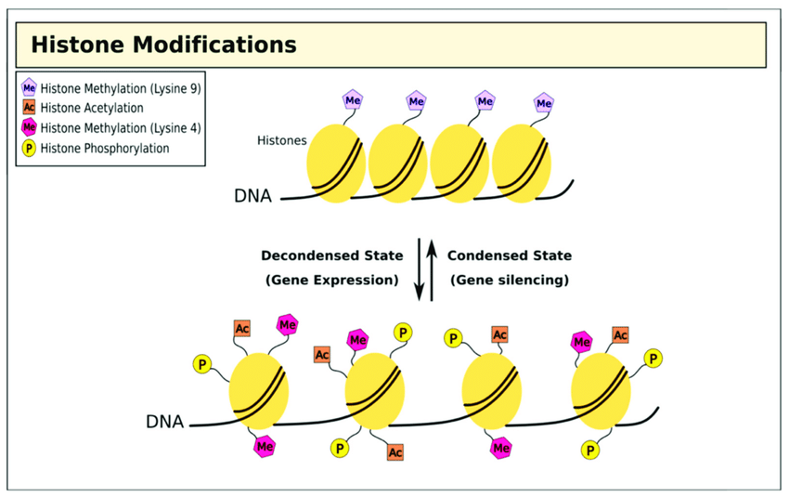
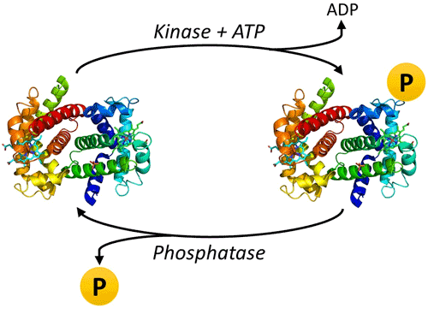
Epigenomics & Proteomics Insights
Epigenomics: DNA methylation, histone mods influencing gene expression
Proteomics: Protein phosphorylation (e.g., EGFR) drives signaling

Slide 7
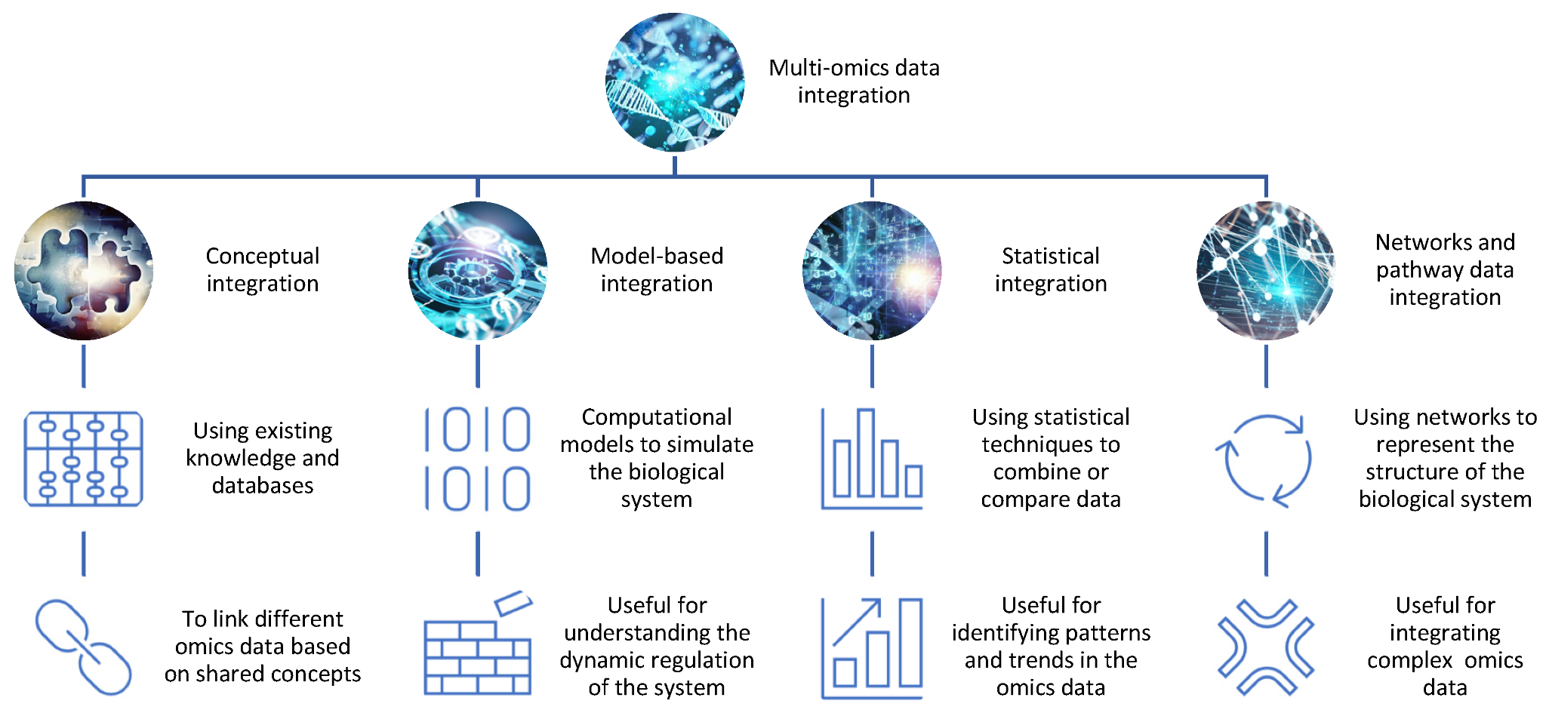
Computational Integration Approaches
Data harmonization, eQTL mapping
Network construction & ML models
Tools: iCluster, MOFA, WGCNA, OmicsIntegrator, Cytoscape

Slide 8
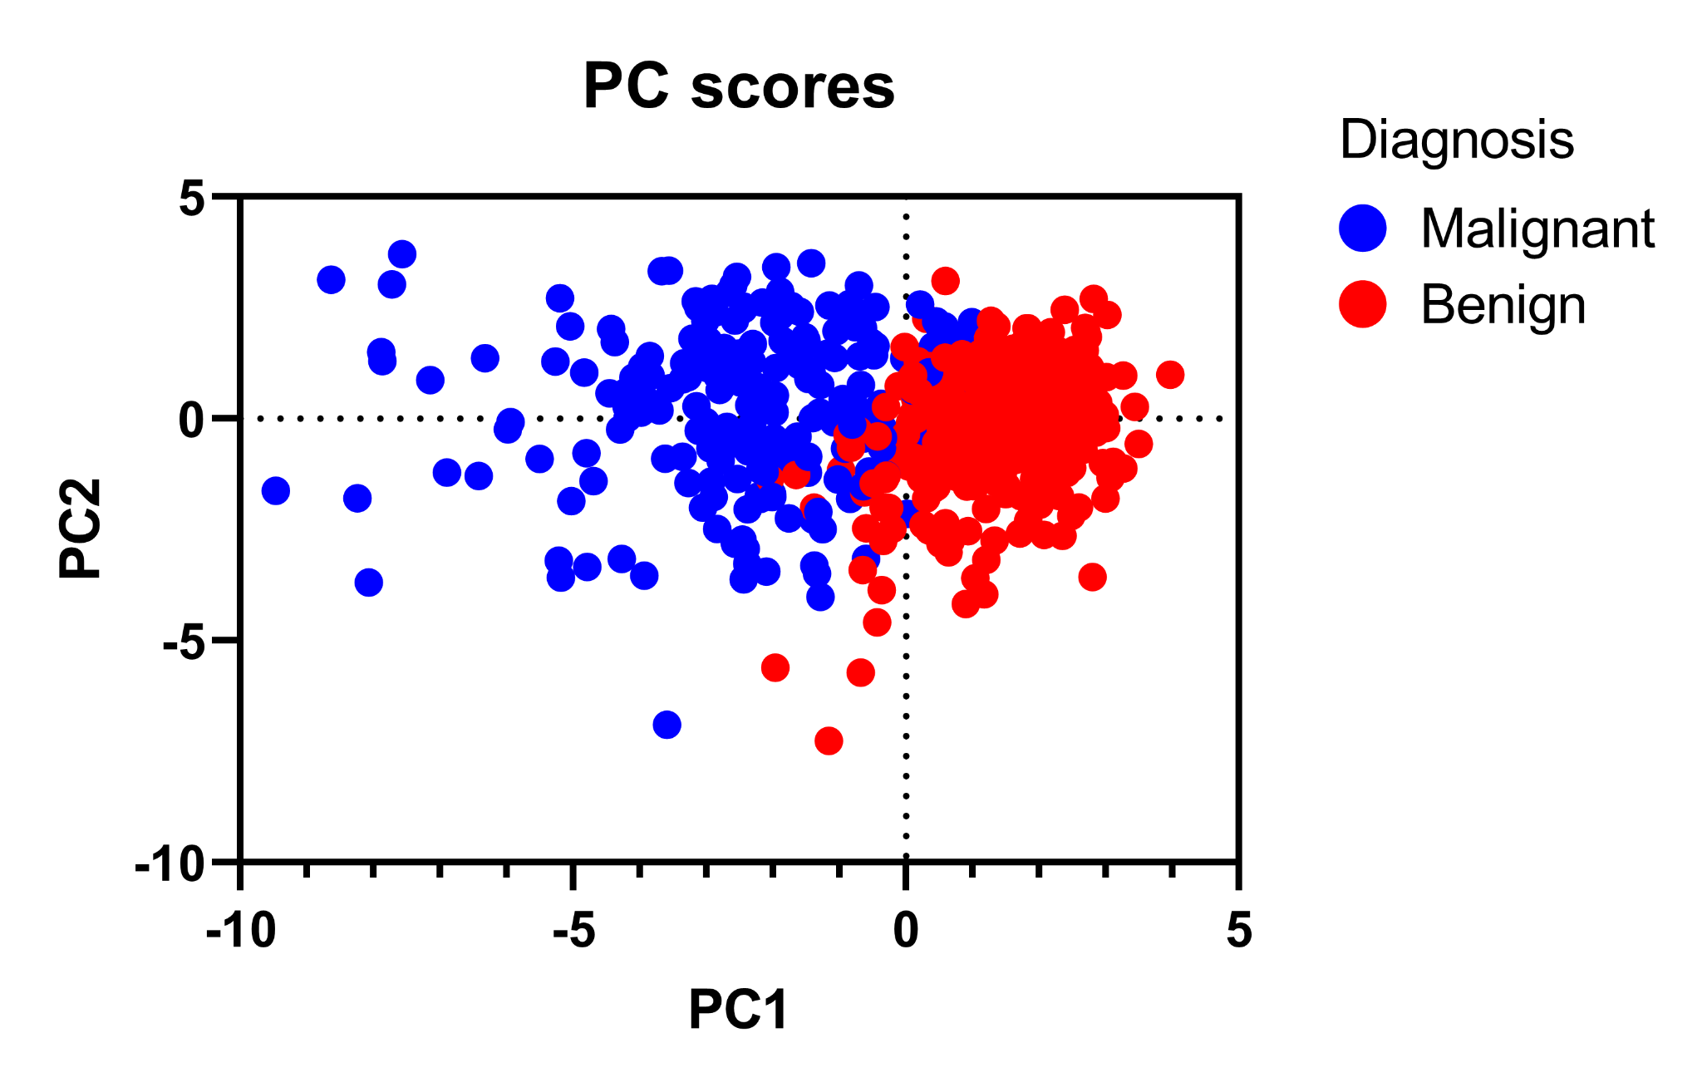
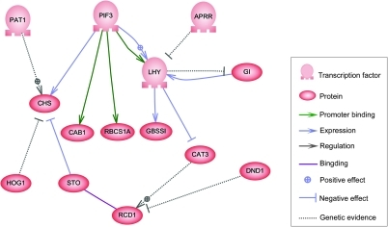
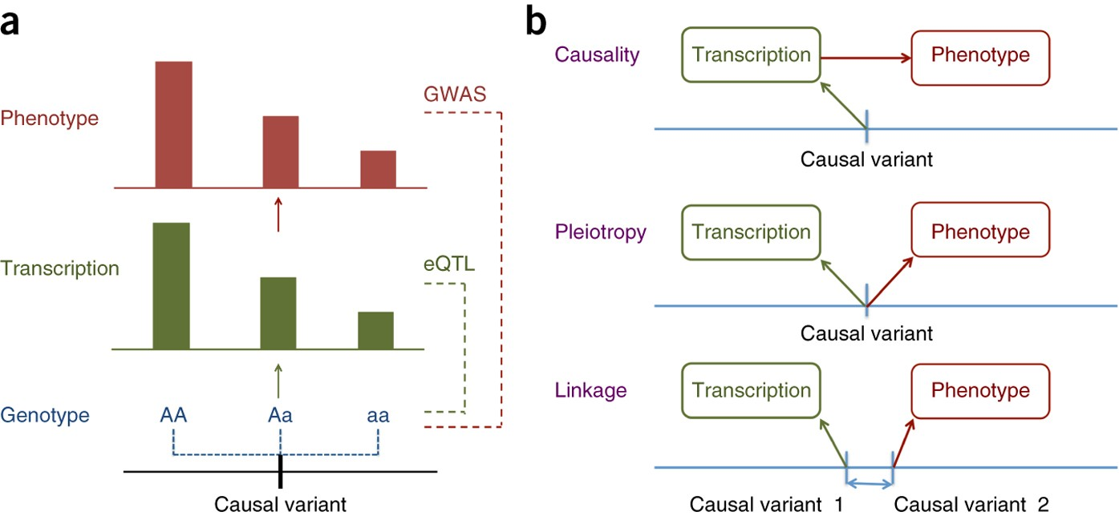
Methods for Integration
Correlation & association (eQTLs)
Dimensionality reduction (PCA, t-SNE)
Network integration (GRNs, PPIs)
ML & Bayesian methods

Slide 9

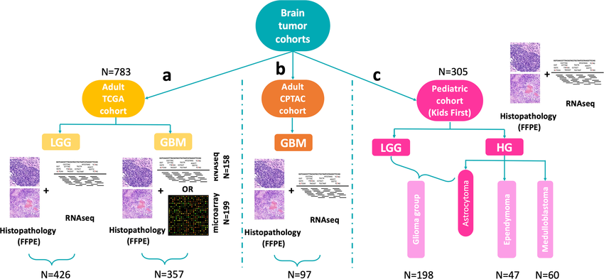
Case Study: Cancer Genomics
Integrating SNPs, expression, epigenomics for breast cancer subtypes
EGFR-driven glioblastoma
FOXM1 in ovarian cancer

Slide 10
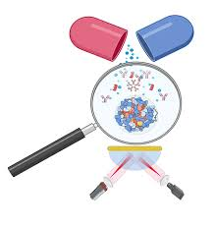
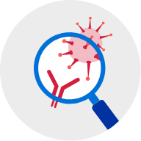
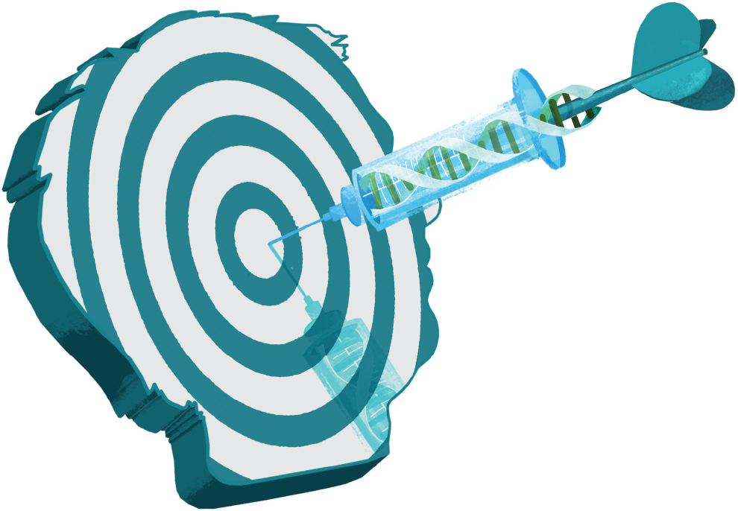
Key Applications in Healthcare
Disease subtyping
Biomarker discovery
Drug target identification

Slide 11
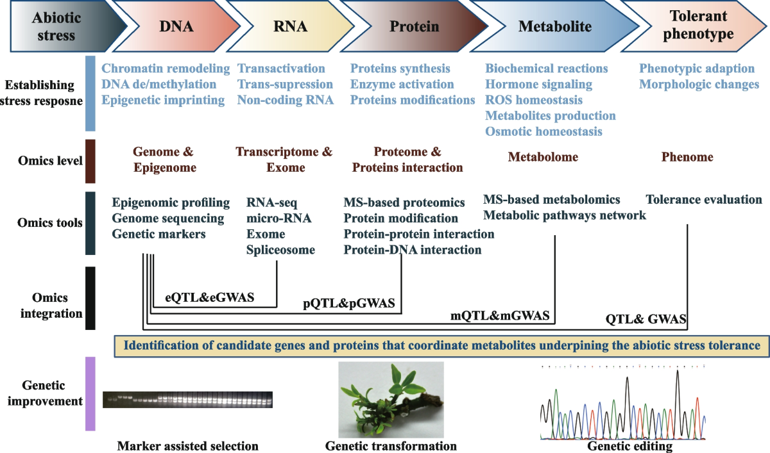
Conclusion & Next Steps
Integrative genomics provides systems-level insights
Beyond single-omics: multi-omics for better disease understanding
Next lab: hands-on integration with gene expression & SNP data

