Slide 1
Recipe Search Engine
Vădineanu Ioana-Maria
Special Topics in Software Engineering

Slide 2
Project Description
Recipe Search Engine is an application that provides fast and accurate recipe results using simple keyword search
Users can find recipes by name, ingredients, cuisine, difficulty, cooking time or dietary preferences using a single search bar

Slide 3
Use Cases
Users can:
Perform full-text searches across multiple recipe attributes using a single input
Browse search results and access detailed recipe information

Slide 4





Technologies Used

Slide 5
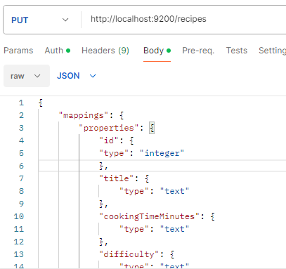
Elasticsearch – Index & Mapping
Recipes are stored in an Elasticsearch index called recipes
Each recipe is indexed as a document
All searchable fields are mapped as text to support flexible keyword search

Slide 6
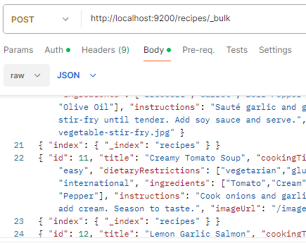
Elasticsearch – Document Indexing
Recipe data was added to Elasticsearch using the Bulk API
Multiple recipe documents were indexed efficiently in a single request
Postman was used create the index, configure mappings and insert data via the Elasticsearch REST API

Slide 7
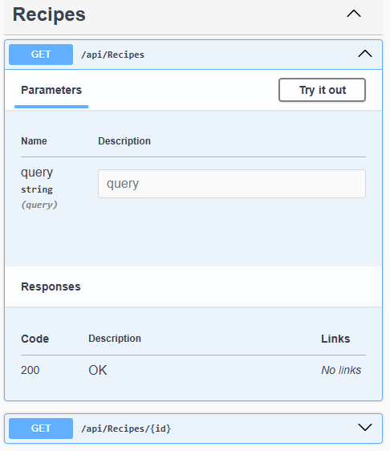
API Endpoints
The application exposes REST API endpoints for searching and retrieving recipes.
Swagger provides an interactive interface for testing endpoints without external tools.

Slide 8
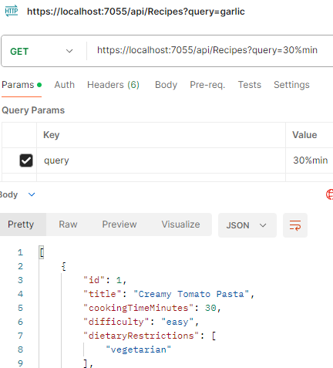
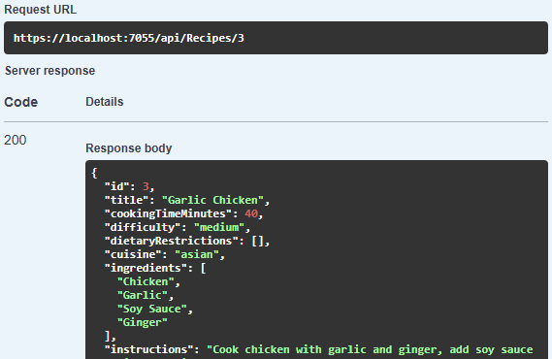
API Testing – Swagger & Postman

Slide 9
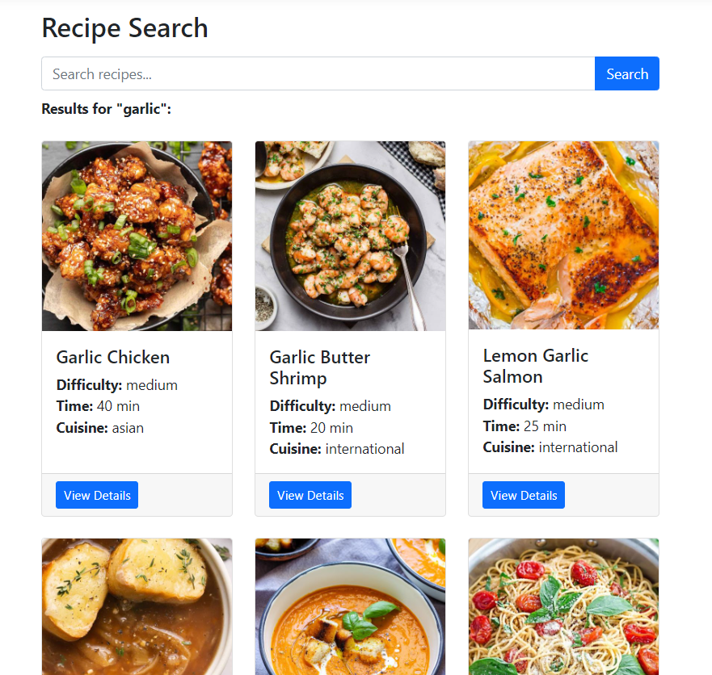
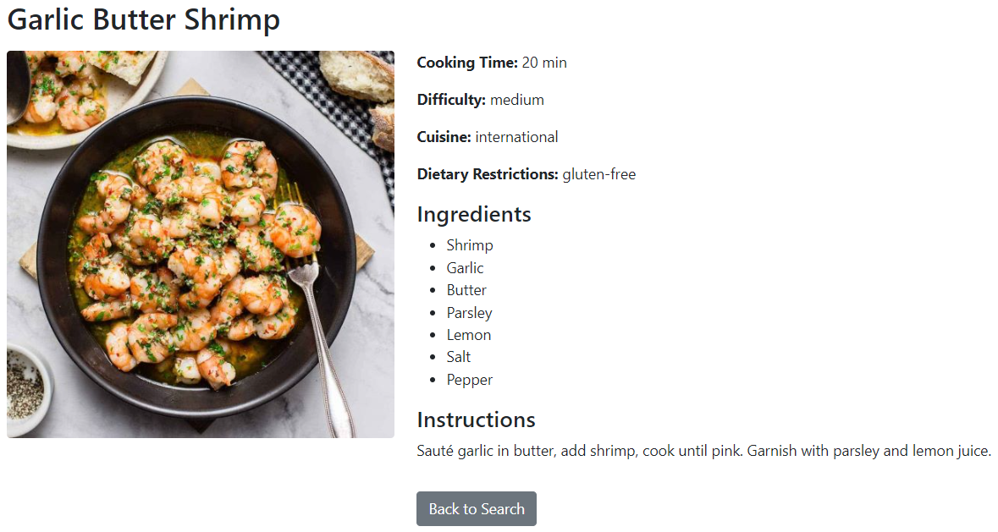
Application UI

Slide 10
Conclusion & Key Points
Recipe Search Engine finds recipes using a single search bar
Elasticsearch provides efficient full-text search across multiple recipe fields
REST API makes recipe data accessible and easy to test with Swagger and Postman
This application demonstrates how Elasticsearch can deliver fast and relevant search results in a simple, real application

