Slide 1
CAPSTONE ROUND 2 · AI CONSULTING
AI-Assisted Lease &
Due Diligence Review
for Commercial Property Developers — Portugal
One question drove every design decision:
"How do I know the AI isn't making things up?"
This presentation answers that question — with research, architecture, experiments, and results.
SECTOR
COMPANY SIZE
STUDENT
PROGRAM
Commercial Real Estate
Mid-market · 200–1,000 staff
Ioanna Renta
Ironhack AI Consulting
1 / 17

Slide 2
01 · THE PROBLEM
Chleo's company loses weeks and hundreds of thousands to manual lease review.
4–8h
13 days
€192k
2 deals
to abstract a single commercial lease manually
total due diligence cycle per acquisition
annual abstraction cost at 12 deals/year
had material clause errors with financial consequences
What the research showed:
• 88% of real estate firms are piloting AI in 2026 (up from 5% in 2023) — but only 8% have automated any process. Most are still in pilot.
• 85% reduction in lease review time in real deployments (Kolena 2025). 95% accuracy on standard clause extraction vs 91% manual (DLA Piper 2025).
• The window for early movers is open — but closing. First movers build trust with lawyers before adoption becomes industry standard.
2 / 17

Slide 3
02 · EVOLUTION
Round 1 proved the concept. Round 2 makes it trustworthy.
Avg peer rating: 4.50/5 · Teaching staff decision: proceed · Every feedback point addressed below.
Round 1 gap (feedback received) | Round 2 solution | Impact
Only 5 synthetic leases — results not convincing | 200 Portuguese synthetic leases + 31-column ground truth CSV | Accuracy now measurable at scale
No page / clause citations — can't verify sources | Every field cites exact page number and clause reference | Lawyer can verify any value in seconds
Single model — no way to know if output is right | Claude Haiku independently validates every GPT-4o extraction | Disagreements flag uncertain extractions
No feedback loop — system doesn't learn from errors | Lawyer corrections → Supabase → few-shot examples in future runs | System improves with each reviewed lease
n8n POC only — not usable in practice | Full 5-tab Streamlit MVP deployed on Render, standalone URL | Anyone can use it without running code
Generic lease — not localised for Portugal | Full NRAU context, NIF, Finanças, PT terminology in every prompt | Differentiator vs generic SaaS tools
3 / 17

Slide 4
03 · ARCHITECTURE
How the system works — end to end.
Lease PDF
PDF extraction
GPT-4o
Claude Haiku
Lawyer UI
Supabase
uploaded by
lawyer
PyPDF
text layer
27 fields +
flagging
validation
agreement %
review, correct
sign-off
persist +
Notion sync
→
→
→
→
→
PORTUGUESE LAW LAYER
RAG CORPUS
LANGSMITH TRACING
FEEDBACK LOOP
portugal_law.py — NRAU Lei 6/2006, NIF rules, Finanças registration, stamp duty attribution, notice periods
Chroma vector store over uploaded leases — natural language queries across the full portfolio
Every extraction + validation call traced — input, output, latency, cost, agreement score logged per run
Lawyer corrections → saved to Supabase → injected as few-shot examples into next extraction prompt
Models available for extraction (instructor-unlocked):
gpt-4o-2024-11-20
o1
o3
o3-mini
o1-pro
Default · fast · recommended
High accuracy · slower
Latest reasoning
Fast reasoning
Max accuracy · slowest
4 / 17

Slide 5
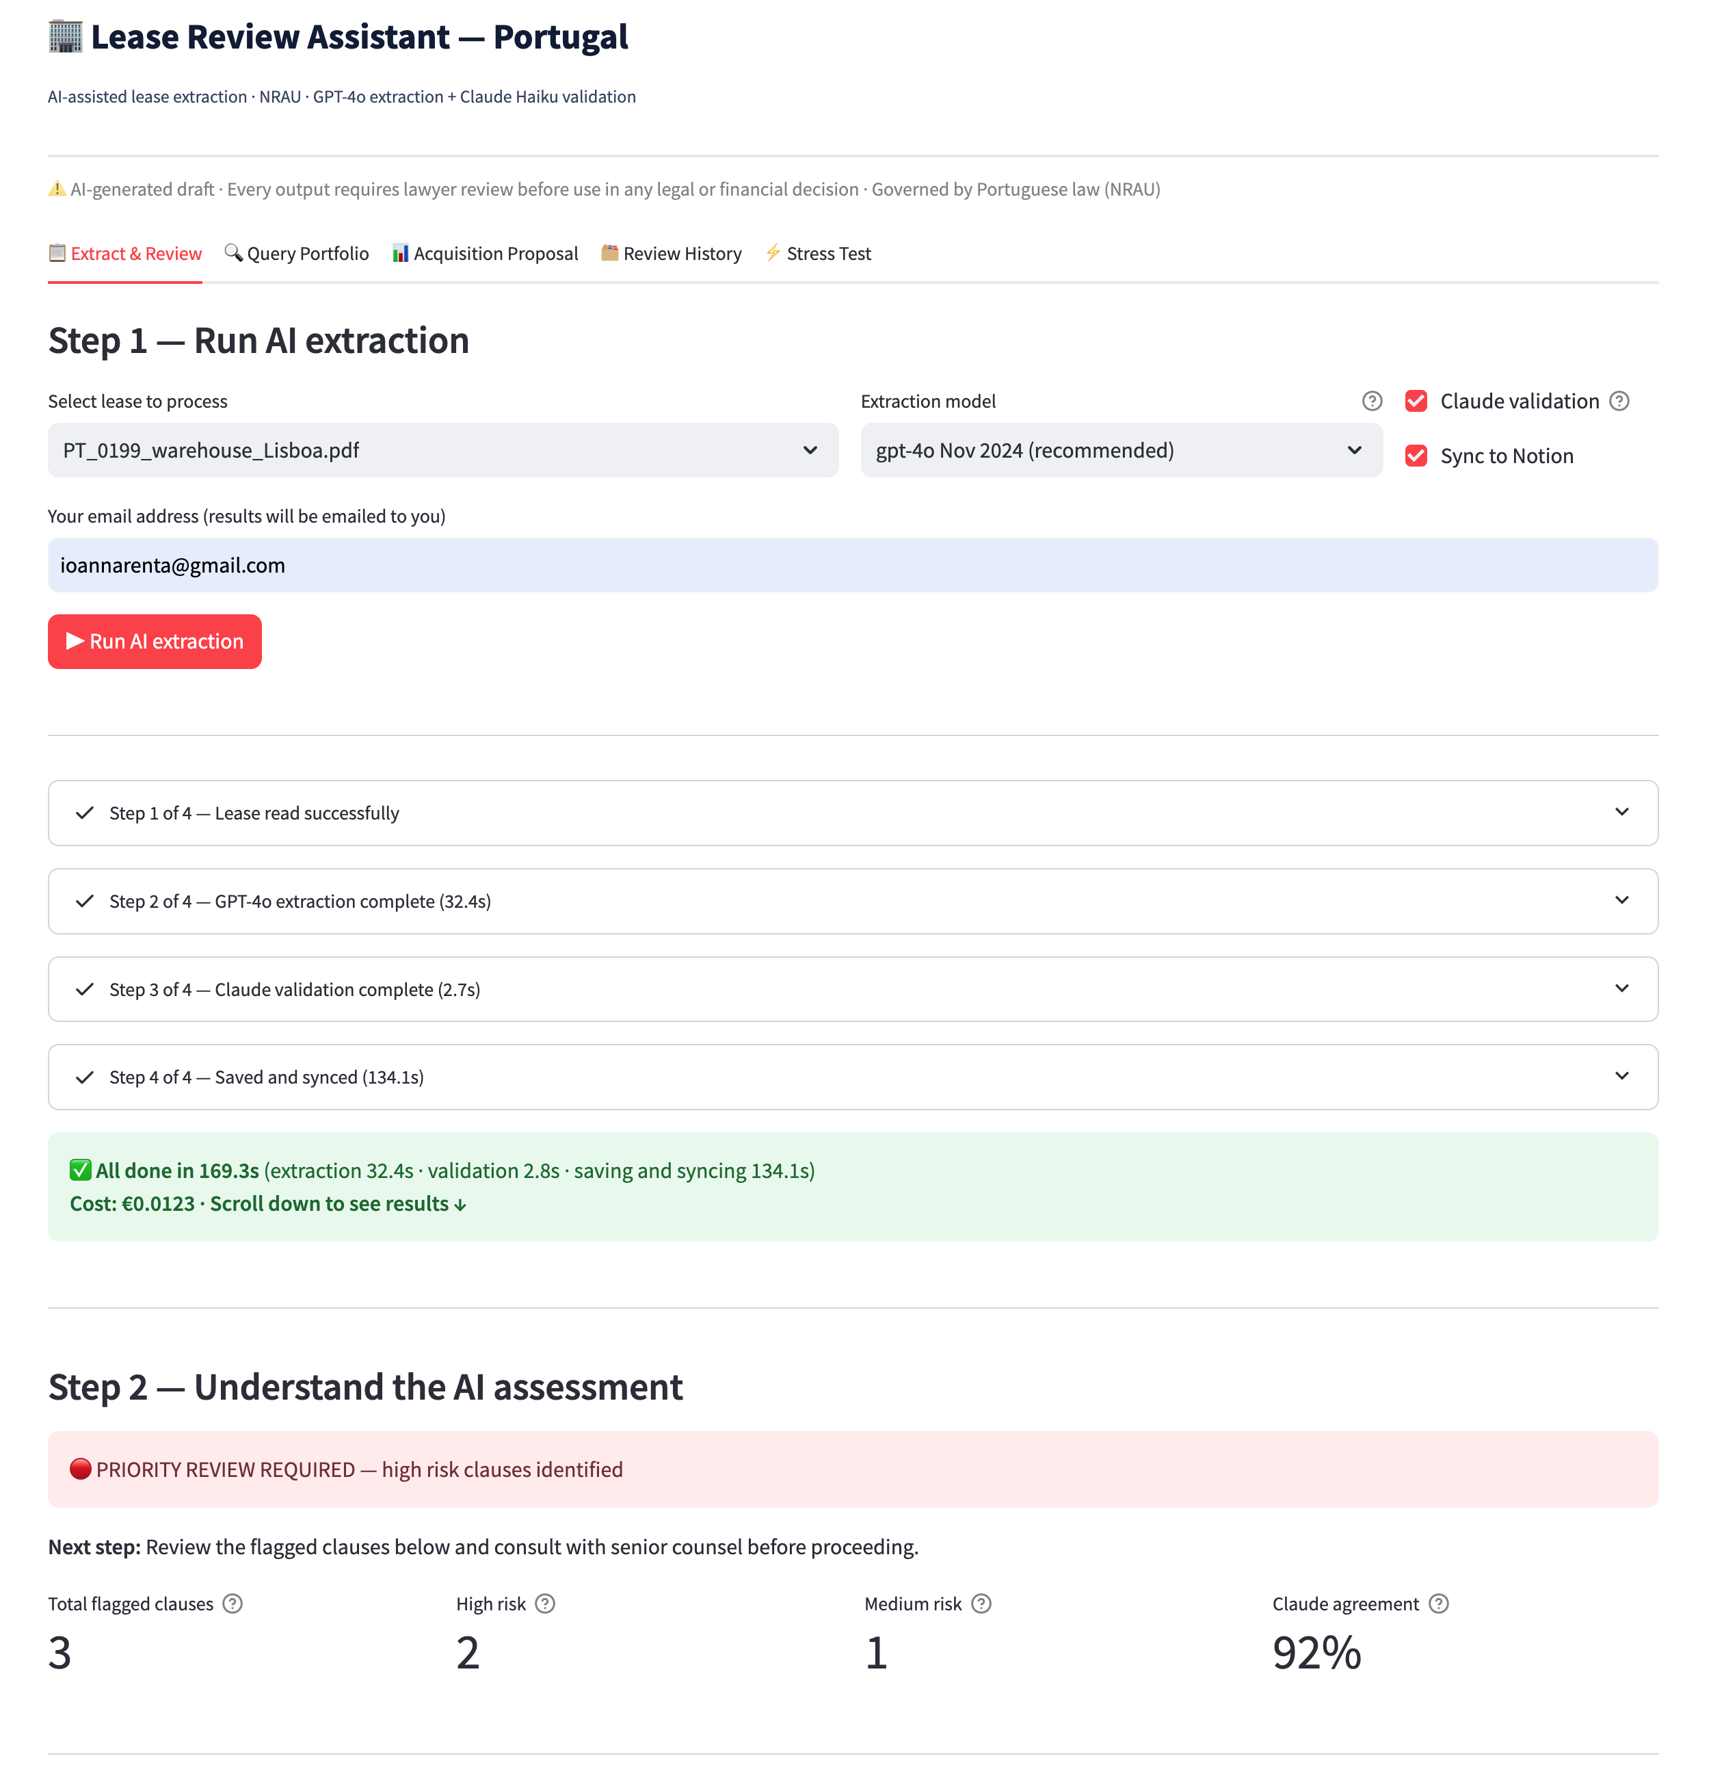
04 · EXTRACTION OUTPUT
Every field cites its source. The lawyer can verify any value in seconds.
🚩 FLAGGED CLAUSE EXAMPLE
Rent
€19,900/month · p.4, Clause 4
Type
Break condition — dilapidations survival
Break option
2029-01-22, 120 days notice · p.3, Clause 3
Risk
🔴 HIGH
Source
p.7, Clause 8.3
Deposit
€39,800 (2 months) · p.6, Clause 6
Quoted text
"dilapidations liability shall not be waived upon exercise of the break option"
NIF tenant
543321819 · p.1, Clause 1
Plain language
Non-standard. Landlord retains right to pursue repair claims after the tenant exercises the break. Significant unexpected financial exposure.
PT law ref
NRAU Art. 1046 — obligations survive unless explicitly waived
Finanças reg
Registered AT · p.8, Clause 9
Action
Negotiate removal. Escalate to senior counsel before proceeding.
5 / 17

Slide 6
05 · VALIDATION EXPERIMENT
Two models, one output. The transparency mechanism.
GPT-4o extracts · Claude Haiku independently validates · Disagreements surface to the lawyer.
GPT-4o
extracts
Claude Haiku
validates
Lawyer
reviews
→
→
What the experiment showed:
✅
82% agreement on standard leases
Fields extracted correctly, values consistent between models
⚠️
0% initially — parsing bug found
Claude wrapped JSON in markdown fences. Fixed with 3-strategy parser (regex strip, fence removal, bracket search).
✅
75–90% range after fix
Agreement score now meaningful. Low scores (<70%) reliably flag leases needing extra lawyer attention.
ℹ️
Different failure modes by design
GPT-4o misses a value → Claude still finds it. Claude misreads context → GPT-4o provides the anchor. Two errors must coincide to pass undetected.
6 / 17

Slide 7
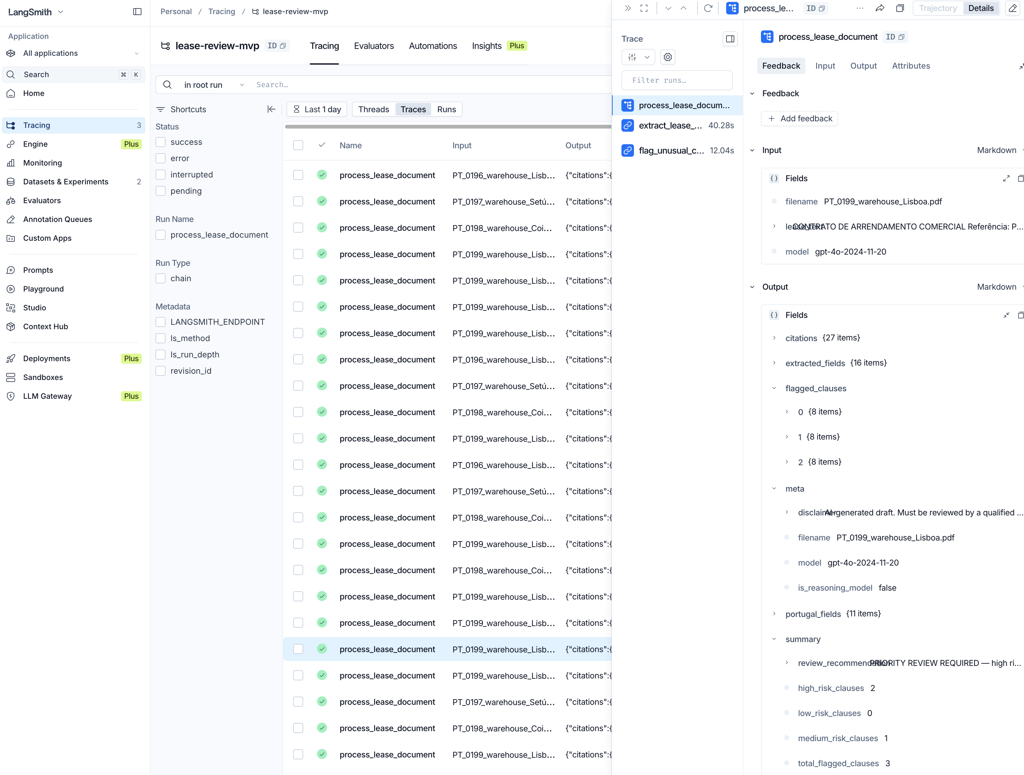
06 · LANGSMITH TRACING
Every decision is auditable. Every run is logged.
What LangSmith captures per run:
extract_lease_fields
Input: lease text truncated to 12k tokens · Output: 27-field JSON · Latency · Token count
flag_unusual_clauses
Input: same lease text · Output: flagged clauses with risk levels · Latency
validate_extraction
Input: extraction result · Output: agreement score 0–100 + field issues · Claude model used
process_lease
Parent trace wrapping all above · Total cost per lease in EUR
Dataset: lease-review-eval · 10 categories · ground truth from 200-lease corpus · traces live at smith.langchain.com → lease-review-mvp
7 / 17

Slide 8
07 · TEST CORPUS
200 synthetic Portuguese leases. Known ground truth. Measurable accuracy.
30
Standard office
20
Assignment restrictions
Clean leases — baseline accuracy
Absolute prohibition, landlord consent
25
Retail
15
Missing fields
Standard with service charge complexity
Partial documents — tests null handling
20
Warehouse
15
Short-term
Industrial clauses, assignment restrictions
<2 year leases — NRAU edge cases
25
Break option issues
15
High-risk combos
Dilapidations survival, conditional breaks
Multiple high-risk flags in one lease
20
Unusual rent review
15
Compliance issues
CPI caps, stepped rent, market review
Stamp duty on tenant, unregistered AT
Ground truth CSV: 31 columns per lease (all extracted fields + expected flags + risk level) · Used for LangSmith evaluation dataset · Excluded from git (200 PDFs), CSV included
8 / 17

Slide 9
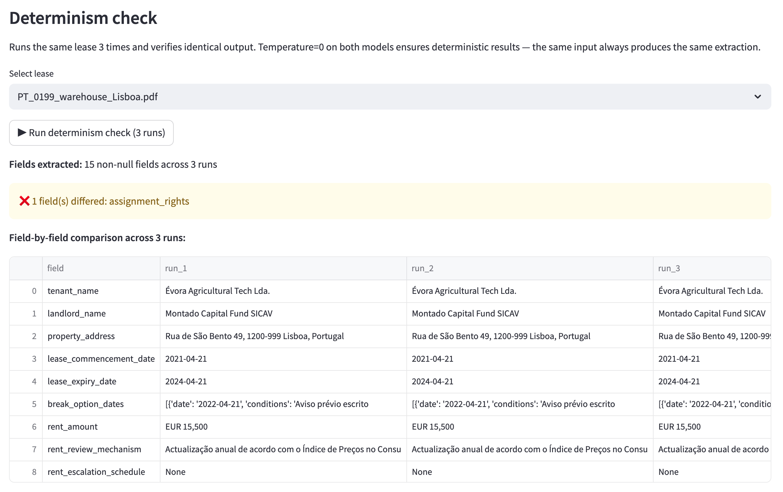
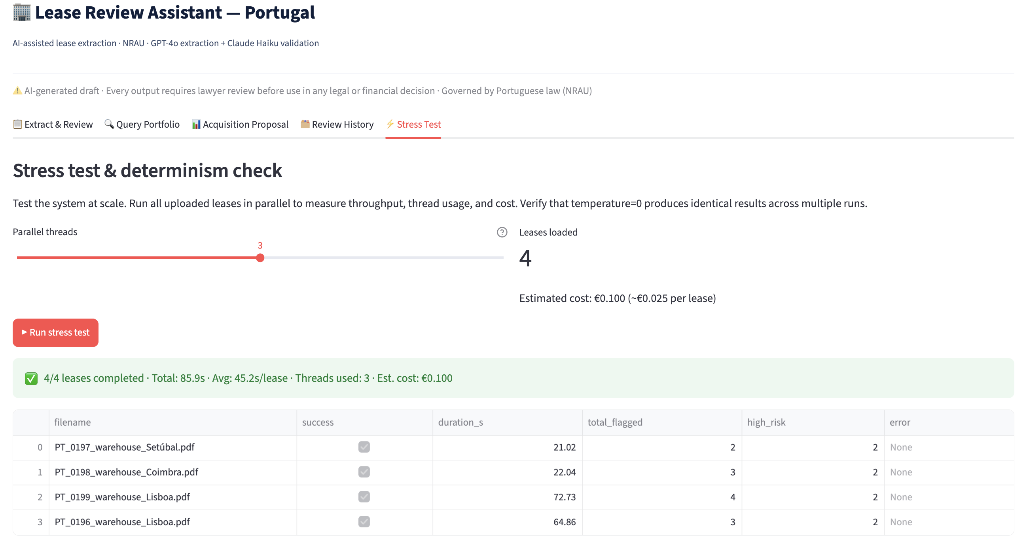
08 · STRESS TEST & DETERMINISM
Performance at scale — tested and documented.
"Untested on more than 5 documents" — Round 1 feedback. Addressed.
4/4
3 threads
85.9s
€0.025
leases completed
in parallel UI test
2.1× speedup
vs sequential
total time
(~180s sequential)
cost per lease
GPT-4o + Claude
Determinism finding: structured fields (dates, rent, NIF) ✅ identical across 3 runs. Free-text fields ⚠️ minor punctuation variation — expected at temperature=0 with long outputs. All material values stable.
9 / 17

Slide 10
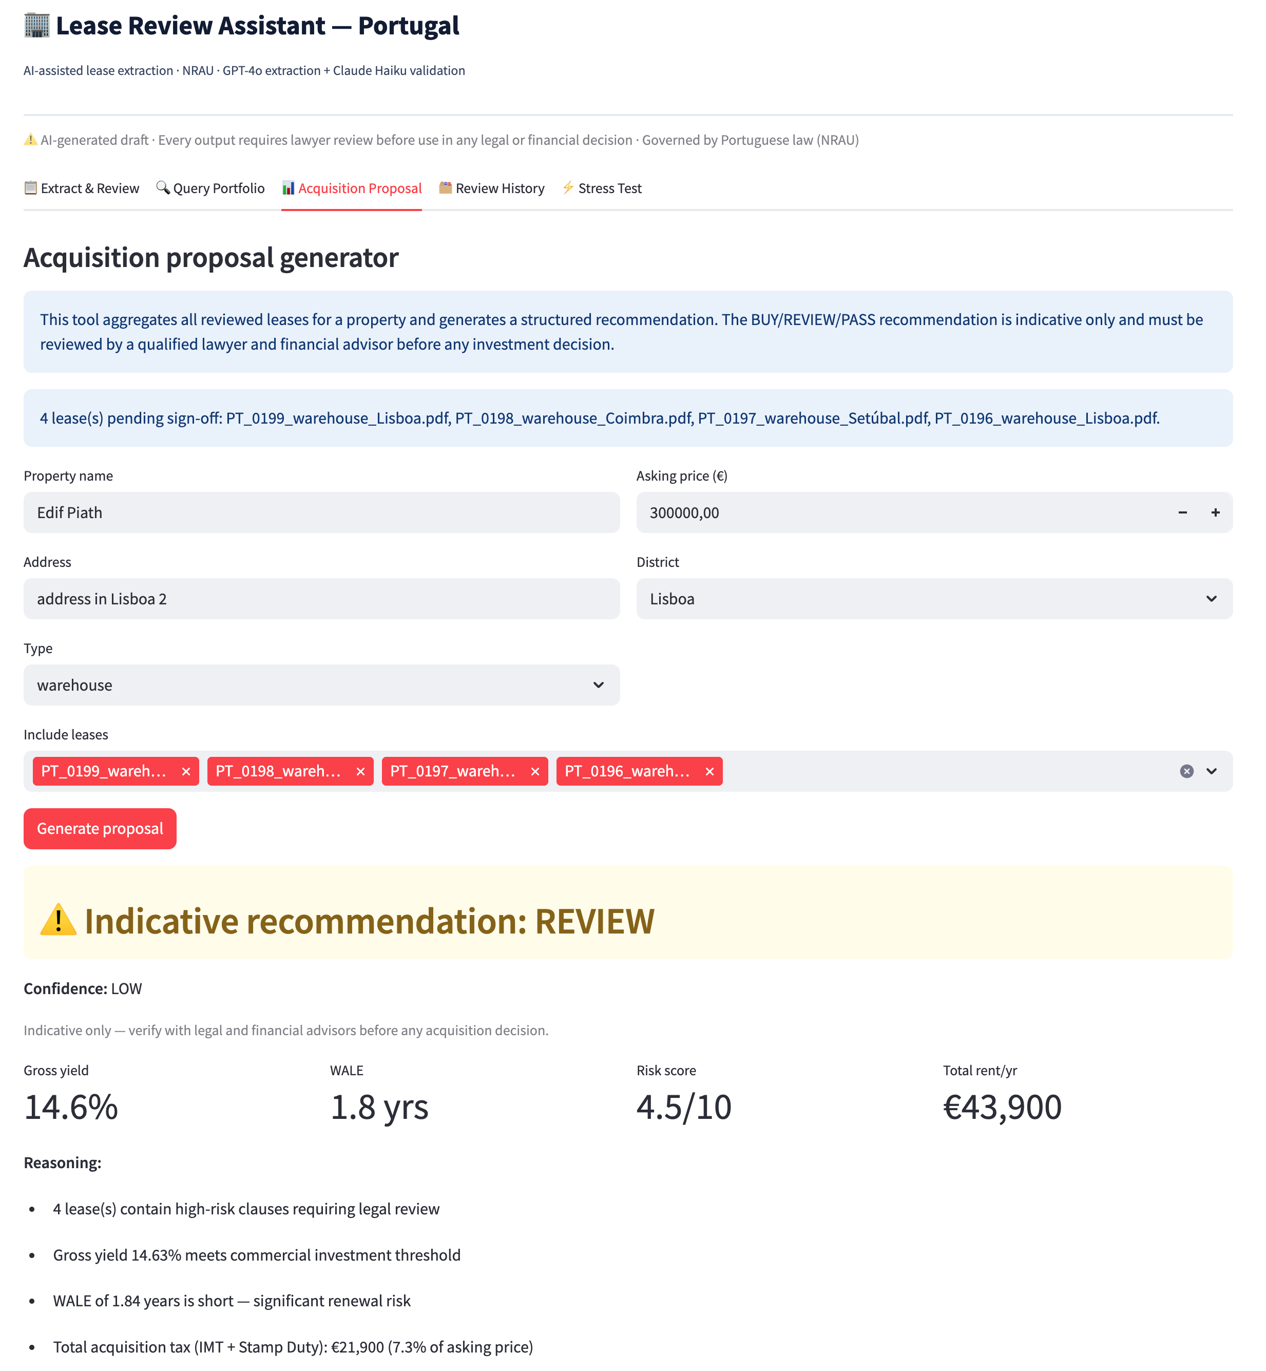
09 · ACQUISITION PROPOSAL
From individual lease reviews to an investment decision — in one click.
What the proposal calculates:
BUY / REVIEW / PASS
Composite risk score + gross yield threshold
Gross yield
Total annual rent ÷ asking price × 100
WALE
Rent-weighted average years remaining
Risk score
High-risk clauses ×2 + medium ×1, normalised 0–10
IMT
Asking price × 6.5% (PT transfer tax)
Stamp duty
Asking price × 0.8% (PT acquisition tax)
Confidence
LOW until all leases lawyer-signed-off
Test run: Parque Logístico Lisboa · 4 warehouse leases · asking €8.5M · REVIEW (high-risk clauses + yield 0.5% below 4% PT threshold) · Total tax €620,500
10 / 17

Slide 11
10 · HONEST EVALUATION
What broke, what we fixed, what the pilot needs to verify.
Transparency about system limitations is part of the design — not a weakness.
🐛 Bug found
EXTRACTION_USER used .format() which broke on {} in legal text. All fields returned "Not found".
→ Fixed with .replace("{lease_text}", lease_text)
lease_text not substituted
🐛 Bug found
Claude wrapped JSON responses in ```json fences. Parser failed silently, defaulted to 0.
→ 3-strategy parser: direct parse → strip fences → find {} block
Claude agreement = 0%
🐛 Bug found
Extraction prompt had no Portuguese terminology mapping. SENHORIO/ARRENDATÁRIO unrecognised.
→ Added PT→EN field mapping to EXTRACTION_SYSTEM prompt
Portuguese fields empty
⚠️ Limitation
Obligation lists and descriptions show punctuation-level variation across runs at temperature=0.
→ Expected behaviour. Material values (dates, numbers) are deterministic. Documented.
Determinism on free-text
⚠️ Limitation
200 leases are AI-generated. Real lease performance is untested.
→ Pilot plan: 20 real leases, manual comparison, accuracy gate ≥85%
Synthetic corpus only
⚠️ Limitation
Render's free tier blocks outbound SMTP (since Sept 2025). Email attempts hung until timeout, adding up to 3 min per run.
→ App detects Render and skips email with an on-screen notice. Works locally. Production: email API over HTTPS.
Sample email screenshot
Email blocked on hosted demo
11 / 17

Slide 12
11 · BUSINESS CASE & COMPLIANCE
The investment pays back within the first year. The risk is limited by design.
ROI SUMMARY
COMPLIANCE
Annual saving (lawyer + paralegal)
€180,000
EU AI ACT: LIMITED RISK
Total build cost
€43,000–€70,000
• Art. 50 transparency only — no conformity assessment
Annual run cost
€8,000–€15,000
• Every output labelled AI-generated draft
12-month ROI
165%
• Human sign-off mandatory — no autonomous decisions
36-month ROI
493%
• Watch: direct feed to valuation model = HIGH RISK shift
Break-even
~Month 5
GDPR
Cost per lease (AI)
€0.025
• Legitimate interest · Supabase EU (Ireland)
Cost per lease (manual)
€480–€960
• OpenAI/Anthropic: SCCs + zero data retention
• DPIA completed — residual risk LOW
12 / 17

Slide 13
12 · STRATEGIC PLAN
POC → Pilot → Full deployment. Pilot gates are explicit.
POC
Complete ✅
Pilot
Q1 2027
Full Deploy
Q3 2027
SaaS
2028+
• n8n workflow, 6 nodes
• 1 real acquisition (10–20 leases)
• All acquisitions processed by AI
• Productise for PT + ES + GR
• 5 cases, all criteria passed
• 2–3 lawyers co-design output
• OCR layer for scanned leases
• Target: 10 clients @ €15k/yr
• Teaching staff: proceed
• Full LangSmith tracing
• Portfolio monitoring dashboard
• Differentiator: NRAU grounding
• Avg peer rating: 4.50/5
• ⛔ Gate: ≥85% accuracy on real leases
• Automated regression testing
• TAM: ~500 mid-market developers
• ⛔ Gate: ≥60% time saving confirmed
• Cost: €15k–€25k build
• ⛔ Gate: zero undetected critical errors
13 / 17
KPIs that greenlight Pilot → Full deployment: ≥85% extraction accuracy · ≥60% time saving · zero undetected critical errors · ≥2/3 lawyers rate system useful

Slide 14
13 · LIVE DEMO
The system is running — standalone URL, no local setup needed.
🔗 [Render URL — update after deployment]
1
Upload a Portuguese commercial lease PDF from the sidebar
2
Select extraction model (gpt-4o-2024-11-20 recommended) · Enter email · Click Run AI extraction
3
Step 2 shows: risk banner · Claude agreement score · flagged clause count
4
Step 3 shows: all 27 fields with page + clause citations · ✏️ Correct any field
5
Step 4: complete mandatory lawyer sign-off (4 checkboxes + name)
6
Acquisition Proposal tab: fill property details + asking price → BUY/REVIEW/PASS + IMT + stamp duty
7
Stress Test tab: show parallel processing results + determinism table
8
LangSmith: switch to smith.langchain.com → show traces appearing in real time
14 / 17

Slide 15
14 · PILOT MEASUREMENT PLAN
What we would watch in a real acquisition — and how we would know it works.
Field accuracy on real leases
≥85%
Manual comparison of AI output vs lawyer abstraction on 20 real leases
Synthetic corpus proves approach — real leases prove production readiness
Claude agreement calibration
≥75% avg
Track whether low agreement (<70%) correlates with actual extraction errors
Determines whether the score is a reliable signal or noise
Lawyer time per lease
<1 hour
Time-tracked by legal team during pilot
Validates the 4–8h → <1h time saving projection
Critical error rate
0
Manual audit of all extracted dates, rents, break options
Any undetected error on a material value invalidates the system
Prompt regression
No degradation
LangSmith dataset run against full corpus after every prompt change
Ensures fixes do not break other categories
Reasoning model accuracy
o3 > gpt-4o on complex
Run 10 leases through both models, compare flagging quality on break conditions
Justifies the higher cost of reasoning models for complex leases
15 / 17
Pilot cost: €20,000–€30,000 · Duration: 10 weeks · Go/no-go decision based on all 6 KPIs before any wider commitment

Slide 16
15 · DELIVERABLES
Everything submitted. Everything documented.
📁 use_case_definition.md
Business problem, stakeholders, success criteria, scope
💻 mvp/app.py
Streamlit 5-tab application
📁 roi_risk_assessment.md
12/36-month ROI, 10-risk matrix with mitigations
💻 mvp/extractor.py
GPT-4o pipeline, 7-model support
📁 compliance/eu_ai_act_compliance.md
Limited Risk classification, Art.50 obligations, tech doc outline
💻 mvp/validator.py
Claude Haiku validation, JSON parser
📁 compliance/gdpr_documentation.md
Data flows, DPIA, third-party transfers, rights
💻 mvp/portugal_law.py
NRAU context, model pricing
📁 strategic_plan.md
POC→Pilot→Full deploy, GTM, KPIs, commercialisation
💻 mvp/generate_corpus.py
200 synthetic PT leases generator
📁 evaluation/langsmith.md
Dataset, traces, what failed, pilot watchlist
💻 mvp/run_stress_test.py
Terminal stress test, 10+ leases
📁 evaluation/stress_test.md
Parallelisation methodology, determinism findings
💻 mvp/schema.sql
Supabase schema (5 tables)
📁 project_overview.md
Full project summary, business case, document index
🌐 Render deployment
Standalone URL, no local setup needed
16 / 17
GitHub: github.com/ioanna-lab/Capstone_mvp · All files committed, .env excluded, PDFs excluded (200 synthetic leases too large), ground_truth.csv included

Slide 17
ROUND 2 · CLOSE
The system is built.
The pilot is the next step.
Chleo's question: "How do I know it's not making things up?"
The answer is built into the architecture: every field cites the page and clause it came from, two independent models validate the same document, disagreements are surfaced to the lawyer, and nothing enters a financial decision without a qualified lawyer completing a mandatory sign-off.
The ask: Commission a 10-week pilot on one upcoming acquisition.
€20,000–€30,000 · Potential saving: €128,000–€192,000/year · Payback within the first deal cycle.
GitHub
Live app
Contact
github.com/ioanna-lab/Capstone_mvp
https://capstone-mvp-k2pj.onrender.com
ioannarenta@gmail.com· linkedin.com/in/ioannarenta
17 / 17

