Slide 1
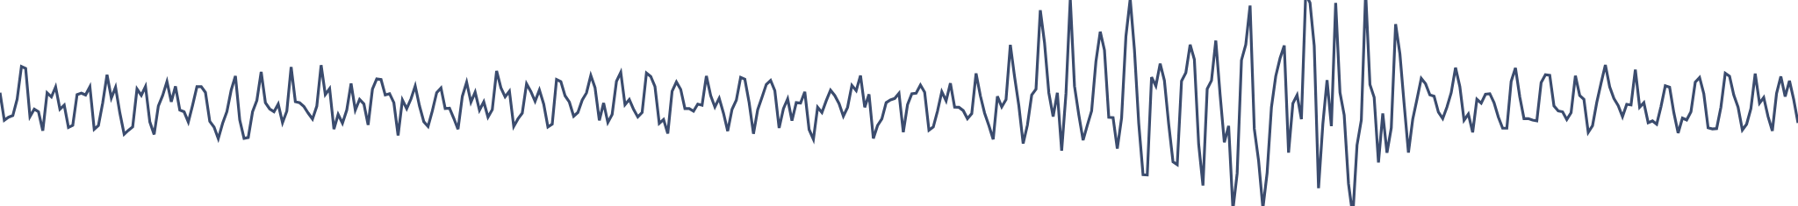
Automated seizure detection from behind-the-ear EEG
SCIENTIFIC PROGRAMMING PROJECT
XGBoost with nested patient-wise cross-validation on the SeizeIT2 dataset
Ioannis Vakkas
October 2026

Slide 2
Detect seizures at home without waking everyone up for nothing
THE PROBLEM
RQ1
A wearable device with two EEG electrodes behind the ears could record patients at home for weeks.
Does detection performance depend on the seizure type?
Every alarm wakes the patient or a carer, so the detector must find seizures and keep false alarms low.
RQ2
Does detection performance depend on the seizure duration?

Slide 3
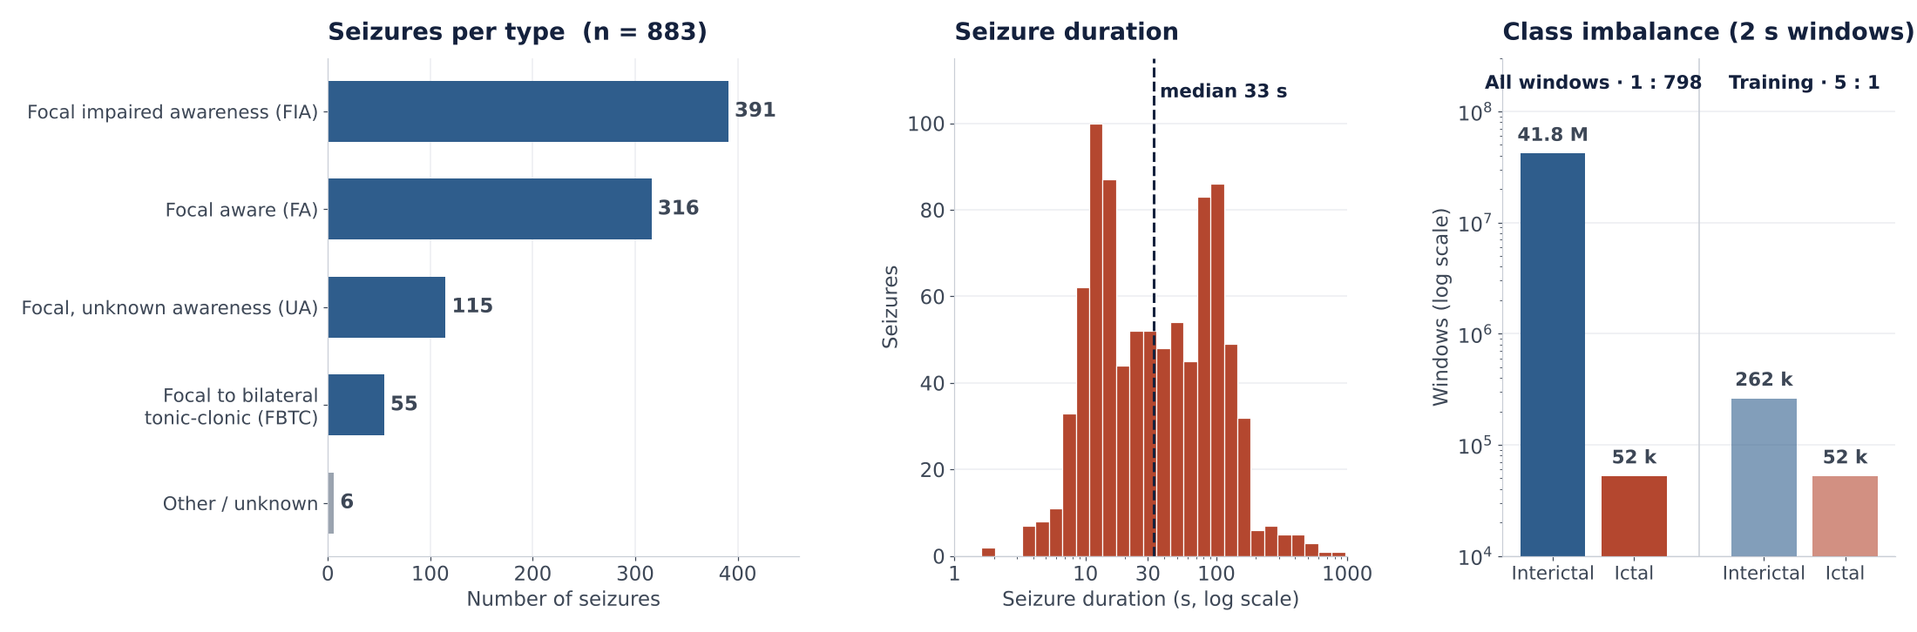
SeizeIT2: a large, public, very imbalanced dataset
DATA
125
11,626 h
883
1 : 798
patients
of recordings
annotated seizures
ictal : interictal windows

Slide 4
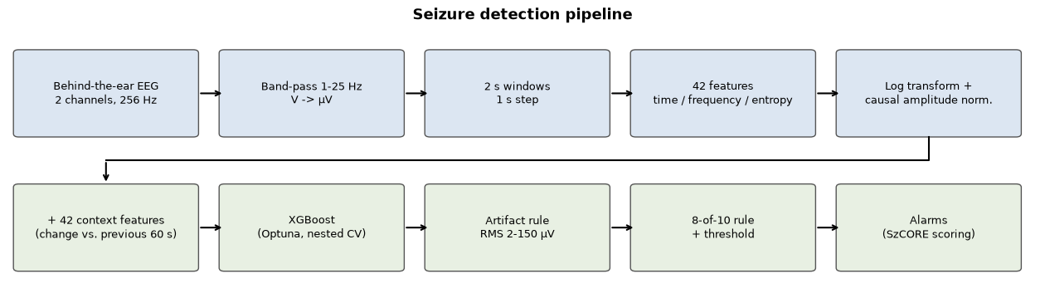
From raw signal to alarm
METHOD
Signal
Features
Model + alarm
µV, band-pass 1–25 Hz, 2 s windows (1 s step)
42 per window + 42 “change vs. previous 60 s” = 84
XGBoost per window; alarm if ≥ 8 of 10 are positive (as in SeizeIT2)
Why: seizure rhythms lie below 25 Hz; 2 s still catches short seizures
Why: a seizure is a change from the patient’s own background
Why: fast on millions of windows; 8/10 removes one-window false alarms

Slide 5
Nested patient-wise cross-validation, no leakage
EVALUATION
125 patients → 10 folds, split by patient
Training patients (~112)
Test patients (12–13)
Split by patient, not by window.
80% fit
20% validation
Never seen. Evaluated once.
Everything that learns (hyperparameters, threshold, undersampling) uses training patients only.
① Fit on 80% → Optuna (15 trials) scores AUPR on the 20%
Before the split: only per-recording, label-free steps.
② Threshold for ≤ 1 FA/h chosen on the 20%
③ Final model retrained on all training patients (5 : 1 undersampling)
Scoring: SzCORE event rules, cross-checked with the official timescoring library.
Repeated for all 10 folds → every patient is tested exactly once.
Notes:
the final model gets more data (also the validation patients); the threshold comes from the 80% model, but validation 58.6% / 0.94 FA/h vs test 55.9% / 0.93 FA/h shows it transfers well.
split by patient because the device must work on new people · nested, so the test patients never influence any choice · AUPR, not AUROC, because with 1 : 798 imbalance AUROC looks good too easily · Optuna (Bayesian search) instead of grid search: finds good settings in 15 trials · threshold for 1 FA/h instead of 0.5, because the clinical limit is false alarms · undersampling 5 : 1 only on training patients: faster training, test stays realistic.
10 folds by patient: random shuffle with seed 42, split into 5 folds of 13 and 5 of 12 · ~112 train / 12–13 test patients · inner split 80 / 20 by patient (≈ 90 fit / ≈ 22 validation, a different random 20% in every fold) · Optuna validation = all seizure windows + 300,000 random background windows, re-weighted · a window is ictal if ≥ 1 s of it is inside a seizure · threshold grid 0.05–0.95, step 0.025 · Optuna 15 trials, maximises AUPR · threshold for ≤ 1 FA/h (median 0.525) · undersampling 5 : 1 on training patients only · SzCORE: 30 s before, 60 s after, merge 90 s · timescoring: 873 events, 497 detected, same 10,790 false alarms.

Slide 6
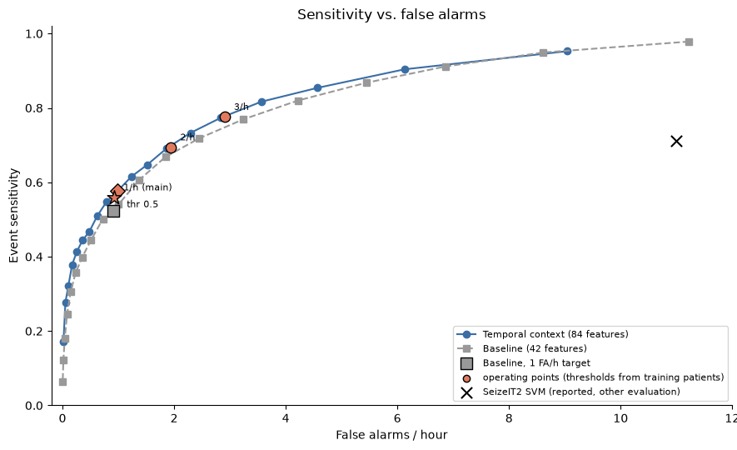
494 of 883 seizures detected at 0.93 false alarms per hour
RESULTS
Operating point | Sensitivity | FA/h
Threshold 0.5 | 57.6% | 0.99
≤ 1 FA/h (main) | 55.9% | 0.93
≤ 2 FA/h | 69.4% | 1.94
≤ 3 FA/h | 77.6% | 2.91
Window specificity 99.5% and accuracy 99.4% look high, but a model that never alarms gets 99.9% accuracy, so we report sensitivity and FA/h instead.

Slide 7
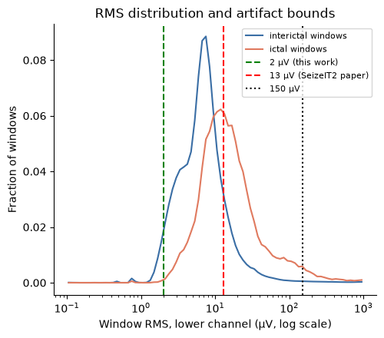
The biggest gain came from fixing the artifact rule
HOW WE GOT THERE
Artifact rule ≥ 13 µV
42.0%
Rule ≥ 2 µV + 8-of-10 alarm
52.3%
+ 60 s context features (final)
55.9%
All at ≈ 0.9 FA/h, same evaluation.
The 13 µV lower limit removed 88% of interictal and 55% of ictal windows; typical bte-EEG RMS is only ≈ 10 µV.
Context features gave a small extra improvement.

Slide 8
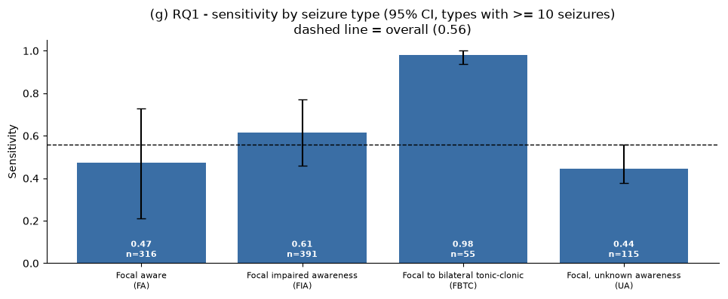
Focal-to-bilateral tonic-clonic seizures are almost always detected
RQ1 · SEIZURE TYPE
FBTC: 98% (n = 55)
Focal types: FIA 61%, FA 47%, UA 44%; intervals overlap
FBTC are also the longest (median 108 s vs ≈ 32 s), so type and duration are linked

Slide 9
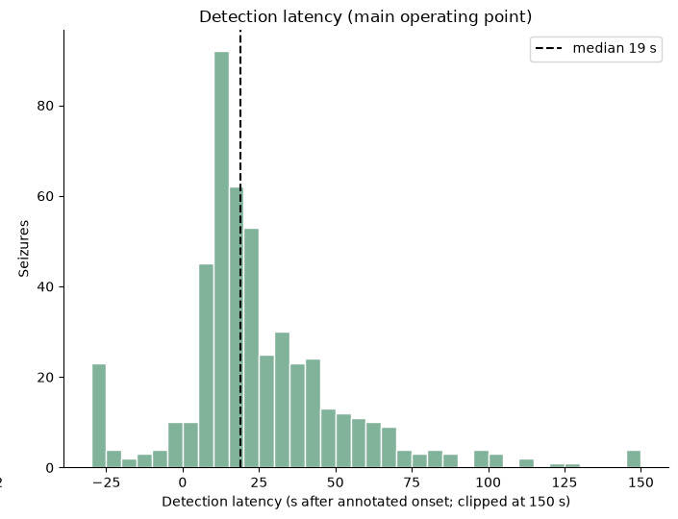
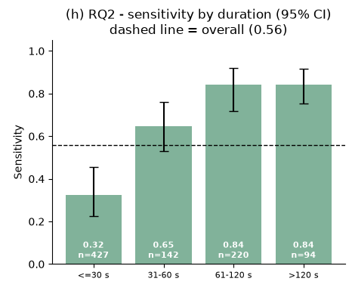
Longer seizures are detected much more often
RQ2 · SEIZURE DURATION
≤ 30 s: 32% → over 60 s: 84%; intervals do not overlap
Median duration: missed 14 s, detected 66 s
Median latency 19 s; 69% of alarms within 30 s

Slide 10
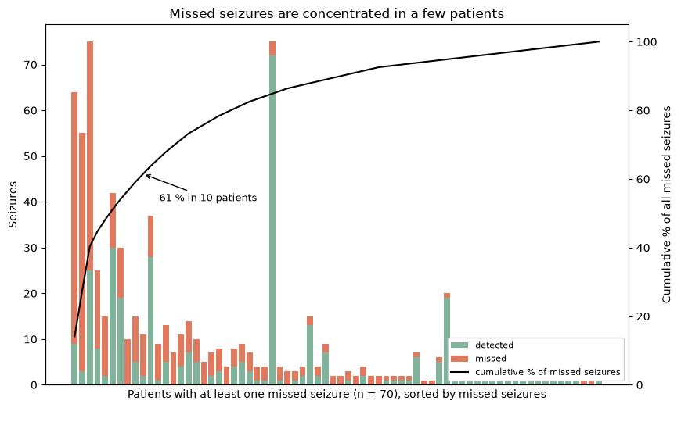
Missed seizures are concentrated in a few patients
FAILURES AND LIMITATIONS
10 patients hold 61% of all missed seizures; median per-patient sensitivity is 80%.
LIMITATIONS
Hospital (EMU) patients with refractory epilepsy, not home users
No external dataset for validation
Two design choices (2 µV rule, context features) made after seeing earlier results
Only two EEG channels

Slide 11
Three mistakes I made and fixed
WHAT I LEARNED
1
2
3
Copied a rule from scalp EEG
Used labels on the test set
Thought the model overfitted
The 13 µV limit threw away half of the seizure windows.
That is data leakage: the test set must look like real life.
The gap of 0.195 compared two different sets of windows.
Fix: checked real amplitudes → 2 µV
Fix: one rule for all windows, no labels
Fix: comparable windows → gap 0.075
BIGGEST SURPRISE
A model that never raises an alarm already gets 99.9% accuracy.

Slide 12
Two behind-the-ear channels detect 56% of seizures at under one false alarm per hour, on patients never seen in training
CONCLUSION
TAKE-HOME
NEXT TIME I WOULD
RECOMMENDATION
Long and tonic-clonic seizures are detected reliably; short focal seizures are the open problem.
Explore the signal before borrowing rules, and keep a set of patients untouched until the very end.
Add the ECG and movement signals already in SeizeIT2, and always report sensitivity with FA/h.
Thank you. Questions?

Slide 13
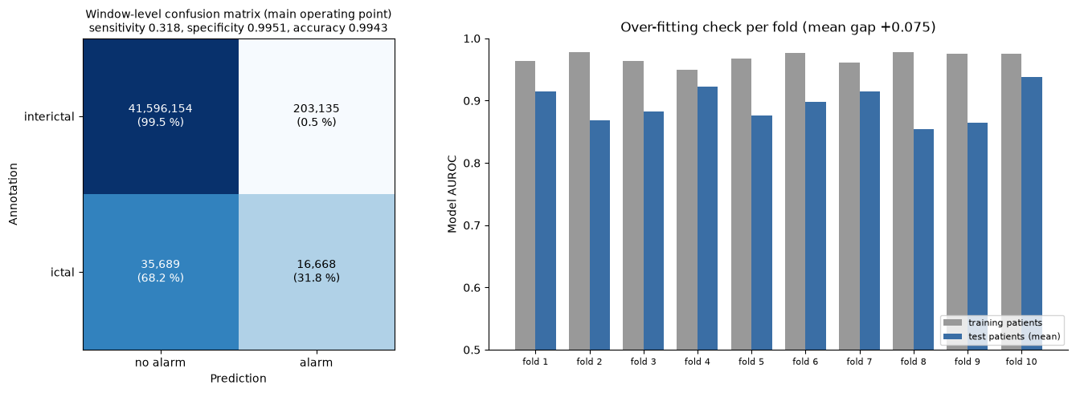
Train AUROC 0.969 vs. test 0.894: a moderate, expected gap
BACKUP · OVERFITTING CHECK
Validation patients 58.6% / 0.94 FA/h vs. test patients 55.9% / 0.93 FA/h: the threshold transfers to new patients.

Slide 14
All versions, same patient-wise evaluation
BACKUP · MODELS TRIED
Model | Event sensitivity | FA/h
SVM + grid search (earlier pipeline) | not comparable; no superiority of XGBoost claimed
XGBoost, 13 µV rule | 42.0% | 0.93
XGBoost, 2 µV + 8/10 (42 features) | 52.3% | 0.90
Final: + context (84 features) | 55.9% | 0.93
Final, threshold 0.5 | 57.6% | 0.99
Final, ≤ 2 FA/h | 69.4% | 1.94
Final, ≤ 3 FA/h | 77.6% | 2.91
Context gain: McNemar p = 0.005 (seizures), Wilcoxon p = 0.043 (patients), but the patient bootstrap CI of the difference includes 0 → small improvement.

